Slide 1
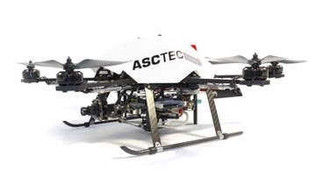
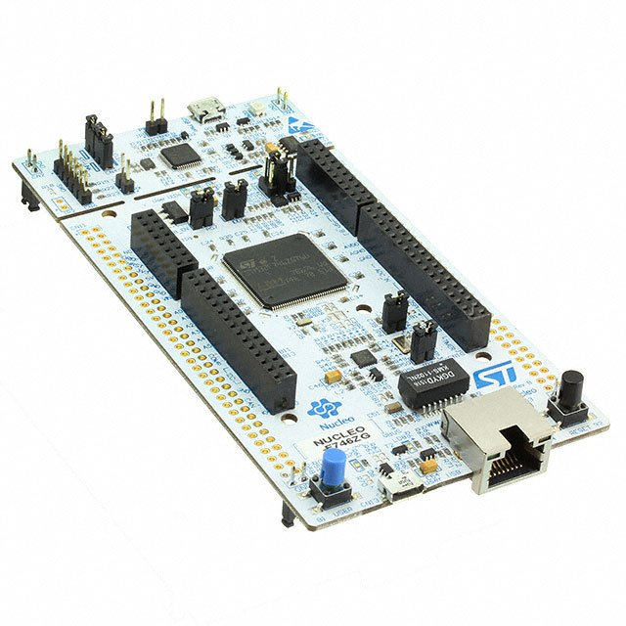
Development of a protocol for inclusion of an microcontroller in an multicopter system
Projektseminar Robotik
und Computational Intelligence
Malte Breitenbach, Xianglun Chen, Zhiyuan Hu
[10]
[11]
Supervisor : Raúl Acuña Godoy , M.Sc.
Dipl.-Ing. Dinu Mihailescu-Stoica

Slide 2
Content
Motivation
Basics
System description
Protocols
Protocol design
Presentation
Results
Summary & Outlook
Notes:
15.06.16
|
| 2

Slide 3
Motivation
Requirements for
sensor fusion
Processor provided by UAV
matrix arithmetic
floating-point arithmetic
processing speed
memory for programming
A new powerful processor
Requirements
Robust
Error detection
Reliability
Fast
Real time
Expandable
Adding specific processor for sensor fusion
Reliable, High Speed Communication
Reliable and high speed communication to the UAV is required
Notes:
Actually, our project belongs to a bigger project about implementing Sensorfusion algorithm in UAV. UAV means unmanned aerial vehicle, commonly known as a drone.
Theoretically there are two approaches to implement the algorithm. One is , another is .
But actually 1. aproach is not realistic. The Processor in UAV can not afford the large calculation requirement of sensorfusion.
For example, processing speed low, memory small, matrix arithmetic not good enough….. Also, for example, the architecture of processor, the calculation speed, the clock frequency. all of those in the processor of UAV are far not enough for the sensorfusion task.
So sensor fusion will be implemented in a new additional powerful specific processor to do so.
But this new processor still need to get data from UAV and send the result to UAV. The communication must be firstly precise guaranteed. Only then the quality of sensor fusion can be guaranteed.
So our task is to achieve this communication. -- ……………. And we need to design protocol to achieve communication. The communication should fulfil these requirements.
e.g. it should be possible to add and remove new sensory by small effort. Also will talk in next slide.
15.06.16
|
| 3

Slide 4
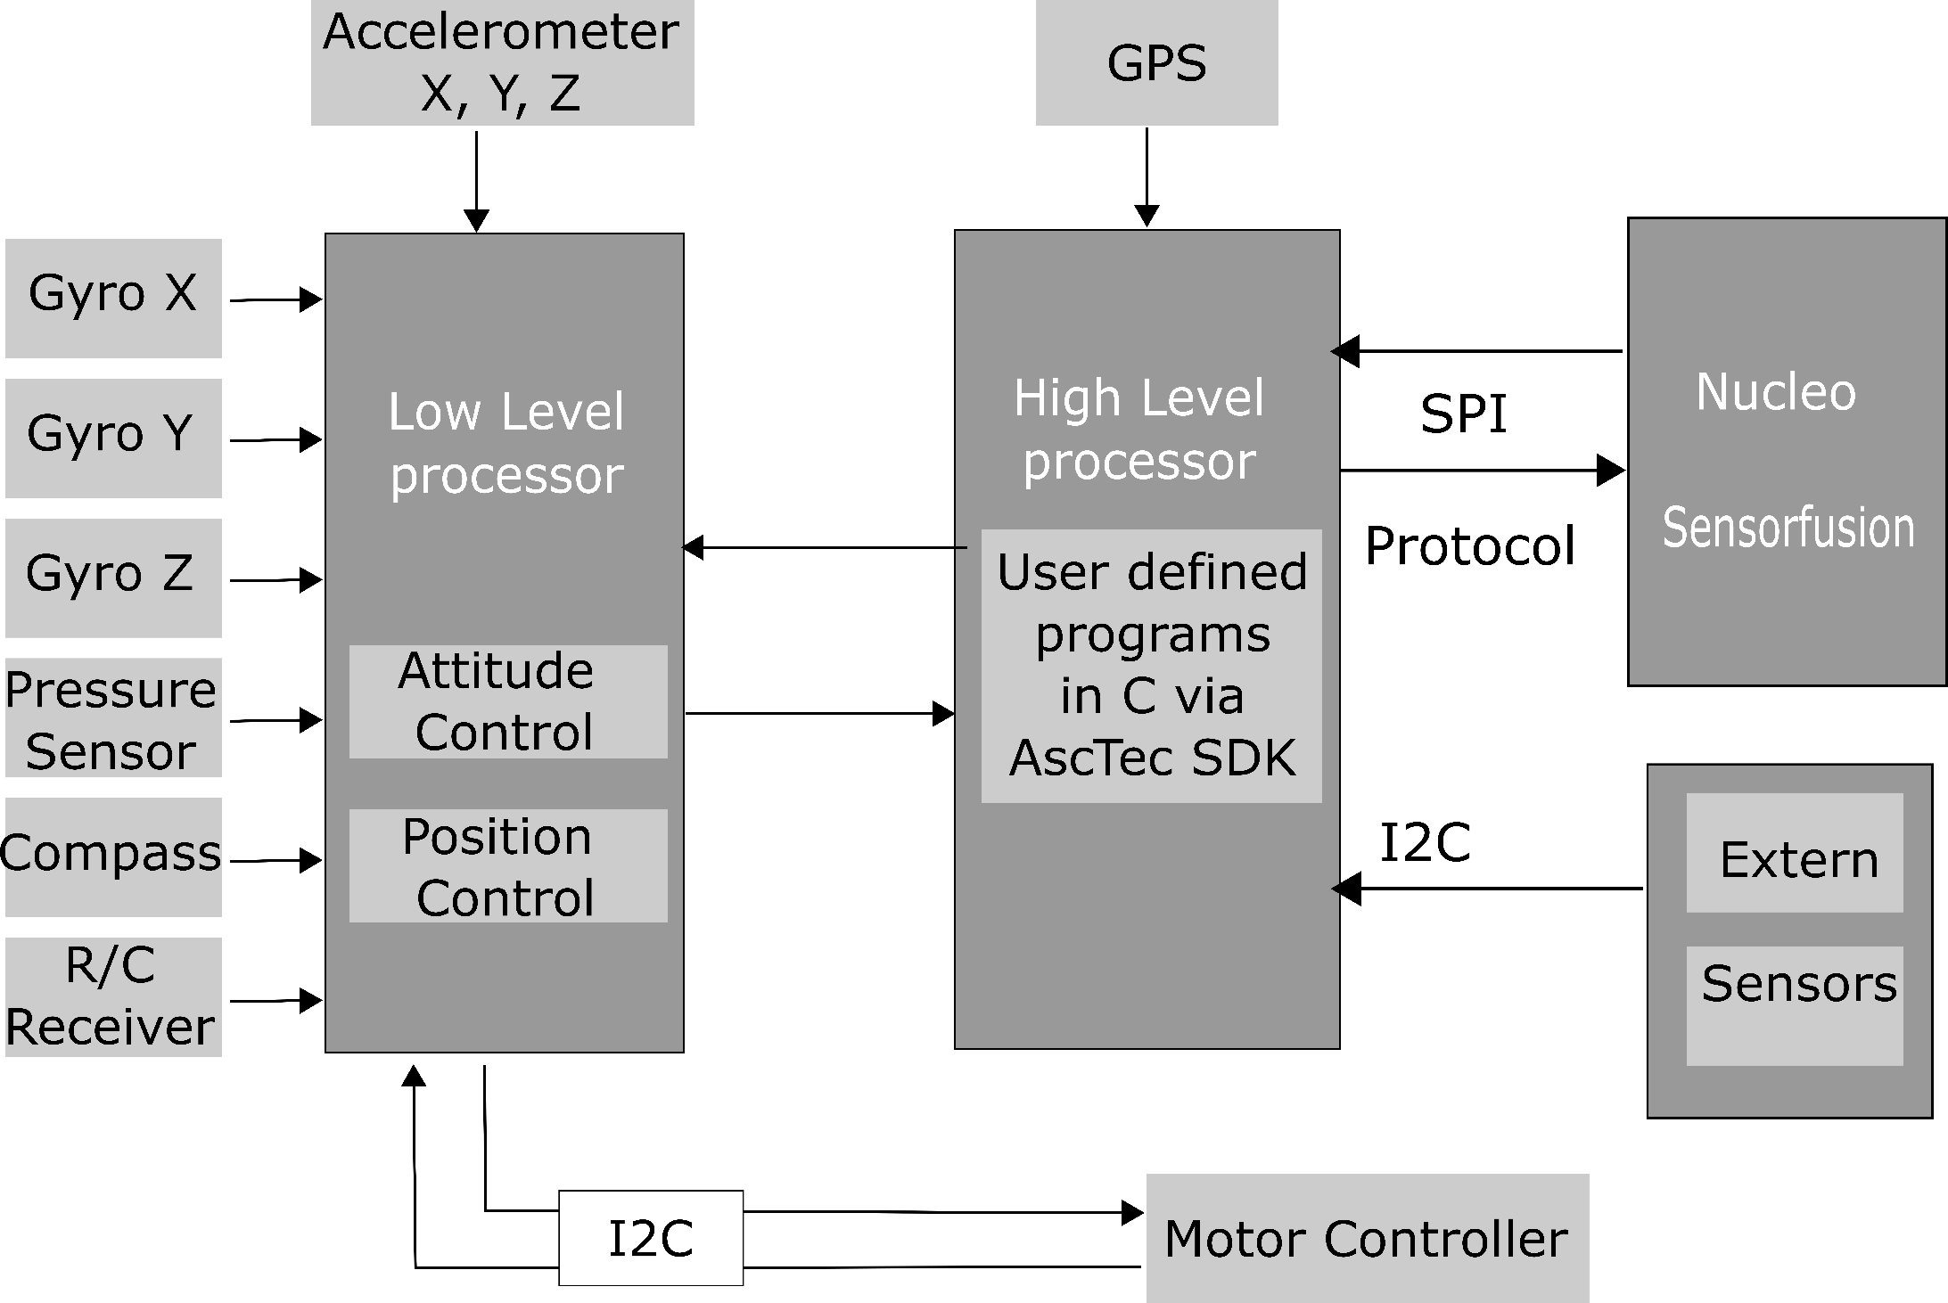
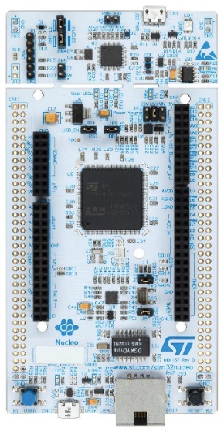
Basics – System Description
Nucleo
UAV
Sensors
Notes:
There are two parts, 1. part is UAV here, second part is additional things.
Nucleo is added to do sensorfusion task.
Library functions, code generating tools, convienient and fast to make prototyping.
The calculation efficiency is very good.
Extern sensors like Lidar, optical flow, is added to adjust complicated environment.
HL
LL closed,. LL Directly control.
But fortunately HL is open for us, HL have SDK, we can write the control command here
Our programming about UAV is mainly based on programming on HL.
But just like we have said, calculation efficiency.
Our project, the communication protocol between Nucleo and UAV is here, it’s based on SPI bus.
The HL will send big package about sensordata and Nucleo send data about attitude estimation back to HL.
Design of protocol should concern the difficulties like control logic in both sides. Also it should fulfill the requirements introduced in last slide, error detection or expandable like those. To communicate efficiently, we use interrupt based communication.
For details of protocol analyse,…
15.06.16
|
| 4

Slide 5
Basics - Protocols
Communication protocol
A set of rules allowing communication partners to transmit information. [1]
Defined timing of communication actions
Defined format of Packet Data Units (PDUs)
Partners need to provide serval protocol features
De- / Encoding of PDUs
Error detection
Layer (provides functions)
Serves the layer above, is served by the layer below
Notes:
Thank you Mr. Hu, my name is Malte Breitenbach and
I would start by explaining to you what a communication protocol is in information technology.
Basically it’s a set of rules allowing communication partners to transmit information. [CLICK]
Therefore both partners have to use a defined timing of communication actions, like transmitting data or decode some data at a a specified point.
The information both partners share are packed in so called PDUs, what stands for „Packet data Unit“.
So it must be defined what the first byte of each packet means and the second and so on… [CLICK]
To achieve a successful communication, both partners need to provide several protocol features
-> De-/Encoding of PDUs
-> Error detection, to detect errors while transmission [CLICK]
An important term in protocol technology is the layer.
Basically each layer provides several functions to fulfill one specific goal.
-> serves the layer above and is served by the layer below (but does not need to know how the other layers are implemented)
15.06.16
|
| 5

Slide 6
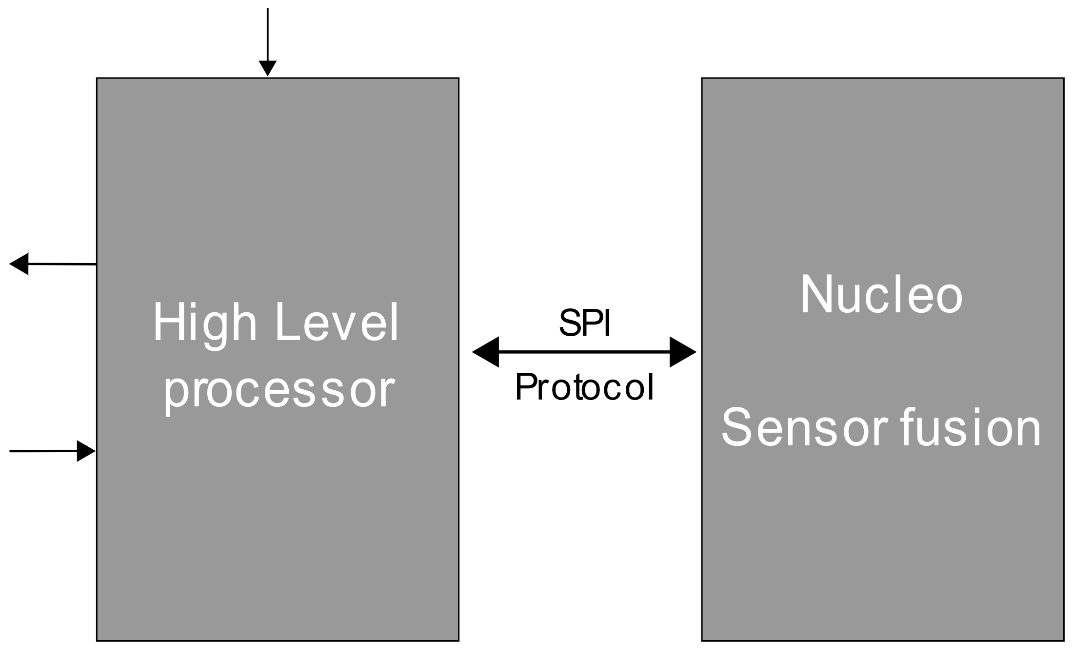
Protocol design – Presentation (1)
Waterfall model
Requirement analysis
Protocol design
Implementation
Testing
Robust
Error detection
Reliability
Fast
Real time
Expandable
COBS (Consistent Overhead Byte Stuffing)
Fletcher’s Checksum
Different implementation on both microcontrollers
SPI drivers
Easy access by a struct
Performance
Robustness
Notes:
To clarify the basics mentioned, we take a look at the protocol we designed.
While the design process the waterfall model was used.
This method intends a requirement analysis as the first step.
Here different requirements were set, so we need a robust, fast and expandable protocol as Mr. Hu already mentioned[CLICK]
Based on that requirements the protocol gets designed in the next step.
Our protocol is based on COBS (Consistent Overhead Byte Stuffing), I will go into more detail on the next slide.
Also on the used Fletchers Checksum for error detection, which is a good compromise between error detection rate and computational requirements [CLICK]
The Design is followed by the Implementation, which should translate the design specification into executable program code.
here two different microcontrollers (as Mr. Hu already meantiond) are used, so two different implementations are needed. [CLICK]
Due to the high demand for transfer speeds, SPI is chosen as the bus technology. So interrupt based SPI drivers have to be implemented on both sides. A major challenge was the implementation on the HLP processor.
Because many other communications are already running there, to which we had to adapt our protocol. [CLICK]
For an easy access of the incoming an outgoing packets, an easy expandable C-struct is used.
At the end there must be a verification of the protocol, Mr. Chen will go into more detail later.
15.06.16
|
| 6

Slide 7
Protocol design – Presentation (2)
Layer representation
Filling / reading new packets in Application layer (N=4)
Bit transfer in physical layer (N=1)
De- /Encoding Layer (N=2)
Physical Layer (N=1)
Transmission Assurance Layer (N=3)
Application Layer (N=4)
Startbyte | Speed reading | Height reading
0x 01 | 0x 00 33 | 0x 12 D3
N=4
N=4
(N=4)-PDU
Startbyte | Speed reading | Height reading | Checksum
0x 01 | 0x 00 33 | 0x 12 D3 | 0x 3F 2D
N=3
N=3
(N=3)-PDU
Encoded Byte stream | Delimiter
0x 02 01 06 33 12 D3 3F 2D | 0x 00
N=2
N=2
(N=2)-PDU
Transport Byte stream
0x 02 01 06 33 12 D3 3F 2D 00
N=1
N=1
(N=1)-PDU
Notes:
To see how the actual protocol works, we take a deeper look into the layer representation. [CLICK]
The highest layer is the application layer, here it’s possible to fill a new packet for example with the latest speed reading for the next packet to be sent.
When a packet is ready to get sent (so basically all data is updated, happening in 500Hz), the next layer comes on. [CLICK]
It’s called tansmission insurance layer, with the goal of detecting transmission errors.
Here a checksum is calculated based on the byte sequence and is attached to the PDU. [CLICK]
The next De- /Encodelayer is not considering the content of the PDU, it’s just treated like a simple ByteStream.
As I said before, the COBS algorithm is used to de and encode the packet.
This algorithm is stuffing some new Bytes into the Bytestream (generating some overhead) to ensure that a specified delimiterByte is not included inside the Packet.
This Delimiter (in that case 0x00) can be used to set boundarys between the messages, so you can easily see the start and the end of each single packet. [CLICK]
Last Layer is the Physical layer, here the Bittransfer between both partners is taking place.
When a message gets received on the right side, decoded, checked for the correct checksum and is now available on the application layer.
SO the data which was packed here, is now available on the receiving side.
This PDU is of course just a small example for demonstration, I reality the PDU sent to the Nucleo looks like the following [CLICK]
15.06.16
|
| 7

Slide 8
Protocol design – Presentation (3)
PDU Definition
char | uint64 | uint32 | uint32 | uint32
uint64 | int16 | int16 | int32
Startbyte
IMU_acc_x
GPS_timeStamp
GPS_height
IMU_timeStamp
IMU_acc_y
GPS_latitude
Startbyte | IMU | GPS | PX4FLOW | LIDAR | CAMERA
Gyroscope
Accelerator
…
Latitude
Longitude
…
Height
Notes:
Thx Malte, now lets have a close look at the PDU definition. There is a Startbyte at the beginning of each Packet to transmit some status flags.
Right behind it are the actual sensory readings, which are separated in groups. Each group has it's own timestamp, which is an indicator for the age of the transmitted readings.
That's important because there is just one single format of a PDU, including all the sensory data, which get's sent in regular 500Hz.
How satisfying the protocol really works, lets move to the part of protocol test.

Slide 9
Evaluation Standards
Conformity
Interoperability
Performance
Robustness
Factors:
SPI transfer speed (in bits per second)
Packet size (in bytes)
Packet exchange rate (number of transmitted PDUs per second)
Operating status of UAV (calibration/initialization)
Notes:
In order to evaluate a communication protocol, there are basically four criterion. Conformity shows whether the protocol meets the demand of the design specification. Interoperability means whether the protocol compatible is when implemented in other microcontroller.
In our project are focoused on the existing HLP and Nucleo, so the follwing last two criterion: Performance and robustness of the protocol are more important and will be tested. The Performance will show how fast using this protocol transmission information. and for Robustness means under some influence factors, to what extend will the performance be affected.
In our cace there are mainly 4 factors could affect protocol's performance.
15.06.16
|
| 9

Slide 10
Analyzing Results
 | accept | reject
correct | A | B
incorrect | C | D
Protocol
Packet
Best situation A: Protocol accepts the packet and in fact the packet is correct.
Worst situation C: Protocol accepts the packet but the packet is incorrect.
Notes:
To test the performance of the protocol, we use the debug instrument so we have access to the test results. And in order to reduce the influence of the debug instrument, we just run debug mode on the Nucleo side. So how it actually work? Nucleo send a predefined message to the HLP. The protocol on HLP unpacks this message and compare the checksum. If the checksum is correct then the protocol accepts this packet. And if we compare the accepted packet with the predefined one, we'll see if this accepted packet are truely correct or not. Then the HLP packs these test result and another predefined message and send them back to the Nucleo. After a same unpack and detect process, we can see the test results of both sides.
There are several situation need to be considered. For the best situation, is that protocol accepts one packet and in fact the packet is also true.In this case we can say the protocol works correctly and consider it as a success transmisson.
And the worst situation is... because the accepted packet will be further processed, and if a wrong control command is sended to the UAV, it could lead to maybe an accident fall.
15.06.16
|
| 10

Slide 11
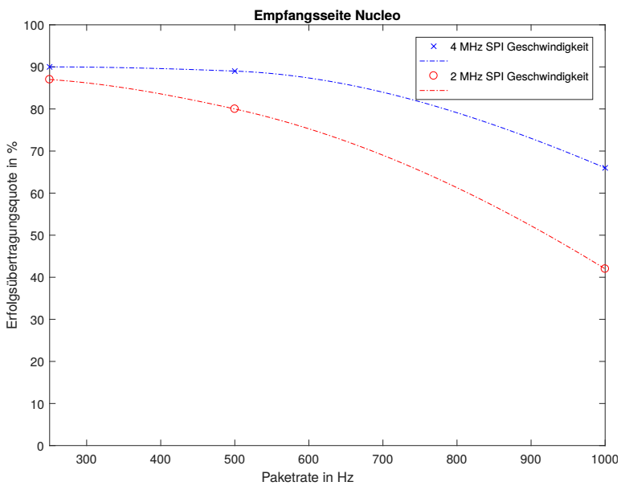
Benchmark Results
4 MHz SPI Speed
2 MHz SPI Speed
Success rate in %
Packet rate in Hz
Notes:
And here is the test result for the side Nucleo receiving. As we can see is, higher pracket rate will cause the successrate drop. And compare two different SPI speed, we can find the 4MHz have a little higher successrate. So according to this picture, we find the “sweet spot” for the best performance of our protocol, which is at 500Hz packet rate and 4MHz SPI speed.And for the HLP receiving, the test resultis is similar as Nucleo.
15.06.16
|
| 11

Slide 12
Summary
A protocol has been developed that meets most expectations
500Hz packet rate
Reliable error detection
Expandable by small effort
Success rate is still improvable
Real control performance not tested (future work)
Notes:
so now we have a tested protocol, which guarantees a reliable and fast enough packet exchange speed. After we implement our protocol in both HLP and Nucleo, we can send all sensor data through the HLP to the high-performance Nucleo.
This protocol can achive 500Hz packet rate, due to the use of checksum, we have a reliable error detection. It reserve expandable possibility by small effort and the success rate can be further improved
Although we still dont test, to implement our procotol in the real control situation of the UAV, we are not sure the real performance of the protocol. Future work can be based on this protocol, which allows to implement komplex control algorithm on the Nucleo and integrate additional sensors to improve the control performance.
15.06.16
|
| 12

Slide 13
Sources
[1] H. König, Protocol Engineering, 1st ed. Wiesbaden, Deutschland: Teubner,
2003.
[2] H. Wörn, Echtzeitsysteme, 1st ed. Springer-Verlag Berlin Heidelberg,
2005.
[3] T.C. Maxino und P.J. Koopman, The Effectiveness of Checksums for
Embedded Control Networks, IEEE Xplore Digital Library, 2009.
[4] J.F. Kurose und K.W. Ross, Computer networking, 5. ed. Boston, MA :
Pearson/Addison-Wesley, Pearson Education, 2009.
[5] S. Cheshire und M. Baker, Consistent Overhead Byte Stuffing, IEEE/ACM
TRANSACTIONS ON NETWORKING, VOL.7, NO. 2, 1999.
[6] C. Noviello, Mastering STM32, Victoria, BC, Canada: Leanpub, 2017.
[7] S.C. Hill und J. Jelemensky und M.R. Heene, Queued serial peripheral
interface for use in a data processing system, Google Patents, 1989.
[8] D. HONEGGER, An open source and open hardware embedded metric
optical flow cmos camera for indoor and outdoor applications, Robotics
and Automation (ICRA), IEEE International Conference on. IEEE, 2013.
[9] J.G. Fletcher, An Arithmetic Checksum for Serial Transmissions, IEEE
Transactions on Communications Vol. 30, 1982.
[10] AscTec Research Home, http://wiki.asctec.de/display/AR/AscTec+Firefly, 23.06.18
Thank you for your Attention!
Notes:
high performence, analyse the existed system, program a protocol, during design face some problem like padding, at last we finish the protocol and according to some test have determined the performens of the protocol. With this already in HLP and Nucleo implemented protocol we can now...And of cause there are still improvement space for our protocol, like use CRC16 as the
15.06.16
|
| 13

