Slide 1
Protocol design
Projektseminar Robotik
und Computational Intelligence
Malte Breitenbach, Xianglun Chen, Zhiyuan Hu

Slide 2
Content
Motivation
Basics
System description
Protocols
Protocoldesign
Presentation
Results
Summary & Outlook
Notes:
15.06.16
|
| 2

Slide 3
Motivation
Requirement of
Sensor Fusion
Properties of Processor in UAV
matrix arithmetic
floating-point arithmetic
processing speed
memory for programming
limited
limited
slow
Not very enough
Adding specific Processor for Sensor Fusion
Reliable, High Speed Communication
1. Reliable and High Speed Communication
2. …
3. …
Notes:
So firstly, why we need an additional processor and protocol specificly for the sensor fusion.
Straightforward if we list the requirement of sensor fusion and propoties of HLP in UAV
Pro in UAV can not afford calculation.
Pro in UAV will do many control task. It demands real-time property and also demands sources to do many calculation tasks.
Also the sensorfusion have very big probability to conflict the original control logic, because the calculation takes time and frequently.
So we add a specific processor to do sensor fusion task.
But firstly, we must ensure the reliable and high speed communication between our specific processer and the HLP, and only then we can make sensorfusion task.
Besides, data comes from many different sensors, so we need large quantity of variables to save them. But the memory of HLP not very enough.
15.06.16
|
| 3

Slide 4
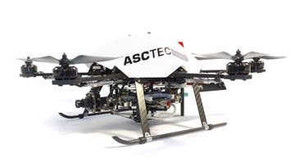
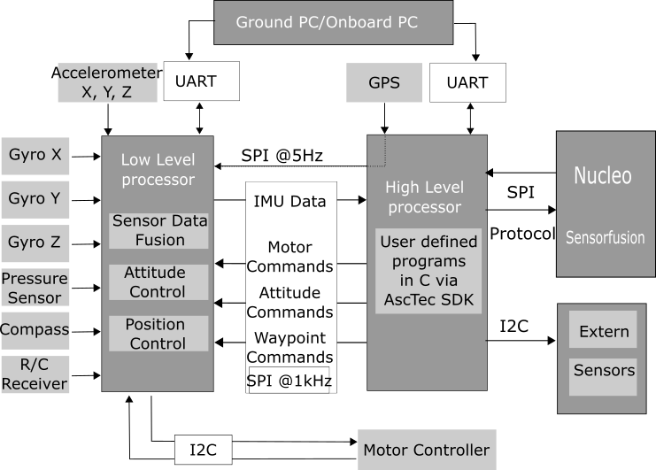
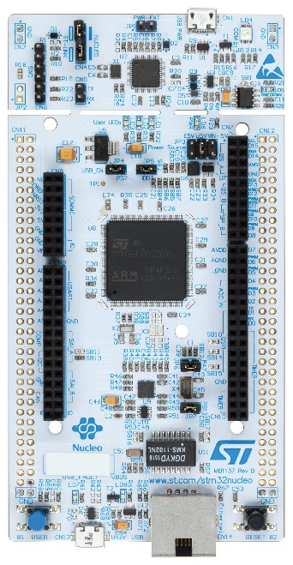
Basics – System Description
Additional Processor
UAV
Sensors
Notes:
1. Object of sensor fusion task
HL LL Directly control.
high level control, like flying along a certain trajectory, but can not afford large quantity of calculations.
2. Nucleo,
Very advanced and popular in embeded system field. Library functions, convienient and fast to make prototyping. The calculation efficiency is very good.
The communication between Nucleo and UAV is based on SPI bus. Also our protocol is based on this bus.
3. Firstly is intern sensors, they are very commonly used sensor, and they are already integrated in the UAV. Like ………..
But in some special situation, it doesn’t work well. For, example, when UAV is flying indoors, GPS will not work.
Like optical flow, Lidar, camera.
for example, if we want to locate the position indoors, or avoid barrier.
15.06.16
|
| 4

Slide 5
Basics - Protocols
Communication protocol
A set of rules allowing communication partners to transmit information.
Defined timing of communication actions
Defined format of PDUs
Partners need to provide serval protocol features
De- / Encoding of PDUs
Error detection
Layer (provides functions)
serves the layer above , is served by the layer below
Notes:
Thank you Mr. Hu, also a good afternoon from my side.
I would start by explaining to you what a communication protocol is in information technology.
Basically it’s a set of rules allowing communication partners to transmit information.
Therefore both partners have to use a defined timing of communication actions, like transmitting data or decode some data at a a specified point.
The information both partners share are packed in so called PDUs, what stands for „Packet data Unit“.
So it must be known for what the first three bytes are, is there a Startbyte for example.
To achieve a successful communication, both partners need to provide protocol features
-> De-/Encoding of PDUs
-> Error detection, to detect errors while transmission
An important term in protocol technology is the layer.
Basically each layer provides functions to fulfill a specific goal.
-> serves the layer above and is served by the layer below (but does not need to know how the other layers are implemented)
15.06.16
|
| 5

Slide 6
Protocoldesign - Presentation
Requirement analysis
Robust
Fast
Protocol design
COBS (Consistent Overhead Byte Stuffing)
Implementation
Different implementation on both microcontrollers
Testing
SPI drivers
Performance
Real time
Expandable
Fletcher’s Checksum
Error detection
Reliability
Robustness
Easy access by a struct
Waterfall model
Notes:
To clarify the basics mentioned, we take a look at the protocol we designed.
While the design process the waterfall model was used.
This method intends a requirement analysis as the first step.
Here different requirements were set, like the protocol needs to be robust.
In this context robust means, that transmission errors need to be detected and handeld AND there should never be a Live- or a Deadlock. So the program must never hang up.
The transfer needs to be fast of course, to reach a high data throuput (so the hexacopter can be stably controlled).
For the same reason the hole implementation needs to be realtime – capable.
Last but not least, the implementation should be easily expandable, so it should be possible to add and remove new sensory by small effort.
The next step is the protocol design. Our protocol is based on COBS (Consistent Overhead Byte Stuffing), I will go into more detail on the next slide.
For the Error detection the Fletchers Checksum is used. This means, we are calculating a checksum based on the byte sequence to be sent. This calculated Checksum is then attached to the send-package, and can be checked on the receiving side.
The Design is followed by the Implementation, which should translate the design specification into
executable program code.
here are two different microcontrollers (as Mr. Hu already meantiond), so two different implementations are needed.
Due to the high demand for transfer speeds, SPI is chosen as the bus technology. So SPI drivers have to be implemented and tested on both sides.
For an easy access of the variables, a C-struct is used.
To test the design and implementation, at the end some benchmarks and testing sequences have to be run through, Mr. Chen will go into more detail later.
15.06.16
|
| 6

Slide 7
Protocoldesign - Presentation
Layer representation
Packing / reading new messages in Application layer (N=4)
Bit transfer in physical layer (N=1)
De- /Encoding Layer
Transmission assurance Layer
Physical Layer
Application Layer
Sending
Receiving
Startbyte | Speed reading | Height reading
0x 01 | 0x 00 33 | 0x 12 D3
N=4
N=4
Startbyte | Speed reading | Height reading | Checksum
0x 01 | 0x 00 33 | 0x 12 D3 | 0x 3F 2D
N=3
N=3
Stuffed Byte | Encoded Byte stream | Delimiter
0x 02 | 0x 01 06 33 12 D3 3F 2D | 0x 00
N=2
N=2
Transport Byte stream
0x 02 01 06 33 12 D3 3F 2D 00 00
N=1
N=1
Notes:
To see how the actual protocol works, we take a deeper look into the layer representation.
The highest layer is the application layer, on that layer you can fill a new package for example with the latest speed reading for the next package to be sent.
When a package is finished (so basically all data is updated, happening in 500Hz), the next layer comes on.
It’s called tansmitssion insurance layer, with the goal of detecting transmission errors.
Here a checksum is calculated based on the byte sequence and is attached to the PDU.
The next De- /Encodelayer is not considering the content of the PDU, it’s just treated like a simple ByteStream.
As I said before, a COBS algorithm is used to de and encode the data.
This algorithm is stuffing some new Bytes into the Bytestream (generating some overhead) to ensure that a specified delimiterByte is not included inside the Packet.
Use you can this Delimiter (in that case 0x00) to set boundarys between the messages, so you can easily see the strat and the end of each single package.
Last Layer is the Physical layer, here the Bittransfer between both partners is taking place.
When a message gets received on the right side, decoded, checked for the correct checksum and is now available on the application layer.
SO the data which was packed here, is now available on the receiving side.
15.06.16
|
| 7

Slide 8
Evaluation Standards
Conformity
Interoperability
Effectiveness
Speed
Robust
SPI transfer speed(in bit/second)
Packet size(in bytes)
Operating status of UAV(calibration/initialization)
Notes:
In order to evaluate a communication protocol, there are basically four criterion, which are... Conformity... Interoperability...And the last two criterion: Effectiveness and robust of the protocol are in our project more important and so we do..Effectiveness ..Robust.. Using the... much time will it take to transfer a message and the success rate. When a error occurred, what excatly goes wrong?
15.06.16
|
| 8

Slide 9
Analysing Results
Protocol | Packet
accept | correct
reject | error
Best situation: when protocol accepts the packet and in fact the packet is ture.
Worst situation: when protocol accepts but it's wrong.
Notes:
Result analyse
For testing there are 4 diff. Situation need to considered...Both sides send fixed message to each other. So when one receive, unpack, check the checksum to see...two main situation...other situation like reject but correct can also happen, like when we face the padding problem.
15.06.16
|
| 9

Slide 10
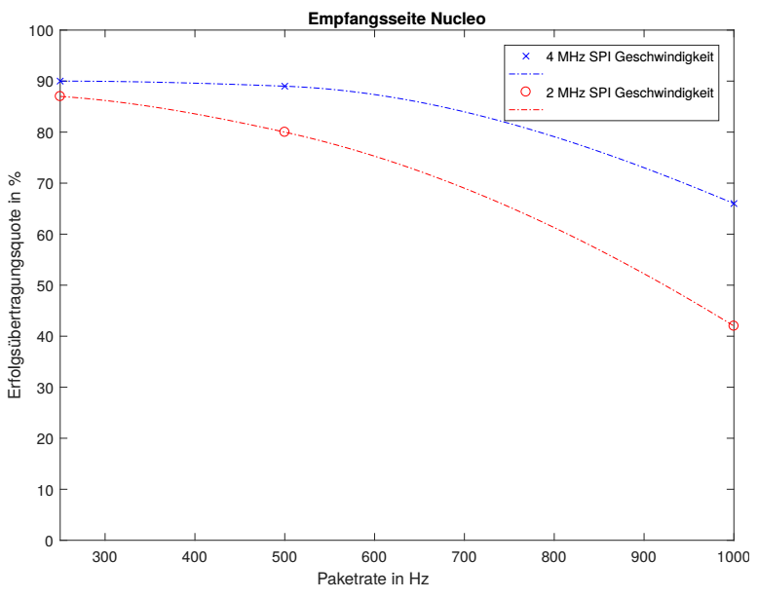
Nucleo Receiving
4 MHz SPI Speed
2 MHz SPI Speed
Successrate in %
Packet rate in Hz
Notes:
first as we can see is... two factor will effect the sucess rate: speed and the size of packet. For the size is apprant,, send and receive a whole packet at once, the longer the packet is , more chance a error occur, and this considered as a error receive case and drop...For the SPI speed needs to mention, According to the common sense...and it's true if both system just do simple SPI communication. but under the cirucumenten the existed UAV is a quite complex system, in
15.06.16
|
| 10

Slide 11
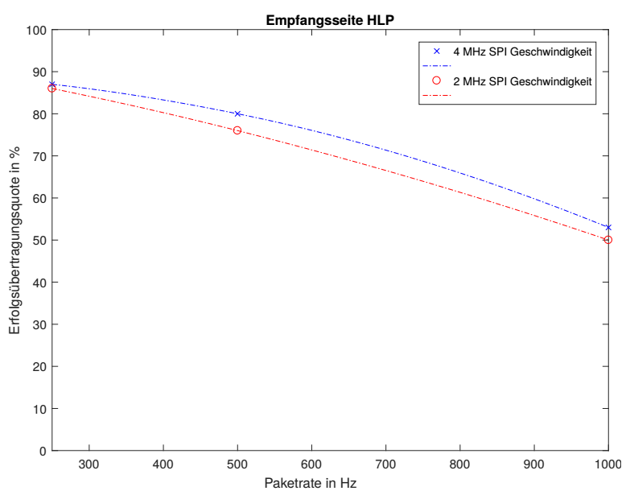
HLP Receiving
Notes:
500Hz,
15.06.16
|
| 11

Slide 12
Summary
Demand Analysis
Improvement:
CRC16
Protocol Design
Test
Notes:
high performence, analyse the existed system, program a protocol, during design face some problem like padding, at last we finish the protocol and according to some test have determined the performens of the protocol. With this already in HLP and Nucleo implemented protocol we can now...And of cause there are still improvement space for our protocol, like use CRC16 as the
15.06.16
|
| 12

Slide 13
Thank you!
Notes:
high performence, analyse the existed system, program a protocol, during design face some problem like padding, at last we finish the protocol and according to some test have determined the performens of the protocol. With this already in HLP and Nucleo implemented protocol we can now...And of cause there are still improvement space for our protocol, like use CRC16 as the
15.06.16
|
| 13

