Slide 1
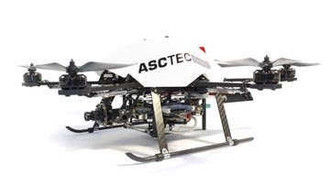
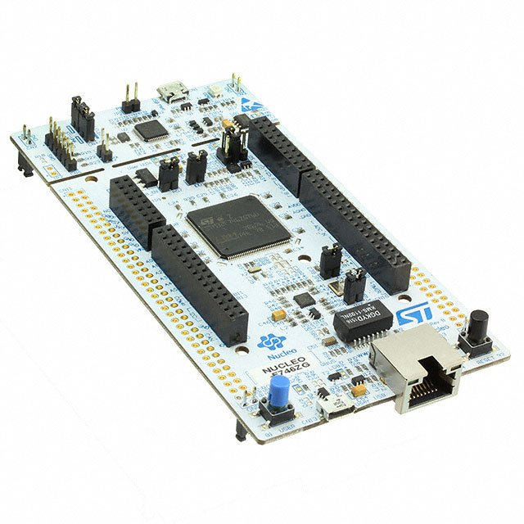
Development of a protocol for inclusion of an microcontroller in an multicopter system
Projektseminar Robotik
und Computational Intelligence
Malte Breitenbach, Xianglun Chen, Zhiyuan Hu

Slide 2
Content
Motivation
Basics
System description
Protocols
Protocoldesign
Presentation
Results
Summary & Outlook
Notes:
15.06.16
|
| 2

Slide 3
Motivation
Requirement of
Sensor Fusion
Properties of Processor in UAV
matrix arithmetic
floating-point arithmetic
processing speed
memory for programming
limited
limited
slow
Not very enough
Adding specific Processor for Sensor Fusion
Reliable, High Speed Communication
1. Reliable and High Speed Communication
2. …
3. …
Notes:
So firstly, why we need an additional processor and protocol specificly for the sensor fusion.
Straightforward if we list the requirement of sensor fusion and propoties of HLP in UAV
Pro in UAV can not afford calculation.
Pro in UAV will do many control task. It demands real-time property and also demands sources to do many calculation tasks.
Also the sensorfusion have very big probability to conflict the original control logic, because the calculation takes time and frequently.
So we add a specific processor to do sensor fusion task.
But firstly, we must ensure the reliable and high speed communication between our specific processer and the HLP, and only then we can make sensorfusion task.
Besides, data comes from many different sensors, so we need large quantity of variables to save them. But the memory of HLP not very enough.
15.06.16
|
| 3

Slide 4
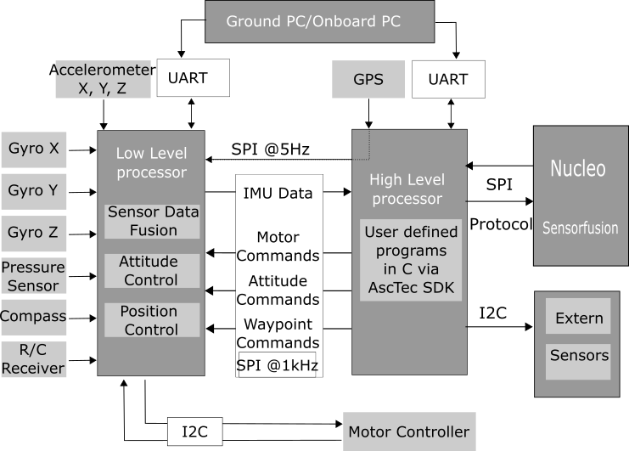
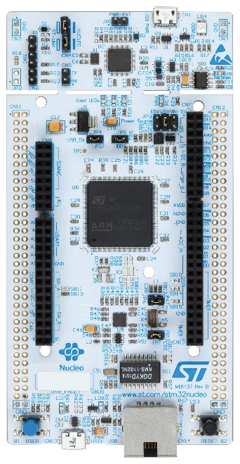
Basics – System Description
Additional Processor
UAV
Sensors
Notes:
1. Object of sensor fusion task
HL LL Directly control.
high level control, like flying along a certain trajectory, but can not afford large quantity of calculations.
2. Nucleo,
Very advanced and popular in embeded system field. Library functions, convienient and fast to make prototyping. The calculation efficiency is very good.
The communication between Nucleo and UAV is based on SPI bus. Also our protocol is based on this bus.
3. Firstly is intern sensors, they are very commonly used sensor, and they are already integrated in the UAV. Like ………..
But in some special situation, it doesn’t work well. For, example, when UAV is flying indoors, GPS will not work.
Like optical flow, Lidar, camera.
for example, if we want to locate the position indoors, or avoid barrier.
15.06.16
|
| 4

Slide 5
Basics - Protocols
Communication protocol
A set of rules allowing communication partners to transmit information. [1]
Defined timing of communication actions
Defined format of PDUs
Partners need to provide serval protocol features
De- / Encoding of PDUs
Error detection
Layer (provides functions)
serves the layer above , is served by the layer below
Notes:
Thank you Mr. Hu, also a good afternoon from my side.
I would start by explaining to you what a communication protocol is in information technology.
Basically it’s a set of rules allowing communication partners to transmit information. [CLICK]
Therefore both partners have to use a defined timing of communication actions, like transmitting data or decode some data at a a specified point.
The information both partners share are packed in so called PDUs, what stands for „Packet data Unit“.
So it must be defined what the first byte of each packet means and the second and so on… [CLICK]
To achieve a successful communication, both partners need to provide several protocol features
-> De-/Encoding of PDUs
-> Error detection, to detect errors while transmission [CLICK]
An important term in protocol technology is the layer.
Basically each layer provides several functions to fulfill one specific goal.
-> serves the layer above and is served by the layer below (but does not need to know how the other layers are implemented)
15.06.16
|
| 5

Slide 6
Protocoldesign - Presentation
Waterfall model
Requirement analysis
Protocol design
Implementation
Testing
Robust
Error detection
Reliability
Fast
Real time
Expandable
COBS (Consistent Overhead Byte Stuffing)
Fletcher’s Checksum
Different implementation on both microcontrollers
SPI drivers
Easy access by a struct
Performance
Robustness
Notes:
To clarify the basics mentioned, we take a look at the protocol we designed.
While the design process the waterfall model was used.
This method intends a requirement analysis as the first step.
Here different requirements were set, like the protocol needs to be robust.
The transfer needs to be fast of course, to reach a high data throuput (so the hexacopter can be stably controlled).
For the same reason the hole implementation needs to be realtime – capable.
Last but not least, the protocol should be easily expandable, so it should be possible to add and remove new sensory by small effort. [CLICK]
The next step is the protocol design. Our protocol is based on COBS (Consistent Overhead Byte Stuffing), I will go into more detail on the next slide.
For the Error detection the Fletchers Checksum is used, which is a good compromise between error detection rate and computation power requirements [CLICK]
The Design is followed by the Implementation, which should translate the design specification into executable program code.
here are two different microcontrollers (as Mr. Hu already meantiond), so two different implementations are needed.
Due to the high demand for transfer speeds, SPI is chosen as the bus technology. So SPI drivers have to be implemented and tested on both sides.
For an easy access of the variables, an easy expandable C-struct is used.
After that we had to test, if the implementation meets the requirements, Mr. Chen will go into more detail later.
15.06.16
|
| 6

Slide 7
Protocoldesign - Presentation
Transmission assurance Layer
De- /Encoding Layer
Physical Layer
Layer representation
Packing / reading new messages in Application layer (N=4)
Bit transfer in physical layer (N=1)
Application Layer
Startbyte | Speed reading | Height reading
0x 01 | 0x 00 33 | 0x 12 D3
N=4
N=4
Startbyte | Speed reading | Height reading | Checksum
0x 01 | 0x 00 33 | 0x 12 D3 | 0x 3F 2D
N=3
N=3
Stuffed Byte | Encoded Byte stream | Delimiter
0x 02 | 0x 01 06 33 12 D3 3F 2D | 0x 00
N=2
N=2
Transport Byte stream
0x 02 01 06 33 12 D3 3F 2D 00 00
N=1
N=1
Notes:
To see how the actual protocol works, we take a deeper look into the layer representation. [CLICK]
The highest layer is the application layer, here it’s possible to fill a new packet for example with the latest speed reading for the next packet to be sent.
When a packet is finished (so basically all data is updated, happening in 500Hz), the next layer comes on. [CLICK]
It’s called tansmission insurance layer, with the goal of detecting transmission errors.
Here a checksum is calculated based on the byte sequence and is attached to the PDU. [CLICK]
The next De- /Encodelayer is not considering the content of the PDU, it’s just treated like a simple ByteStream.
As I said before, the COBS algorithm is used to de and encode the packet.
This algorithm is stuffing some new Bytes into the Bytestream (generating some overhead) to ensure that a specified delimiterByte is not included inside the Packet.
This Delimiter (in that case 0x00) can be used to set boundarys between the messages, so you can easily see the start and the end of each single packet. [CLICK]
Last Layer is the Physical layer, here the Bittransfer between both partners is taking place.
When a message gets received on the right side, decoded, checked for the correct checksum and is now available on the application layer.
SO the data which was packed here, is now available on the receiving side.
15.06.16
|
| 7

Slide 8
Evaluation Standards
Conformity
Interoperability
Effectiveness
Speed
Robust
SPI transfer speed(in bit/second)
Packet size(in bytes)
Operating status of UAV(calibration/initialization)
Notes:
In order to evaluate a communication protocol, there are basically four criterion, which are... Conformity... Interoperability...And the last two criterion: Effectiveness and robust of the protocol are in our project more important and so we do..Effectiveness ..Robust.. Using the... much time will it take to transfer a message and the success rate. When a error occurred, what excatly goes wrong?
15.06.16
|
| 8

Slide 9
Analysing Results
Protocol | Packet
accept | correct
reject | error
Best situation: when protocol accepts the packet and in fact the packet is ture.
Worst situation: when protocol accepts but it's wrong.
Notes:
Result analyse
For testing there are 4 diff. Situation need to considered...Both sides send fixed message to each other. So when one receive, unpack, check the checksum to see...two main situation...other situation like reject but correct can also happen, like when we face the padding problem.
15.06.16
|
| 9

Slide 10
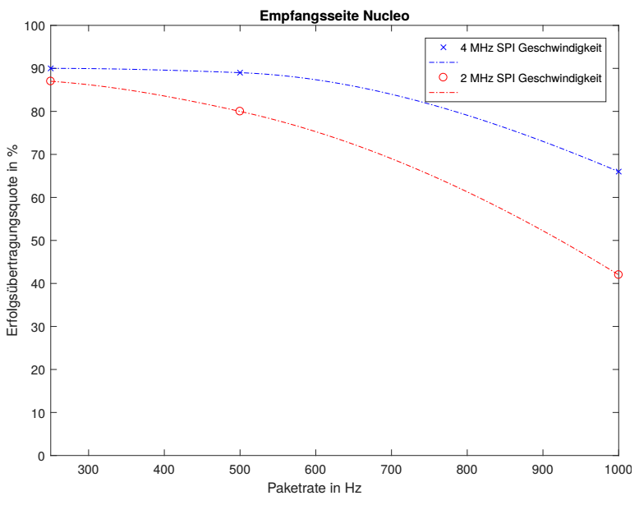
Nucleo Receiving
4 MHz SPI Speed
2 MHz SPI Speed
Successrate in %
Packet rate in Hz
Notes:
first as we can see is... two factor will effect the sucess rate: speed and the size of packet. For the size is apprant,, send and receive a whole packet at once, the longer the packet is , more chance a error occur, and this considered as a error receive case and drop...For the SPI speed needs to mention, According to the common sense...and it's true if both system just do simple SPI communication. but under the cirucumenten the existed UAV is a quite complex system, in
15.06.16
|
| 10

Slide 11
Sources
[1] H. König, Protocol Engineering, 1st ed. Wiesbaden, Deutschland: Teubner,
2003.
[2] H. Wörn, Echtzeitsysteme, 1st ed. Springer-Verlag Berlin Heidelberg,
2005.
[3] T.C. Maxino und P.J. Koopman, The Effectiveness of Checksums for
Embedded Control Networks, IEEE Xplore Digital Library, 2009.
[4] J.F. Kurose und K.W. Ross, Computer networking, 5. ed. Boston, MA :
Pearson/Addison-Wesley, Pearson Education, 2009.
[5] S. Cheshire und M. Baker, Consistent Overhead Byte Stuffing, IEEE/ACM
TRANSACTIONS ON NETWORKING, VOL.7, NO. 2, 1999.
[6] C. Noviello, Mastering STM32, Victoria, BC, Canada: Leanpub, 2017.
[7] S.C. Hill und J. Jelemensky und M.R. Heene, Queued serial peripheral
interface for use in a data processing system, Google Patents, 1989.
[8] D. HONEGGER, An open source and open hardware embedded metric
optical flow cmos camera for indoor and outdoor applications, Robotics
and Automation (ICRA), IEEE International Conference on. IEEE, 2013.
[9] J.G. Fletcher, An Arithmetic Checksum for Serial Transmissions, IEEE
Transactions on Communications Vol. 30, 1982.
Thank you for your Attention!
Notes:
high performence, analyse the existed system, program a protocol, during design face some problem like padding, at last we finish the protocol and according to some test have determined the performens of the protocol. With this already in HLP and Nucleo implemented protocol we can now...And of cause there are still improvement space for our protocol, like use CRC16 as the
15.06.16
|
| 11

