Slide 1

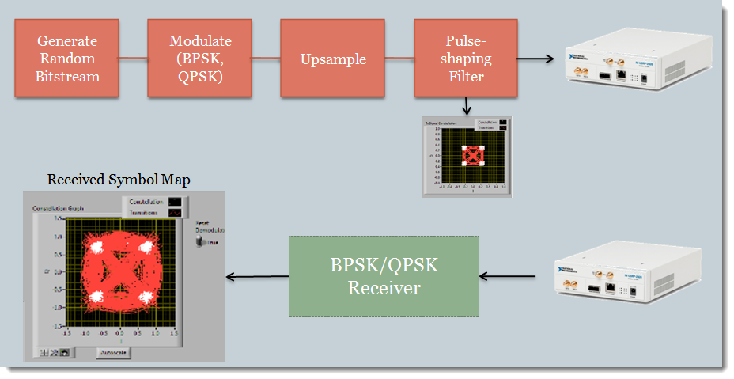
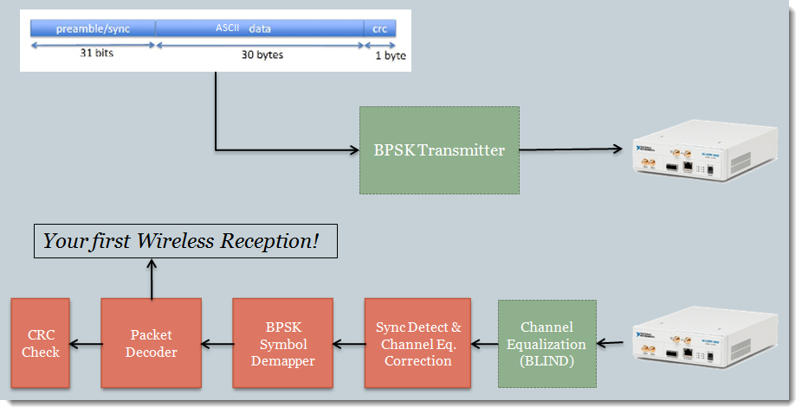
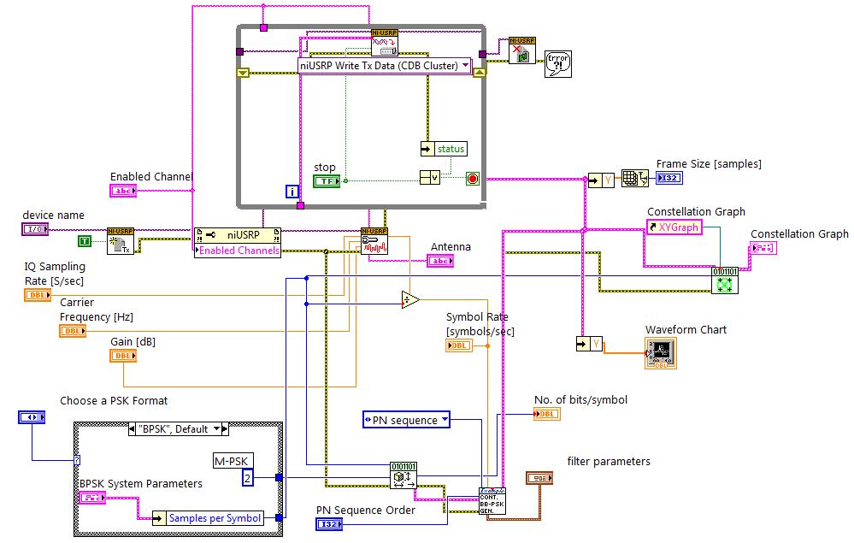
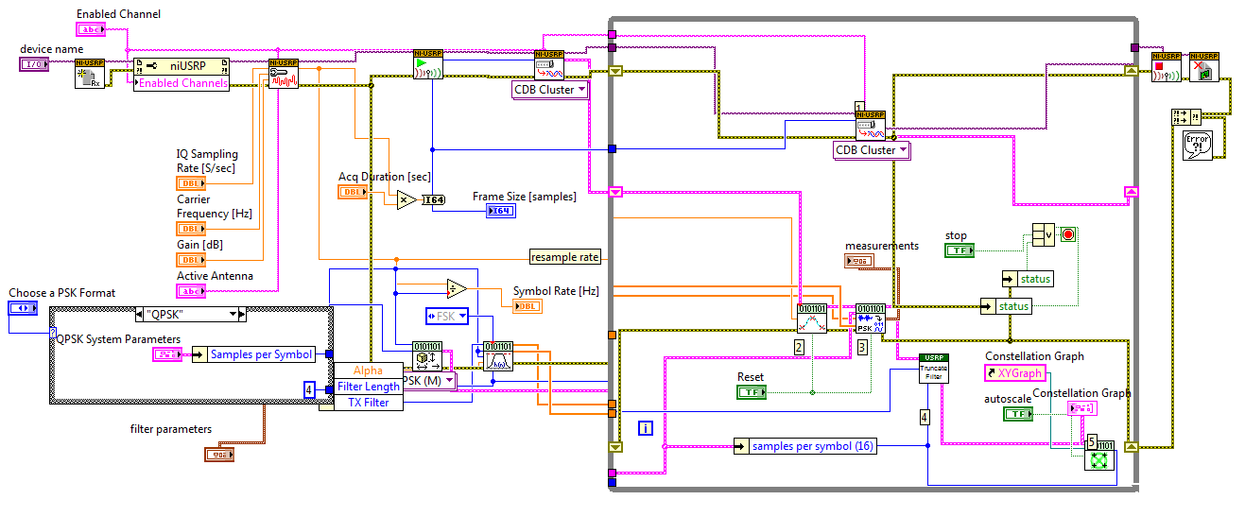
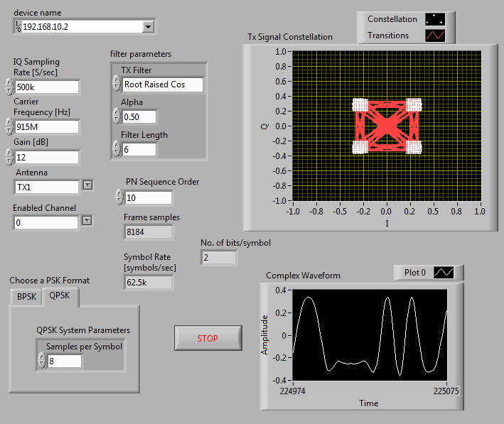
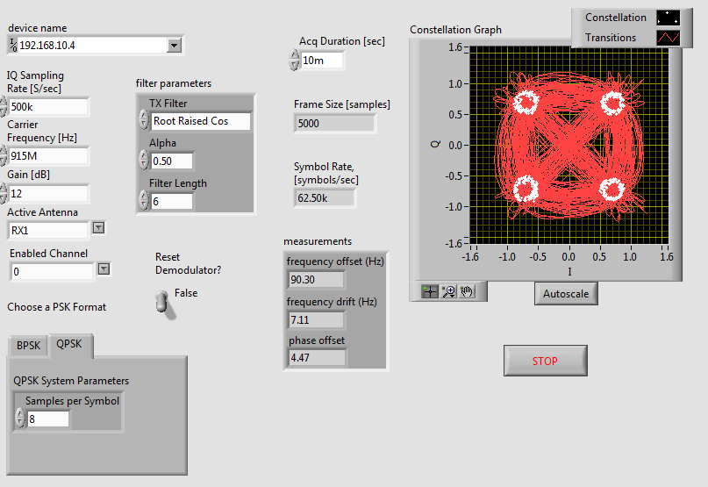
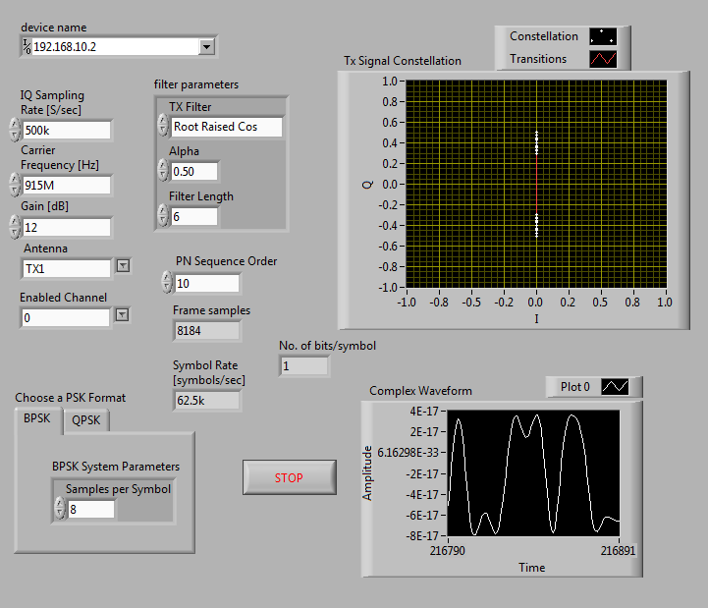
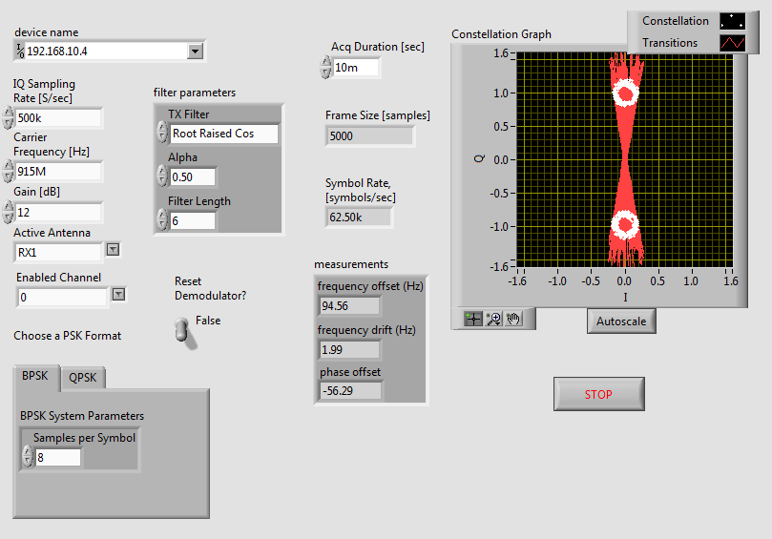
Implementation of BPSK/ QPSK Transmitter and Receiver on NI USRP
Rajat Kumar (2015163)
Rajesh Kumar (2015164)
Abstract
Description (Methods and Materials)
Digital communication Systems are widely used in all fields of communication. We have different digital modulation schemes based on keying techniques that are used for implementation of digital communication systems. Some of the major techniques of keying that widely used are FSK, ASK, PSK, etc. In this report, we are going to focus on BPSK and QPSK. These are types of Phase shift keying. BPSK uses two points on the constellation diagram to represent the two phases and can encode one bit per phase and QPSK uses two points on the constellation diagram to represent the two phases and it can encode two bits per phase [4]. We are going to use LABVIEW for BPSK and QPSK simulation. LABVIEW provides good programming environment being graphical and also gives good visualization of the results
Transmitter: On transmitter side we generate random bit stream then do modulation (BPSK,QPSK) and after that we apply pulse shaping filter (root raised cosine) to avoid ISI. The whole setup will look like as shown in figure 1[6].
Receiver: The setup of receiver side will look like as shown in figure 2[7]. Where we first do synchronize detection then demodulation and symbol detection and then error checking to check whether the bits detected are received correctly or not.
Figure 1.
Figure 2.
Block Diagrams
Results
Figure 3. Transmitter Block Diagram
Figure 4. Receiver Block Diagram
We made transmitter and receiver by using BPSK and QPSK modulation scheme and implemented on NI USRP hardware. We analyzes that carrier frequency and signal energy reduces because of noise in wireless transmission channel. And LabVIEW is a graphical programming tool and easy to use and learn.
Introduction
BPSK is the simplest form of PSK. It has 2 phases i.e., In the constellation diagram there are two constellation points - 0 and 1 which are represented by different carrier phases each is 180 degree apart from other. The Binary Phase shift keying (BPSK) uses two different phases to represent 0 and 1. While Quadrature Phase shift keying has four points on the constellation diagram to represent the four phases which are 90 degrees apart from each other and can encode two bits per symbol. Shifting Keying is the technique of modulation forms which is used to transmit digital signals and data over an analog channel. Modulation is the technique of casting a signal to send information. For expressing digital signals into analog waveform the keying technique can be used. The modulating signals have only restricted number of states to represent the corresponding digital states in keying. The main purpose of the modulation techniques is to increase the data rate transmitting efficiency. In wireless communication, QPSK has widely used modulation technique as it can transmit at twice of the data rate for a fixed bandwidth over BPSK. And for a given data rate the transmission bandwidth can be reduced by 2 by using QPSA. We will implement BPSK/QPSK communication system using the software LabVIEW. AWGN noise is added to the data and then the input signal is recovered at the output after removing the noise. LabVIEW i.e., Laboratory Virtual Instrumentation Engineering Workbench is a graphical programming language introduced by National Instruments. It has many built-in functions, which is used as a tool for simulation and control. The main areas where this it’s programming environment is used involves digital communication, industrial automation, controller design applications, etc. They can be implemented on many platforms including Windows and Linux. [4][5]
Conclusions
[1] [2]
We implemented QPSK and BPSK using LabVIEW on Ni-USRP. Experimental results are shown which are generated by LabVIEW program. The graphical environment of LABVIEW is easy to learn and simple to transform a concept to a working program. And with the help of LABVIEW graphical environment it is possible to continuously vary the input parameters in front panel and to observe the corresponding results. In the Transmitter Front panel we can select the format of PSK i.e., we can transfer BSPK and select its configuration like Samples per Symbol, Symbol Rate and can see it’s original constellation diagram and at the receiver end we get the same constellation diagram that is send by the transmitter but with some noise.
Figure 5. Transmitter Front Panel (QPSK)
Figure 6. Receiver Front Panel (QPSK)
Figure 2. Receiver Front Panel (BPSK)
Figure 7. Transmitter Front Panel (BPSK)
Figure 8. Receiver Front Panel (BPSK)
Future Directions
We can implement and test multiple modulation schemes in LabVIEW and can see the impact on different parameters like bandwidth, BER, probability of error and SNR.
Contact Information
References
Rajat Kumar and Rajesh Kumar
IIIT-Delhi
Email (1): rajat15163@iiitd.ac.in
Email (2): rajesh15164@iiitd.ac.in
https://forums.ni.com/t5/Curriculum-and-Labs-for/EE49-Lab-3-Introduction-to-Modulation-BPSK-QPSK/ta-p/3502880
https://forums.ni.com/t5/Curriculum-and-Labs-for/EE49-Lab-4-Introduction-to-Demodulation-and-Decoding-BPSK-QPSK/ta-p/3502725
https://www.ijareeie.com/upload/2017/april/31_2_Implementation.pdfhttps:/forums.ni.com/t5/Curriculum-and-Labs-for/EE49-Lab-3-Introduction-to-Modulation-BPSK-QPSK/ta-p/3502880
https://en.wikipedia.org/wiki/Phase-shift_keying
https://www.allaboutcircuits.com/technical-articles/quadrature-phase-shift-keying-qpsk-modulation/
https://forums.ni.com/t5/Curriculum-and-Labs-for/EE49-Lab-3-Introduction-to-Modulation-BPSK-QPSK/ta-p/3502880
https://forums.ni.com/t5/Curriculum-and-Labs-for/EE49-Lab-4-Introduction-to-Demodulation-and-Decoding-BPSK-QPSK/ta-p/3502725

