Slide 1
INT 213 - PYTHON PROGRAMMING PROJECT
SNAKES GAME DEVELOPMENT
USING PYGAME
SUBMITTED BY: Aaditya Raj 12004802
Nisha Bisht 12001718
SUBMITTED TO: Mr. P. Raja 21019

Slide 2
Overview of The Project
The main aim of this project was to develop a snake game using pygame module.
The snake in this Snake game is controlled using the four direction buttons relative to the direction it is headed in. In this game, the main objective of the player is to catch the maximum number of fruits or food without hitting the wall or itself. If the snake hits the wall or hits itself the player loses the game.

Slide 3
Libraries Used
Pygame-
Pygame is a cross-platform set of Python modules which is used to create video games.
It consists of computer graphics and sound libraries designed to be used with the Python programming language.
Random-
Python Random module is an in-built module of Python which is used to generate random numbers. These are pseudo-random numbers means these are not truly random.
This module can be used to perform random actions such as generating random numbers, printing random value for a list or string, etc.
OS-
The OS module in Python provides functions for creating and removing a directory (folder), fetching its contents, changing and identifying the current directory, etc.

Slide 4
Files Used
Backgroud.jpg: A background image used in the game.
Backimg.jpg: Image used for the splash screen.
Overscreen.jpg: Image used in the game over screen.
Highscore.txt: A text file used to read and write the high score of player.
Gamemusic.mp3: Soundtrack that accompanies our game.
Gameover.mp3: Music played when the player loses the game.
Main.py: The main code of our project.

Slide 5
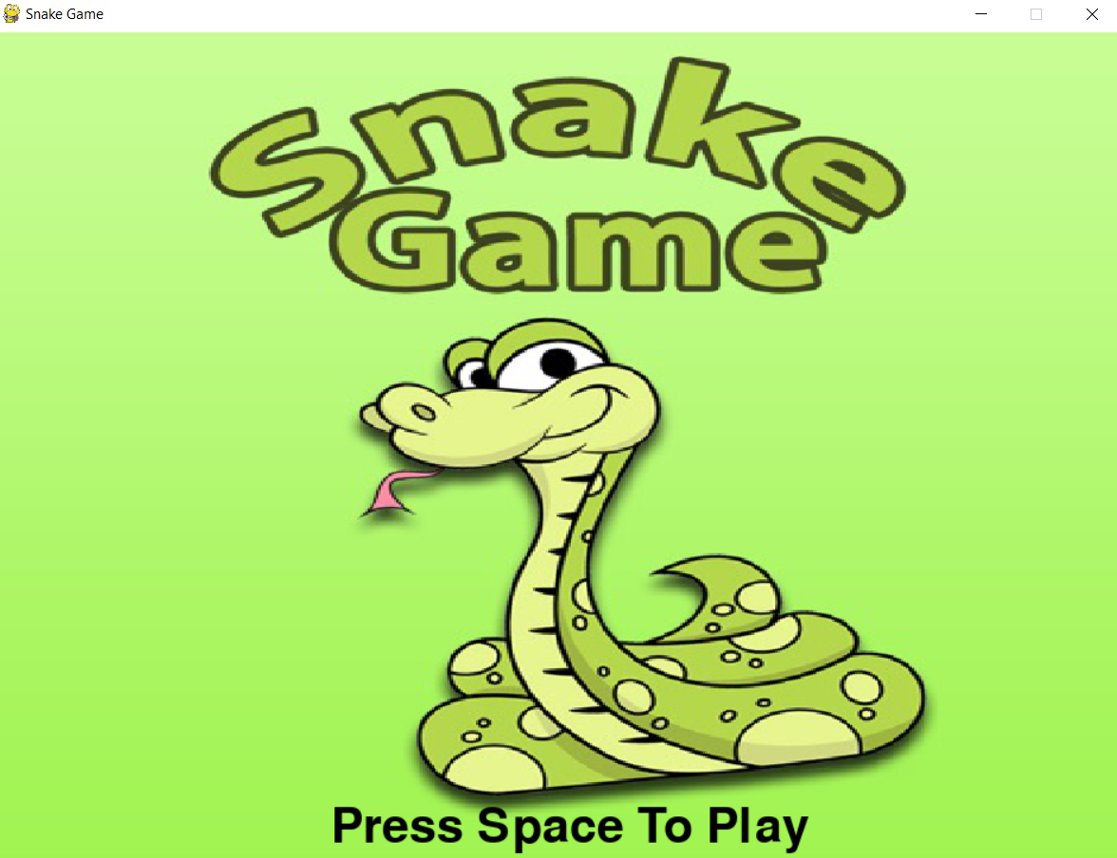
Output Screen
Splash Screen

Slide 6
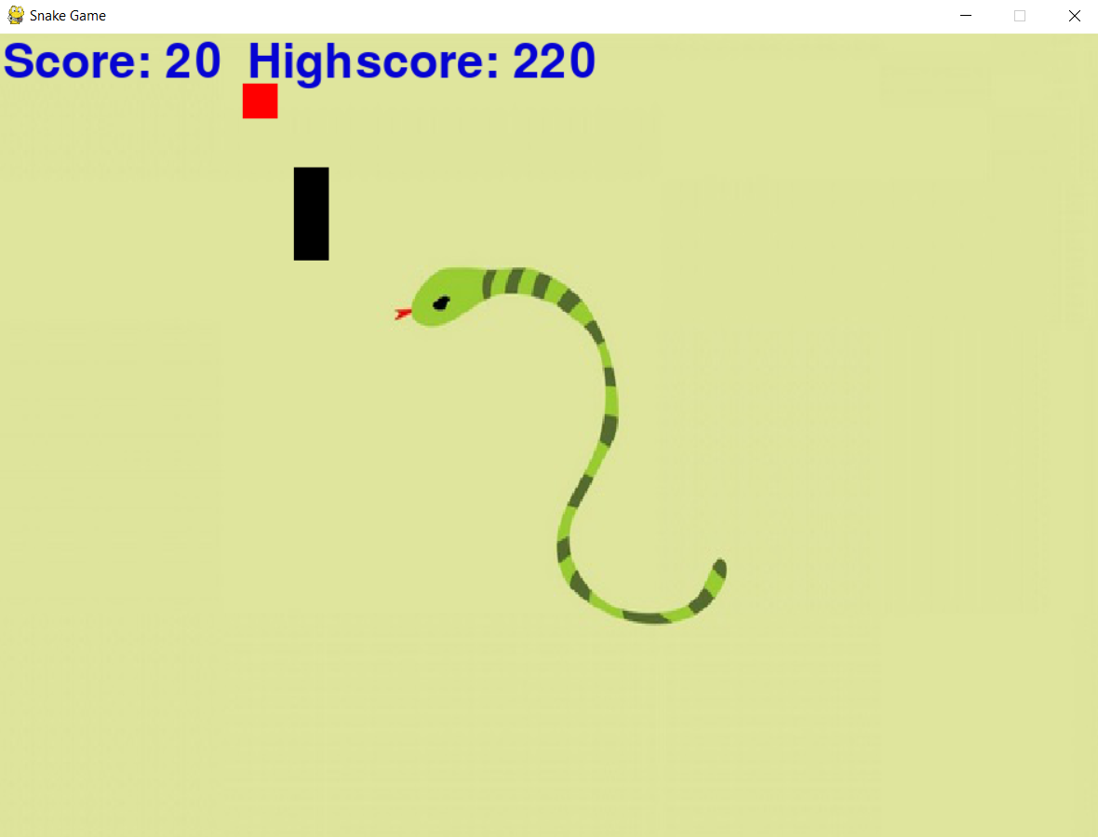
Main Game Window

Slide 7
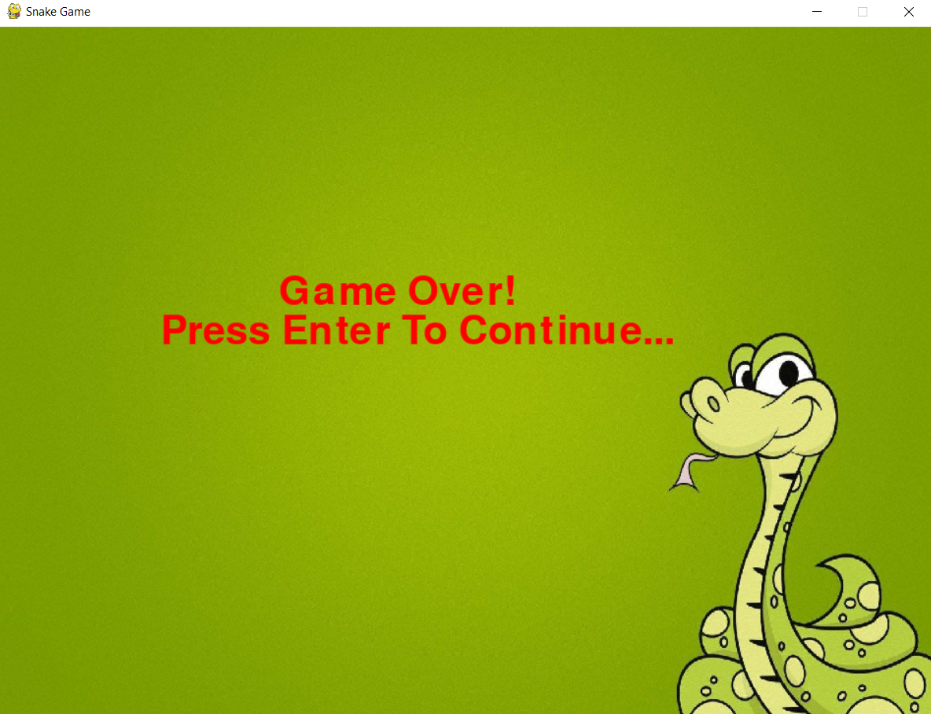
Game Over Screen

Slide 8
BIBLIOGRAPHY
Pygame
https://www.pygame.org
Stackoverflow
https://stackoverflow.com/
Python
https://www.python.org/doc/
W3Schools
https://www.w3schools.com/python/

