Slide 1

Startup Profit Prediction
Team no.: 159

Slide 2

AGENDA
To give startups companies a prediction on the amount of profits they can make on the basis of the money spent in various department.

Slide 3

PROBLEM STATEMENT
Startup companies are often confused how to use their funds.
So they need to know on what fields they should spend money so that they can maximize the profit.
Even investors can get an idea whether the startup they have invested in is profitable or not.

Slide 4

PROJECT OVERVIEW
Inputs: Expenses (Marketing, RND, and administrator) and Location.
We are using Multi linear regression model to predict profits where we use several explanatory variables to predict the outcome of a response variable.

Slide 5

WHO IS THE END USERS?
Startup companies is our main end user.
Investors who invest in startup companies can also use this model to predict the profit of the companies.

Slide 6
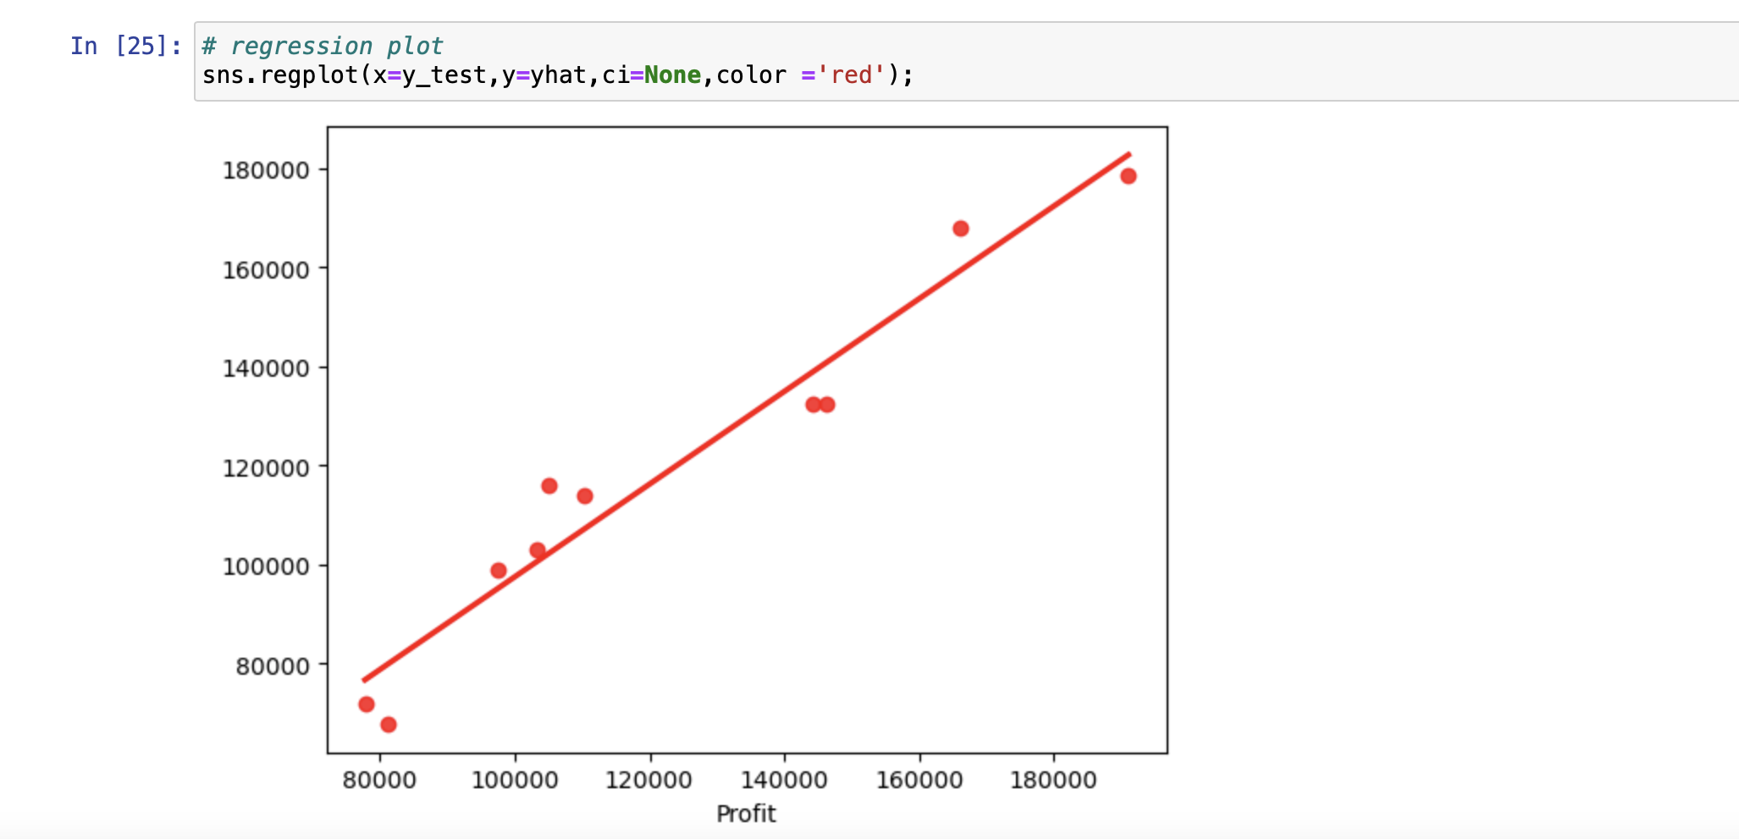
THE WOW IN OUR SOLUTION
We are amazed that our model's give 95% accuracy!
Red dot show the actual profit and line show our predict profit that is very close.

Slide 7

MODELLING
Multilinear regression is used as a model for predicting profits.
Python libraries used:
Pandas
Matplotlib
Sklearn
Numpy

Slide 8
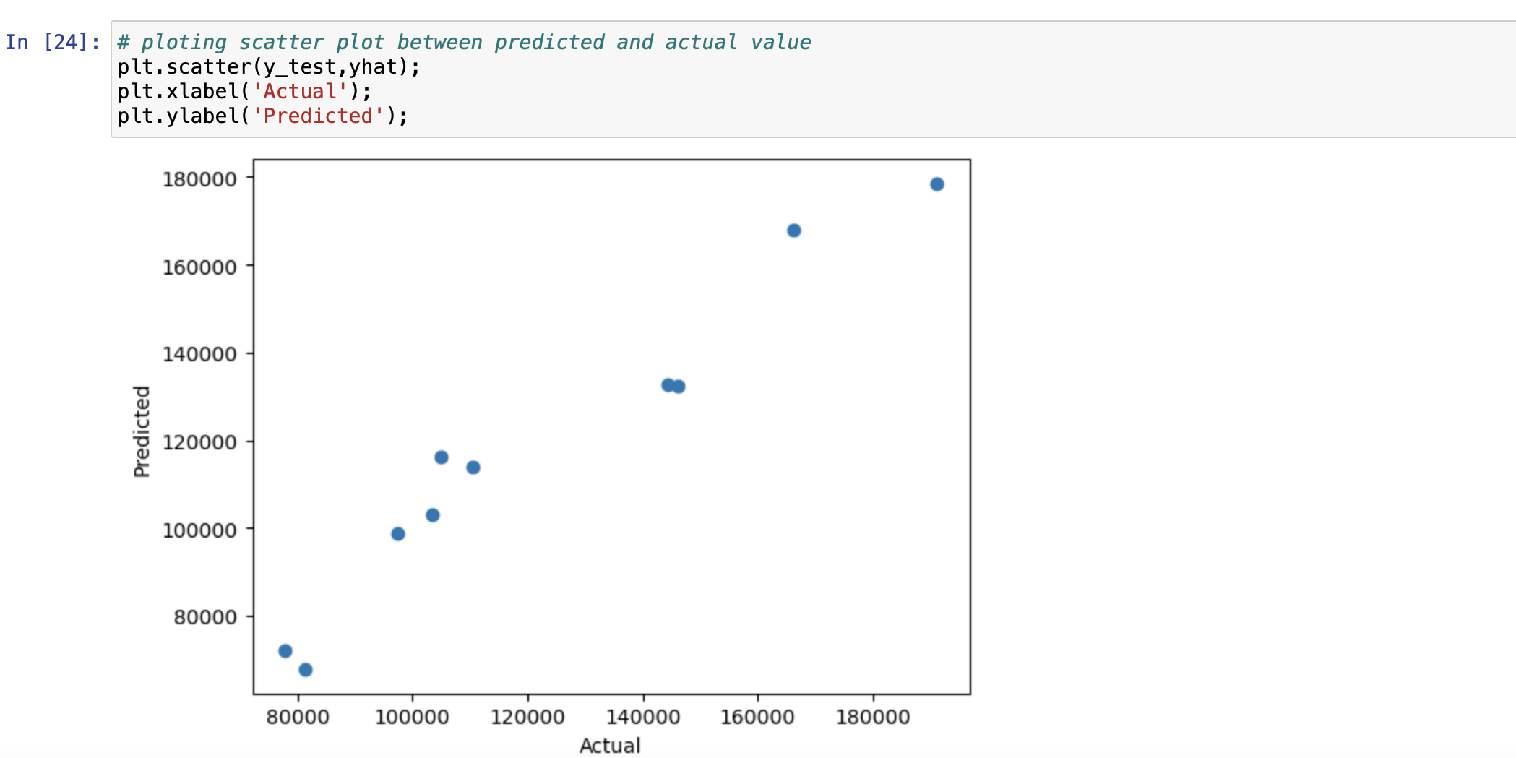
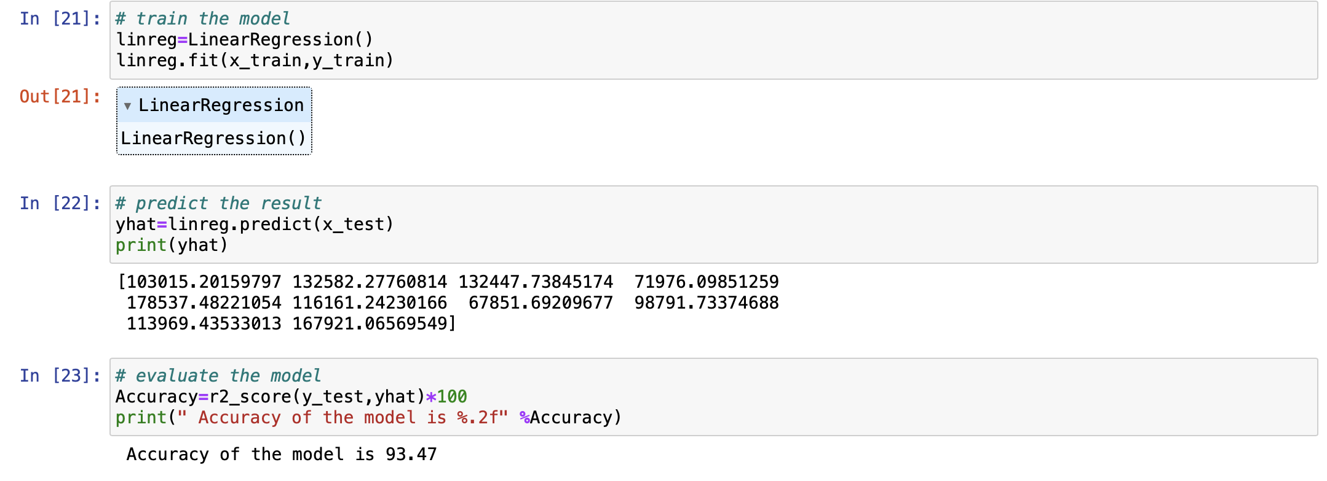
RESULTS

