Slide 1
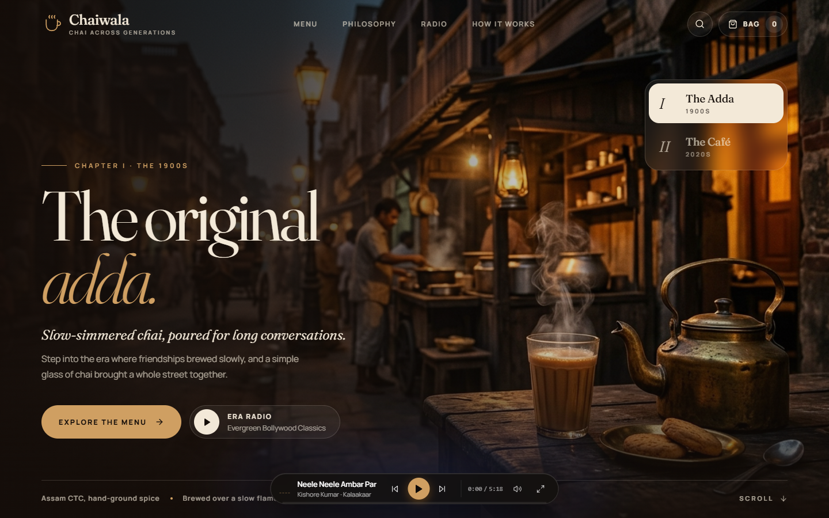
ACADEMIC MINI PROJECT • MCA 2025–27
CHAIWALA
Chai Across Generations
“Waqt badla. Baithak wahi.” (Time changes. The gathering remains.)
A cinematic, QR-first web application bridging nostalgic 1900s Adda heritage with contemporary 2020s café-speed ordering and capacity-controlled pickup slots.
STUDENT & INSTITUTIONAL RECORD
Student Presenter: [STUDENT NAME] (Chandan Mahapatra)
Program: Master of Computer Applications (MCA) | Batch 2025–27
Institution: Srusti Academy of Management and Technology (Autonomous), Bhubaneswar
⚡ React 19 + Vite • 🗄️ PostgreSQL Slot Locks • 📻 Web Audio API
LIVE SYSTEM DEMONSTRATION
Viewport: 1900s Nostalgic Adda Cinematic Hero & Ambient Radio Deck
• Seamless era switching dynamically reconfigures typography, menu catalogue, and audio soundtrack.
• Touch-optimized responsive interface designed specifically for table QR-code scanning.
• Eliminates physical counter line-ups through scheduled 15-minute pickup slots.

Slide 2
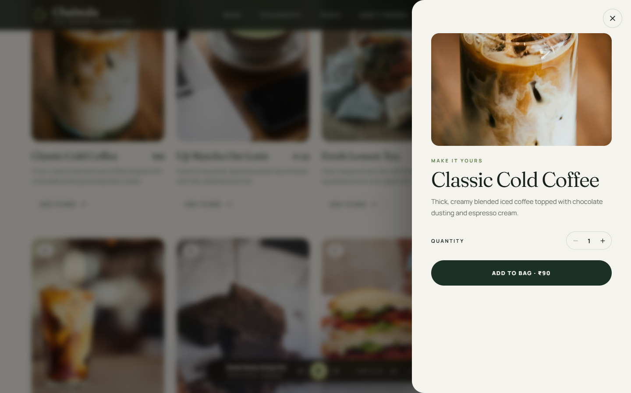
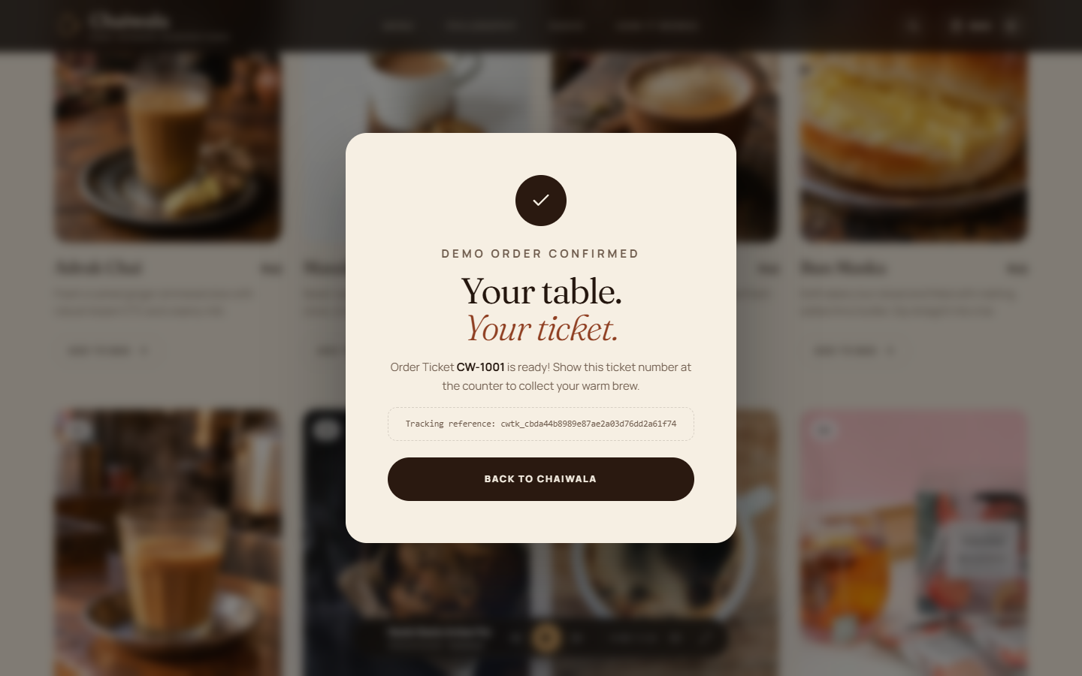
CHALLENGE & SOLUTION ARCHITECTURE
Modern Queue Bottlenecks vs. Authentic Heritage
Eliminating rush-hour counter congestion while preserving Subcontinental tea-counter warmth.
THE PROBLEM STATEMENT
• Peak Rush Congestion: Morning and evening chai breaks create chaotic counter choke points and blind customer waiting.
• Cultural Commoditization: Generic delivery apps turn chai into a sterile, transactional commodity, erasing community 'adda' camaraderie.
• Kitchen Overbooking: Lack of concurrency-managed scheduling leads to dropped orders and barista overload.
THE CHAIWALA SOLUTION — 4 CORE PILLARS
1. Dual-Era Curation: Instant toggle between 1900s Adda (brass, cutting chai, vintage radio) and 2020s Café (lilac, matcha, iced boba).
2. Tactile Customization: Real-time modifiers for sweetness, cup size (Cutting vs. Kulhad Mug), and spice blends with dynamic price computation.
3. Concurrency-Controlled Slots: 15-minute pickup windows enforcing capacity limits (6 orders/slot) via PostgreSQL SELECT FOR UPDATE locks.
4. Resilient Order Fulfillment: Zero-setup offline browser storage fallback combined with live Supabase RPC and cryptographic tracking tokens.
TACTILE MODAL
Multi-Group Beverage Customization
Enables precise customer control over sugar grades, cup sizing, and spice additions with real-time paise-level price delta updates.
FULFILLMENT TICKET
Digital Order Ticket (#CW-1001)
Generates secure tracking tokens (cwtk_...), committed 15-minute pickup slots, and counter instructions eliminating verbal order chaos.

Slide 3
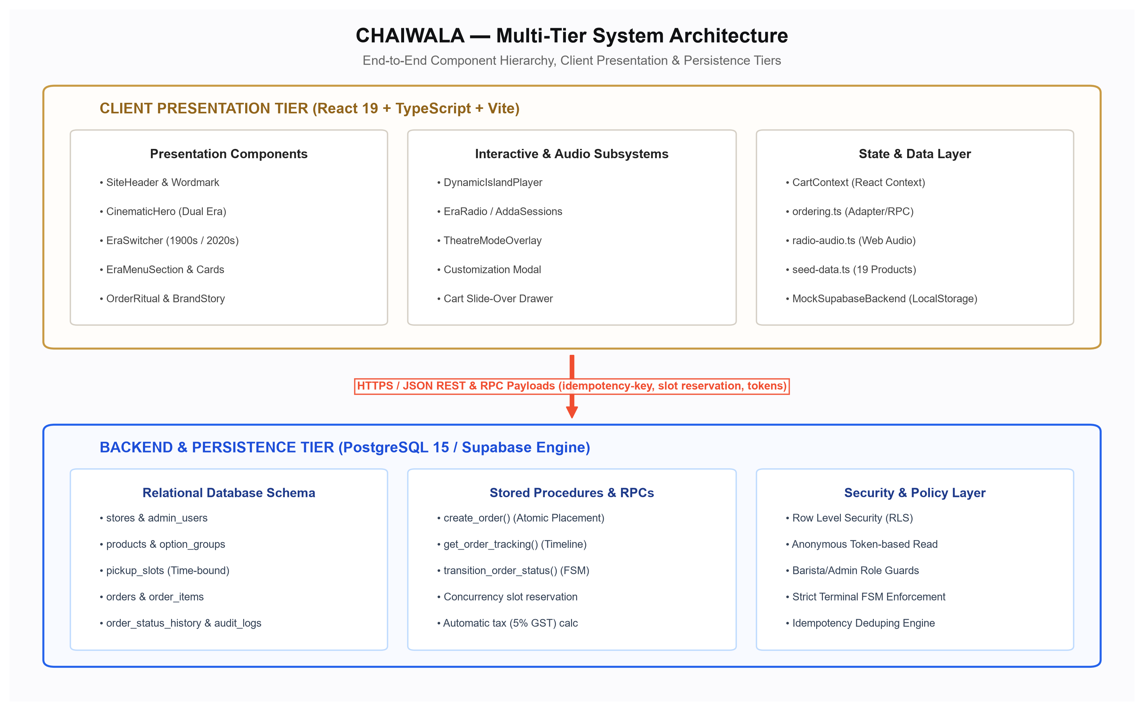
SYSTEM ARCHITECTURE & TECHNICAL FOUNDATIONS
Multi-Tier Reactive Architecture with Concurrency Control
A production-grade separation between presentation, state orchestration, and atomic database persistence.
VERIFIED TECHNOLOGY STACK BY ROLE
🌐 Frontend Presentation Tier
• React 19.0.0 & Vite 6.1.0: Lightning-fast rendering and Hot Module Replacement.
• TypeScript 5.7.3: Strict end-to-end interface typing.
• Lucide React & Web Audio API: Featherweight vector icons and opt-in ambient radio.
• Pure CSS Design Tokens: Zero-dependency CSS custom properties for instant theme shifts.
⚙️ State & Concurrency Engine Tier
• React Context (CartContext): Persistent itemized bag and quantity management.
• Integer Paise Precision: Avoids floating-point rounding errors in 5% GST and packaging fee calculations.
🗄️ Database & Security Tier
• Supabase (PostgreSQL 15): Relational schema spanning 14 tables.
• Atomic Stored Procedures: create_order (SELECT FOR UPDATE) and transition_order_status FSM.
• Row Level Security (RLS): Strict tokenized order isolation protecting customer privacy.
🛡️ Resilience & Mock Layer
• MockSupabaseBackend: PostgREST-compatible localStorage emulator for 100% offline presentations without API keys.
END-TO-END EXECUTION FLOW
Client Browser (QR Scan) ──► React Cart Context ──► Atomic RPC (create_order)
PostgreSQL Slot Lock (FOR UPDATE) ──► Slot Decrement ──► Order Token Issued
Figure 3.1: Multi-Tier Architecture combining stateless client rendering with ACID-compliant concurrency locking.

Slide 4
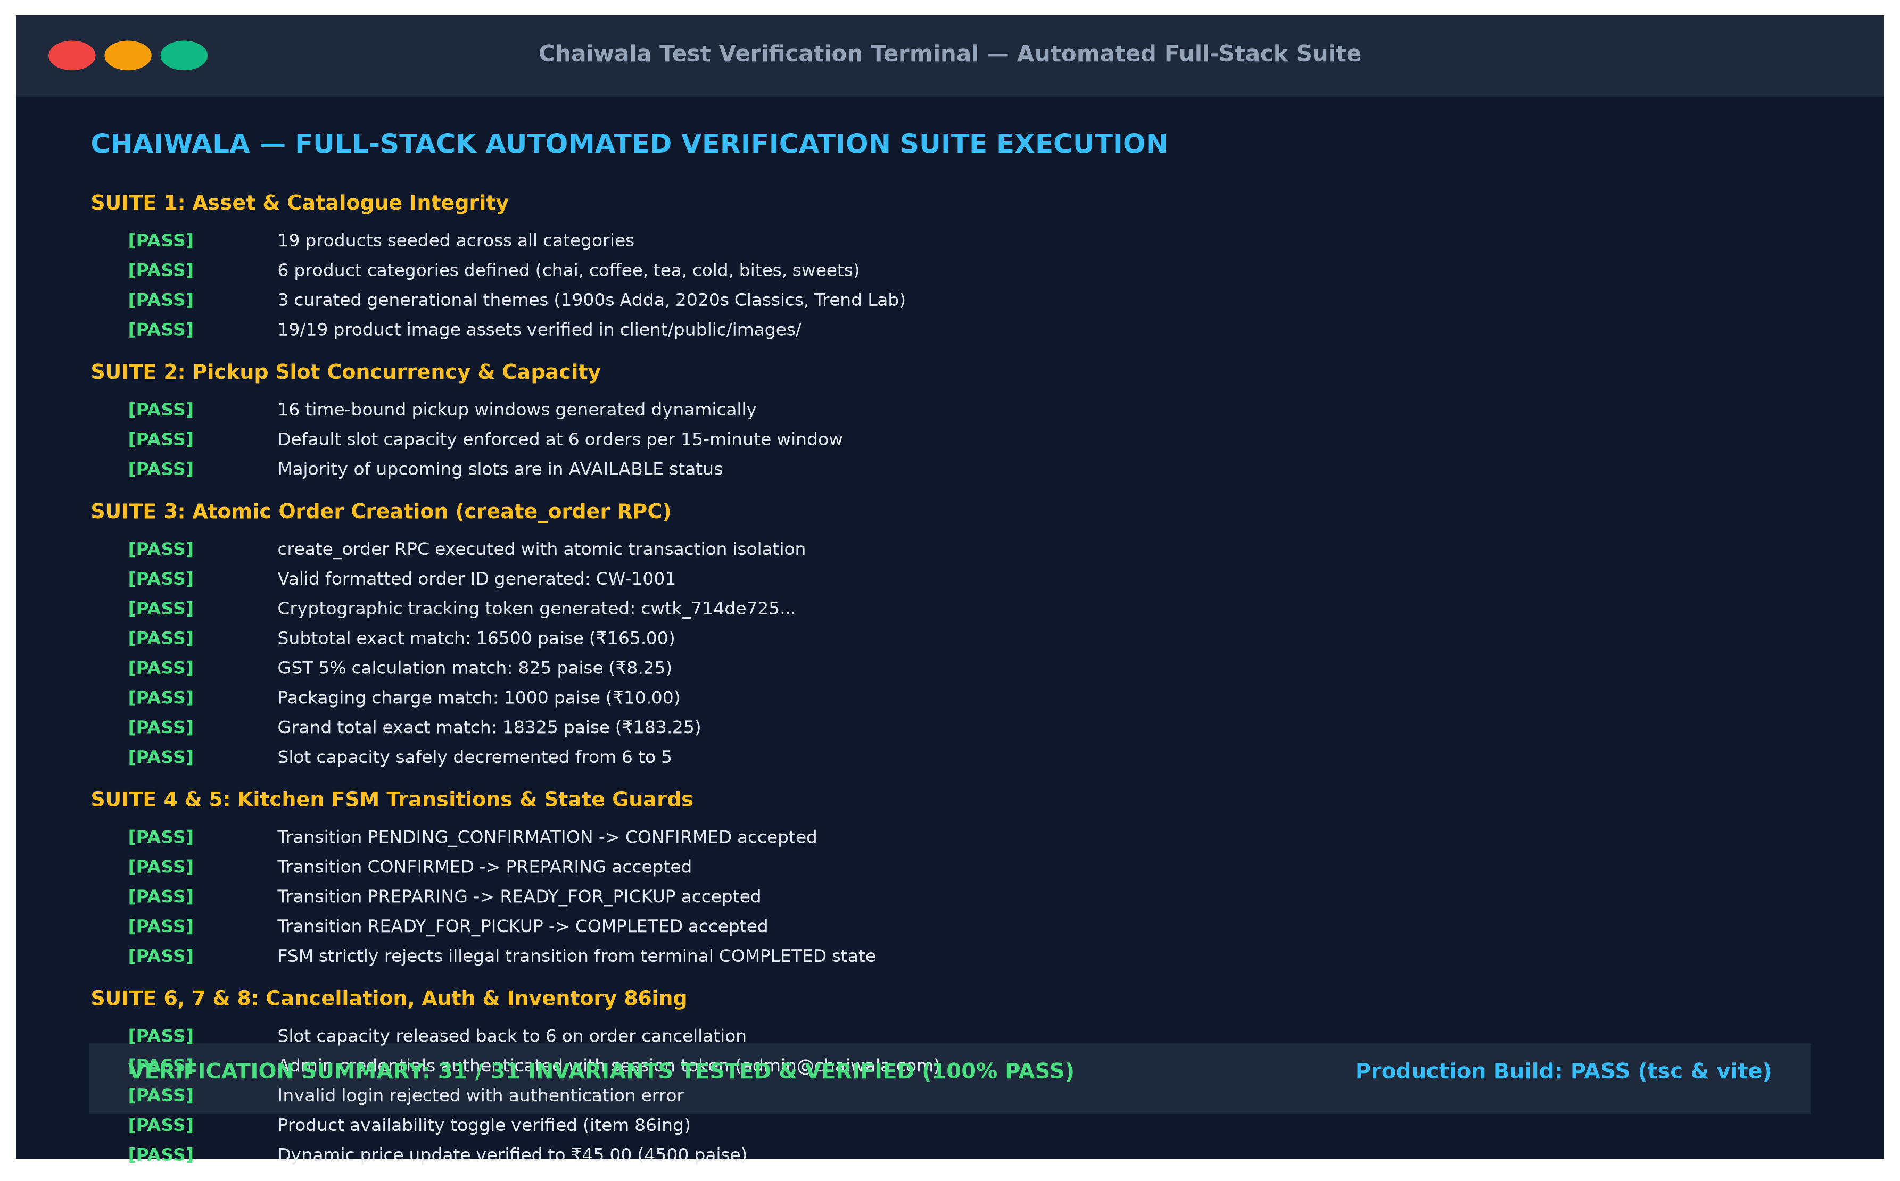
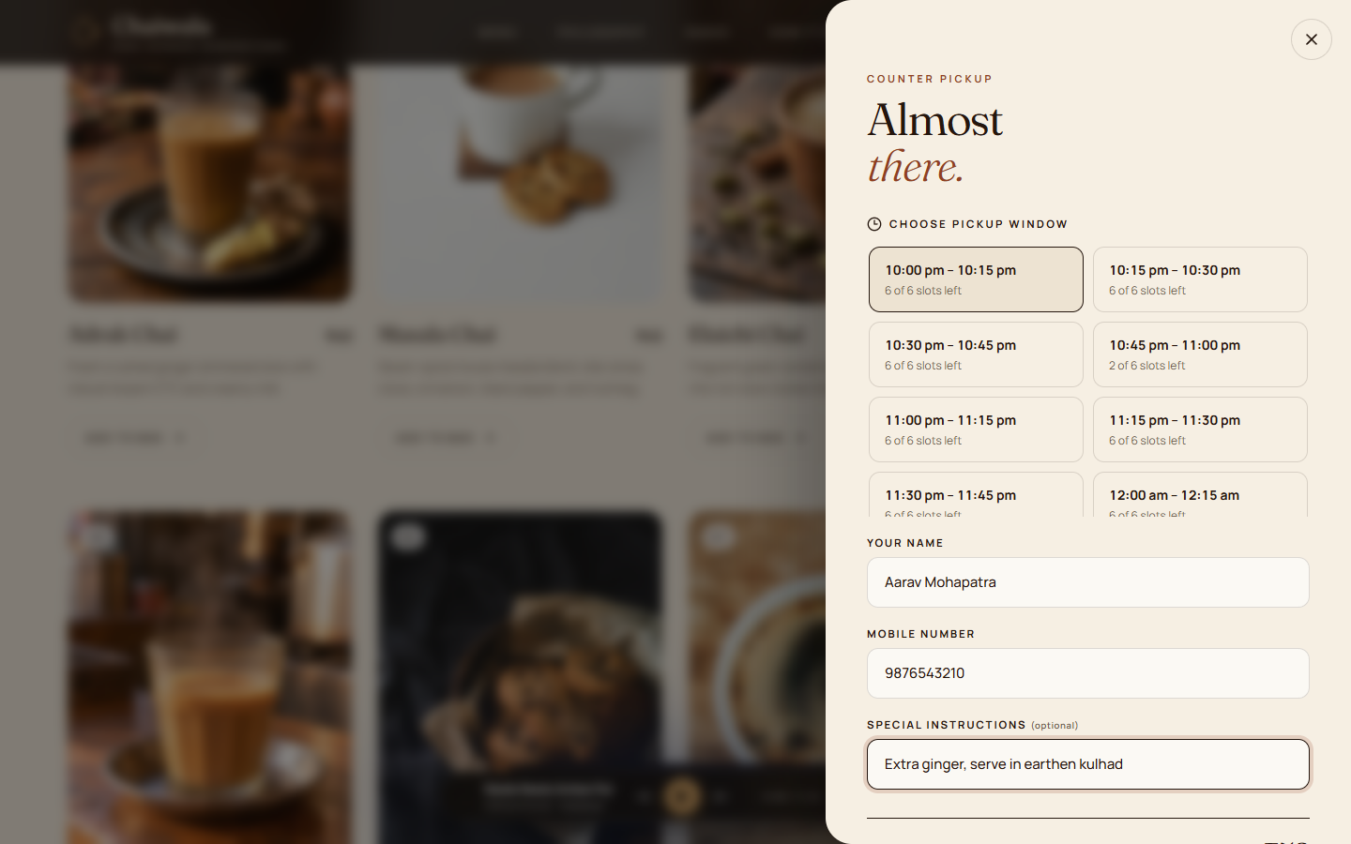
LIFECYCLE, AI WORKFLOW & VERIFICATION
From Design System to Verified Production Code
Structured software lifecycle combining prompt-assisted architecture with strict automated verification.
5-STAGE SYSTEMATIC ENGINEERING LIFECYCLE
1. Research & PRD: Cultural grounding, queue analysis, persona use-cases.
2. Design Tokens: Fraunces & DM Sans typography, brass/vermilion CSS tokens.
3. Database & Concurrency: 14 PostgreSQL tables, atomic RPCs, 7-state kitchen FSM.
4. Reactive Implementation: React 19 UI, Web Audio radio, local mock adapter.
5. Automated Verification: 31-invariant test harness & Playwright visual tests.
RECONSTRUCTED AI DEVELOPMENT PROMPTS
💬 Concurrency Engineering Prompt:
“Write an atomic PostgreSQL function for a tea counter that reserves a 15-minute slot using SELECT FOR UPDATE to prevent race conditions during rush hours.”
💬 Design System Architecture Prompt:
“Design a CSS custom property system that switches seamlessly between an authentic 1900s brass Adda theme and a modern lilac Café theme without page reload.”
VERIFIED INVARIANTS
31 / 31 Test Harness
Validates catalogue integrity, atomic RPC pricing, GST calculation, slot capacity decrements, and terminal state enforcement.
CAPACITY CONTROL
15-Min Pickup Selector
Live capacity indicators (AVAILABLE, FILLING FAST, FULL) prevent counter crowding and give customers predictable collection times.

Slide 5

PROJECT CONCLUSION & CODEBASE ACCESS
Preserving Cultural Heritage with Modern Engineering
Demonstrating how thoughtful UX and robust backend concurrency solve real-world retail queue bottlenecks.
CORE PROJECT TAKEAWAYS
• Cultural Immersion Meets Commercial Speed: Proved that digital ordering doesn't need to be sterile; nostalgic storytelling elevates engagement while cutting queue times.
• Atomic Concurrency Guarantees: Database row locks (SELECT FOR UPDATE) completely eliminate rush-hour double-booking and protect kitchen throughput.
• Zero-Dependency Resilience: Runs anywhere — with cloud PostgreSQL/Supabase or fully offline via browser localStorage PostgREST emulation.
FUTURE ENHANCEMENTS
• Live Barista Kitchen Display System (KDS) via Supabase Realtime subscriptions.
• Direct UPI payment gateway integration (Razorpay / PhonePe) with instant webhook reconciliation.
• PWA service-worker offline caching for zero-connectivity environments.
THANK YOU!
Questions & feedback are warmly welcomed.
Presenter: [STUDENT NAME] (Chandan Mahapatra) • MCA 2025–27, Srusti Academy
VERIFIED GITHUB REPOSITORY
Inspect Source Code, Migrations & Tests:
https://github.com/im-chandanmahapatra/CHAI-WALA
📱 Scan with any smartphone camera to open the live GitHub repository.
Includes full 30-page academic report, SQL migration scripts, and test suite.

