Slide 1
INSUREWELL DIGITAL SUITE | NEW FEATURE RELEASE
Downloadable Policy Renewal Reminders
Programmatic on-the-fly PDF generation matched with conditional responsive alert banners.
DEVELOPMENT PHASE: SDLC FEATURE RELEASE | AUTHOR: COPILOT AGENT BUILT WITH: SPRING BOOT 3.1 & APACHE PDFBOX (BACKEND) + REACT 18 & PLAYWRIGHT (FRONTEND)

Slide 2
01 / ARCHITECTURE & BACKEND IMPLEMENTATION
Robust PDF Generation Architecture
Dynamic Document Service
• Apache PDFBox Core Integration:
Dynamic canvas API translates java memory model into exact-dimension PDF blocks. No filesystem clutter - streaming bytes on-the-fly.
• Streamlined Controller Endpoint:
Exposes /api/policies/{id}/reminder-pdf to deliver PDF byte arrays directly with content-disposition and no-cache control headers.
• Comprehensive Domain Models:
Hydrates the PDF layout with active user account details, customized coverage metrics, policy end dates, and claim summaries.
• Robust MockMvc Unit Coverage:
PolicyControllerTest.java tests successful execution streams, correct MIME headers, and 404 handler safety.
📄 pom.xml
Role: Core PDFBox Dependencies
Adds Apache PDFBox 3.0.0 coordinate mapping for rendering graphics, tables, and typography fonts on the JVM.
📄 PolicyController.java
Role: GET Endpoint Mapping
Orchestrates mapping for /api/policies/{id}/reminder-pdf. Returns ResponseEntity<byte[]> containing the output stream.
📄 RenewalReminderPdfService.java
Role: Drawing & Math Canvas Engine
Constructs a brand-centric canvas, draws custom accent banners, structures the claim history, and computes deadline alerts.

Slide 3
02 / USER EXPERIENCE & FRONTEND INTEGRATION
Responsive Banners & Action Cards
Interactive UI Components
• RenewalReminderBanner Component:
A high-visibility notification bar injected at the top of the dashboard. Adapts layout, color-schemes, and typography dynamically depending on the selected policy's state.
• Dashboard.js State Orchestrator:
Coordinates loading, selects active policy indexes, binds API triggers to policy tables, and dispatches dynamic PDF bytes directly to the browser window.
• Claims.js Interlock:
Synchronizes claim details and supports direct navigation from policy notifications back into granular claim files.
• Professional UX Styles (CSS):
Applies standard warning gradients, hover states, card flex-box offsets, and polished download button layouts.
● Orange Warning Banner
Context: Upcoming Renewal Alert
POL-2024-001 (Alex Johnson) expires within 30 days. Triggers a prominent orange warning with download reminders in both the banner and detail card.
● Red Urgent Banner
Context: Expired Policy Alert
POL-2023-009 (David Chen) is past due. Triggers a high-priority red warning urging immediate renewal, disabling the detail card downloads to prompt action.
● Active Standard Card
Context: Fully Covered Policy
POL-2024-002 (Maria Garcia) is fully active and active. No intrusive banners displayed, but provides the 'Download Reminder' action cleanly within her policy detail card.

Slide 4
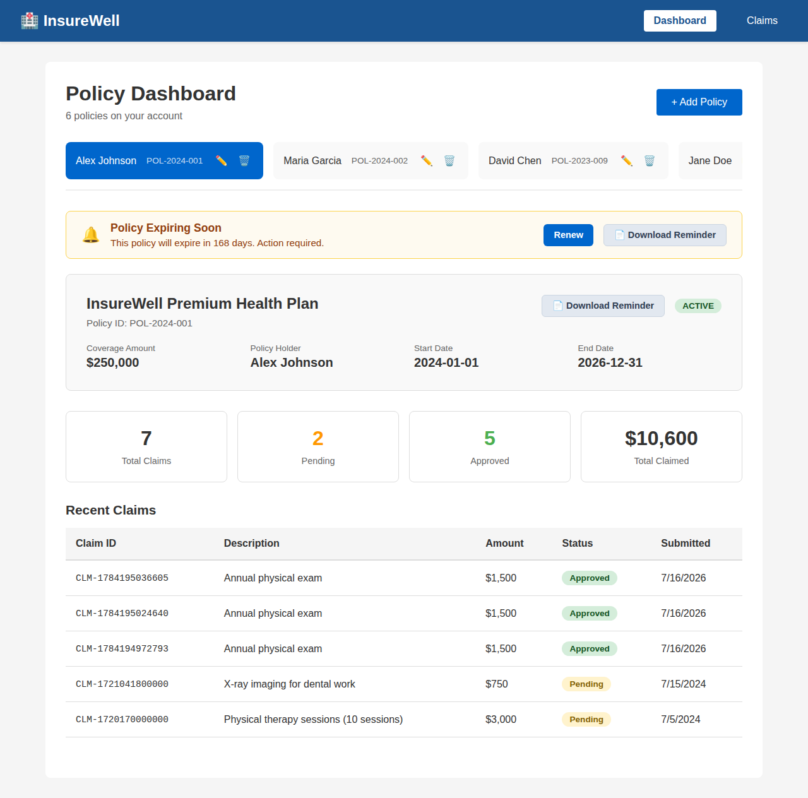
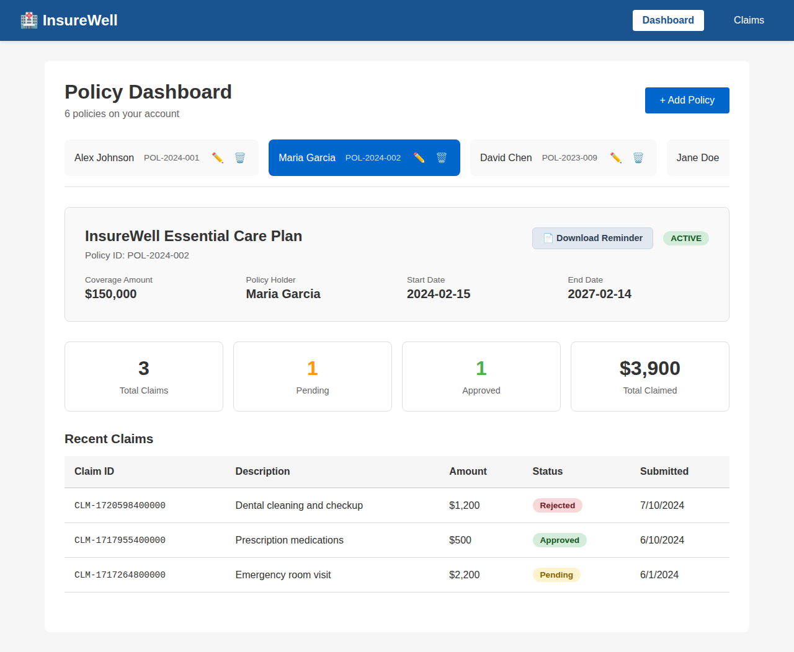
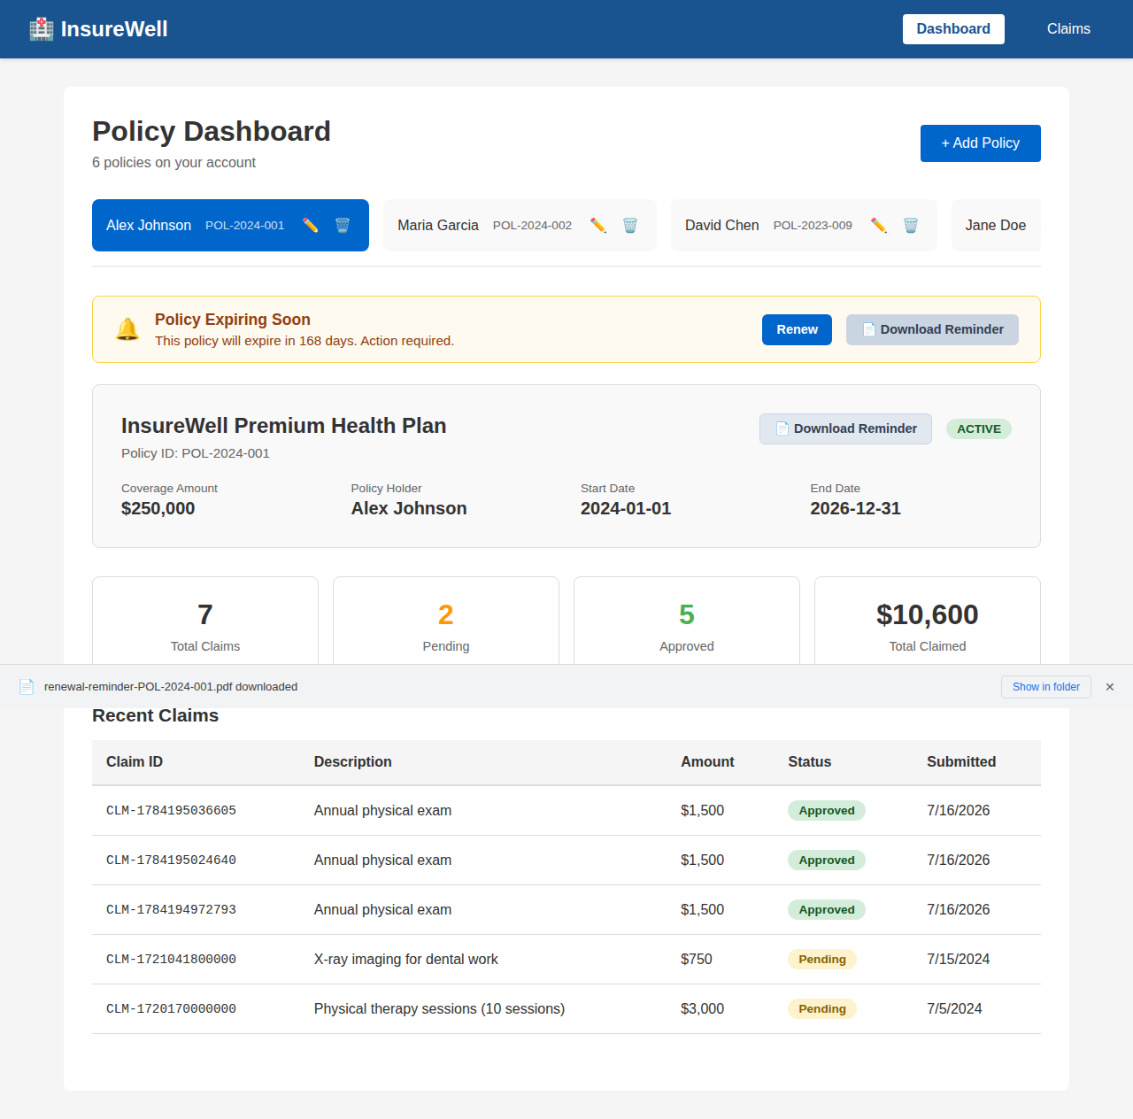
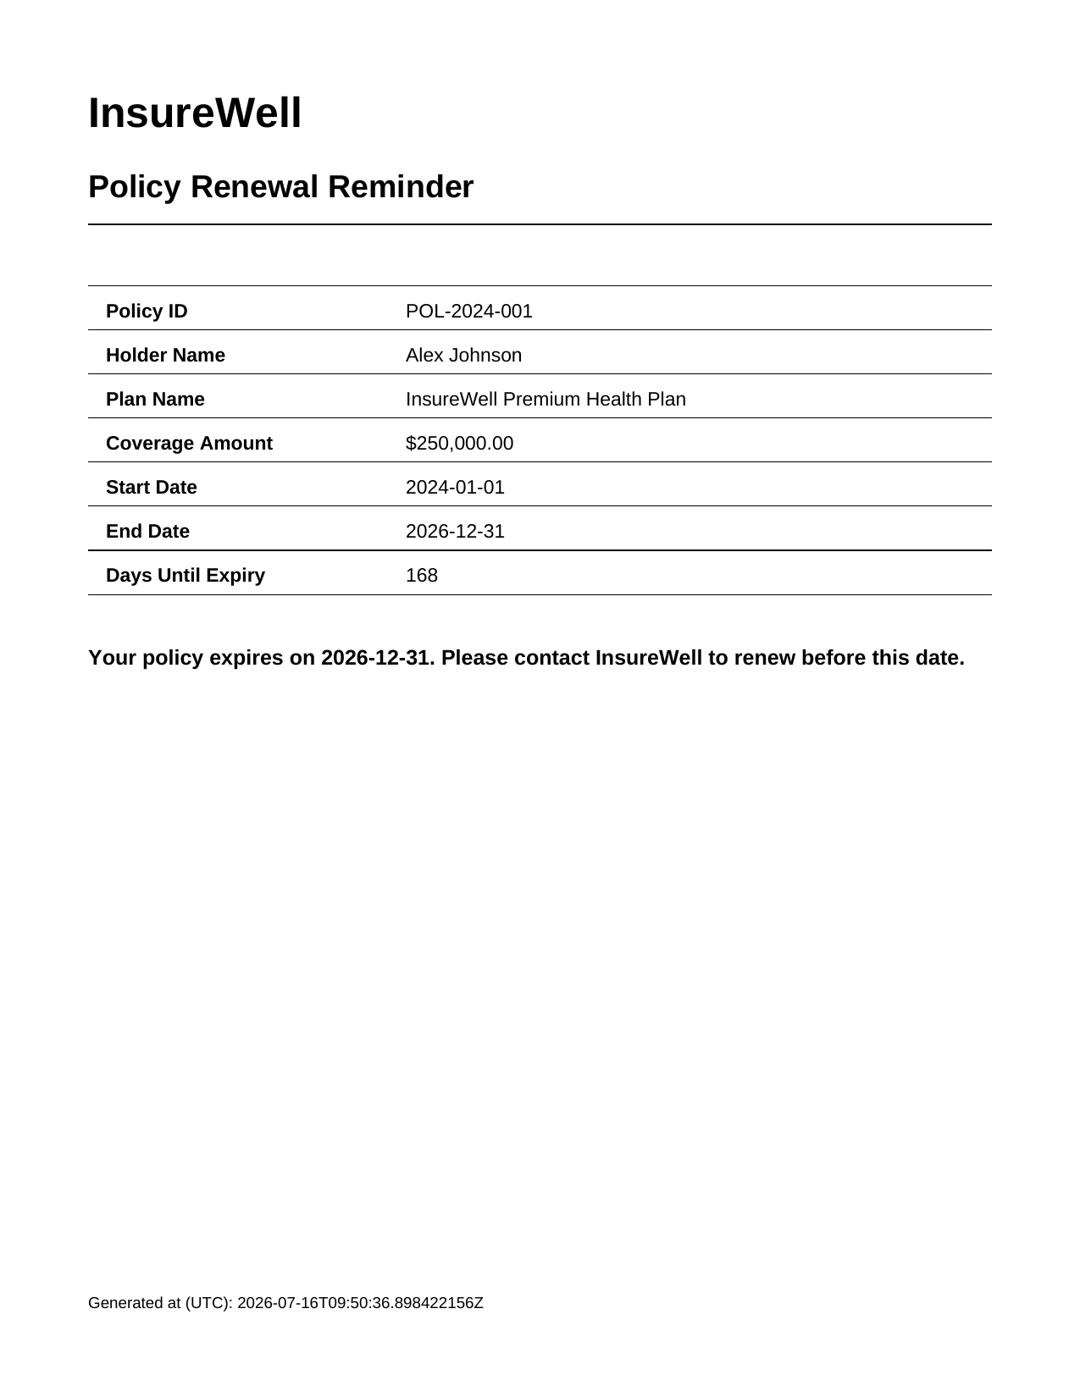
03 / FEATURE WALKTHROUGH
Visual User Interface Verification
1. Active Warning Banner (POL-2024-001)
2. Active Standard Policy Card (POL-2024-002)
3. Dynamic Download & Browser Shelf Simulation
4. Dynamic Output PDF Inspection

Slide 5
04 / TESTING & SDLC QUALITY GATES
Comprehensive Quality Verification
100%
Automated Test Pass Rate
All unit, API controller integration, and frontend Playwright E2E suites passed without modifications or regressions.
Integration Verification Details
✔ Spring Boot Endpoint Guard
MockMvc test harness ensures the controller responds with valid APPLICATION_PDF media type, correct stream sizing, and handles non-existent resources with standard 404 response envelopes.
✔ Playwright E2E Automation
Browser script successfully simulates all visual states, interacts with policy tabs, clicks download elements, downloads the file binary, and validates full-page visual layouts.
✔ UI & Layout Integrity
Manual/E2E visual inspections verify strict compliance with branding guidelines: correct color codes, margin widths, high-contrast banner icons, and readable typography layouts.
25 / 25
Test Cases Fully Executed
Comprising 2 robust backend controller tests (com.insurewell.controller.PolicyControllerTest) and 23 total frontend E2E and component-spec flows.

