Slide 1
Internal Combustion Engines
Introduction
Engine Classification, terminology and parts
Prof. Amitava Datta
Jadavpur University
Power Engineering Department
3rd Year, 2nd Semester

Slide 2
Thermodynamic Cycles
Power producing cycles
or
Heat Engine cycles
Power absorbing cycles
or
Heat Pump cycles
Heat Engine
Heat Engine is a device which operates in a cycle and produces work continuously while exchanging heat at least with two reservoirs
Internal Combustion Engine
External Combustion Engine

Slide 3
In an Internal combustion engine, combustion takes place within working fluid of the engine, thus combustion products acts as working fluid in part of the cycle.
  Petrol/Gasoline engine and Diesel engine are examples of internal combustion engine.
In an External combustion engine, working fluid gets energy using boilers by burning fossil fuels or any other fuel, thus the working fluid does not come in direct contact with combustion products.
  Steam engine is an example of external combustion engine, where the working fluid is steam.
  Thermal power plant running on steam turbine is also external combustion engine

Slide 4
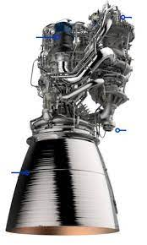
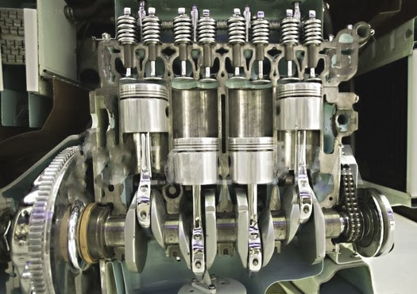
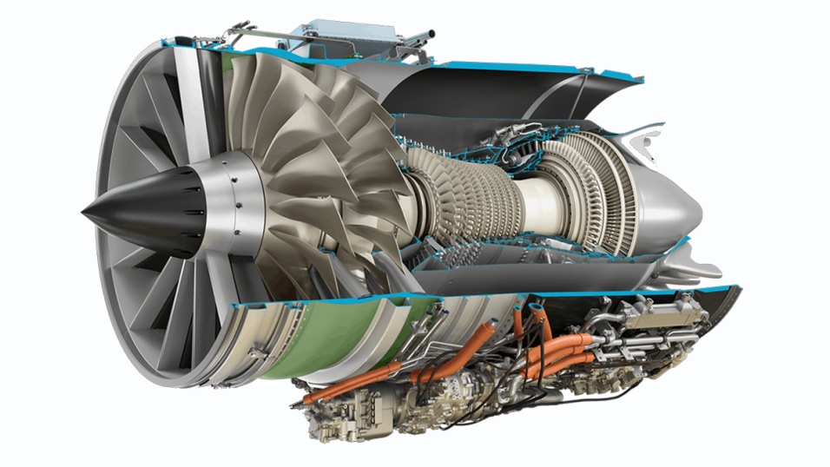
Internal Combustion Engine
Definition of an ICE: a heat engine in which the heat source is the combustion of fuel and the combustion products also serves as the working fluid to produce work
The working fluid in turn is used either to
  Produce shaft work by pushing on a piston or turbine blade that in turn drives a rotating shaft or
  Creates a high-momentum fluid that is used directly for propulsive force

Slide 5
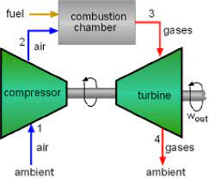
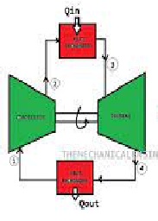
Heat Engine
Internal Combustion Engine
External Combustion Engine
Reciprocating
Rotary
Reciprocating
Rotary
S.I.Engine / Gasoline Engine
Steam Engine
C.I.Engine / Diesel Engine
Closed cycle Gas Turbine
Steam Turbine
Open cycle Gas Turbine

Slide 6
Internal combustion engines may be classified as :
  Spark Ignition engines.
  Compression Ignition engines.
Spark ignition engine (SI engine): An engine in which the combustion process in each cycle is started by use of a spark.
Compression ignition engine (CI engine): An engine in which the combustion process starts when the air-fuel mixture self ignites due to high temperature in the combustion chamber caused by high compression.
  Spark ignition and Compression Ignition engine operate on either a four stroke cycle or a two stroke cycle.

Slide 7
Applications:
Automobiles
Transportation
Trucks and Buses
Locomotives
Reciprocating I.C.Engines
Ships / Marine
Power Generation
DG Sets
Aviation
Transportation
Marine
Gas Turbines
Power Generation
GT / CC power
generation

Slide 8
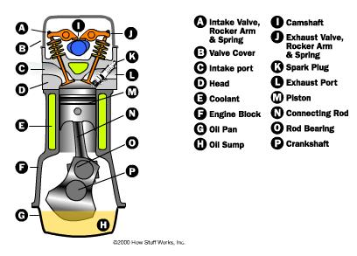
Reciprocating Internal Combustion Engine – Schematic

Slide 9
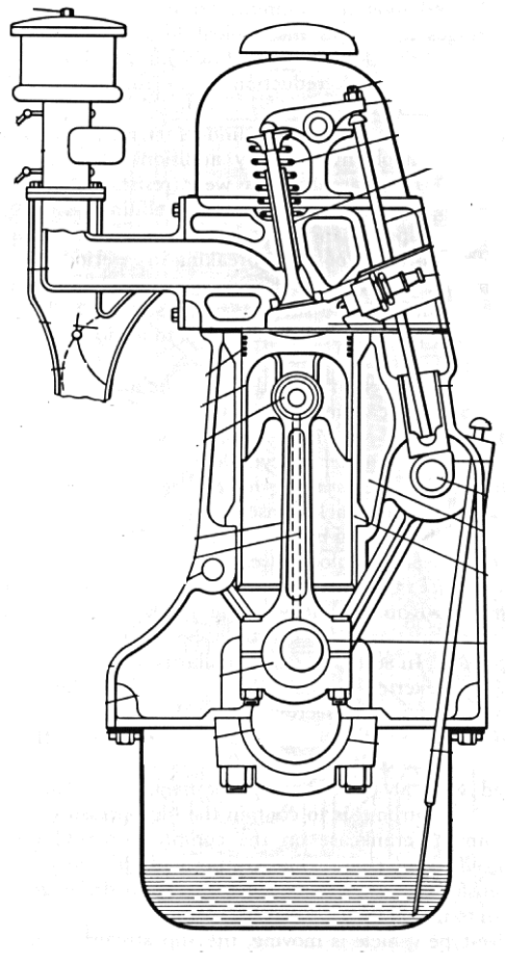
Parts of an IC Engine
Cylinder head
Air cleaner
Breather cap
Rocker arm
Choke
Valve spring
Throttle
Valve guide
Pushrod
Intake manifold
Sparkplug
Exhaust manifold
Combustion chamber
Tappet
Piston rings
Dipstick
Piston
Cam
Wrist pin
Camshaft
Cylinder block
Water jacket
Connecting rod
Oil gallery to piston
Wet liner
Oil gallery to head
Crankcase
Connecting rod bearing
Crankpin
Crankshaft
Main bearing
Oil pan or sump

Slide 10
Important Nomenclature
V_{c}
TDC
B
Cylinder bore (B)
Stroke or stroke length (L)
Stroke to Bore ratio (L/B)
  L/B =1 : Square engine
  L/B > 1 : Under-square engine
  L/B < 1 : Over square engine (operates at higher speed)
Dead Center (TDC & BDC or IDC & ODC)
Displacement volume or swept volume (V_{s} = 0.7854B²S)
Cubic capacity (V_{s} × k, k=no. of cylinders in a multi-cylinder engine)
Clearance volume (V_{c})
Compression ratio: r= (V_{s}+V_{c)} / V_{c} = 1+V_{s}/V_{c}
V_{s}
L
Piston motion
BDC
for vertical cylinder
for horizontal cylinder

Slide 11
Internal combustion Engine Components:
Cylinder Block : Body of the engine containing cylinders, made of cast iron or aluminum.
Cylinder : The circular cylinders in the engine block in which the pistons reciprocate back and forth.
Head : The piece which closes the end of the cylinders, usually containing part of the clearance volume of the combustion chamber.
Combustion chamber: The end of the cylinder between the head and the piston face where combustion occurs.
  The size of combustion chamber continuously changes from minimum volume when the piston is at TDC to a maximum volume when the piston at BDC.

Slide 12
Connecting rod : Rod connecting the piston with the rotating crankshaft, usually made of steel or alloy forging in most engines but may be aluminum in some small engines.
Piston rings: Metal rings that fit into circumferential grooves around the piston and form a sliding surface against the cylinder walls.
Crankshaft : Rotating shaft through which engine work output is supplied to external systems.
  The crankshaft is connected to the engine block with the main bearings.
  It is rotated by the reciprocating pistons through the connecting rods connected to the crankshaft, offset from the axis of rotation. This offset is sometimes called crank throw or crank radius.

Slide 13
Intake manifold :Piping system which delivers incoming air to the cylinders, usually made of cast metal, or composite material.
        In most SI engines, fuel is added to the air in the intake manifold system either by fuel injectors or with a carburetor.
  The individual pipe to a single cylinder is called runner.
Carburetor : A device which meters the proper amount of fuel into the air flow by means of pressure differential.
  For many decades it was the basic fuel metering system on all spark ignition engines.
Exhaust manifold : Piping system which carries exhaust gases away from the engine cylinders, usually made of cast iron .

Slide 14
Camshaft : Rotating shaft used to push open valves at the proper time in the engine cycle, either directly or through mechanical or hydraulic linkage (push rods, rocker arms, tappets) .
Push rods : The mechanical linkage between the camshaft and valves on overhead valve engines with the camshaft in the crankcase.
Crankcase : Part of the engine block surrounding the crankshaft.
  In many engines the oil pan makes up part of the crankcase housing.
Spark plug : Electrical device used to initiate combustion in an SI engine by creating high voltage discharge across an electrode gap.

Slide 15
Materials used for different engine components
Component name | Material
Cylinder | Cast iron
Piston | Aluminum alloy, steel
Piston ring | Grey cast iron
Cylinder liner | Cast iron or nickel alloy steel
Connecting rod | Forged steel or carbon steel
Crankshaft | Alloy steel
Bearing | White metal
Valves | HSS, cobalt-chrome steel

Slide 16
Internal Combustion Engine
Air breathing engines – take air directly from the atmosphere to run the engine
Classification
Naturally aspirated engine
Supercharged / turbocharged engine
Petrol engine
Diesel engine
Gas engine
Dual fuel engine
Spark Ignition engine
Compression ignition engine
Air cooled engine
Water / liquid cooled engine
Four stroke engine
Two stroke engine
Wet sump lubrication
Dry sump lubrication
Pressure lubrication
Horizontal
Single cylinder engine
Multi cylinder engine
Vertical
In-line
V-
Radial
Opposed
Piston
Opposed
Cylinder

Slide 17
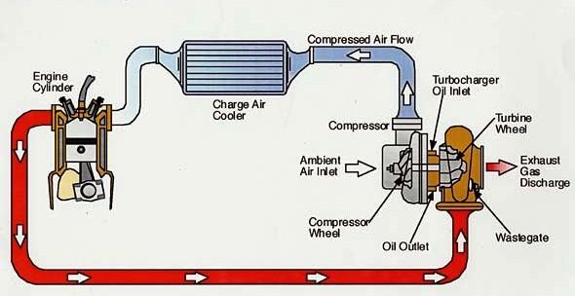
Classification based on charge induction
Naturally aspirated engines – engines which take the air directly from the atmosphere into the engine cylinder
Supercharged engine – engines in which the air is admitted from the atmosphere through a supercharger into the engine cylinder. The supercharger is like a compressor, which increases the pressure of air into the cylinder. Thus more mass of air can be admitted. So more fuel can be burned inside the cylinder. Thus power output can be increased.
Turbocharger is a special type of supercharger where the compressor is driven by a turbine which is run using the exhaust gas of the engine.
Intake air to the engine
Exhaust gas from the engine used to drive the turbine
Turbocharged engine

Slide 18
Spark and Compression Ignition Engines
In order to initiate the combustion of the fuel-air mixture in the engine cylinder, ignition is required
Ignition can be done by
  using a spark – forced ignition (as in a Spark Ignition Engine)
  increasing the temperature of the charge by compressing the air over a high compression ratio – self/auto ignition (as in a Compression Ignition Engine)
Spark Ignition (S.I.) engine admits fuel-air mixture into the cylinder during the intake stroke. The fuel-air mixture is prepared outside the cylinder in the intake line, called intake manifold
Compression Ignition (C.I) engine admits air into the cylinder during the intake stroke. Fuel is injected later after compressing the air.
S.I. engine uses petrol/gasoline as the fuel. Auto-ignition temperature of petrol is high. It requires a spark to ignite the fuel.
C.I. engine used diesel as the fuel. Auto-ignition temperature of diesel is low. It can be ignited by raising the temperature os air during compression over a high compression ratio.

Slide 19
Comparison of S.I. and C.I. Engines
Description | S.I. Engine | C.I. Engine
Basic cycle | Otto cycle | Diesel / Dual combustion cycle
Fuel | Gasoline: high volatility and high auto-ignition temperature | Diesel: low volatility and low auto-ignition temperature
Introduction of fuel | In the induction manifold during suction | In the engine cylinder near the end of compression
Load control | Through the throttle valve | Through regulating the fuel
Ignition | Spark ignition | Compression ignition
Compression Ratio | Low (6 – 10) | High (12 – 22)
Speed | High | Low
Thermal Efficiency | Low | High
Weight | Low | High

Slide 20
Engines Classification based on number of strokes
The extreme positions of the reciprocating piston inside the engine cylinder are called dead centers. At the dead centers the piston reverses its direction of motion. The instantaneous velocity of the piston is zero at the dead center, but the acceleration is the maximum.
Stroke is the movement of the piston from one dead center to the next dead center,
Like, from TDC to BDC is one stroke and from BDC to TDC is the next stroke for a vertical engine.
Similarly, from IDC to ODC and from ODC to IDC are the two strokes for the horizontal engine.
One working cycle of the engine contains four activities –
(i) Suction / Intake, (ii) Compression. (iii) Expansion, (iv) Exhaust
These four activities may be completed in either FOUR piston strokes or TWO piston strokes
Accordingly both S.I. and C.I. engines can be of two types
  1. Four Stroke Engine; 2. Two Stroke Engine

Slide 21
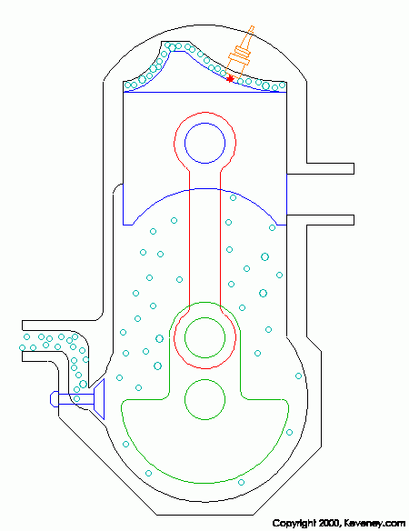
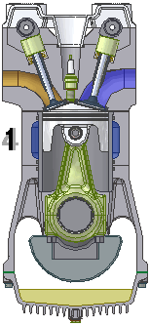
Working of 4-stroke and 2-stroke engines
Exhaust Valve
Intake Valve
Exhaust port
Valves are operated by cams.
Cams are mounted on camshaft, which is driven by the engine crank shaft
Transfer port
Two stroke engine has no valve. The gas exchange takes place through ports
Intake port
4-Stroke S.I.Engine
2-Stroke S.I.Engine
Stroke 1. Intake valve open, piston moves down, fresh charge enters cylinder
Stroke 2. Both valves close, piston moves up, charge gets compressed. Ignition near the end of stroke
Stroke 3. Fuel burns, heat release occurs, temperature rises, pressure rises, piston moves down, expansion work done
Stroke 4. Exhaust valve open, piston moves up, burnt gas goes out
Stroke 1. Piston moves up. Pressure in the crankcase below the piston falls. Charge intake occurs in the crankcase through intake port. Charge in the cylinder is compressed after the exhaust valve closes. Ignition near the end of stroke.
Stroke 2. Piston moves down. Fuel burns, heat release occurs, pressure increases, expansion work done. Exhaust port open and exhaust starts. Transfer port opens, charge transfer fro crankcase to cylinder starts and scavenging occurs

Slide 22
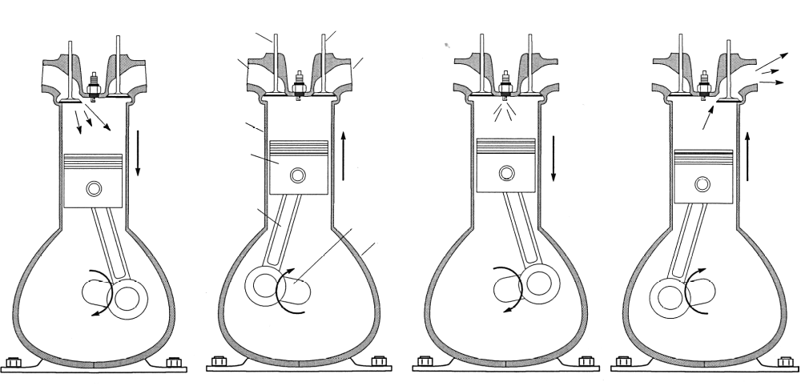
4 Stroke S.I. Engine Processes
1
Intake Valve
2
Exhaust Valve
3
4
Intake
Manifold
Exhaust
Manifold
Spark
Plug
Cylinder
Piston
Connecting
Rod
Crank
Crankcase
Compression Stroke
Both valves closed,
Fuel/air mixture is
compressed by rising
piston. Spark ignites
mixture near end of
stroke.
Power Stroke
Fuel-air mixture burns,
increasing temperature
and pressure, expansion
of combustion gases
drives piston down. Both
valves closed - exhaust
valve opens near end
of stroke
Exhaust Stroke
Exhaust valve open,
exhaust products are
displaced from cylinder.
Intake valve opens
near end of stroke.
Intake Stroke
Intake valve opens,
admitting fuel and air.
Exhaust valve closed
4-stroke engine can also work for C.I. Engine with necessary processes

Slide 23
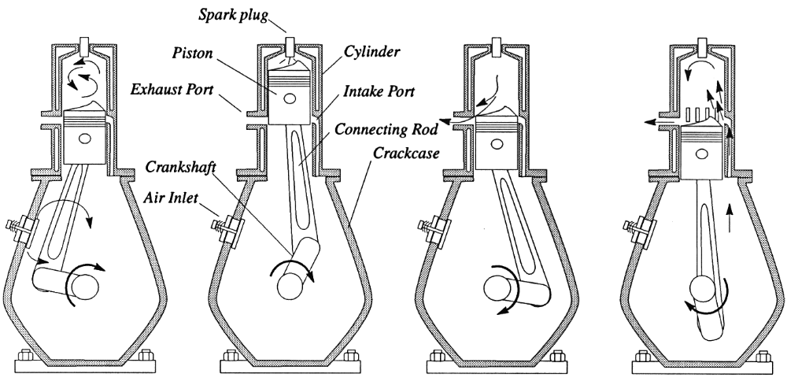
2 Stroke S.I. Engine Processes
Air intake
Compression
(ports closed)
Air Taken Into
Crankcase
Combustion
(ports closed)
Exhaust
(intake port closed)
Scavenging
and Intake
(ports open)
Air compressed in crankcase
2-stroke engine also works for C.I. Engine with necessary processes

Slide 24
Comparison between Four stroke and Two stroke Engines
Four stroke | Two stroke
Thermodynamic/working cycle completed in four strokes i.e. two crank revolutions | Thermodynamic/working cycle completed in two strokes i.e. one crank revolutions
Turning moment is less uniform, requires heavier flywheel | Turning moment is more uniform, requires lighter flywheel
Weight to Power ratio is high for one power stroke in two revolutions | Weight to Power ratio is low for one power stroke in every revolutions
Lower cooling and lubrication requirement | Greater cooling and lubrication requirement
Valves and valve actuating mechanism for operating the intake and exhaust valves | Have ports instead of valves
Volumetric efficiency is high | Volumetric efficiency is low
Thermal efficiency is higher. Part load efficiency is high | Lower thermal efficiency and part load efficiency
Initial cost is high | Initial cost is less
Used where efficiency is important | Used where size and initial cost are important

Slide 25
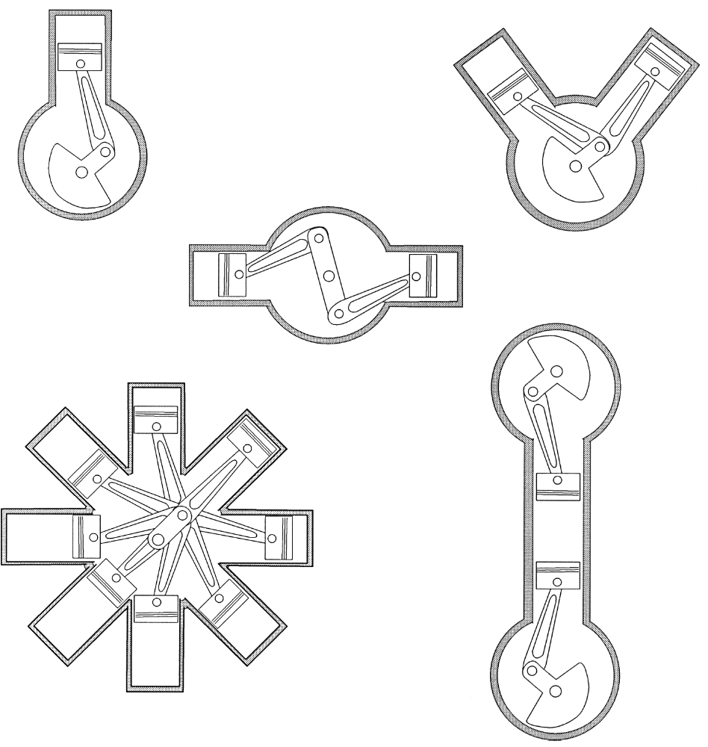
Multi-cylinder Engine Configurations
In Line
(Automobile)
V
(Automobile)
Horizontally Opposed Cylinder
Opposed Piston
Radial (Aircraft)

Slide 26
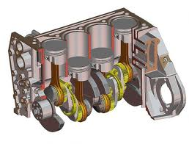
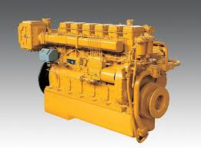
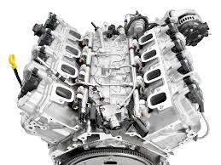
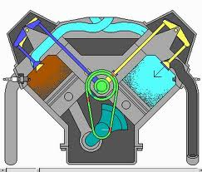
In-line Arrangement of Cylinders
V-Arrangement of Cylinders

Slide 27
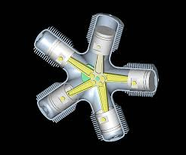
WHY MULTI-CYLINDER?
Multi-cylinder engines are used for
more power output
better balancing
even distribution of torque on the crankshaft
Radial Arrangement of Cylinders
Application of engines based on cylinder arrangements
Cylinder arrangement | Applications
In-line and V arrangement | Automobiles, small aircrafts and general purpose
Radial | Medium and large aircrafts
Opposed piston | Large diesel engine installations

Slide 28
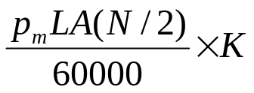
Important Performance Terms
Indicated power (IP)
Brake Power (BP)
Brake Torque
Mean effective pressure ( Power = )
Mechanical efficiency (=BP/IP)
Thermal efficiency
  Indicated thermal efficiency
  Brake thermal efficiency
Specific fuel consumption
  Indicated specific fuel consumption
  Brake specific fuel consumption
Volumetric efficiency

Slide 29
Engine parameters of some cars
Model | No. of Cylinders | Cubic capacity | Power/Torque Output
Maruti, Alto (Petrol) | 3 | 796 cc | 48 bhp @ 6000 rpm, 69 Nm @ 3500 rpm
Maruti Swift Dzire (Diesel) | 4, Inline | 1248 cc | 74 bhp @ 4000 rpm 190 Nm @ 2000 rpm
Honda City (Petrol) | 4, Inline | 1497 cc | 116 bhp @ 6600 rpm 146 Nm @ 4600 rpm
Toyota Etios (Petrol) | 4, Inline | 1496 cc | 90 bhp @ 5600 rpm 132 Nm @ 3000 rpm
Tata Sumo Victa (Diesel) | 4, Inline | 1948 cc | 68 bhp @ 2800 rpm 117 Nm @ 1800 rpm

