Slide 1
Stock trading platform
Abhishek Khandate Dally Bhandiya Meenanki Bhide Prathamesh Mane Pratik Lohiya
https://github.com/im-pratham/Stock-Trading-Platform
s

Slide 2
Agenda
Architecture
Application Flow Diagram
Tools Used
Agile Development : Sprint Details
Challenges and Resolution
Demo

Slide 3
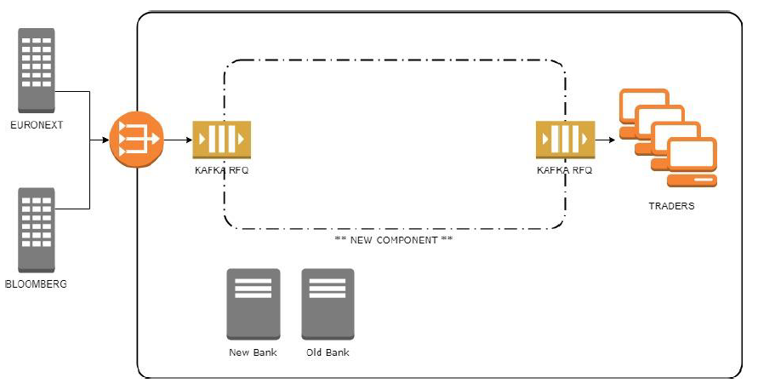
ARCHITECTURE

Slide 4
Application Flow Diagram
RFQ Publisher
Chatterbox Server
Extractors (one for each user story)
RFQ Decorator Main
RFQ Processor
History Server
Trade Data Loader
Testing component

Slide 5
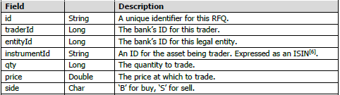
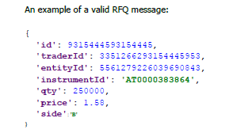
RFQ Message format

Slide 6
Tools Used
Apache Spark
Java
IntelliJ
Junit
Git

Slide 7
Agile development Sprint 1: Details
Tasks | Assigned To | Open/Close | Review Comments
Set Up Git repository and understand the code | All | Close | -

Slide 8
Sprint 1I: Details
Tasks | Assigned To | Open/Close | Review Comments
Create a new file for testing –’Volume-trade-2.json’ | Meenanki | Close | Test file
Create a new file for testing , ‘trades-neg.json’ | Prathamesh | Close | To collect trade information which were not successful
User Story 1 | Abhishek | Close | Total volume traded for an Instrument.
User Story 2 | Dally | Close | Volume traded by legal entity
User Story 3 | Prathamesh/Pratik | Close | Strike rates

Slide 9
Sprint Iii : Details
Tasks | Assigned To | Open/Close | Review Comments
Presentation | Meenanki/ Dally | Close | -
User Story 4 | Dally and Meenanki | Close | Instrument Liquidity
User Story 5 | Pratik | Close | Average traded price
User Story 6 | Prathamesh/ Pratik | Close | Development utilities
User Story 7 | Abhishek | Close | Report Buy/Sell ratio to downstream

Slide 10
User story 1 – TOTAL VOLUME TRADED FOR INSTRUMENT
REQUIREMENT – To gauge the level of a customer’s interest in a given instrument.
INDICATOR – The volume traded by that customer for that instrument over the past week/month/year.
SOLUTION –
Input : RFQ
Filtering : SecurityID
Output : Volume traded on that day, in the past week, in the past month and the past year. (volumeTradedForInstrumentToday, volumeTradedForInstrumentPastWeek, volumeTradedForInstrumentPastMonth volumeTradedForInstrumentPastYear)

Slide 11
User story 2 – TOTAL VOLUME TRADED with entity
REQUIREMENT – To know the health of trading relationship between the trader, customer and entity.
INDICATOR – The volume traded by that customer with that entity over the past week/month/year.
SOLUTION –
Input : RFQ
Filtering : TraderID and EntityID
Output : Volume traded on that day, in the past week, in the past month and the past year. (volumeTradedWithEntityToday, volumeTradedWithEntityPastWeek, volumeTradedWIthEntityPastWeek, volumeTradedWIthEntityPastYear)

Slide 12
User story 3 – RFQ strike rates
REQUIREMENT – To know the health of trading relationship between the trader and customer.
INDICATOR – The percentage of successful trades by that customer with that trader.
SOLUTION –
Input : RFQ
Processing : Created an additional dataset for unsuccessful trades.
Filtering : TraderID
Output : Percentage of successful trades over negative trades. (strikeRateWithTrader)

Slide 13
User story 4 – instrument liquidity
REQUIREMENT – To maintain liquidity of instruments and hence status of trader in the market.
INDICATOR – Volume of that instrument that has been traded recently.
SOLUTION –
Input : RFQ
Filtering : SecurityID and EntityID
Output : Quantity of that instrument traded in the last one month. (instrumentLiquidityPastWeek)

Slide 14
User story 5 – average traded price
REQUIREMENT – To determine a fair price for an instrument.
INDICATOR – Average price of that instrument traded by the bank.
SOLUTION –
Input : RFQ
Filtering : SecurityID and EntityID
Output : Average price per quantity of that instrument traded by the bank in the past week. (averageTradedPricePastWeek)

Slide 15
User story 6 – development utilities
REQUIREMENT – Simple test tools to simulate RFQ submissions.
SOLUTION –
Input : RFQ
Output : RFQ submission history of current session.

Slide 16
User story 7 – Trade Side bias
REQUIREMENT – To detect whether a customer is trying to build or offload their position for an instrument .
INDICATOR – Ratio of amount of instrument bought to the amount of instrument sold.
SOLUTION –
Input : RFQ
Filtering : SecurityID and TraderID
Output : A single figure ratio of buy/sell trades for an instrument and negative value in case of no trade. (tradeSideBiasPastWeek, tradeSideBiasPastMonth)

Slide 17
Thank you

