Slide 1
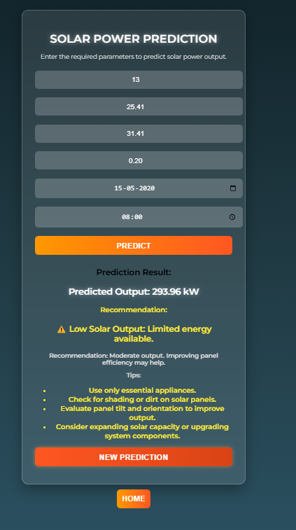
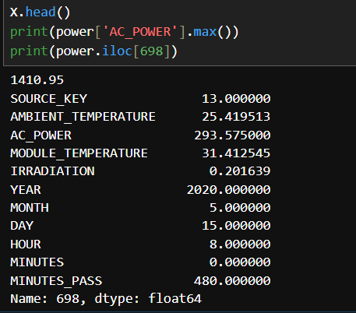
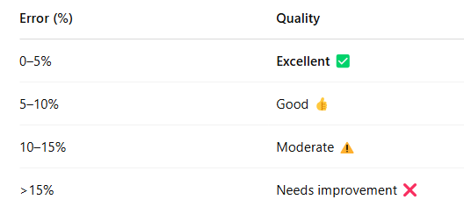
💡 In your solar forecasting case, where values can range from small to large,
👉 Percentage error (like MAPE) is usually more meaningful — it gives a fairer sense of how good the prediction is relative to the actual value.
Percentage error- 0.13%

Slide 2
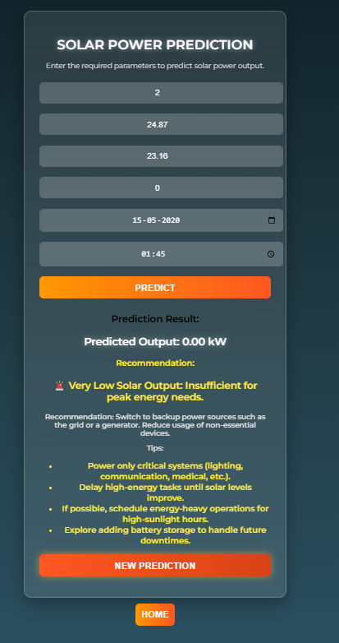
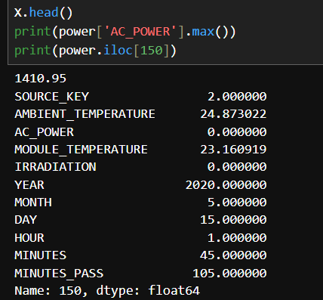
Actual-0.0
Predicted-0.0
Percentage error-0%

Slide 3
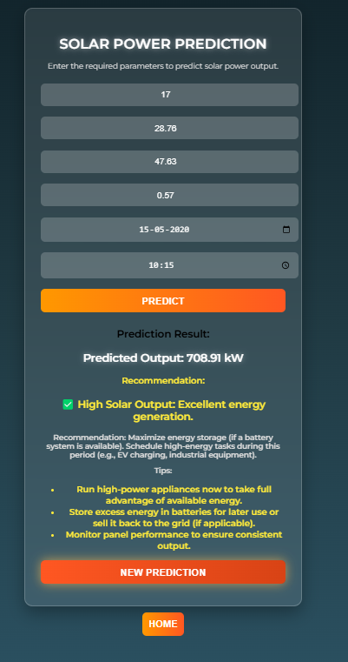
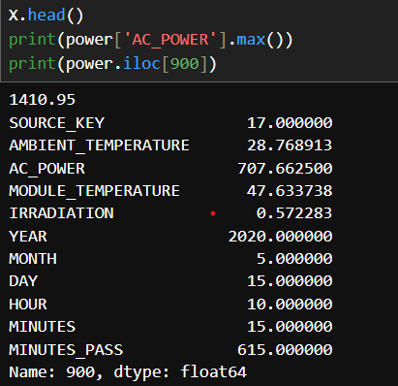
Actual-707.66
Predicted-708.91
Percentage error-0.17%

Slide 4
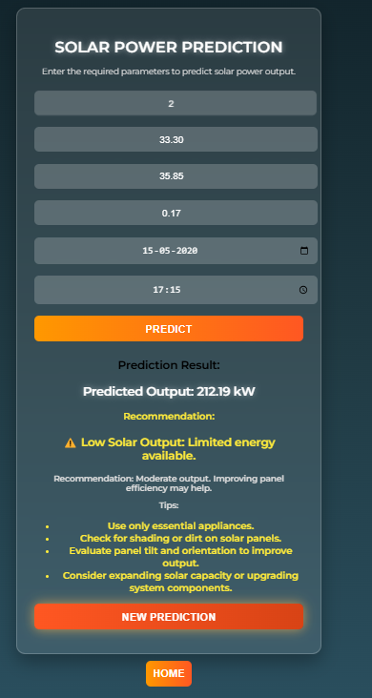
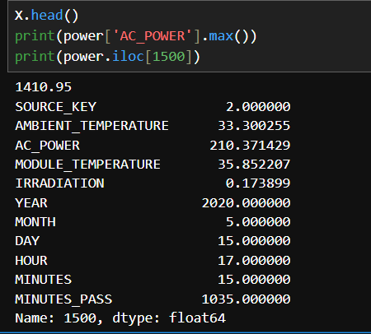
Actual=210.37
Predicted=212.19
Percentage error=1%

Slide 5
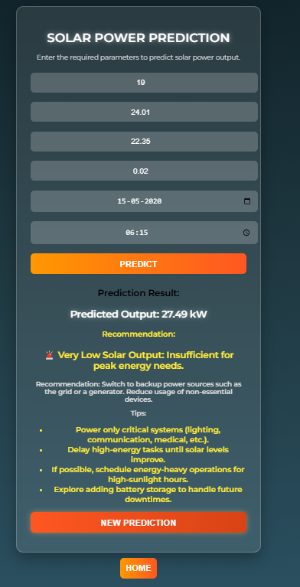
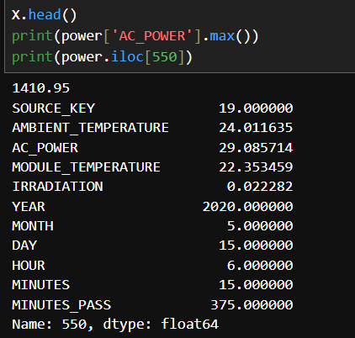
Actual-29.08
Predicted-27.49
Percentage error-5.0%

Slide 6
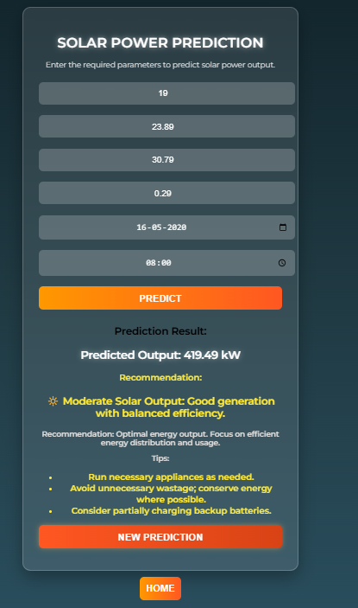
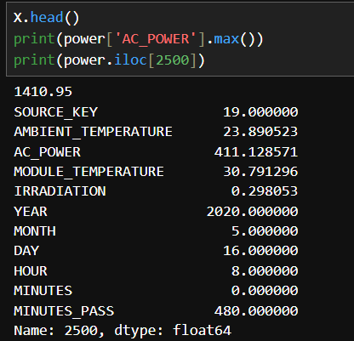
Actual=411.12
Predicted=419.49
Percentage error=2%

Slide 7
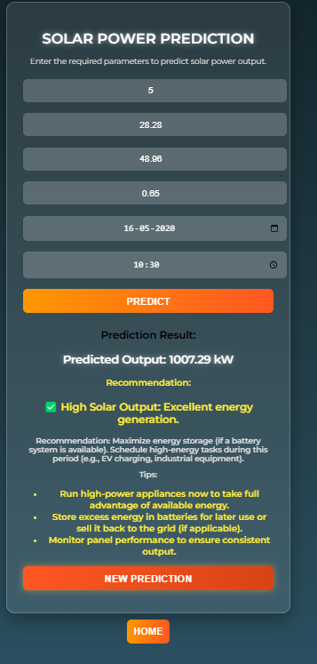
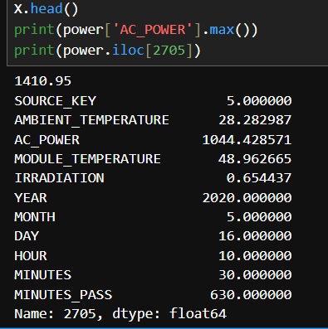
Actual=1044.4
Predicted=1007.29
Percentage error=3.5%

Slide 8
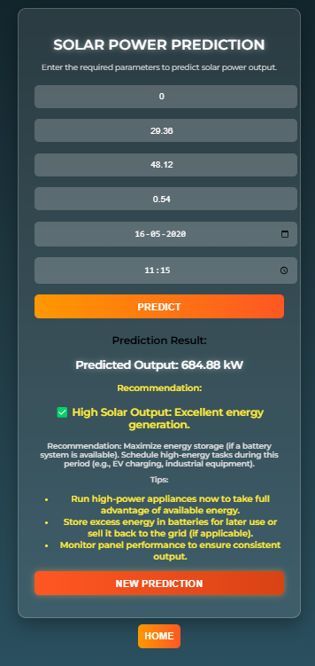
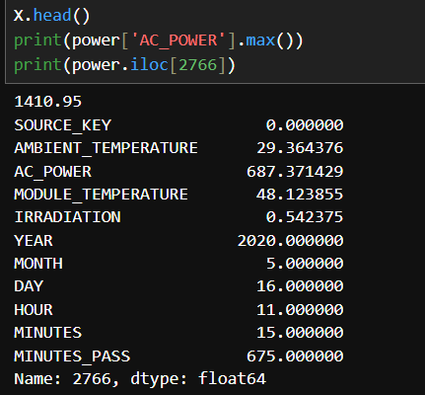
Actual=687.37
Predicted=684.88
Percentage error=0.36%

Slide 9
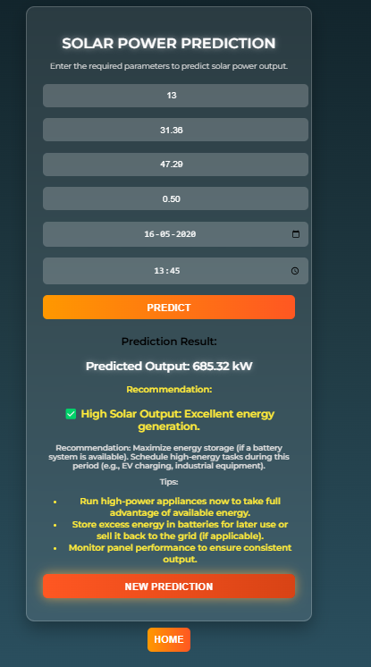
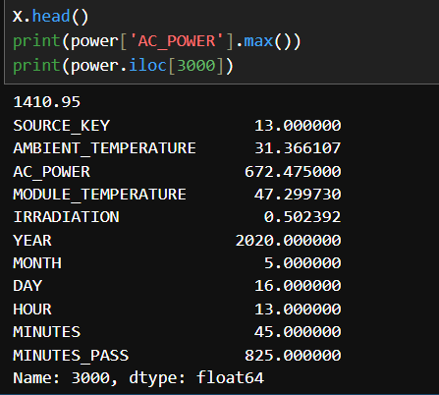
Actual=672.47
Predicted=685.32
Percentage error=1.9%

Slide 10
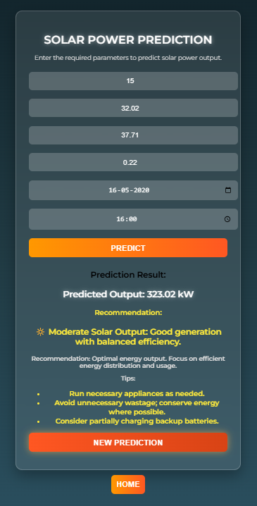
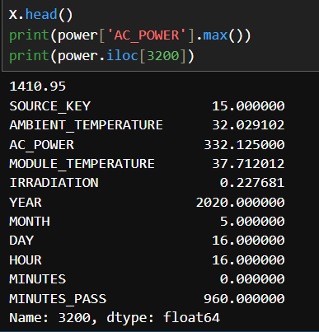
Actual=332.12
Predicted=323.02
Percentage error=2.7%

Slide 11
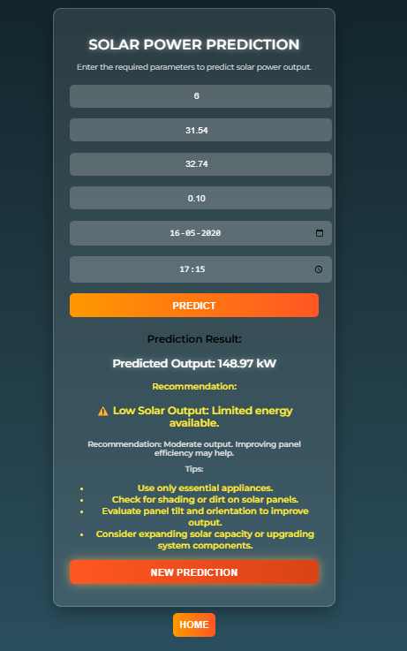
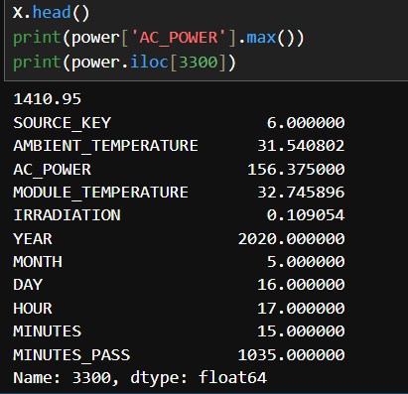
Actual=156.37
Predicted=148.97
Percentage error=4.6%

Slide 12
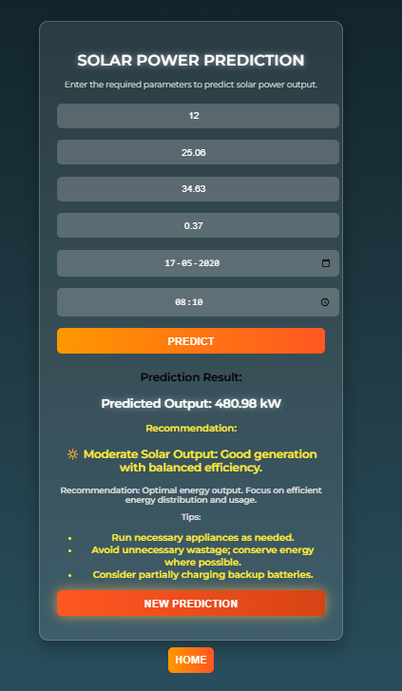
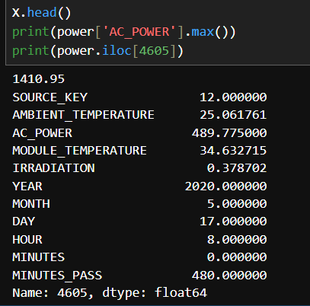
Actual=489.77
Predicted=480.98
Percentage error=1.7%

Slide 13
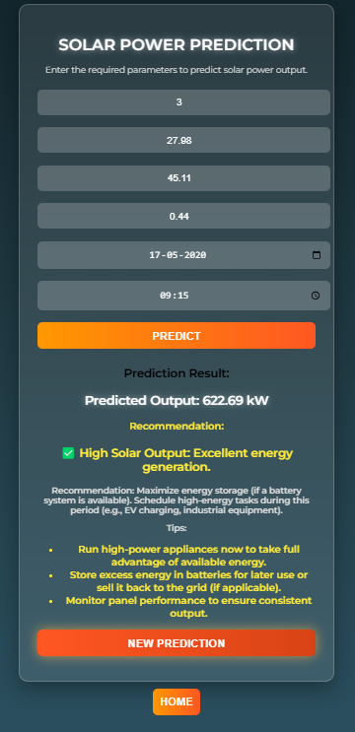
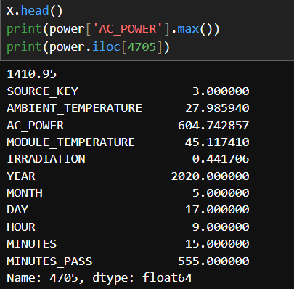
Actual=604.74
Predicted=622.69
Percentage error=2.9%

Slide 14
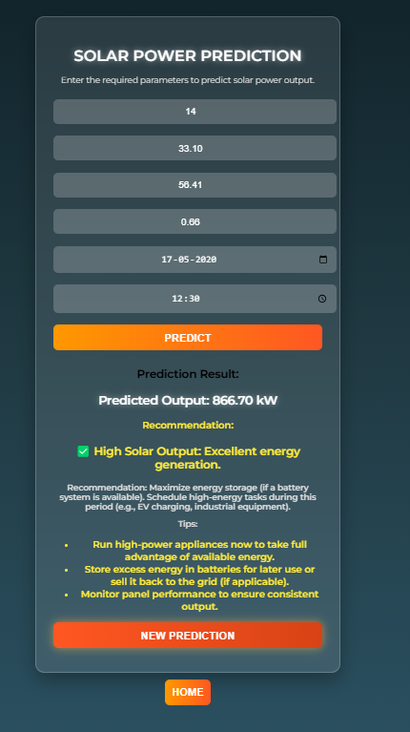
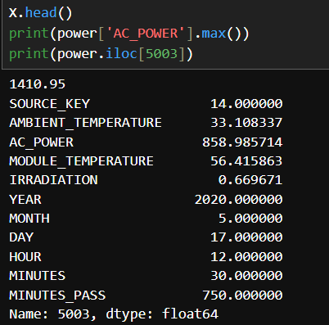
Actual=858.98
Predicted=866.70
Percentage error=0.89%

Slide 15
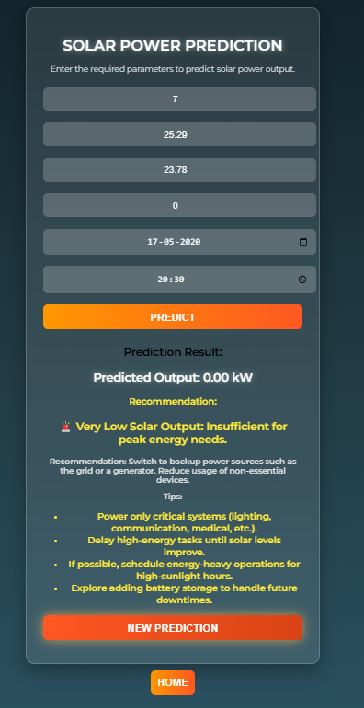
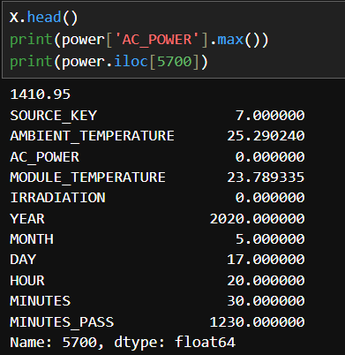
Actual=0
Predicted=0
Percentage error=0%

