Slide 1
SmartMailCluster 22AIE205-INTRODUCTION TO PYTHON
GROUP 3:
Team Members
1.) Jivites Damodar - CB.SC.U4AIE24020
2.) Kiruthikpranav - CB.SC.U4AIE24023
3.) Usman Shareef - CB.SC.U4AIE24024
4.) Ramkumar K R - CB.SC.U4AIE24042
5.) Sukanthan - CB.SC.U4AIE24056
DATE:25-8-25

Slide 2
ABSTRACT
SmartMailCluster is a Python-based web application designed to organize large-scale email communication by automatically threading conversations and clustering related emails by topic. The objective is to reduce information overload in enterprise email systems by providing structured, searchable email threads. The methodology involves modeling emails as graph nodes and using BFS to reconstruct conversation threads, while Tries, Suffix Trees, and Union-Find are used to group emails by similar topics. The expected outcome is a fully functional web application that allows users to browse threaded conversations and view clustered topics through an intuitive React frontend or CLI, supported by a Django backend

Slide 3
INTRODUCTION
Background & Motivation:
Enterprises and large teams receive massive volumes of emails daily, making manual organization time-consuming and inefficient.
Importance of the Problem:
Unstructured email communication can lead to missed messages and reduced productivity.
Scope & Expected Outcomes:
Automatic reconstruction of conversation threads using BFS.
Clustering emails by topic using Tries, Suffix Trees, and Union-Find.
Intuitive web interface to browse threads and topic clusters.
Target Users / Domain:
Enterprises, project teams, and organizations handling high-volume email communication

Slide 4
OBJECTIVES
Short-term Goals:
Complete and stabilize email threading and user/thread graph functionality.
Ensure Django backend supports send, reply, forward, and view operations.
Long-term Goals:
Cluster emails based on common topics using Tries, Suffix Trees, and Union-Find.
Integrate the React frontend or CLI to visualize and interact with clustered email threads..
Expected Outcome by Final Submission:
Fully functional Python-based web application with threaded emails and topic clusters accessible via a React frontend or CLI and Django backend

Slide 5
Tools & Technologies
Python Basics
Variables → For storing email/thread attributes (sender, receiver, subject, etc.)
Control Structures (Loops, If-Else) → Iterating over emails & applying conditions in thread linking
Collections (List, Tuple, Set) → Managing email sets, adjacency lists, and unique users
OOP (Classes, Inheritance, Encapsulation) → Email & Thread classes for modular, reusable design
Framework / Backend
Django + Django REST Framework (DRF) →Data Handling, Request handling, APIs, managing email/thread data
Django Models / In-Memory Graphs → Store & manage email interactions & thread structures
Sqlite → Used for storing the emails
Libraries
Collections (defaultdict, deque) → Efficient graph storage & traversal
Frontend
React.js → User-friendly email & thread visualization

Slide 6
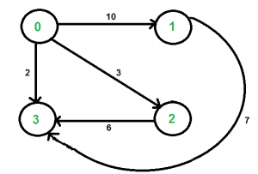
DATA STRUCTURES
Graph:
Graph is a non-linear data structure consisting of vertices and edges. The vertices are sometimes also referred to as nodes and the edges are lines or arcs that connect any two nodes in the graph. More formally a Graph is composed of a set of vertices( V ) and a set of edges( E ). The graph is denoted by G(V, E).
Directed weighted graph:
It is a type of graph where edges have both a direction (meaning they point from one vertex to another) and a weight (a numerical value assigned to each edge)

Slide 7
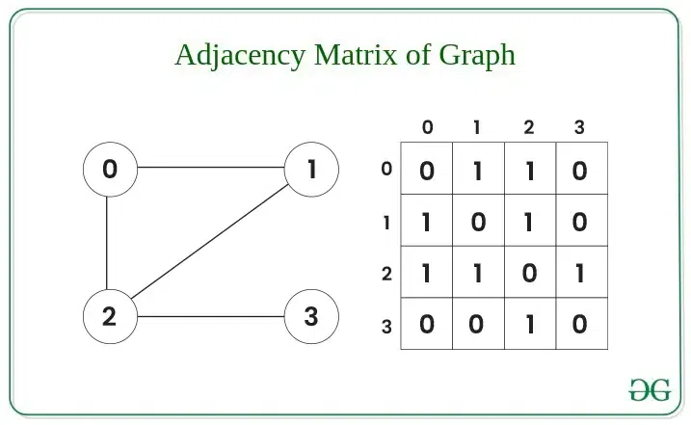
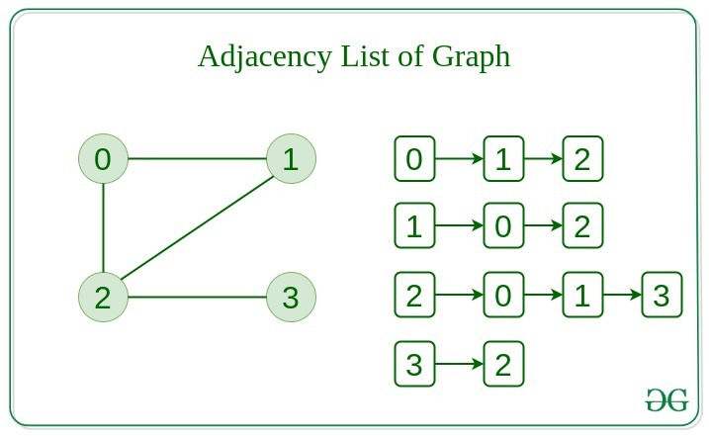
Adjacency Matrix & Adjacency List
Adjacency Matrix
In this method, the graph is stored in the form of the 2D matrix
where rows and columns denote vertices. Each entry in the
matrix represents the weight of the edge between those vertices
Adjacency List
This graph is represented as a collection of linked lists. There is an array of pointer which points to the edges connected to that vertex.

Slide 8
USER GRAPH STRUCTURE
Users graph:
email_id → Unique identifier for each email (Primary Key). Node: Each email account.
sender → Email sender (string or can link to User model). Edges: Email interactions between users.
receiver → Email recipient.
subject → Email subject line.
body → Email content.
thread_id → Associates email with a conversation thread.
parent_email → Links to the original email if it’s a reply or forward (self-referential).
Edge in Users Graph:
to → The recipient email ID of this edge.
weight → Number of emails sent from the sender to this recipient (incremented each time an email is sent).
thread_id → The thread associated with this email interaction.

Slide 9
THREAD GRAPH STRUCTURE
Thread Graph:
Nodes:
Each individual email(email_id) in the system
Original emails, replies, and forwards are all separate nodes.
Edges:
Directed edges represent reply or forward relationships.
An edge from Email A → Email B indicates B is a reply/forward of A.

Slide 10
DJANGO
What is Django:
Django is a high-level Python web framework that encourages rapid development and clean, pragmatic design.
Handles HTTP requests, routing, database operations, and REST APIs.
Usage in SmartMailCluster:
Implements backend logic for send/reply/forward/view emails.
Django ORM stores emails and threads.
Provides REST APIs for frontend integration.
Works with in-memory graphs to reconstruct email threads efficiently.

Slide 11
Methodologies Used
1. Email Graph Construction
Represent users(user graph),email id (thread graph) as nodes.
Directed edges for sending/receiving emails.
Maintain adjacency list & matrix.
Thread graph to link replies/forwards.
2. Core Operations:
Send Email: create new thread, store in DB, add graph edge.
Reply Email : same thread_id, add reply link in thread graph.
Forward Email: same thread_id, add forward link in thread graph.
View Thread :BFS traversal from root email.
3. Email Clustering :
Trie: : detect content similarity between emails.
Disjoint Set (Union-Find) :group similar emails into clusters.

Slide 12
Methodologies Used
4. Backend & Database:
Django ORM for storing emails.
In-memory graph synced with DB.
REST APIs for send, reply, forward, and view operations.
5. Testing & Validation :
Postman used to test API endpoints.
Verified email threads and relationships.

Slide 13
CORE FUNCTIONALITIES
1.Send Email:
Creates a new thread with unique thread_id.
Adds edge in Adjacency List & Matrix.
Stores email in DB with no parent.
2. Reply Email:
Uses existing thread_id of original mail.
Subject prefixed with "RE:".
Added as child node in threadGraph.
Maintains reply linkage to parent

Slide 14
CORE FUNCTIONALITIES
3. Forward Email:
Uses existing thread_id.
Subject prefixed with "FWD:".
Added as child node in threadGraph.
Maintains forward linkage to parent.
4. View Thread:
Finds root email of the thread.
Traverses threadGraph using BFS.
Returns all emails in proper sequence.

Slide 15
WORK COMPLETED
Completed Tasks
Designed User Graph & Thread Graph
Implemented core functions
Used Adjacency List + Matrix for user interactions
Added BFS traversal to reconstruct conversations
Integrated Django framework for web-based interface
Challenges & Resolutions
Thread Tracking → Solved using unique thread IDs
Graph Representation → Combined list + matrix for efficiency
Conversation Flow → Applied BFS for ordered traversal
Reply vs Forward → Marked edges with relation tags

Slide 16
FUTURE WORK
For future work, we plan to implement email clustering to automatically group related emails into topic-based threads using content similarity. Additionally, we will develop a CLI or React frontend to provide an interactive interface where users can easily browse conversation threads and view clustered emails. This will enhance the usability of the system and provide a clear visualization of email relationships.
Timeline:
Week 1-2: Implement clustering logic
Week 3:Develop React frontend or CLI to display threads and clusters
Week 4:Connect frontend with backend APIs and perform end-to-end testing

Slide 17
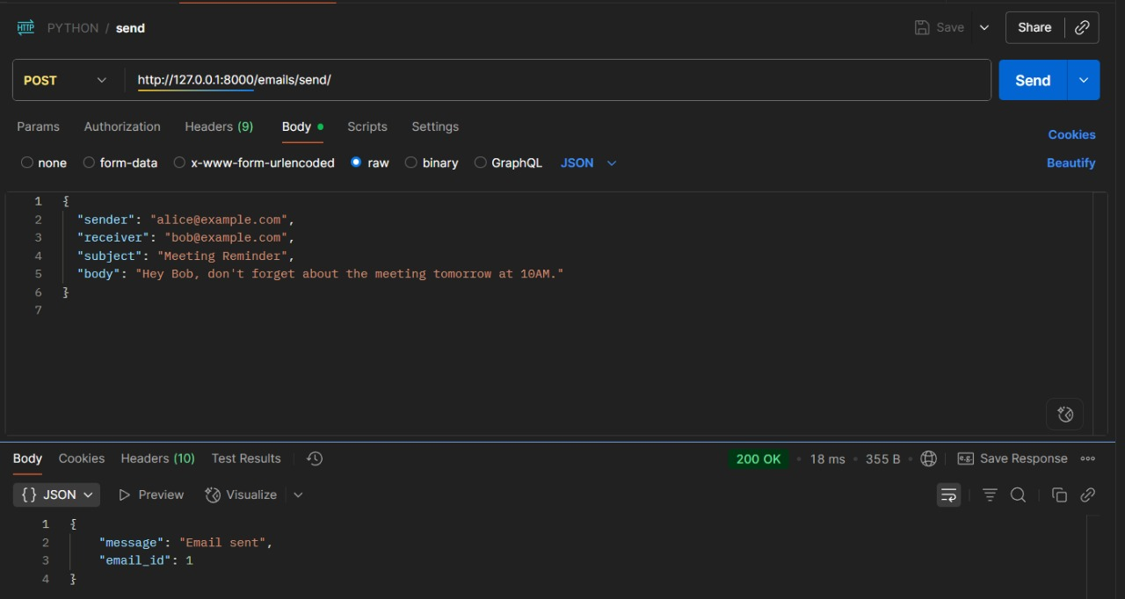
PREMLIMINARY RESULTS
Send Email

Slide 18
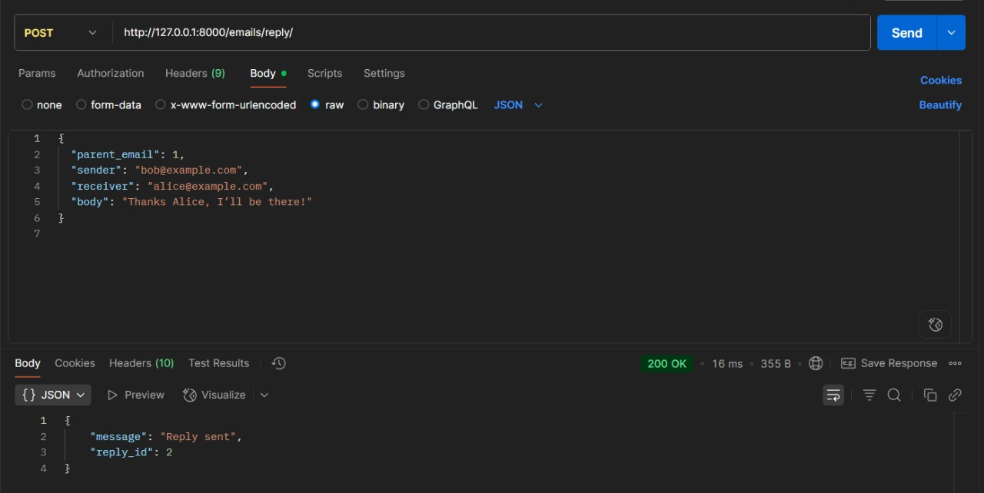
PREMLIMINARY RESULTS
Reply Email

Slide 19
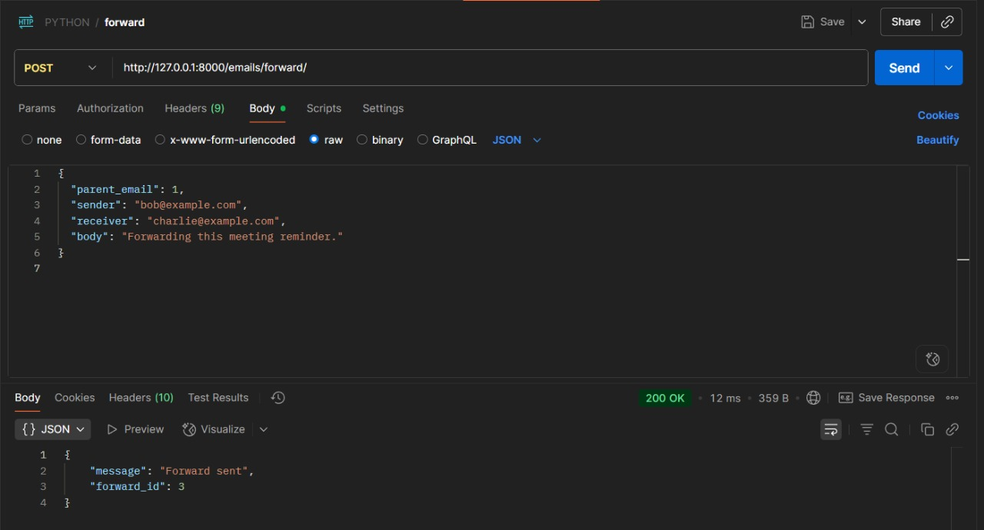
PREMLIMINARY RESULTS
Forward Email

Slide 20
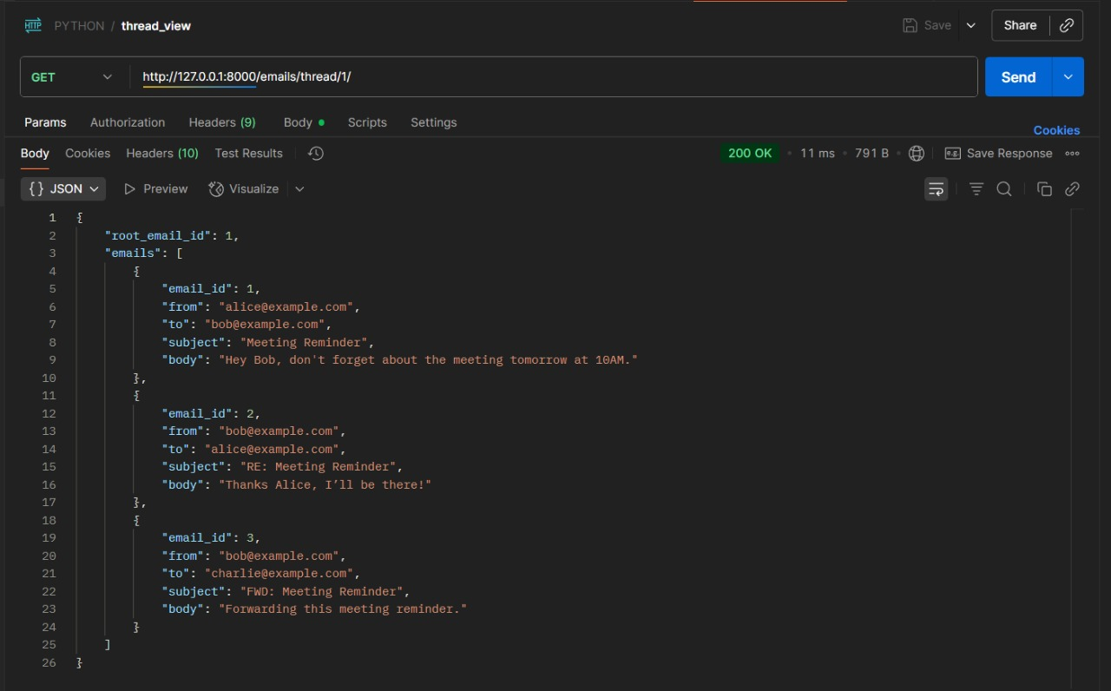
PREMLIMINARY RESULTS
View Thread

Slide 21
Challenges & Risks
Limitations: The current system does not include a CLI or fully developed React frontend for interactive visualization of emails and threads.
Time Constraints: Limited time may impact the completion and refinement of the GUI.

Slide 22
CONCLUSION
So far, we have successfully implemented the core functionality of SmartMailCluster, including user and thread graph construction, email sending, replying, forwarding, and thread reconstruction using BFS traversal. The backend using Django is fully functional, storing emails and maintaining graph relationships. For the next steps, we aim to implement email clustering for topic-based grouping and develop a React frontend or CLI to provide an intuitive interface for browsing threads and viewing clustered conversations, enhancing the overall user experience.

Slide 23
THANK YOU

