Slide 1
CSCI 152 Project
Rodrigo Palacios
Blaine Parks
Shaymas Irving
Yilin Chen

Slide 2

Yilin Chen

Slide 3
What is Open Access?
Open access means document can be free accessed in public. Open access data allow any user reading, downloading, copying, transferring, printing, retrieving or super linking. Open access data can be used as software input data or for any other lawful purposes. When using these documents, users will never be constrained by financial, laws and technical. They only need to keep the integrity of the document when accessing, so the only copyright of authors is that they have right to control the integrity of their works and make their works accepted and quoted by users correctly.

Slide 4

Characters of Open Access
Free
Immediate
Research Articles
Online
Availability
Re-use Rights

Slide 5

How to distribute article in past?
(before open access)
In past, if you want to make your article distributed widely, you need send it to journal. That will cost your money.

Slide 6

Disadvantage of Journals
The journals are not
producing material.
The journals do not
employ the people who
write the papers.
The journals do not even
employ the reviewers.
The journals can not make
sense in terms of what
science is supposed to be
about.

Slide 7
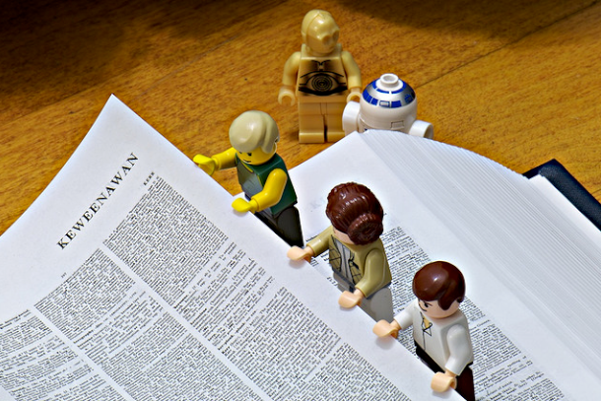
Example 1
The problem of journal access is something people run into all the time without realizing it. They do not realize there is a whole system behind it. But their education depends on access to the journal literature. Professor can only teach what they have access to.

Slide 8

Example 2
Students and researchers in low and middle income countries really struggle. It prevents them from contributing fully to world class research.

Slide 9

Example 3
There also have a problem about paper on web. You do not know which article is relevant until after you pay for it because abstracts do not always make it clear what is contained.

Slide 10

How to distribute article now?
(after open access)
Open access use digitization to distribute your work. This is about making all scientific research content available for anyone anywhere in the world to read and access and build upon , so people can do interesting things in new ways with the materials.

Slide 11

Two Components to Open Access
Free to read
Free to re-use

Slide 12
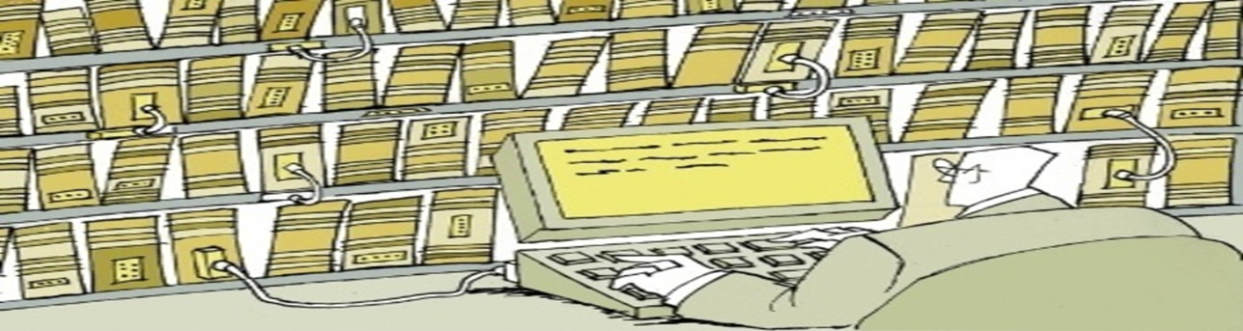
Example 1
Researcher can build new tools that can interact with articles and uncover new relationships. if you want to reuse that, you do not need to negotiate rights with every single publisher. In an open access world all this would be free and unrestricted.

Slide 13

Example 2
The more people that see your work, the more they can build upon it and cite you. it is not just good for the person that can read your paper, it is also good for you. nowadays, people believe that science spreads and increases best when there are no restrictions to access. people want discovery to happen faster and openness helps.

Slide 14
Introduction of MVC4 programming
Yilin Chen

Slide 15
using System;
using System.Collections.Generic;
using System.Linq;
using System.Web;
using System.Web.Mvc;
using System.Net;
using PagedList;
using oagum0._01.Models;

Slide 16
namespace oagum0._01.Controllers //name of file is oagum0._01, it will add a library include controllers
{

Slide 17
public class SearchController : Controller //SearchController is a new controller,control methods is action methods, they will return action result
{
private ArticleAuthorRelationshipEntities db = new ArticleAuthorRelationshipEntities();
//define a new ArticleAuthorRelationshipEntities named db
private SearchViewModel searchClient = new SearchViewModel();
//define a SearchViewModel named searchClient

Slide 18
public ActionResult Index()
public ActionResult Index()
//the Index method will return a string with a message that is hard-coded in the controller class, in this index method, it will create a view template file using the Razor view engine Razor-based view templates have a .cshtml file extension, and provide an elegant way to create HTML output using C#,Razor minimizes the number of characters and keystrokes required when writing a view template, and enables a fast fluid coding workflow

Slide 19
{
var articles = db.T_Article.ToList();
//define article to get all data from T_Article
ViewBag.TotalCount = articles.Count(); //ViewBag can transport data from controller to view. ViewBag.TotalCount means transport total amount of data. This segment means transport all content of articles to view
return View(); //return a View object, it will use a view template to generate an HTML response to the browser
}

Slide 20
public ActionResult Results(string searchString, string filterString, int? pageNo)
public ActionResult Results(string searchString, string filterString, int? pageNo)
//define Results action method

Slide 21
{
var articles = from article in db.T_Article
select article;
//define articles which is article come from T_Article
ViewBag.TotalCount = articles.Count(); //ViewBag can transport data from controller to view.ViewBag.TotalCount means transport total amount of data. This segment means transport all content of articles to view

Slide 22
if (searchString != null)
//if there have no article
{
pageNo = 1;
//when there have no article, make pageNo=1
}
else
{
searchString = filterString;
//if searchString have content, make searchString = filterString
}

Slide 23
ViewBag.FilterString = searchString; //transport searchstring to view
if (!String.IsNullOrEmpty(searchString)) //under condition that searchString is not null or empty
{
articles=articles.Where(s=>s.Title.Contains(searchString));
//make articles equal to the articles which contain title named searchString
}

Slide 24
ViewBag.SearchCount = articles.Count();
//after we search content we need, we transport what we find to view
int elemPerPage = 1;
//make elemPerPage = 1
int numOfPage = (pageNo ?? 1);
//if pageNo is not null, make numOfPage=pageNo, else numOfPage=1
var res = articles.OrderBy(p => p.Title).ToPagedList(numOfPage, elemPerPage);
//make res as articles ordered ascendingly, and it will only contain elemPerPage max of articles
return View(res);
//transport res to view
}

Slide 25
public ActionResult Details(int? id)
public ActionResult Details(int? id) //define Details action method

Slide 26
{
if (id == null)
//if this id can not work
{
return new HttpStatusCodeResult(HttpStatusCode.BadRequest); //return a error
}
T_Article t_article = db.T_Article.Find(id);
//make t_article as T_Article which is belong to id
if (t_article == null)
//if this t_article is not exist
{
return HttpNotFound();
//return http can not found
}

Slide 27
var authors =
//define authors
(from author in db.T_Author
//it must start with "from"
join authorarticle in db.T_ArticleAuthor
//make what selected connect with authorarticle in db.T_ArticleAuthor
on author.ID equals authorarticle.AuthorId
//it is precondition of join or connection,the precondition of join is author.ID equals authorarticle.AuthorId
where (authorarticle.ArticleId == id)
//return elements authorarticle.ArticleId which equal to id
select new
//select new means select author.Name
{
author.Name
});

Slide 28
ViewBag.Authors = authors; //transport authors to view
return View(t_article); //transport t_article suit to precondition to view
}
}
}

Slide 29
Requirements
Backend:
Database (SQL Server, Entity framework)
  Articles
  Users
Focused Crawler (Scrapy)
  iopscience.com
  jtaphys.com

Slide 30
Requirements
Frontend:
Views (C#,HTML,jQuery,LINQ)
  Users – favorite articles, info
  Search
    Pagination of results
    Details view for each result
    Full preview of article

Slide 31
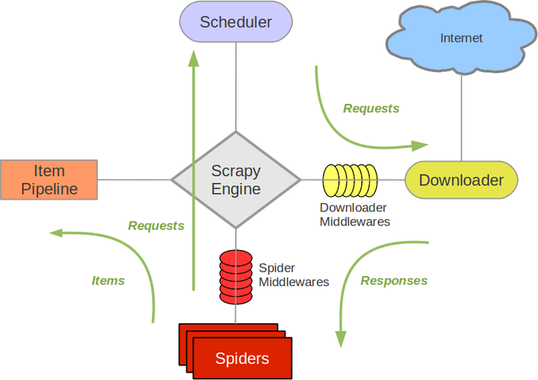
Crawler

Slide 32
Data Transfer
Python scripts to “clean” up data
Used SQL “insert into” commands
MVC’s Scaffolding + Entity Framework
  easy mapping from database to POCO

Slide 33
The Entity Framework
Blaine Parks

Slide 34
What is Entity?
Set of technologies of the .NET
Fullfills two objectives
  Common, abstract model for data
  Provides engine for functionality

Slide 35
Entity Uniqueness
Multiple storage systems
Different protocols
Data conglomeration

Slide 36
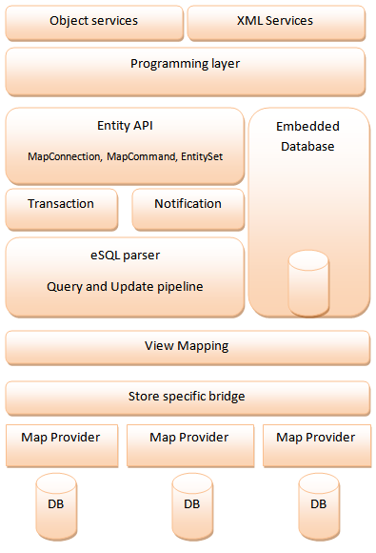
Entity Architecture

Slide 37
Entity Example
Entity Object: CustomerEntity
  Name -> Customers table
  Address -> Contacts table
  Purchase -> Orders table
Data Conversions
Edm.Boolean
Edm.Double

Slide 38
The Power of Entity
Easy implementation
Relates any object type
Operations on discrete objects

Slide 39
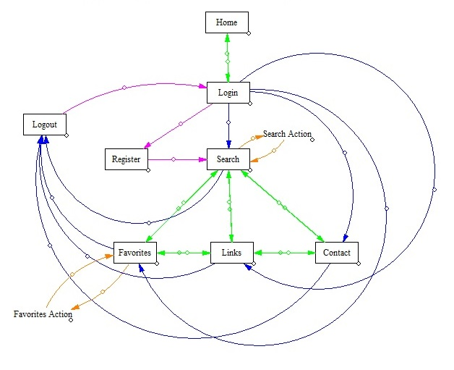
State Diagram

Slide 40
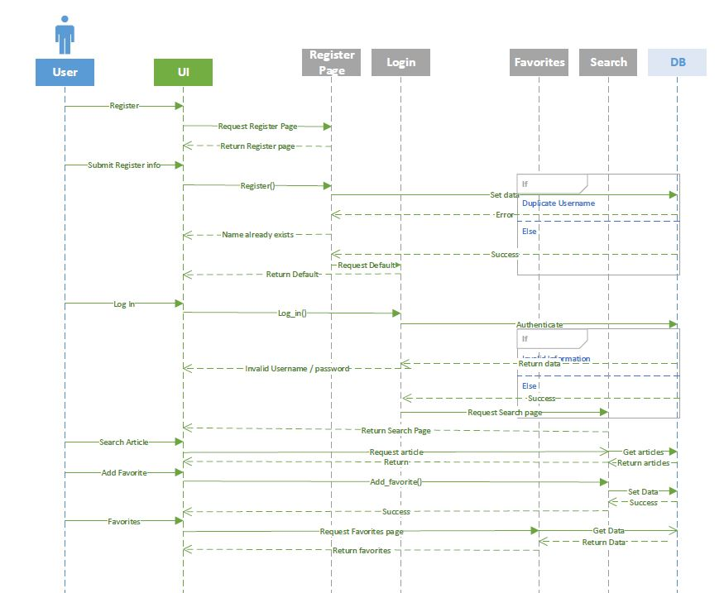
Sequence Diagram

Slide 41
MVC VS WEBFORMS
Much steeper learning curve
Worth it in the long run
Higher cohesion
More control over HTML / URLS
Better Unit Testing
Shaymas Irving

Slide 42
Registration
Created Database for Users
Checks for possible errors
Stores all user information in Database

Slide 43
Login / Logout
Checks validity of user input
Displays appropriate error message to user
Session variable set on successful login
Redirect to search
Clear Session Variables

Slide 44
Favorites!
Created Table to take session id / article Id
Star button to show favorite links
Favorites page

Slide 45
Unit Testing / Coded UI
Tests all branches of login / register function
Also tests database connections and accurate queries
Coded UI automates user input

