Slide 1

ANLI Round 2 Multiclass Classification
Rohan Tanwar
MS AI

Slide 2
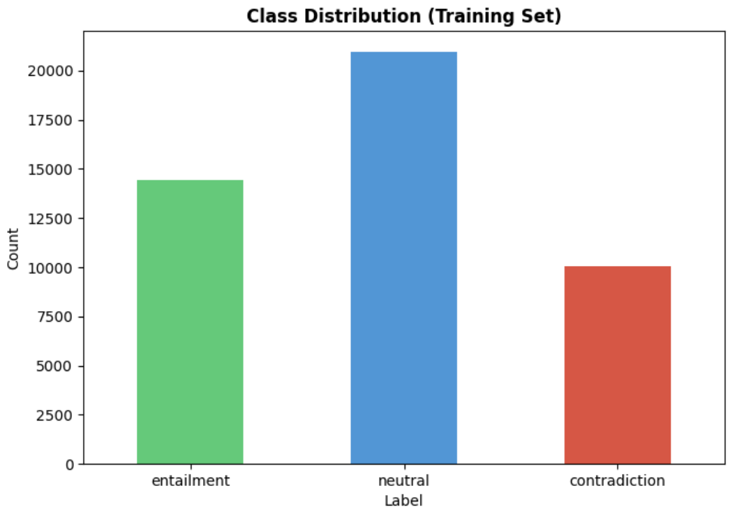
Dataset
Training: 45,460 examples
Validation: 1,000 examples
Test: 1,000 examples
Class Distribution –
Entailment: 14,448 (31.78%)
Neutral: 20,959 (46.10%)
Contradiction: 10,053 (22.11%)
Average premise: ~ 54 words
Average hypothesis: ~ 10 words

Slide 3
ML Pipeline
Data Loading: Load dataset from Hugging face
EDA: Class Distribution and text length analysis
Preprocessing: Tokenize premise-hypothesis pairs for NLI task
Training: Setup training arguments and train the model
Evaluation: Evaluate the model on validation and test data. Compute the confusion matrix.
Deployment: Deploy the model using docker and FastAPI

Slide 4
Model Selection
Model 1 - DeBERTa-v3-base
microsoft/deberta-v3-base
NLI Specialized model employing Disentangled Attention and Enhanced Mask Decoder
But we move to the next model because its growth plateaued despite initial steady learning.
Possibility of achieving better results if trained for more epochs.
Not pursued due to GPU time constraints.
Model 2 – Pre-trained DeBERTa-v3-base on MNLI/FEVER/ANLI R1
MoritzLaurer/DeBERTa-v3-base-mnli-fever-anli
More likely to provide better results as its already trained on R1 providing task specific checkpoint for NLI.

Slide 5
Result and Analysis
Random Baseline – 33.3%
SOTA Models – 78%
Model | Training Accuracy | Validation Accuracy | Test Accuracy
Base | 50% | 50% | 48.5%
Transfer Learning | 55% | 55% | 52%
The confusion matrix reveals that both models struggle most with detecting contradictions - only 41% recall.
They frequently misclassify contradictions as neutral, showing they learned to be 'uncertain' rather than making strong predictions.

Slide 6
Deployment
Docker for deployment
FastAPI for API endpoints
API endpoints –
Health Check
Predict: Base | Transfer Learning | Both
Model info

Slide 7
Key Takeaways
Evaluated multiple models, varying training arguments and identified failure modes through metrics
Understanding the nature of adversarial data which is designed to exploit model biases
Developed a complete ML pipeline and deployed the resuling model using docker & FastAPI.
Future Work
Ensemble methods (base + transfer + other architectures)
Extended training (20+ epochs with better regularization)

Slide 8
THANK YOU

