Slide 1

LLOYD INSTITUTE OF ENGINEERING & TECHNOLOGY
Greater Noida | Department of Computer Science & Engineering
B.TECH FINAL YEAR MAJOR PROJECT · BCS753
AI Recruitment System
Project Presentation – I | Session 2026–27
GUIDE NAME
SUBMITTED BY
Dr. Rajeev Sharma
1. Rohit Kumar — Roll No. [ 2401720109022 ] — Sec [ C ]
2. Prakash Kumar — Roll No. [ 2401720109020 ] — Sec [ C ]
3. Manish Jitender Mishra — Roll No. [2401530109013] — Sec [ C]
[ Assistant Professor, Department of CSE ]

Slide 2
01
OVERVIEW
Presentation Agenda
1
Problem Statement
5
System Workflow / Architecture
2
Objectives
6
Expected Outcome
3
Technology Stack
7
References
4
Literature Survey
BCS753 · B.TECH MAJOR PROJECT PRESENTATION
2

Slide 3
02
SECTION 02
Problem Statement
AI Interview System automates resume screening, skill extraction, question generation, interview recording and candidate evaluation.
BCS753 · B.TECH MAJOR PROJECT PRESENTATION
3

Slide 4
03
SECTION 03
Objectives
Resume Parsing
Skill Extraction
Interview Automation
Candidate Evaluation
BCS753 · B.TECH MAJOR PROJECT PRESENTATION
4

Slide 5
04
SECTION 04
Technology Stack
• React.js
• Node.js
• Express.js
• PostgreSQL
BCS753 · B.TECH MAJOR PROJECT PRESENTATION
5

Slide 6
05
SECTION 05
Literature Survey
S.No | Paper Title | Author(s) | Journal / Year | Key Findings
[1] | AI-Based Resume Screening and Recruitment Analytics: A Bibliometric and Systematic Review | Chowdhury Md. Ashraful Bari, Moin Mahedi Sharker, Md. Aminul Haque Khan, Kazi Abdul Mannan | SSRN, 2026 | AI improves resume screening efficiency and recruitment analytics. Major challenges include algorithmic bias, explainability, and fairness
[2] | Role of Artificial Intelligence in Employee Recruitment: Systematic Review and Future Research Directions | Alina R. Rybakova et al. | Discover Global Society, 2025 | AI automates resume parsing, candidate screening, interview scheduling, and predictive hiring while reducing manual effort. Ethical concerns include transparency and bias.
BCS753 · B.TECH MAJOR PROJECT PRESENTATION
6

Slide 7
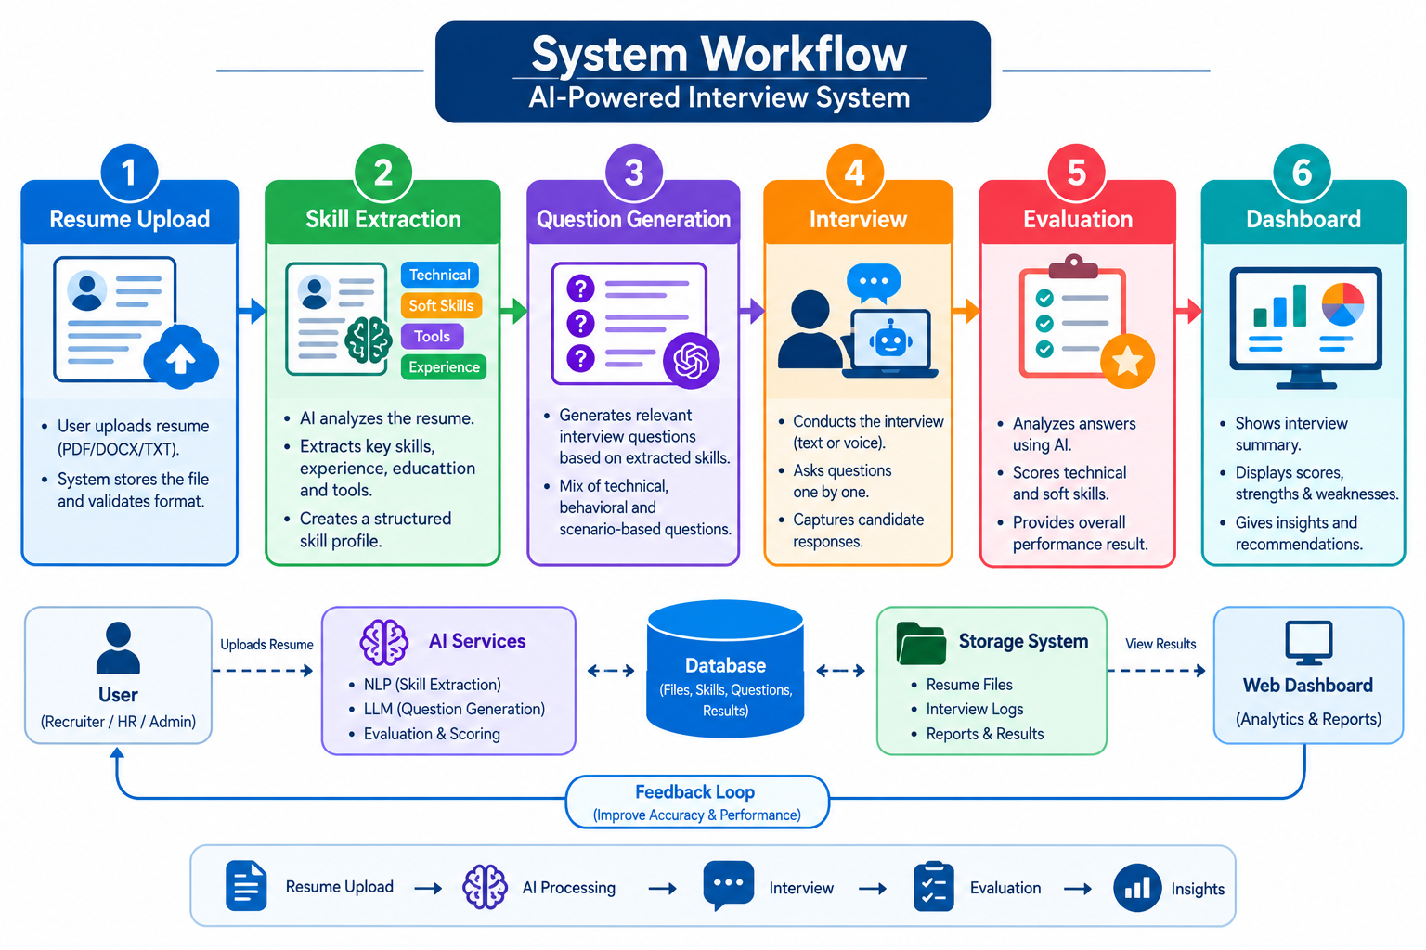
06
SECTION 06
System Workflow / Architecture
BCS753 · B.TECH MAJOR PROJECT PRESENTATION
7

Slide 8
07
SECTION 07
Expected Outcome
✓ Faster Hiring
✓
✓ Automated Evaluation
✓
✓ Better Screening
✓
✓ Centralized Management
✓
BCS753 · B.TECH MAJOR PROJECT PRESENTATION
8

Slide 9
08
SECTION 08
References
[1] React Docs
[2] Node.js Docs
[3] PostgreSQL Docs
.
BCS753 · B.TECH MAJOR PROJECT PRESENTATION
9

Slide 10
THANK YOU
Questions & suggestions are welcome
Lloyd Institute of Engineering & Technology, Greater Noida

