Slide 1
AWT

Slide 2
User Interface
CUI: Character user Interface,ex. DOS, command and result is in terms of characters.
GUI: Graphical user Interface, every OS has different look and feel, windows and MAC based OS. AWT framework, Swing and JavaFx provides GUI.
AWT- Abstract Window Toolkit, java providing toolkit for developing window based application. Abstract means look and feel depends on os. Toolkit-set of components, various classes.
Java AWT is an API to develop Graphical User Interface (GUI) or windows-based applications in Java.
Java AWT components are platform-dependent i.e. components are displayed according to the view of operating system. AWT is heavy weight i.e. its components are using the resources of underlying operating system (OS).
The java.awt package provides classes for AWT API such as TextField, Label, TextArea, RadioButton, CheckBox, Choice, List etc.

Slide 3
Java AWT Hierarchy
Component
Canvas-used for drawing
Button
Checkbox
Choice
Container
Panel: without border applet used to execute in browsers
Applet
Window
Dialog
Frame- class mostly desktops applications use it
List
Label
Scrollbar
Textcomponent
TextArea multiline
TextField

Slide 4
Useful methods of Component class
Method | Description
public void add(Component c) | Inserts a component on this component.
public void setSize(int width,int height) | Sets the size (width and height) of the component.
public void setLayout(LayoutManager m) | Defines the layout manager for the component.
public void setVisible(boolean status) | Changes the visibility of the component, by default false.

Slide 5
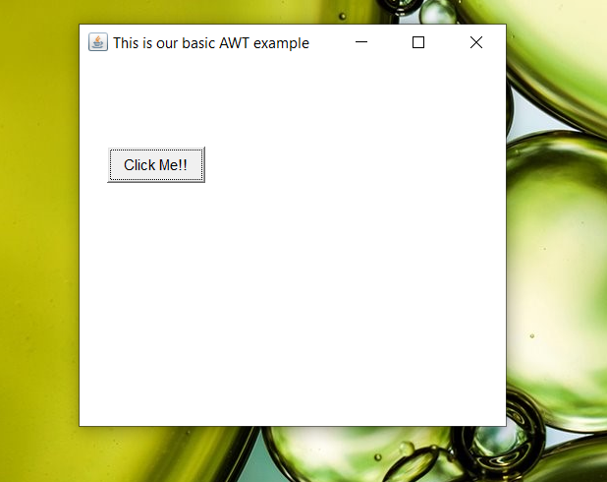
import java.awt.*;
public class AWTExample1 extends Frame {
AWTExample1() {
Button b = new Button("Click Me!!");
b.setBounds(30,100,80,30);
add(b);
setSize(300,300);
setTitle("This is our basic AWT example");
setLayout(null);
setVisible(true);
}
public static void main(String args[]) {
AWTExample1 f = new AWTExample1();
}
}

Slide 6
Java Event Handling
Changing the state of an object is known as an event. For example, click on button, dragging mouse etc. The java.awt.event package provides many event classes and Listener interfaces for event handling.
Event Classes | Listener Interfaces
ActionEvent | ActionListener | When Button is pressed, List item gets double clicked, MenuItem is selected
MouseEvent | MouseListener and MouseMotionListener | Mouse clicked,dragged,moved,released,
MouseWheelEvent | MouseWheelListener
KeyEvent | KeyListener | Input from keyboard
ItemEvent | ItemListener | CheckBox selected or deselected, choice is changed
TextEvent | TextListener | Text component generates Text events
AdjustmentEvent | AdjustmentListener | Scrollbar changed
WindowEvent | WindowListener | Window activated, deactivated, opened, closed, iconified, deiconfied
ComponentEvent | ComponentListener
ContainerEvent | ContainerListener
FocusEvent | FocusListener

Slide 7
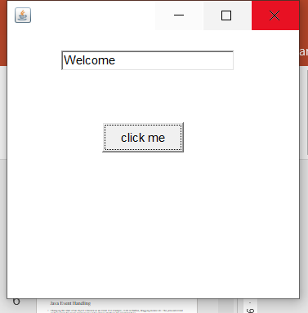
import java.awt.*;
import java.awt.event.*;
class AEvent extends Frame implements ActionListener{
TextField tf;
AEvent(){
tf=new TextField();
tf.setBounds(60,50,170,20);
Button b=new Button("click me");
b.setBounds(100,120,80,30);
b.addActionListener(this);
add(b);
add(tf);
setSize(300,300);
setLayout(null);
setVisible(true);
}
public void actionPerformed(ActionEvent e)
{
tf.setText("Welcome");
}
public static void main(String args[]){
new AEvent();
}
}

Slide 8
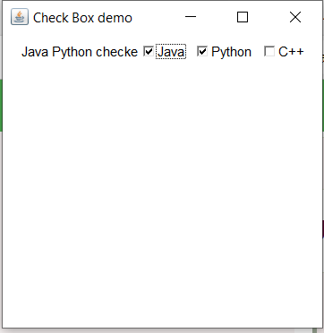
import java.awt.*;
import java.awt.event.*;
class CheckboxExample extends Frame implements ItemListener{
Label l;
Checkbox c1,c2,c3;
CheckboxExample(){
super("Check Box demo");
l=new Label("Nothing is selected");
c1=new Checkbox("Java");
c2=new Checkbox("Python");
c3=new Checkbox("C++");
c1.addItemListener(this);
c2.addItemListener(this);
c3.addItemListener(this);
setLayout(new FlowLayout());
add(l);
add(c1);
add(c2);
add(c3);
setSize(300,300);
setVisible(true);
}
public void itemStateChanged(ItemEvent e){
String str=" ";
if(c1.getState())
{
str=str+" "+c1.getLabel();
}
if(c2.getState())
{
str=str+" "+c2.getLabel();
}
if(c3.getState())
{
str=str+" "+c3.getLabel();
}
if(str.isEmpty())
{
str="Nothing is selected ";
}
l.setText(str+" checked");
}
}
class CheckboxDemo
{
public static void main(String args[]){
new CheckboxExample();
}
}

Slide 9
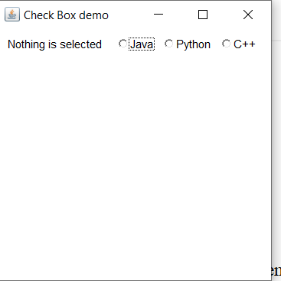
import java.awt.*;
import java.awt.event.*;
class CheckboxExample extends Frame implements ItemListener{
Label l;
Checkbox c1,c2,c3;
CheckboxGroup cbg;
CheckboxExample(){
super("Check Box demo");
l=new Label("Nothing is selected");
cbg=new CheckboxGroup();
c1=new Checkbox("Java",false,cbg);
c2=new Checkbox("Python",false,cbg);
c3=new Checkbox("C++",false,cbg);
c1.addItemListener(this);
c2.addItemListener(this);
c3.addItemListener(this);
setLayout(new FlowLayout());
add(l);
add(c1);
add(c2);
add(c3);
setSize(300,300);
setVisible(true);
}
public void itemStateChanged(ItemEvent e){
String str=" ";
if(c1.getState())
{
str=str+" " +c1.getLabel();
}
public void itemStateChanged(ItemEvent e){
String str=" ";
if(c1.getState())
{
str=str+" " +c1.getLabel();
}
if(c2.getState())
{
str=str+" " +c2.getLabel();
}
if(c3.getState())
{
str=str+" " +c3.getLabel();
}
if(str.isEmpty())
{
str="Nothing is selected ";
}
l.setText(str);
}
}
class CheckboxDemo
{
public static void main(String args[]){
new CheckboxExample();
}
}

Slide 10
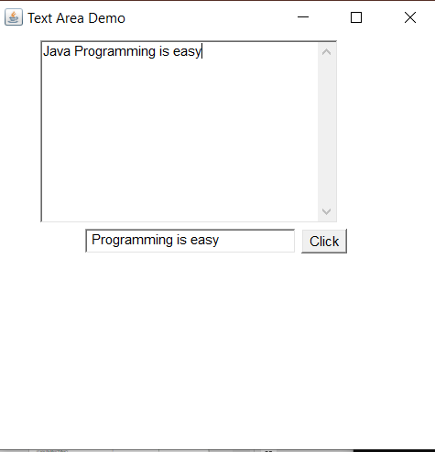
import java.awt.*;
import java.awt.event.*;
class TextAreaExample extends Frame implements ActionListener {
TextField tf;
TextArea ta;
Button b;
TextAreaExample() {
super("Text Area Demo");
ta = new TextArea(10,30);
tf=new TextField(20);
b=new Button("Click");
setLayout (new FlowLayout());
add(ta);
add(tf);
add(b);
b.addActionListener(this);
setSize (400, 400);
setVisible (true);
}
public void actionPerformed(ActionEvent ae)
{
ta.append(tf.getText());
}
public static void main(String[] args) {
new TextAreaExample();
}
}

Slide 11
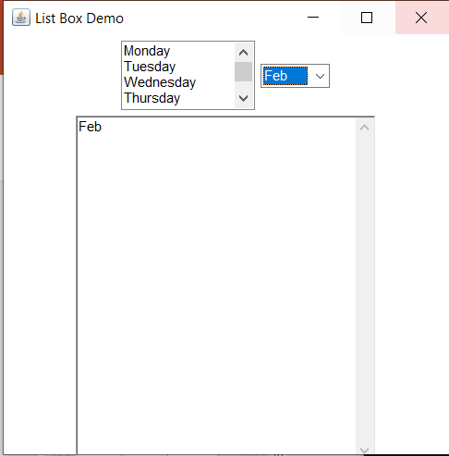
import java.awt.*;
import java.awt.event.*;
class ListExample extends Frame implements ItemListener
{
List l;
TextArea ta;
Choice c;
ListExample() {
super("List Box Demo");
l = new List(4,true);
c = new Choice();
ta=new TextArea(20,30);
setLayout (new FlowLayout());
l.add("Monday");
l.add("Tuesday");
l.add("Wednesday");
l.add("Thursday");
l.add("Friday");
l.add("Saturday");
l.add("Sunday");
c.add("Jan");
c.add("Feb");
c.add("March");
l.addItemListener(this);
c.addItemListener(this);
add(l);
add(c);
add(ta);
setSize (400, 400);
setVisible (true);
}
public void itemStateChanged(ItemEvent ie)
{
if(ie.getSource()==l)
ta.setText(l.getSelectedItem());
else
ta.setText(c.getSelectedItem());
}
public static void main(String[] args) {
new ListExample();
}
}

Slide 12
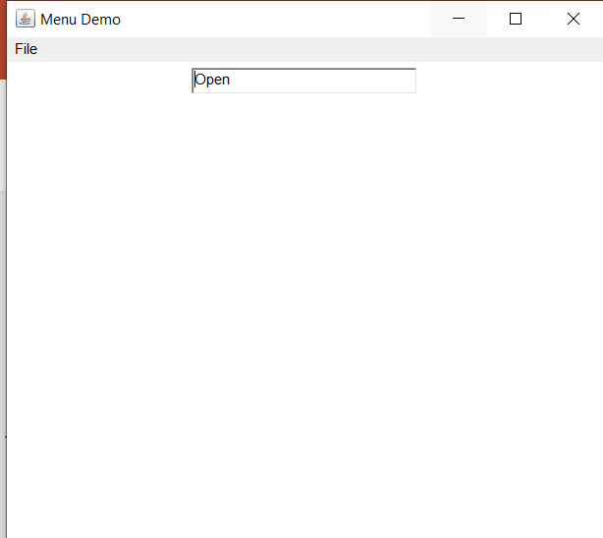
import java.awt.*;
import java.awt.event.*;
class MenuDemo extends Frame implements ActionListener{
Menu file,sub;
MenuItem open,save,close,closeall;
CheckboxMenuItem auto;
TextField tf;
MenuDemo() {
super("Menu Demo");
open = new MenuItem("Open");
save = new MenuItem("Save");
close = new MenuItem("Close");
closeall = new MenuItem("Close All");
auto=new CheckboxMenuItem("Auto Save");
file=new Menu("File");
sub=new Menu("Close");
file.add(open);
file.add(save);
file.add(sub);
file.add(auto);
sub.add(close);
sub.add(closeall);
MenuBar mb=new MenuBar();
mb.add(file);
setMenuBar(mb);
tf=new TextField(20);
setLayout (new FlowLayout());
add(tf);
open.addActionListener(this);
save.addActionListener((ActionEvent ae)->tf.setText("Save"));
close.addActionListener((ActionEvent ae)->tf.setText("Close"));
closeall.addActionListener((ActionEvent ae)->tf.setText("Close All"));
auto.addItemListener((ItemEvent ie)->
{
if(auto.getState())
tf.setText("Auto on");
else
tf.setText("Auto off");
});
setSize (500, 500);
setVisible (true);
}
public void actionPerformed(ActionEvent ae){
tf.setText("Open");
}
public static void main(String[] args) {
new MenuDemo();
}
}

Slide 13
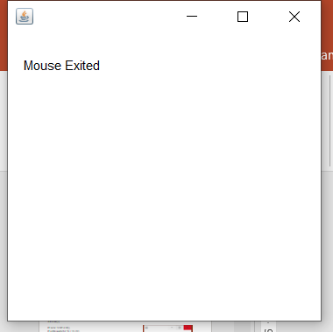
import java.awt.*;
import java.awt.event.*;
public class MouseLExample extends Frame implements MouseListener{
Label l;
MouseLExample(){
addMouseListener(this);
l=new Label();
l.setBounds(20,50,100,20);
add(l);
setSize(300,300);
setLayout(null);
setVisible(true);
}
public void mouseClicked(MouseEvent e) {
l.setText("Mouse Clicked");
}
public void mouseEntered(MouseEvent e) {
l.setText("Mouse Entered");
}
public void mouseExited(MouseEvent e) {
l.setText("Mouse Exited");
}
public void mousePressed(MouseEvent e) {
l.setText("Mouse Pressed");
}
public void mouseReleased(MouseEvent e) {
l.setText("Mouse Released");
}
public static void main(String[] args) {
new MouseLExample(); } }

Slide 14
import java.awt.*;
import java.awt.event.*;
import java.util.*;
class KeyEventDemo extends Frame implements KeyListener{
Label l1,l2,l3,l4;
KeyEventDemo(){
super("KeyEvent demo");
l1=new Label(" ");
l2=new Label(" ");
l3=new Label(" ");
l4=new Label(" ");
setLayout(null);
l1.setBounds(30,30,100,20);
l2.setBounds(30,50,100,20);
l3.setBounds(30,80,100,20);
l4.setBounds(30,110,200,20);
add(l1);
add(l2);
add(l3);
add(l4);
addKeyListener(this);
setSize(400,400);
setVisible(true);
}
public void keyPressed(KeyEvent ke)
{
l1.setText("Key Pressed");
l2.setText("");
}
public void keyReleased(KeyEvent ke)
{
l2.setText("Key Released");
l1.setText("");
l3.setText("");
l4.setText("");
}
public void keyTyped(KeyEvent ke)
{
l3.setText("Key Typed");
l4.setText(new Date(ke.getWhen())+"");
}
public static void main(String args[])
{
new KeyEventDemo();
}
}

Slide 15
import java.awt.*;
import java.awt.event.*;
import java.util.*;
class WindowEventDemo extends Frame implements WindowListener {
Label l1,l2,l3,l4;
WindowEventDemo(){
super("Window Event demo");
l1=new Label(" ");
setLayout(new FlowLayout());
add(l1);
addWindowListener(this);
setSize(400,400);
setVisible(true);
}
public void windowOpened(WindowEvent we){
l1.setText("Window Opened");
}
public void windowActivated(WindowEvent we){
l1.setText("Window Activated");
}
public void windowClosing(WindowEvent we){
l1.setText("Window Closing");
System.exit(0);
}
public void windowClosed(WindowEvent we)
{
l1.setText("Window Closed");
}
public void windowIconified(WindowEvent we)
{
l1.setText("Window Iconified");
}
public void windowDeiconified(WindowEvent we)
{
l1.setText("Window Deiconified");
}
public void windowDeactivated(WindowEvent ke)
{
l1.setText("Window Deactivated");
}
public static void main(String args[])
{
new WindowEventDemo();
}
}

Slide 16
import java.awt.*;
import java.awt.event.*;
class WindowEventDemo1 extends Frame {
WindowEventDemo1(){
super("Window Adapter demo");
addWindowListener(new MyWindowAdapter());
setSize(400,400);
setVisible(true);
}
class MyWindowAdapter extends WindowAdapter
{
public void windowClosing(WindowEvent we)
{
System.exit(0);
}
}
public static void main(String args[])
{
new WindowEventDemo1();
}
}

