Slide 1
Multithreading

Slide 2
Multithreading
Multithreading in Java is a process of executing multiple threads simultaneously.
A thread is a lightweight sub-process, the smallest unit of processing. Multiprocessing and multithreading, both are used to achieve multitasking.
However, we use multithreading than multiprocessing because threads use a shared memory area. They don't allocate separate memory area so saves memory, and context-switching between the threads takes less time than process.
Java Multithreading is mostly used in games, animation, etc.
Threads are independent. If there occurs exception in one thread, it doesn't affect other threads. It uses a shared memory area.
There are two ways to create a thread:
By extending Thread class
By implementing Runnable interface.

Slide 3
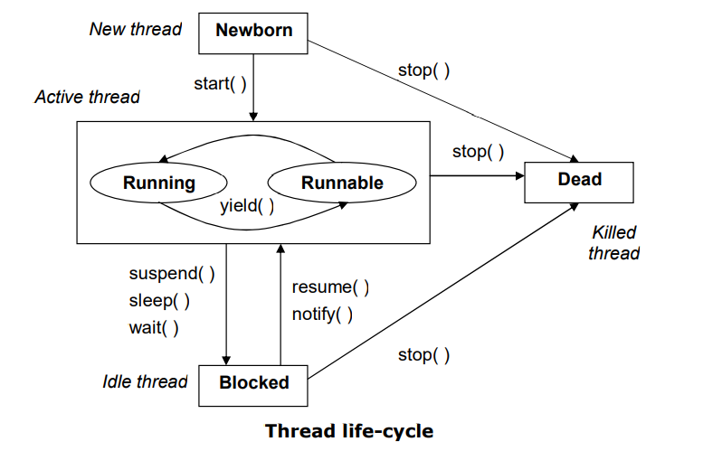
Life cycle of Thread

Slide 4
Thread class: Thread class provide constructors and methods to create and perform operations on a thread. Thread class extends Object class and implements Runnable interface.
Commonly used Constructors of Thread class:
Thread()
Thread(String name)
Thread(Runnable r)
Thread(Runnable r, String name)
Commonly used methods of Thread class:
public void run(): is used to perform action for a thread.
public void start(): starts the execution of the thread. JVM calls the run() method on the thread.
public void sleep(long milliseconds): Causes the currently executing thread to sleep (temporarily cease execution) for the specified number of milliseconds.
public void join(): waits for a thread to die.
public void join(long milliseconds): waits for a thread to die for the specified milliseconds.
public int getPriority(): returns the priority of the thread.
public int setPriority(int priority): changes the priority of the thread.
public String getName(): returns the name of the thread.
public void setName(String name): changes the name of the thread.
public Thread currentThread(): returns the reference of currently executing thread.
public int getId(): returns the id of the thread.
public Thread.State getState(): returns the state of the thread.
public boolean isAlive(): tests if the thread is alive.
public void yield(): causes the currently executing thread object to temporarily pause and allow other threads to execute.

Slide 5
class ThreadTest extends Thread
{
public void run()
{
int i=1;
while(i<=5)
{
System.out.println(i+" Hello");
i++;
}
}
public static void main(String[] args)
{
ThreadTest t=new ThreadTest();
t.start();
int i=1;
while(i<=5)
{
System.out.println(i+ " World");
i++;
}
}
}
Output
1 World
1 Hello
2 Hello
2 World
3 Hello
4 Hello
5 Hello
3 World
4 World
5 World

Slide 6
class ThreadTest implements Runnable
{
public void run()
{
int i=1;
while(i<=5)
{
System.out.println(i+" Hello");
i++;
}
}
public static void main(String[] args)
{
ThreadTest tt=new ThreadTest();
Thread t=new Thread(tt);
t.start();
int i=1;
while(i<=5)
{
System.out.println(i+ " World");
i++;
}
}
}
Output
1 World
2 World
3 World
4 World
1 Hello
2 Hello
5 World
3 Hello
4 Hello
5 Hello

Slide 7
Methods in Thread class
class Mythread extends Thread{
public Mythread(String name){
super(name);
setPriority(Thread.MAX_PRIORITY);
}
}
class ThreadDemo
{
public static void main(String[] args) throws Exception
{
Mythread t=new Mythread("My Thread");
System.out.println("Id:"+t.getId());
System.out.println("Name:"+t.getName());
System.out.println("Priority:"+t.getPriority());
System.out.println("State:"+t.getState());
System.out.println("Alive:"+t.isAlive());
t.setPriority(5);
System.out.println("New Priority:"+t.getPriority());
t.start();
System.out.println("State:"+t.getState());
System.out.println("Alive:"+t.isAlive());
}
}
Output:
Id:14
Name:My Thread
Priority:10
State:NEW
Alive:false
New Priority:5
State:RUNNABLE
Alive:true

Slide 8
Sleep,Join, isAlive method
Output
1 Odd Thread
2 Even Thread
3 Odd Thread
4 Even Thread
5 Odd Thread
6 Even Thread
7 Odd Thread
8 Even Thread
9 Odd Thread
10 Even Thread
11 Odd Thread
12 Even Thread
13 Odd Thread
14 Even Thread
15 Odd Thread
16 Even Thread
17 Odd Thread
18 Even Thread
19 Odd Thread
20 Even Thread
false
Bye
class Even extends Thread{
public void run(){
for(int i=1;i<=20;i++){
if(i%2==0)
System.out.println(i+" Even Thread ");
try{Thread.sleep(1000);}catch(Exception ex){}
} }
}
class Odd extends Thread{
public void run(){
for(int i=1;i<=20;i++){
if(i%2!=0)
System.out.println(i+" Odd Thread");
try{Thread.sleep(1000);}catch(Exception ex){}
}
}
}
class ThreadTest1 {
public static void main(String[] args) throws Exception{
Even e=new Even();
Odd o=new Odd();
e.start();
try{Thread.sleep(10);}catch(Exception ex){}
o.start();
e.join();
o.join();
System.out.println(e.isAlive());
System.out.println("Bye");
}
}

Slide 9
Synchronization
Synchronization in java is the capacity to control the access of multiple threads to any shared resource. Java synchronization is better option where we want to allow only one thread to access the shared resources.

Slide 10
class MyData{
synchronized void display(String str)
{
for(int i=0;i<str.length();i++)
System.out.println(str.charAt(i));
}}
class MyThread1 extends Thread{
MyData d;
MyThread1(MyData dat)
{ d=dat;}
public void run()
{
d.display("Hello World");
}
}
class MyThread2 extends Thread
{ MyData da;
MyThread2(MyData data)
{ da=data;}
public void run()
{
da.display("Welcome to Java");
}}
class SynDemo
{
public static void main(String[] args) throws Exception
{
MyData d=new MyData();
MyThread1 p=new MyThread1(d);
MyThread2 co=new MyThread2(d);
co.start();
p.start();
}
}
Output:
W
e
l
c
o
m
e
t
o
J
a
v
a
H
e
l
l
o
W
o
r
l
d
//Hello WorWelcome to Javald

Slide 11
Interthread Communication
class MyData{
int value;
boolean flag=true;
synchronized public void set(int v)
{
while(flag!=true)
try{ wait(); } catch(Exception ex){}
value=v;
flag=false;
notify();
}
synchronized public int get()
{
int x=0;
while(flag!=false)
try{ wait(); } catch(Exception ex){}
x=value;
flag=true;
notify();
return x;
}
}
class Producer extends Thread{ MyData d;
public Producer(MyData dat)
{
d=dat;
}
public void run()
{
int count=1;
while(true){
d.set(count);
System.out.println("Producer:"+count);
count++;
}
}
}
class Consumer extends Thread
{ MyData da;
public Consumer(MyData data)
{
da=data;
}
public void run()
{
int value;
while(true)
{
value=da.get();
System.out.println("Consumer:"+value);
}
}
}
class SynDemo1
{
public static void main(String[] args) //throws Exception
{
MyData data1=new MyData();
Producer p=new Producer(data1);
Consumer co=new Consumer(data1);
p.start();
co.start();
}
}

