Slide 1


"The most popular open source database" "The web database"
"The world's most advanced open source database" "The open source Oracle"

Slide 2


History of MySQL
●
MySQL Server development started in 1994, marketed by TCX DataKonsult AB
MySQL AB founded in 1995 by Michael “Monty” Widenius, David Axmark and Allan Larsson
Server development based on requirements for practical production use: few features, but fast and stable
Frequent releases with small changes Easy to install and use (15-minute rule)
●
●
●
●

Slide 3

History of PostgreSQL
1986: POSTGRES at the University of California, Berkeley
Michael Stonebraker project
Successor to INGRES
1994: first commecialized
as Illustra (later merged into Informix)
1995: open-sourced
Ported to SQL
PostgreSQL Global Development Group formed
1997: ported to Japanese, supported in Japan
1999: first full-time developers & corporate support
2004: native Windows support
2006: supported by Sun

Slide 4

Development History
Designed by/for Application Developers
Designed by/for Database Administrators

Slide 5
Development Priorities
(historically)
PostgreSQL 1.Data integrity 2.Security 3.Reliability 4.Standards 5.DB Features 6.Performance 7.Ease-of-use
8.Programmer Features
MySQL
1.Ease-of-use 2.Performance 3.Programmer Features 4.Reliability
5.DB Features 6.Data integrity 7.Security 8.Standards

Slide 6
Development Direction
(a simplification)
MySQL
PostgreSQL
Simple, Easy to Use, Fast
Features, Security, Standards

Slide 7
Community
Owned by one company with user community
Community-owned with many companies involved

Slide 8

Core MySQL is 100% owned by Sun/MySQL 90% of MySQL developers work for Sun
●
●
except for the many storage engines
MySQL has a large user community
many thousands active worldwide
many partners in other open source groups
Sun/MySQL contributes to other OSS projects
PHP especially
●
●

Slide 9
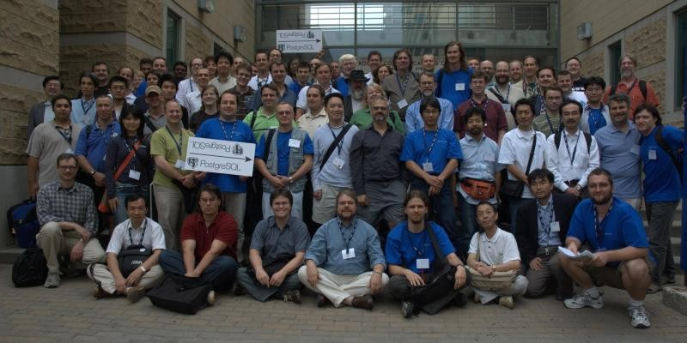
PostgreSQL has a large distributed developer and user community
●
Not owned by any one company
dozens of companies and individuals contribute code
est. over 200 developers in 14 time zones
"Community Owned"
supported by 5 different non-profits
●
●

Slide 10
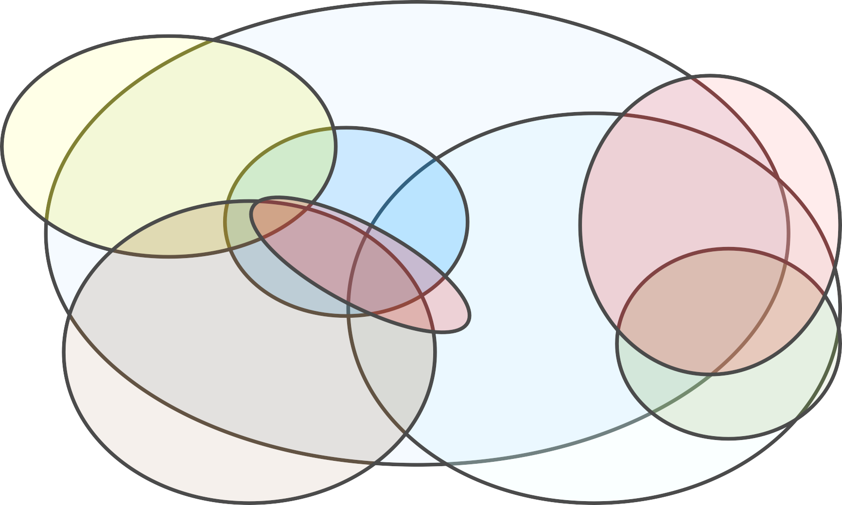
PostgreSQL Community Map
Hackers
Projects
Committers
User Groups and
National Groups
Advocacy
Core
Companies
Foundations

Slide 11
Most Common Uses
Web sites CRM
Logging
OEM applications Telecom (cluster) Network tools Data Warehouse
ERP
Data Warehouse Geograpic
Web Sites
OEM applications Network tools CRM
●
●
●
●
●
●
●
●
●
●
●
●
●
●

Slide 12
Releases
●
Feature-based releases
new features in minor releases
every 1-3 years
Time-based releases
no new features in minor releases
every year
●
3.23: 2000
4.0: 2003
4.1: 2004
5.0: 2005
5.1: 2008?
7.4: 2003
8.0: 2004
8.1: 2005
8.2: 2006
8.3: 2008
●
●
●
●
●
●
●
●

Slide 13
Features

Slide 14
Storage Engines
●
Pluggable "Storage Engines" allow MySQL to behave like a variety of different databases
Telecom DB: MySQL Cluster
Non-transactional: MyISAM
Transactional: InnoDB
Compressed: Archive
In-Memory: Memory
Write-only: Blackhole

Slide 15
Programmer Features
Excellent drivers for all languages
including JDBC4
PHP
high-performance drivers & special syntax
Native driver
MySQL Proxy
●
●
●

Slide 16
3rd Party Support
●
Most open source web projects default to MySQL
many use only MySQL
primary relational database for most top 25 web sites
Hundreds of vendors support MySQL
more than 50% of multi-database products
many "MySQL Partners"
●

Slide 17







MySQL Scale-Out
●
Simple Replication makes it (relatively) simple to scale out
used by Google, Yahoo
load-balance reads on slaves
being supplanted by memcached
Master
Writes
Reads Reads
Slave
Requests
Load Balancer
Slave

Slide 18
Simplicity
Easy to set up
"15 minute rule"
everything included
Easy to administrate
programmer-administered
most installations don't need tuning
Easy Replication
very simple master-slave & multimaster replication
●
●
●

Slide 19
Features

Slide 20
Migrateability
Closest to proprietary enterprise DBs Automatic migration from Informix
Informix is 50% PostgreSQL
Relatively easy migration from Oracle
easiest of any OSS database
puts migration cost within affordable range
tools for data integration
SQL Server, DB2 harder
but easier that MySQL
●
●
●
●

Slide 21

Security
"... by default, PostgreSQL is the most security-aware database available ..."
Database Hacker's Handbook
(based on a comparison of PostgreSQL, MySQL, Oracle, DB2 and SQL Server)

Slide 22
Security
Authentication
multiple methods: login, SSL, Kerberos, more
host-based authentication
Logging
log output is highly configurable and supports user auditing
Permissions model
SQL ROLES supported, including nested roles
multiple settable permissions on all database objects
●
●
●

Slide 23
Security
Clean code
only one security patch per two months
community patches usually out in less 72 hours
only one exploit in the field in the last four years
DB Auditing
PostgreSQL supports highly configurable triggers and other DB automation
No “auditing toolkit” out yet
●
●

Slide 24
Transaction Support
"Bulletproof" ACID thanks to MVCC
possibly best of any RDBMS
Transactional DDL
apply schema changes in a transaction
great for change management
●
●
including agile development
Savepoints
– spec-compliant "subtransactions"
●

Slide 25
BI/DW Features
Large database management features
tablespaces, table partitioning
automatic large field/row compression
Powerful query planner & executor
complex queries with nested subselects, outer joins and calculated fields
large many-table joins with multiple join types
Data mining features
full text indexing and regex support
embed external language DM modules
●
●
●

Slide 26
BI/DW Features
select a12.DAY_OF_WEEK_NBR AS DAY_OF_WEEK_NBR, max(TO_CHAR(a12.DATE_DESC ,'Day')) AS CustCol_6, a11.DATE_ID AS DATE_ID,
max(a12.DATE_DESC) AS DATE_DESC, a11.FI_ID AS FI_ID,
max(a13.FI_NAME) AS FI_NAME, a12.WEEK_YEAR_ID AS WEEK_YEAR_ID, max(a14.SHORT_WEEK_DESC) AS SHORT_WEEK_DESC,
sum (session_count) AS WJXBFS1, sum ( a11_count ) AS WJXBFS2
from ( SELECT DATE_ID, FI_ID, count(distinct SESSION_ID) as
session_count, COUNT(*) as a11_count FROM edata.WEB_SITE_ACTIVITY_FA
WHERE DATE_ID in (2291, GROUP BY DATE_ID, FI_ID )
a11
2292, 2293, 2294, 2295)
join join join
edata.DATE_LU a12 on
(a11.DATE_ID = a12.DATE_ID) (a11.FI_ID = a13.FI_ID) (a12.WEEK_YEAR_ID = a14.WEEK_YEAR_ID
edata.DIM_FI a13 on
edata.WEEK_LU a14 on
group by a12.DAY_OF_WEEK_NBR, a11.DATE_ID,
a11.FI_ID, a12.WEEK_YEAR_ID

Slide 27
Extensibility
Create your own database objects
– almost any db object can be extended easily:
●
functions types operators aggregates pseudo-tables
●
●
●
●
●
user-created objects are (usually) first class objects
everything is a function
12 different function languages
●

Slide 28
Extensibility
CREATE OR REPLACE FUNCTION _choose_random_text ( thestate _random_text,
newvalue TEXT )
RETURNS _random_text AS $f$ DECLARE result _random_text; BEGIN
result.runcount := COALESCE(thestate.runcount, 0) + 1;
IF random() < ( 1::FLOAT / result.runcount::FLOAT ) THEN result.choice := newvalue;
ELSE
result.choice := thestate.choice; END IF;
RETURN result;
END; $f$ LANGUAGE plpgsql;
CREATE AGGREGATE random_agg( BASETYPE = text,
SFUNC = _choose_random_text,
STYPE = _random_text, FINALFUNC = _exit_random_text
);

Slide 29
Special Data
Base Types:
char, varchar
large text
numeric
integers
floats
time, date, timestamp
bytea (for binary)
Exotic types
geometric: polygon, line
GIS (through PostGIS)
crypto
ISN & ISBN
XML
network: INET, CIDR
arrays
full text index
genome
●
●

Slide 30
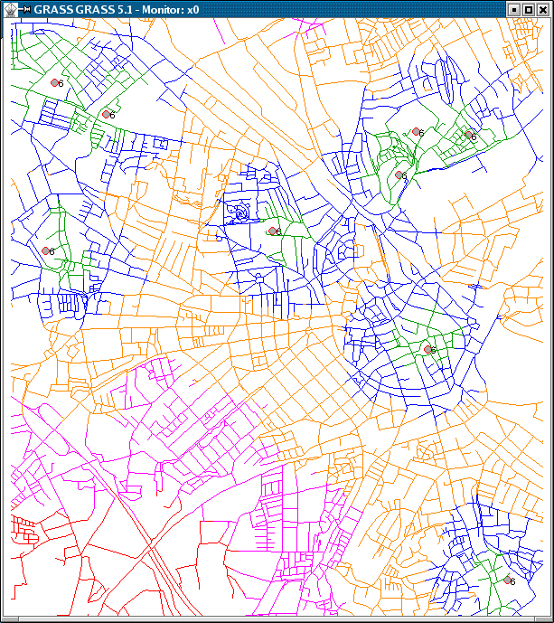
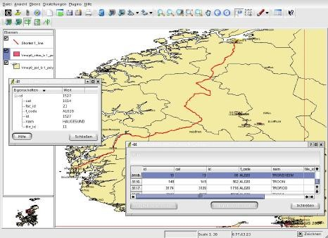

Special Data: GIS

Slide 31
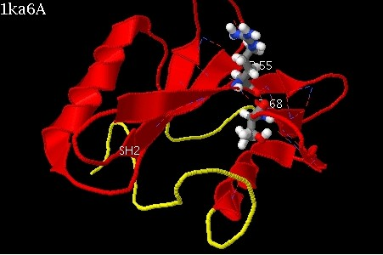
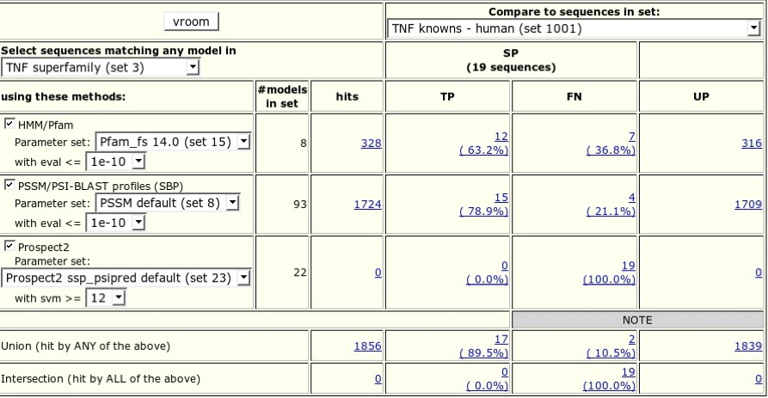
Special Data: genomics
●
BLASTgres, Unison Protein Database

Slide 32
Procedural Languages
●
Use the language you prefe– r, inside the database:
SQL
PL/pgSQL
C
– C++
Perl
Python
Java
shell
R
PHP
Ruby
Tcl
●
In beta now: PSM, Lua

Slide 33
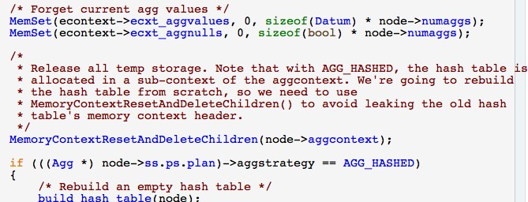
Hackability
Clean, easy to read code
Modular interfaces with clean separation of layers #1 most hacked up database
– Yahoo, Greenplum, Paraccel, Netezza, Truviso ....
●
●
●

Slide 34
Performance
Better with simple queries and 2-core machines
Better with complex queries and multi-core machines

Slide 35
Benchmarks
– SpecJAppserver 2004, as of July 2007
J2EE Througput
Acquisition Cost Comparison
900
200000
800
180000
700
160000
600
Cost in US Dollars
140000
500
120000
400
100000
80000
300
60000
200
40000
100
20000
0
0
MySQL
PostgreSQL
Oracle
MySQL
PostgreSQL
Oracle

Slide 36
Essential Performance
Every application performs best with the database for which is was designed.
Performance benchmarks for databases are constantly increasing.
Top databases are close enough that you can pick the one which suits you best.

Slide 37
Questions?
e-mail: josh@postgresql.org
IRC: irc.freenode.net, #postgresql
blog: blogs.ittoolbox.com/database/soup
●
●
●
Special thanks to:
Giuseppe Maxia and Harrison Fisk of MySQL for information about MySQL
This talk is copyright 2008 Josh Berkus, and is licensed under the creative commons attribution license

