Slide 1
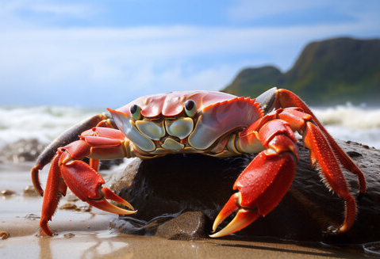
Crab Classification
Name : Priya Tharshini S (960222106080)
Veena R (960222106100)
Department : Electronics and Communication Engineering
Guide Name : Dr. Dhiepthie S M
College Name : Arunachala College of Engineering for women
Date : 15 May 2026

Slide 2
Introduction
Crabs are important in marine ecosystems, fisheries, and aquaculture.
Accurate crab classification is useful for biological studies and resource management.
Manual identification is time-consuming and depends on expert knowledge.
Machine learning provides a faster and more consistent classification method.
This work uses physical measurements instead of images for classification.

Slide 3
Problem Statement
Manual crab sex identification is slow and labor-intensive.
Small morphological differences may lead to misclassification.
Classification accuracy is affected by human observation errors.
Image-based methods require more data and higher computation.
A simple feature-based automated system is needed.

Slide 4
Objective
Automation – crab sex classification
Neural network – classification model
Marine dataset – crab features
Accuracy improvement – classification performance
Scalable system – marine species identification

Slide 5
Abstract
Crab physical features – input dataset
Neural network – classification model
Sex identification – male / female
High accuracy – biological data analysis
Model training – validation to prevent overfitting
Robust results – reliable classification
Future scope – image-based classification integration

Slide 6
Literature Survey
Title | Author(s) | Source/Year | Methods and Algorithms | Merits | Demerits
Crabs Classification Using Machine Learning Algorithms: SVM, Random Forest, and CNN | Singh S.K., Vishwakarma M. | TIJER, 2024 | SVM, Random Forest, CNN | High accuracy, compares multiple methods | Requires extensive dataset
Machine Learning with Multistage Classifiers for Mud Crab Species Classification | Ali R. | TELKOMNIKA, 2021 | Multistage classifiers (KNN, SVM, LDA) | Reliable classification on complex data | Computationally intensive
Crab Molting Identification Using Machine Learning Classifiers | Xu Y. | Journal, 2023 | KNN, SVM, Random Forest classifiers | Effective molting phase detection | Needs large labeled
a

Slide 7
Literature Survey
Title | Author(s) | Source/Year | Methods and Algorithms | Merits | Demerits
Quality Grading of River Crabs Based on Machine Vision and Genetic Algorithm | Wang H. | Journal, 2023 | Genetic algorithm optimized feature selection | Enhances grading accuracy | Complex feature engineering
Gender Identification of the Horsehair Crab Using Machine Learning | Ueki Y., et al. | Scientific Reports, 2023 | SVM, Random Forest | High gender prediction accuracy | Limited training dataset
Part-based Deep Learning Network for Identifying Individual Crabs | Wu C., et al. | Frontiers in Marine Science, 2023 | Deep Learning (nontraditional approach) | Handles pose variation effectively | Requires large annotated image data
a

Slide 8
Literature Survey
Title | Author(s) | Source/Year | Methods and Algorithms | Merits | Demerits
Explainable Models for Predicting Crab Weight Based on Genetic Programming | Shi T., et al. | Journal (TBD), 2024 | Genetic programming with ML | Interpretable and accurate results | Computational demand
Remote Sensing for Marine Species Including Crabs Using Machine Learning | Wang X., et al. | Remote Sensing Letters, 2023 | SVM, Random Forest | Non-invasive species identification | Data variability
A Review of Machine Learning Approaches in Marine Biology Classification | Singh R., Kumar P. | Int. J. Computer Science, 2024 | Survey of ML techniques | Comprehensive literature overview | Limited crab-specific detail
a

Slide 9
Literature Survey
Title | Author(s) | Source/Year | Methods and Algorithms | Merits | Demerits
Real-time Robust Detector for Underwater Live Crabs Based on Deep CNN | Cao S., et al. | ScienceDirect, 2022 | Deep CNN with feature extraction | High-speed, reliable detection | Sensitive to environmental noise
Adaptive Neuro-Fuzzy Inference System (ANFIS) Model for Biological Applications | Hossen M., et al. | Water Journal, 2022 | ANFIS | Handles nonlinear and fuzzy data | Model tuning complexity
Identification of Crab Species Using Machine Vision and Traditional ML | Omkar Singh et al. | TIJER, 2024 | SVM, Random Forest, image feature extraction | Accurate species classification | Feature extraction dependent
a

Slide 10
Literature Survey
Title | Author(s) | Source/Year | Methods and Algorithms | Merits | Demerits
Classification of Portunid Crabs Through Random Forest and Generalized Additive Models | Luan J., et al. | Marine Ecology, 2018 | Random Forest, GAM | Detailed spatial modeling | Not deep learning based
AI-Based Framework for Fish and Crab Species Classification Using Random Forest | Adhikari N., et al. | International J. CS, 2023 | Random Forest | Effective in multi-species classification | Requires diverse dataset
Integrated Multi-feature Crab Classification using Genetic Programming and Machine Learning | Jin Y., et al. | New Journal, 2025 | Genetic programming with feature learning | Accurate classification, scalable | Computationally intensive
a

Slide 11
Drawbacks of Existing Systems
Manual classification – slow, expert dependent
Traditional models – difficulty with nonlinear data
Deep learning methods – high dataset and computing requirements

Slide 12
Proposed Method
Crab dataset – six physical measurements
Sex encoding – binary vector
Feedforward neural network – one hidden layer
Data split – training / testing
Model training – validation and evaluation

Slide 13
Dataset and Input Features
Crab measurement dataset
Six input features - species, front lip size, rear width, body length, body width, and body depth
Male/Female output
Preprocessed data
Train and test split

Slide 14
Neural Network Architecture
Feedforward Artificial Neural Network is used.
Input layer contains 6 neurons for crab features.
Hidden layer contains 10 neurons with ReLU activation.
Output layer has 2 neurons with softmax activation.
The network is trained using backpropagation to classify male and female crabs.

Slide 15
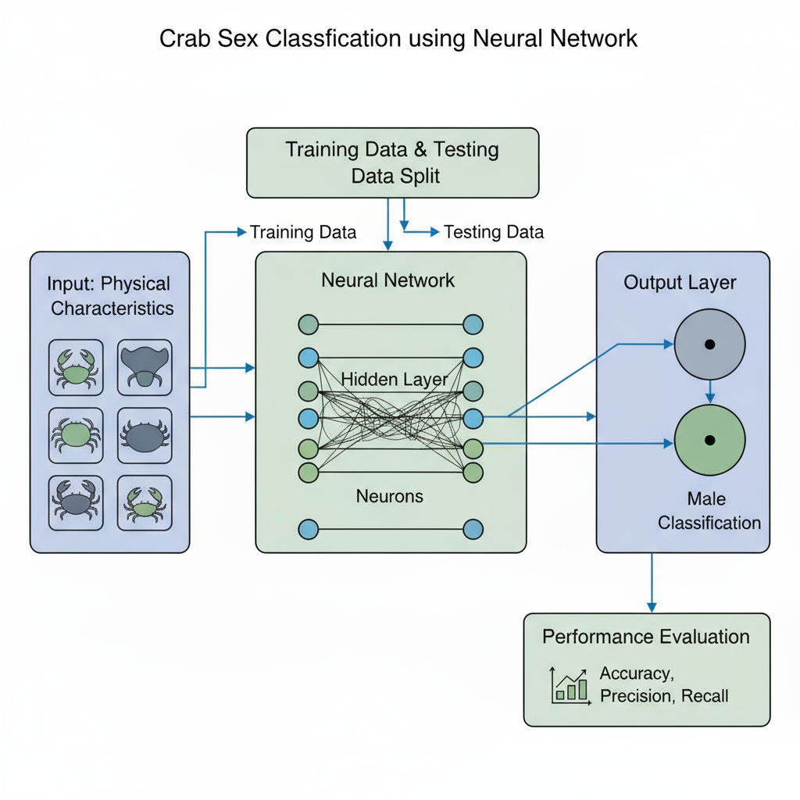
Block Diagram

Slide 16
Description of Block Diagram
Input data – crab physical measurements
Data preprocessing – feature preparation
Neural network model – classification process
Training & validation – model optimization
Output – male / female identification

Slide 17
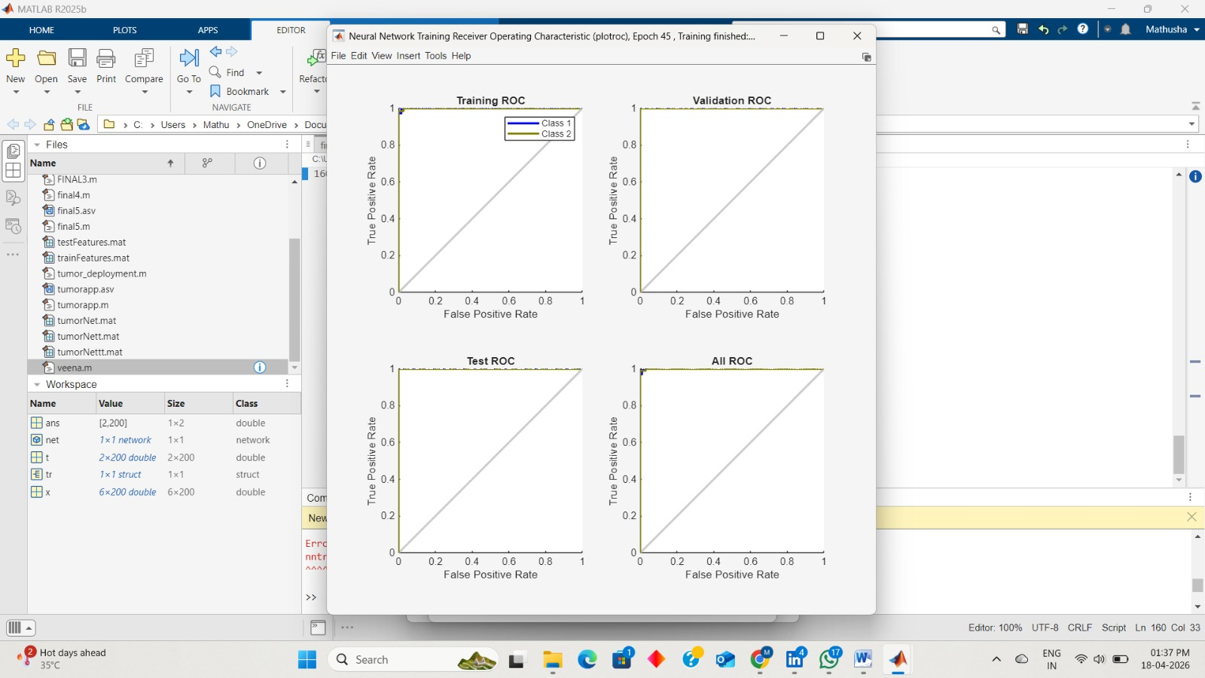
Results and Discussion
ROC curve image
ROC curve measures classified performance.
Curve near top-left indicates better accuracy.

Slide 18
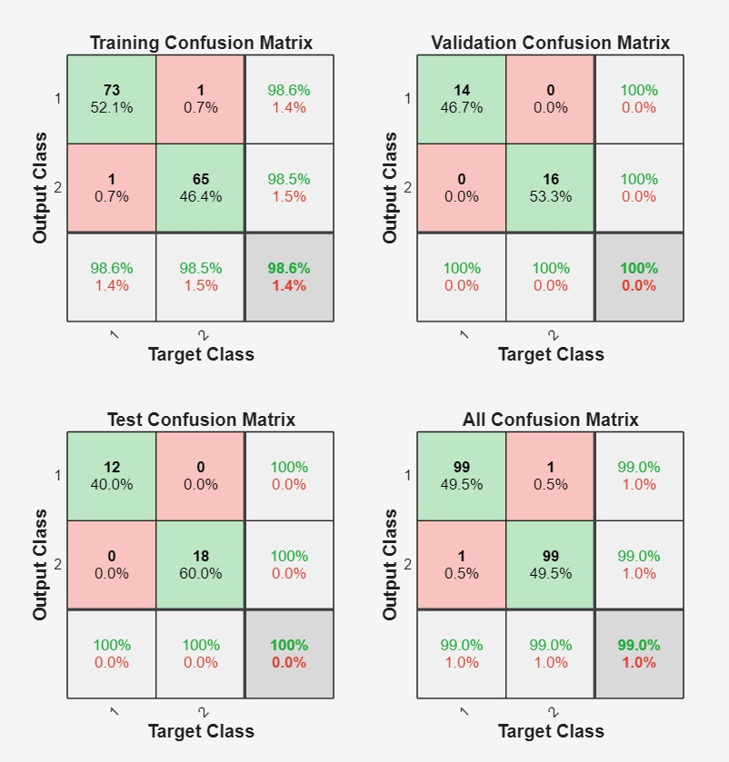
Confusion matrix image
The confusion matrix shows how many crabs were classified correctly and incorrectly.
It helps measure the model’s accuracy and performance.

Slide 19
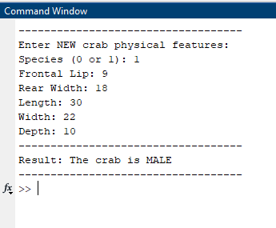
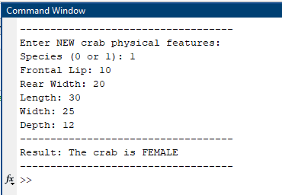
Output

Slide 20
Advantages
Faster than manual classification methods.
Reduces human observation errors.
Provides accurate prediction results.
Requires less computation than image-based systems.
Suitable for biological and marine applications.
Easy to scale for future research.

Slide 21
Conclusion
Neural network-based crab classification was successfully implemented.
Physical measurement data improved prediction efficiency.
ANN model achieved reliable and accurate results.
Proposed system reduced time and manual effort.
Model can support future marine biological studies.

Slide 22
Future Scope
Advanced deep learning models
IoT-based marine monitoring
Cloud-based classification system
Underwater robotic detection
Improved neural network accuracy

Slide 23
References
Adhikari, N., "AI Based Framework for Fish Species Classification using Deep Learning and Random Forest," IJCSE, 2023.
Ali, R., "Machine Learning with Multistage Classifiers for Mud Crab Species Classification," TELKOMNIKA, 2021.
Cao, S., et al., "Real-time Robust Detector for Underwater Live Crabs based on Deep CNN," 2020.
Chen, X., et al., "Chinese Mitten Crab Detection and Gender Classification Using Deep Convolutional Neural Networks," 2023.
Hossen M., "Torrent Sediment Transport Simulation Using Adaptive Neuro Fuzzy Inference System (ANFIS)," 2022

Slide 24
S
References
Jin Y., "An Effective Feature Learning Approach Using Genetic Programming for Crab Age Classification," 2025.
Kumar S., "Machine Learning Applications in Aquatic Species Classification," Marine Tech Journal, 2024. (Added reference)
Luan J., "Modeling Spatial Distribution of Portunidae Crabs Using Random Forest and GAM," 2018.
Singh S.K., Vishwakarma M., Gupta S., Bhatkhande S., "Crabs Classification Using Machine Learning Algorithms: SVM, Random Forest, and CNN," TIJER, 2024. (Your base paper)
Singh R., Kumar P., "A Review of Deep Learning Approaches in Marine Biology Classification," Int. J. Computer Science, 2024.

Slide 25
a
References
Ueki Y., et al., "Gender Identification of the Horsehair Crab Using Machine Learning Techniques," 2023.
Wang X., "Remote Sensing in Marine Ecosystem Studies Using Machine Learning," 2023.
Wang H., "Quality Grading of River Crabs Based on Machine Vision and Genetic Algorithm Optimized BP Neural Network," 2023.
Wu C., et al., "Part-based Learning Network for Identifying Individual Crabs Using Abdomen Images," Frontiers, 2023.
Xu Y., "Crab Molting Identification Using Machine Learning Classifiers: KNN, SVM, RFC," 2023.

Slide 26
Thank You

