Slide 1

KESHAV MEMORIAL ENGINEERING COLLEGE A unit of Keshav Memorial Technical Educational Society (KMTES) (Approved by AICTE, New Delhi & Affiliated to Osmania University, Hyderabad)
DEPARTMENT OF COMPUTER SCIENCE & ENGINEERING
(CSE – A )
Mini Project Presentation on
ONLINE INTEGRATED PLATFORM FOR PROJECTS
By
CH SRI SAI GANESH - 245522733015
S VISHNU VARDHAN – 245522733054
V BHANU PRAKASH REDDY – 245522733060
Guide:
Mrs. K SRIHARITHA
(Assistant Professor )

Slide 2
Index
Batch No. A4 “Online Integrated Platform For Projects"
1. Abstract
2. Introduction
3. Literature Survey
4. Problem Statement
5. Methodology
6. Modules
7. Software & Hardware Requirements
8. Dataset Description
9. Design / UML Diagrams
10. Implementation
11. Results
12. Conclusion & Future Scope
13. References
14. Thank You

Slide 3
1. Abstract
Batch No. A4 “Online Integrated Platform For Projects"
In many academic institutions, student projects are stored in isolated systems or offline formats, limiting visibility, collaboration, and innovation across universities. There is no centralized and structured platform dedicated specifically to academic project sharing with proper metadata, feedback, and moderation features. ProjectNinjas is a full-stack web application developed to address this gap by enabling students to upload, search, and explore academic projects from various colleges. The platform supports secure authentication, file uploads for project reports, search and filter functionality, as well as features like comments, ratings, and admin moderation. It fosters an ecosystem of shared knowledge and encourages academic collaboration among students.
Keywords: MERN Stack, Student Projects, Project Repository, Authentication, File Uploads, Academic Collaboration

Slide 4
2. Introduction
Batch No. A4 “Online Integrated Platform For Projects"
ProjectNinjas is an online platform developed to streamline the process of sharing and discovering academic projects among students from various colleges and universities.
The platform allows students to submit their project details and reports, making them accessible to peers and faculty across institutions.
It encourages academic collaboration, reduces repetition of project topics, and improves project visibility.
Key features include secure user authentication, role-based access, project uploads, filtering options, and peer engagement through ratings and comments.
The system aims to foster innovation and knowledge exchange in the academic community.

Slide 5
3. Literature Survey
Batch No.A4 “Online Integrated Platform For Projects"
The paper “A Unified Framework for Academic Project Repositories” discusses the lack of centralized systems for managing and sharing student projects.
It highlights challenges such as limited accessibility, absence of metadata tagging, and no support for peer feedback.The second paper, “MERN Stack for Scalable Educational Platforms”, explores how MERN technologies can build efficient academic portals.
However, it points out common issues like inadequate role-based access, missing interactive features, and poor file handling
.These gaps directly relate to our project, and ProjectNinjas aims to address them through structured project uploads, user authentication, rating, and admin moderation.

Slide 6
4. Problem Statement
Batch No. A4 “Online Integrated Platform For Projects"
Students currently share academic projects through platforms like GitHub, Google Drive, or internal college portals, which are unstructured and lack visibility outside their institution.
These platforms are not tailored for academic use and do not support essential features like filtering by domain or tech stack, rating, comments, or role-based access.
Additionally, there is no centralized system that enables students to engage with peer projects across institutions.
These limitations highlight the need for a dedicated, moderated platform that supports secure project submissions, advanced search, peer interaction, and administrative oversight.
ProjectNinjas is designed to address these challenges directly.

Slide 7
5. Methodology
Batch No. A4 “Online Integrated Platform For Projects"
Authentication Module: Handles user registration and login using JSON Web Tokens (JWT) with role-based access for students and admins.
Project Upload Module: Allows users to submit project details along with a file (PDF/DOC) using Multer for file handling.
Project Listing & Filtering: Displays all uploaded projects and supports search/filtering by domain, tech stack, and college
Interaction Module: Enables users to like projects, rate them (1–5 stars), and post comments (linked to user and project).
User Dashboard: Displays user-uploaded projects, with options to edit/delete and view stats like likes, ratings, and comments.
Admin Panel: Provides admin access to view/delete projects or comments and mark featured projects.
Process Flow: Follows modular development — frontend in React.js, backend in Node.js with Express, and MongoDB for storage..

Slide 8
6. Modules & Features
Batch No. A4 “Online Integrated Platform For Projects"
Authentication Module:
Handles user registration and login using JWT with role-based access (student/admin).
Project Upload Module:
Allows users to submit project details along with PDF/DOC files via Multer.
Project Listing & Filtering:
Displays uploaded projects with options to filter by domain, tech stack, and college.
Interaction Module:
Enables users to like, rate (1–5 stars), and comment on projects.

Slide 9
7. Software & Hardware Requirements
Batch No. A4 “Online Integrated Platform For Projects"
🧰 Software Requirements:
Frontend: React.js, Tailwind CSS
Backend: Node.js, Express.js
Database: MongoDB (local setup using MongoDB Compass or CLI)
Authentication: JWT (JSON Web Tokens)
File Upload: Multer middleware (local storage)
IDE: Visual Studio Code
Testing Tools: Postman, browser developer tools
Environment Management: .env file for local configuration
🖥️ Hardware Requirements:
System with minimum 4 GB RAM, i3 processor or above
OS: Windows 10 / Ubuntu / macOS
100–200 MB of free disk space for local storage and project files
Stable internet connection (optional, for downloading dependencies or GitHub use)

Slide 10
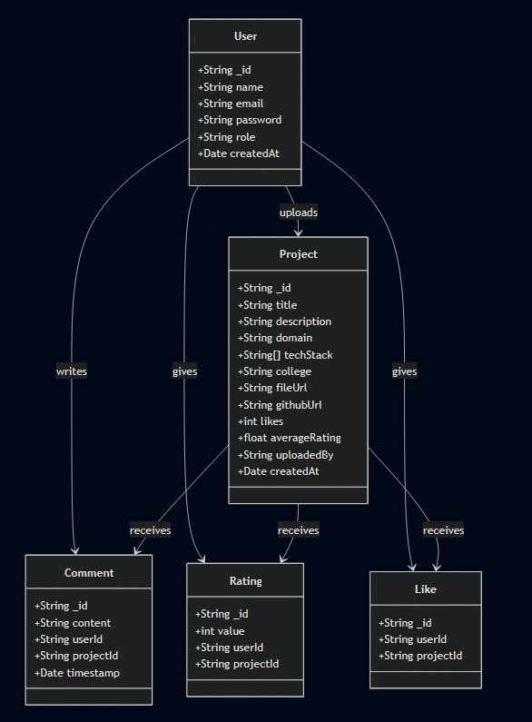
8. Design / UML Diagrams
Batch No. A4 “Online Integrated Platform For Projects"
Class Diagram

Slide 11
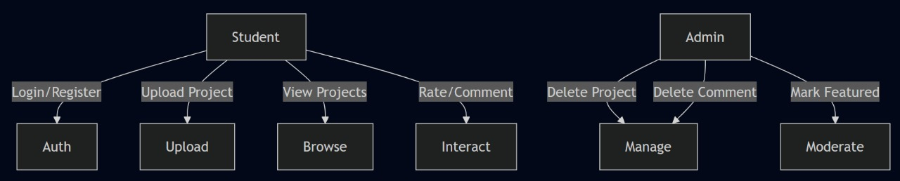
8. Design / UML Diagrams
Batch No. A4 “Online Integrated Platform For Projects"
Usecase Diagram

Slide 12
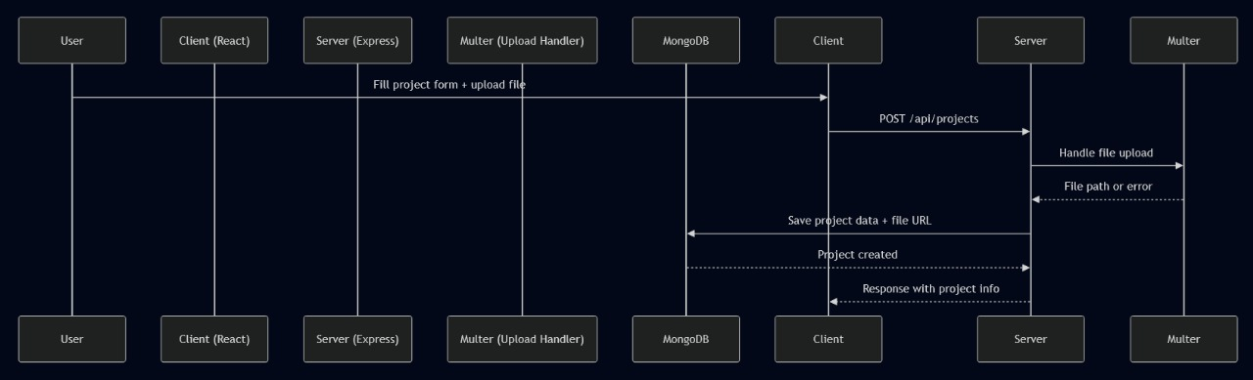
8. Design / UML Diagrams
Batch No. A4 “Online Integrated Platform For Projects"
Sequence Diagram

Slide 13
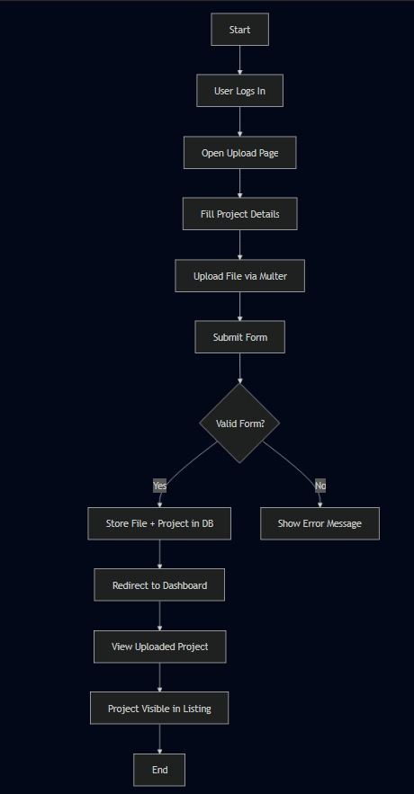
8. Design / UML Diagrams
Batch No. A4 “Online Integrated Platform For Projects"
Activity Diagram

Slide 14
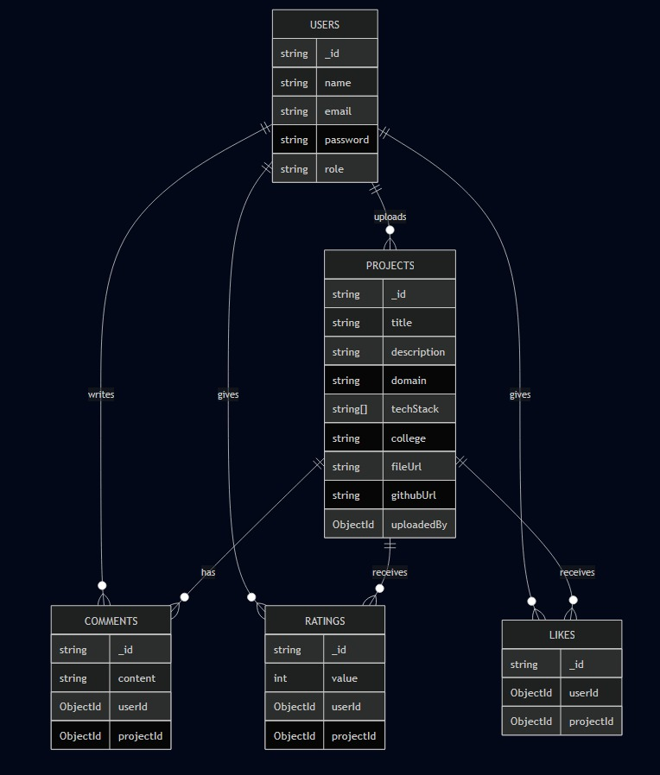
8. Design / UML Diagrams
Batch No. A4 “Online Integrated Platform For Projects"
Entity Relationship Diagram

Slide 15
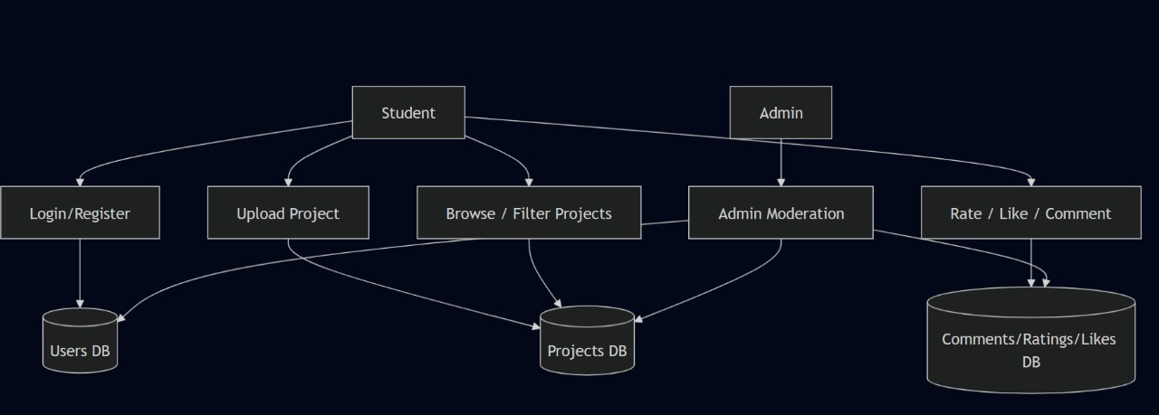
8. Design / UML Diagrams
Batch No. A4 “Online Integrated Platform For Projects"
Dataflow Diagram

Slide 16
9. Implementation
Batch No. A4 “Online Integrated Platform For Projects"
Frontend: React.js with Tailwind CSS for building the user interface
Backend: Node.js with Express.js for creating RESTful APIs
Authentication: JWT used for login and role-based access (student/admin)
File Upload: Multer used to upload PDF/DOC reports to local storage
Database: MongoDB (local) used to store users, projects, comments, ratings
Environment: Project runs locally using npm and nodemonTesting
Tools: Postman for APIs, browser for frontend testing.

Slide 17
10. Results
Batch No. A4 “Online Integrated Platform For Projects"
ProjectNinjas was successfully developed and tested locally
Core features like authentication, project upload, and filtering work as expected
User roles (student/admin) and project interactions (likes, comments, ratings) functioned properly
System showed stable performance for small to medium datasets
Offers better structure and interactivity compared to informal tools like GitHub or Google Drive

Slide 18
11. Conclusion & Future Scope
Batch No. A4 “Online Integrated Platform For Projects"
Conclusion: ProjectNinjas creates a structured platform for academic project sharing, enabling better visibility, peer feedback, and organized access.
Next Features (Future Scope):
Add plagiarism detection for uploaded reports
Email notifications for comments and ratings
Project bookmarking/favorites feature
Public profiles with user project history
Deploy system online with cloud storage for scalability

Slide 19
12. References
Batch No. A4 “Online Integrated Platform For Projects"
A Unified Framework for Academic Project Repositories, IEEE Xplore
MERN Stack for Scalable Educational Platforms, International Journal of Computer Applications
MongoDB Documentation – https://www.mongodb.com/docs/
Express.js Guide – https://expressjs.com/
React.js Official Docs – https://reactjs.org/Tailwind
CSS Documentation – https://tailwindcss.com/
JSON Web Token (JWT) Guide – https://jwt.io/introduction
Multer File Upload Middleware – https://github.com/expressjs/multer
Postman API Testing Tool – https://www.postman.com/

Slide 20
13. Thank You
Batch No. A4 “Online Integrated Platform For Projects"
“Any Questions or Suggestions?”
We appreciate your time and attention.
We’re open to queries and feedback from the panel
ProjectNinjas – A Student Project Sharing Platform

