Slide 1
Exploratory Data Analysis with R
Lecture 1

Slide 2
General Information
Class: PubH 6002 section 10
Instructor: Naji Younes
Office: Science and Engineering Hall 7680
Email: naji@gwu.edu

Slide 3
The Teaching Assistants
Team | Room | TA
1 | 100 | Abbey Woolverton
2 | 200A | CJ Stratton
3 | 300C | Hala Nsouli
4 | 500A | Hamid Ferdosi
5 | 500B | Kathleen Hamill
6 | 400B | Morgan Byrne
7 | 200B | Rachael Crockett
8 | 300B | Hannah Yellin

Slide 4
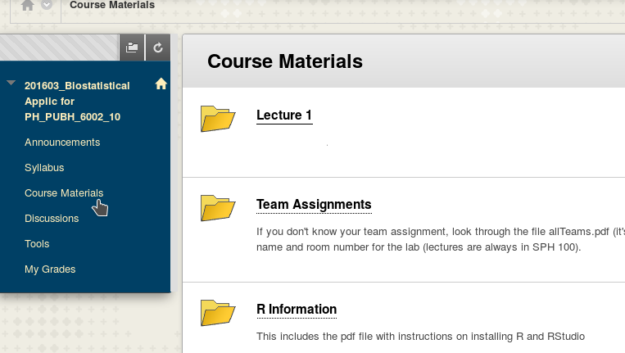
Finding Course Materials on Blackboard

Slide 5
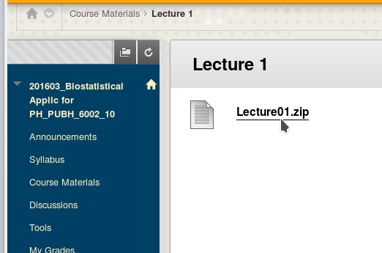
Downloading the zip file

Slide 6
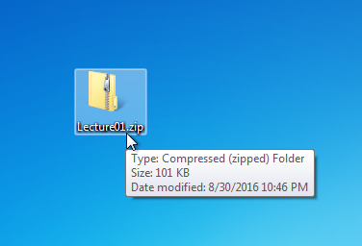
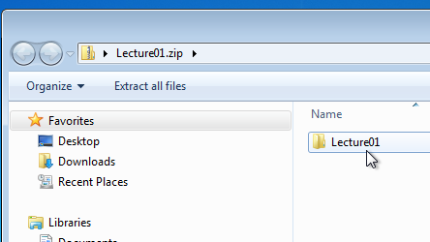
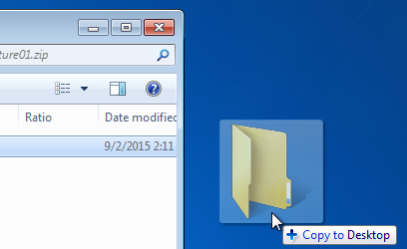
Pulling the lecture folder out of the zip file
1. Double click to open the zip file
2. Drag and drop the
folder out of the zip file

Slide 7
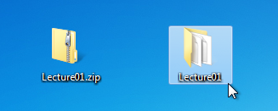
Pulling the lecture folder out of the zip file
Work from the folder, not the zip file
This one
Is trouble
Use this

Slide 8
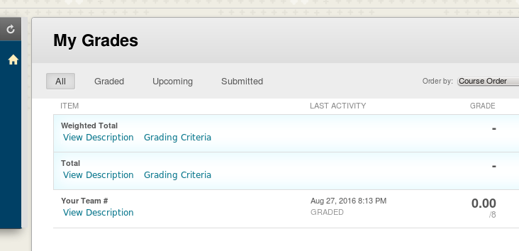
Team Number in the Grades Section

Slide 9
Course Objectives
1. Developing a routine for exploring data
What's going on? Are there interesting patterns, relationships, anomalies?
2. Do these patterns/relationships look real?
Are they just there in the sample by chance?
3. Are our conclusions solid?
Is there something we overlooked? Are we approaching the data wrong?
4. How do we best convey what we found?
5. How do we make our work reproducible?

Slide 10
Using Statistical Software
Avoid equations or calculations
Focus on data analysis, interpretation, and communication
Many options: R, SAS, SPSS, Stata, Matlab, etc…
R used in this class

Slide 11
R's place in this class
Used extensively in lecture, labs, quizzes
It’s a tool, not the focus of the class
Focus on a simple, practical subset of R
Bring your laptops so you can follow along, experiment. And charge them ahead.
laptops not needed during exams.

Slide 12
What we're assuming
No prior experience with statistical software
No experience with R

Slide 13
Working with R
It will be frustrating at first
It gets easier
A little struggling is ok. A lot is not!
if you're stuck and not making progress email your TA or email me.

Slide 14
Major topics
1. Exploratory data analysis (lectures 1-4)
2. Formal Methods (lecture 5)
3. Association and basic regression (lectures 6-8)
4. Common regressions models (lectures 9-11)
5. Other regression models (lectures 10-11)
6. Design of experiments (lecture 12)
7. Issues in generalizing (lecture 13)
8. Review session

Slide 15
Biostat Textbooks
None required
Optional
Motulsky “Intuitive Biostatistics” 3d ed
Rosner “Fundamentals of Biostatistics” 7th ed
Not used in class

Slide 16
R Textbooks
Not really needed
Many free tutorials on the web, but more complex than you’ll need for this class
R in action by Robert I. Kabacoff
Using R and RStudio for Data Management, Statistical Analysis, and Graphics by Nicholas J. Horton and Ken Kleinman

Slide 17
Assignments and Quizzes
3 take home (due the following week)
3 in class
One experiment
Final
Worst of the 3 take home + 3 in class dropped.

Slide 18
Take home Quizzes
Open book and notes
Preparation for the in-class
Please work individually

Slide 19
In Class Quizzes
Closed book
Multiple versions
Very similar to the take home ones, same material.
Not evil

Slide 20
Experiment
A chance to explore
More details as we get closer

Slide 21
Final
Closed book
Cumulative, but emphasis on the last 4 lectures
Very much like the quizzes
Also not evil

Slide 22
Percentages
Quizzes (1 dropped, 5 count) 50%
Experiment 15%
Labs 15%
Final 20%

Slide 23
Lecture Structure
Most weeks
Lecture 6:10 to 8:00
Lab: 8:10 to 9:00
Weeks with an in-class quiz
Quiz: 6:10 to 6:45 approximately
Lecture: 6:55 to 9:00

Slide 24
Labs
Review and practice class material
Full lab attendance = attending 9/11 labs

Slide 25
Teams

Slide 26
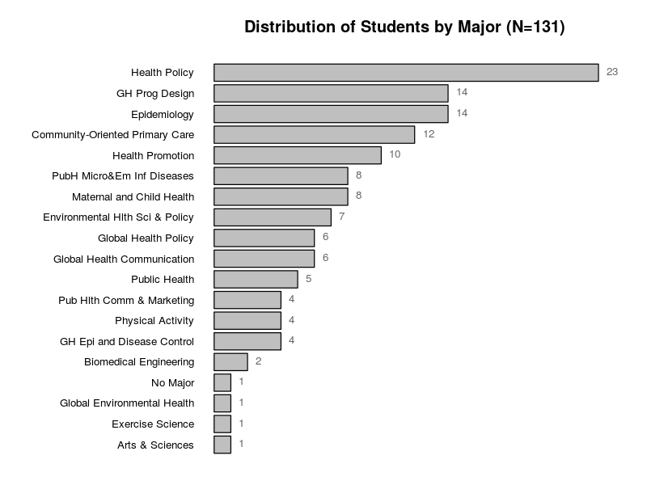

Slide 27
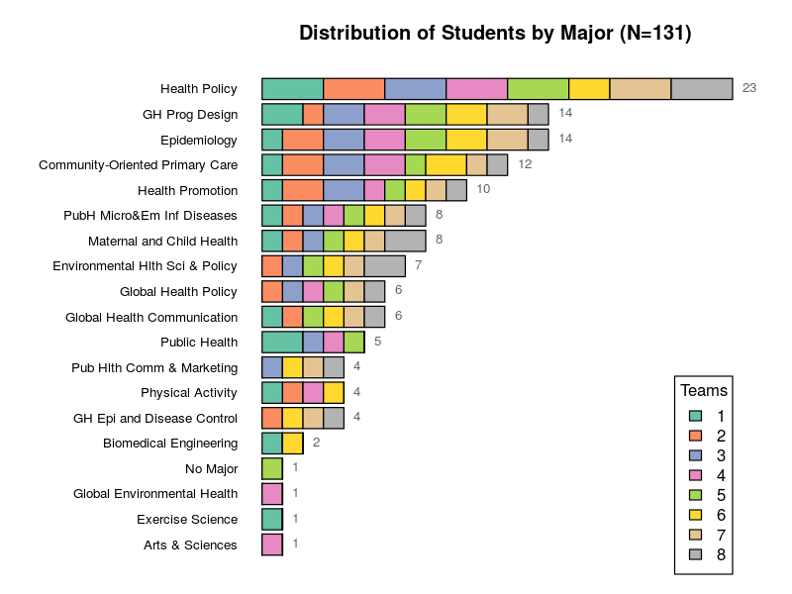

Slide 28
Team Assignments and Rooms
Check the file allTeams.pdf in the lecture 1 folder
Team lists also on blackboard
Assignments are final
If you don't see your name in the team list, please talk to me after the lecture

Slide 29
R Basics

Slide 30
What R does
Free language for statistics, data mining and graphics
Powerful and you get the full thing
Free, works on most platforms
Relatively simple
Popular

Slide 31
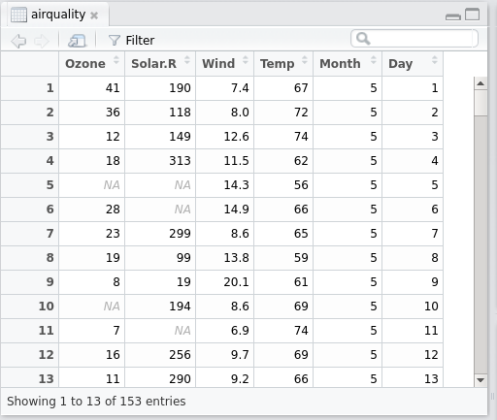
R Objects
You’ll be working with datasets, variables, results, etc. The generic name for of these “objects”.
Each object has a
Name and contents
A dataset

Slide 32
R Objects are created using “=”
Create a variable with a single value in it
age = 27
Create a dataset by reading data from a file
aq = read.csv(‘airquality.csv’)

Slide 33
Comments
You can use comments to annotate your work. The # symbol indicates the beginning of a comment.
# This is a comment
age = 27 # This is another comment

Slide 34
Special Comments
Some comments start with #’
These become regular text when you convert your R file to a word document.
More on this later

Slide 35
Spaces and blank lines
They don't matter. For example, these are all equivalent
age=27
age = 27
age = 27

Slide 36
Nothing is required at the end of a line
Some statistical packages require you to end things with a period or a semicolon.

Slide 37
Functions
Most of the work in R is done through functions:
Some functions are calculator-style functions, e.g. log()
Some summarize data, e.g. summary()
Some plot, e.g. plot() or hist()

Slide 38
Examples of functions
log(12.4) the log of 12.4
mean(age) the average (mean) of the age values
hist(age) make a histogram of age values

Slide 39
Capitalization matters
These are two different variables
age = 18
Age = 18
This applies to everything, including functions
sqrt(4) equals 2
Sqrt(4) gives an error

Slide 40
Numbers, Characters, Objects
Numbers
age = 27.5
Objects
ageNextYear = age+1
Characters
city = 'Washington'
city = "Washington" same thing

Slide 41
RStudio

Slide 42
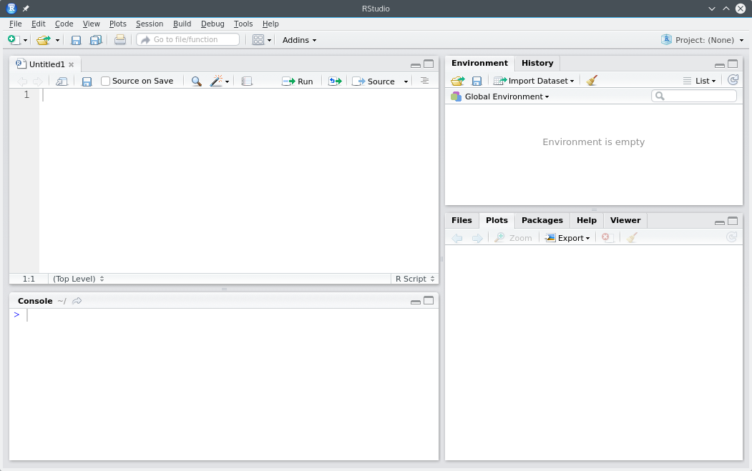

Slide 43
Editor
Most work saved here
Environment
Objects live here
Plots tab
Plots appear here
Files tab
The files in the current folder
Console
Thing “run” here
Also used for quick stuff
Packages
Extra functionality added to R

Slide 44
Launching RStudio

Slide 45
RStudio should to be tied to a folder
RStudio works best when it’s rooted inside a folder.
Don’t simply launch it as an application

Slide 46

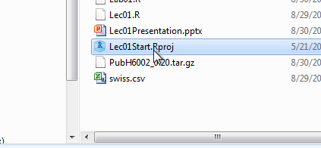
1. Open the folder (not the zip file)
2. Double click on the “Start” file

Slide 47
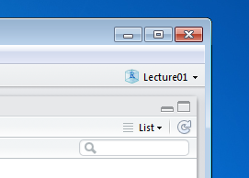
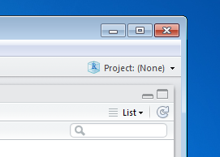
Did it work?
Check the upper right corner of RStudio: it should show the name of the folder.
If it shows “Project: (None)” you’re in the wrong place!
Good
Uh Oh

Slide 48
Configure RStudio
You only need to do this once

Slide 49
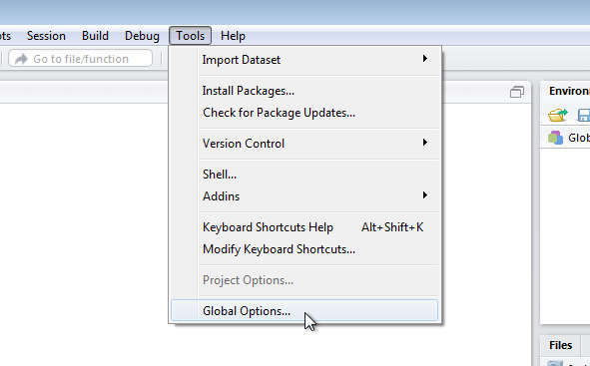

Slide 50
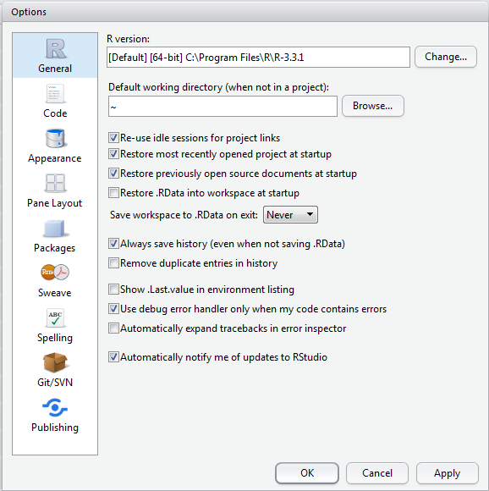

Slide 51
Installing The Class Package
We’ll be doing this pretty much every week

Slide 52

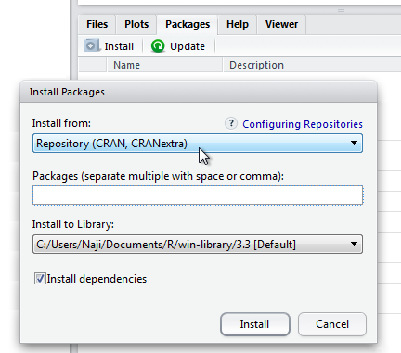
Go to the packages tab
Click Install

Slide 53
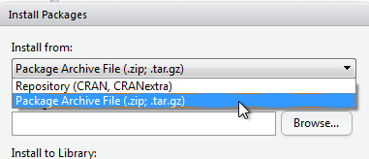
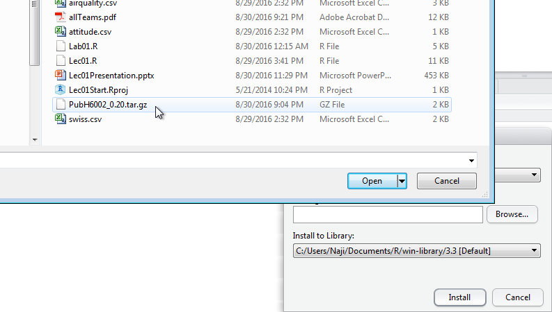
Change install From to Package archive file
Navigate to the lecture folder
Pick the “.tar.gz” file

Slide 54
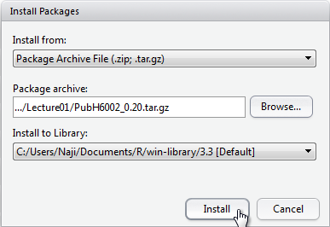
Click install

Slide 55
Trying It out

