Slide 1
Data Problems
Lecture 4

Slide 2
Admin Stuff

Slide 3
Temporary adjustments
Team 6 (Morgan) in Room 200A (with CJ)

Slide 4
Take Home Assignment (Lectures 1-3)
In this week’s zip file
Due: next week by 6:00pm
Not intentionally tricky, not evil
Individual work, preparation for in-class
Complete, compile notebook, upload notebook to Blackboard
R problems, errors? Contact us!

Slide 5
So Far

Slide 6
Exploratory analysis to detect issues
General
Incorrect/bad data, missing values
Numerical variables
Skewed distributions, outliers, multiple modes
Categorical Variables
Underrepresented categories

Slide 7
Options for dealing with these issues
Once you’ve identified an issue, you can
Do nothing
Remove data
Modify data
Use specialized statistical methods

Slide 8
Problem 1: Missing Data

Slide 9
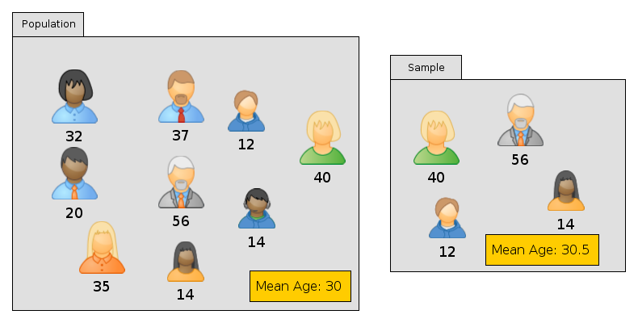

Slide 10
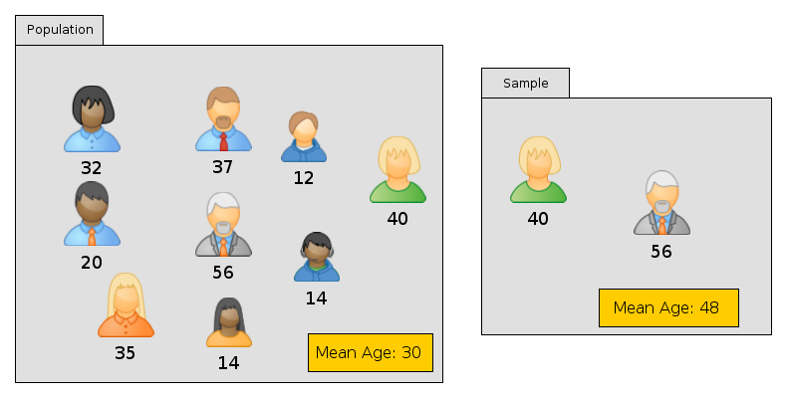

Slide 12


Slide 13
Missing value examples
Subject refusal
Missed visits, losses to follow-up
Procedural error, analysis error, lost sample
Logistics, no time to do the test
Subject misunderstands the question

Slide 14
Missing values and bias
How much is missing?
Why is it missing?
What can we do about it?

Slide 15
How much is missing?
Very little (impact hopefully small)
A bunch
A large amount (credibility issue)

Slide 16
Is there a pattern to what’s missing?
Are some groups more likely to have missing data?
Are some values more likely to be missing?

Slide 17
Missing Completely At Random
MCAR Tendency to be missing unrelated to anything in the study (missing or observed)
Roughly There is no pattern to what’s missing

Slide 18
Examples of (probable) MCAR
Lab tech dropped the sample (oops)
Patient misses a visit for scheduling reasons (unrelated to disease or exposures)
Some values were illegible in the chart

Slide 19
Reasons: Missing At Random
MAR Tendency to be missing related only to observed values.
Roughly People with missing information are similar to the people with complete information.
We can use the information we have to guess the missing values

Slide 20
Example of (probable) MAR
Younger patients more likely to refuse to take a diabetes severity test.
Refusal depends on age
does NOT depend on severity
So the patients who refuse aren’t sicker. We may be able to guess their values based on patients of similar ages who agreed to take the test

Slide 21
Silly Example
Patient | Age | Severity
1 | 18 | 4
2 | 8 | 7
3 | 8 | ? (really 7)
4 | 4 | 9
5 | 4 | 8
6 | 4 | ? (really 8.6)
7 | 3 | 10

Slide 22
Reasons: Missing Not At Random
MNAR Tendency to be missing related at least in part to unobserved values.
Roughly People with missing values differ from people with data in ways we can’t describe

Slide 23
Example of (probable) MNAR
Patients with more severe diabetes more likely to refuse to take a diabetes severity test.
Refusal depends on severity
So the patients who refuse are generally different (worse) from those who agree. We can’t use the data we have to predict the missing information!

Slide 24
Silly Example: values over 10 missing
Patient | Age | Severity
1 | 15 | 4
2 | 8 | 7
3 | 8 | ? (really 12)
4 | 4 | 9
5 | 4 | 8
6 | 4 | ? (really 13)
7 | 3 | 10

Slide 25
 | Chance of missing depends on
Missing completely at random (MCAR) | Nothing
Missing at random (MAR) | Observed quantities only
Missing not at random (MNAR) | At least in part on unobserved quantities

Slide 26
Important Result
Dropping the missing values gives you
the right answer
only if
The missing values are MCAR

Slide 27
MCAR, MAR, MNAR… how can you tell?
MAR vs. MCAR
If there a pattern to the missing values?
Do you see a lot more missing values in some groups? For some risk factors?
Does the distribution of the outcome look truncated?
MAR vs. MNAR
No good answer. Watch me squirm.

Slide 28
Dealing with Missing Data

Slide 29
Option 1: Only use available data
Also called “Complete case analysis”
Problems:
Only valid if the data are MCAR. Otherwise you get selection biases
You can lose a LOT of data that way

Slide 30
Outcome: Severity | Predictor: Age | Predictor: Smoker | Predictor: Weight | Predictor: Blood Pressure
12 | 22 | N | 140 | ?
8 | 28 | N | 130 | 114
8.1 | 34 | ? | 160 | 118
7.4 | ? | Y | 110 | 132
10 | 25 | N | ? | 141
? | 21 | N | 210 | 145
6.2 | ? | N | 170 | 130
11 | 33 | N | 190 | ?
8 | 29 | ? | 120 | 118
7.5 | 17 | N | ? | 160

Slide 31
Outcome: Severity | Predictor: Age | Predictor: Smoker | Predictor: Weight | Predictor: Blood Pressure
12 | 22 | N | 140 | ?
8 | 28 | N | 130 | 114
8.1 | 34 | ? | 160 | 118
7.4 | ? | Y | 110 | 132
10 | 25 | N | ? | 141
? | 21 | N | 210 | 145
6.2 | ? | N | 170 | 130
11 | 33 | N | 190 | ?
8 | 29 | ? | 120 | 118
7.5 | 17 | N | ? | 160

Slide 32
Option 2: Impute Values
Examples:
Replace missing values
By their mean
By the previous observation carried forward
By a value predicted by some model

Slide 33
Example: Last observation carried forward
Patient | Visit 1 | Visit 2 | Visit 3 | Visit 4 | Visit 5 | Visit 6
1 | 140 | 130 | ? | 128 | 140 | 150
2 | 150 | 140 | 150 | ? | ? | 155
Patient | Visit 1 | Visit 2 | Visit 3 | Visit 4 | Visit 5 | Visit 6
1 | 140 | 130 | 130 | 128 | 140 | 150
2 | 150 | 140 | 150 | 150 | 150 | 155

Slide 34
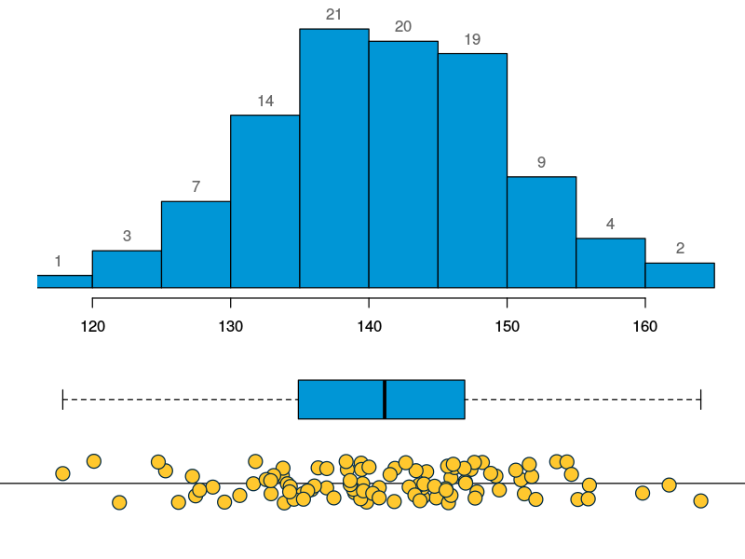
Weight
133.7
141.8
131.6
156.0
143.3
131.8
etc..

Slide 35
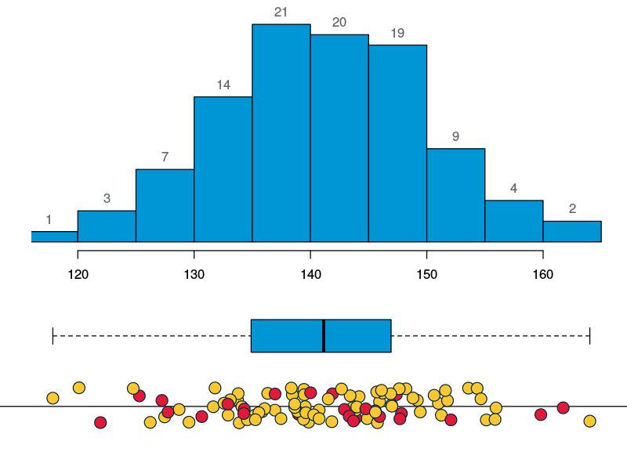
Weight
133.7
NA
131.6
156.0
NA
131.8
etc..

Slide 36
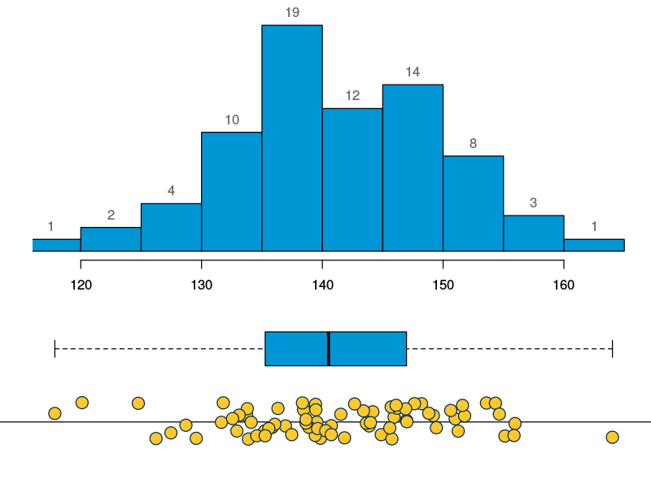
Weight
133.7
NA
131.6
156.0
NA
131.8
etc..

Slide 37
Weight
133.7
NA
131.6
156.0
NA
131.8
etc..
Mean of weights is 141

Slide 38
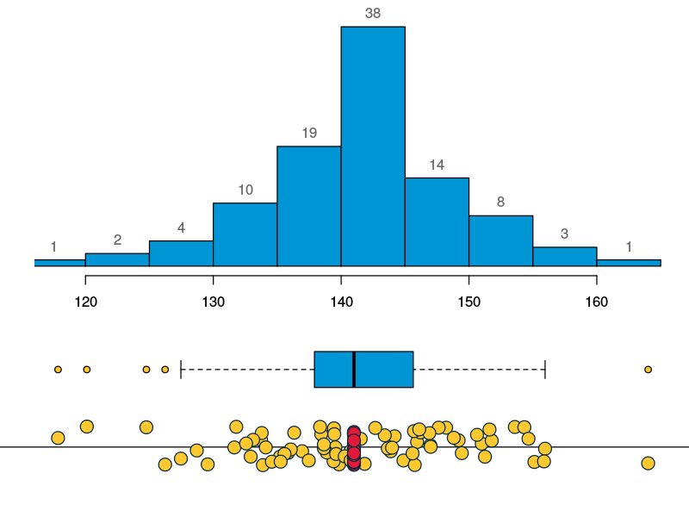
Weight
133.7
141
131.6
156.0
141
131.8
etc..

Slide 39

Weight
133.7
141
131.6
156.0
141
131.8
etc..

Slide 40
Imputing a constant
May mess up the mean (if you impute the wrong value)
Even if you impute the correct value: Will artificially decrease the spread

Slide 41
Option 3: Multiple Imputation
Instead of imputing a fixed value, impute a random value
Generate multiple such values for each missing value
Combine results

Slide 42
Sensitivity Analyses
Do the analysis several ways
Drop all missing values
Fixed value imputation
Multiple imputation
Do the various methods agree qualitatively?

Slide 43
Option 4: Avoid missing values
Careful design
Realistic data collection

Slide 44
Problem 2: Outliers

Slide 45
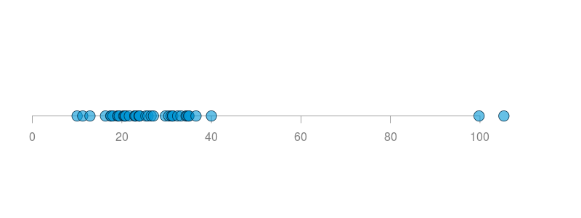

Slide 46
Outliers
Points that are very far from the bulk of the values

Slide 47
What could they be?
Data capture error: typo, incorrect units, mistake calculation
Coding issue: 99, 9999, 11/11/1911
Unusual but real subjects
Experimental error: equipment malfunction, subject not fasting
Skewed distribution

Slide 48
Outliers may not be obvious
Height: 4’8”
Weight: 210lb
BMI: 47.1

Slide 49
Influential Observations

Slide 50
Why do we worry about outliers?
Statistics can be affected by very large/very small values
Some are particularly sensitive (e.g. mean, standard deviation)

Slide 51
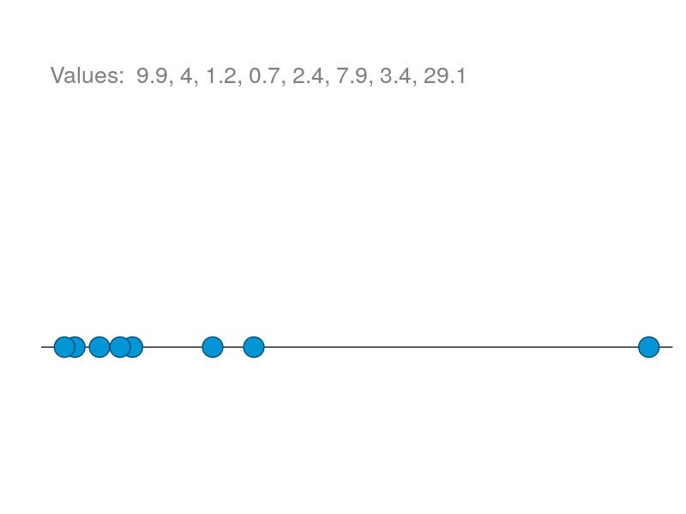

Slide 52
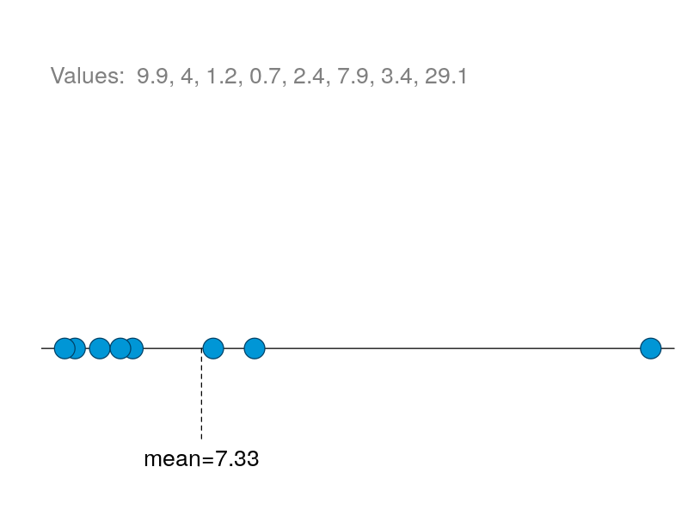

Slide 53
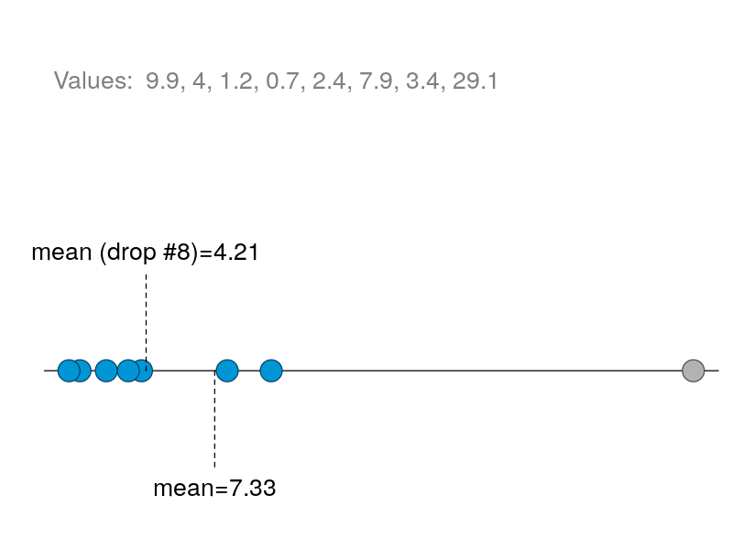

Slide 54
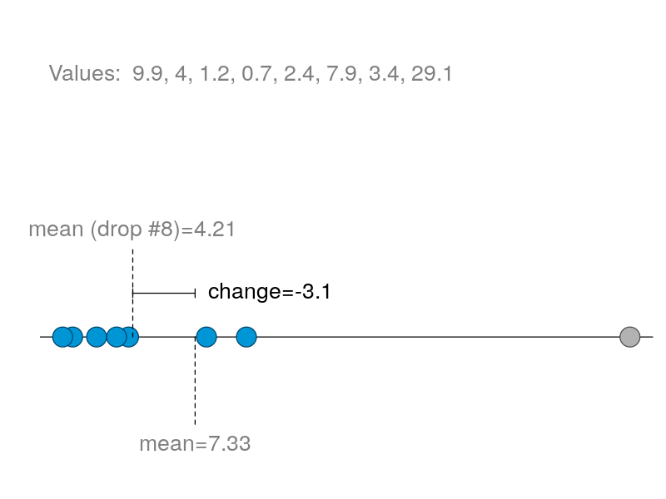

Slide 55
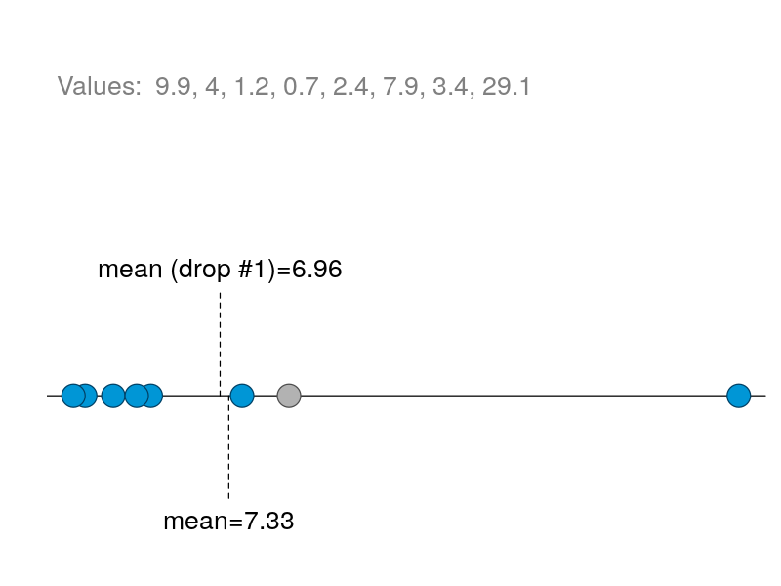

Slide 56
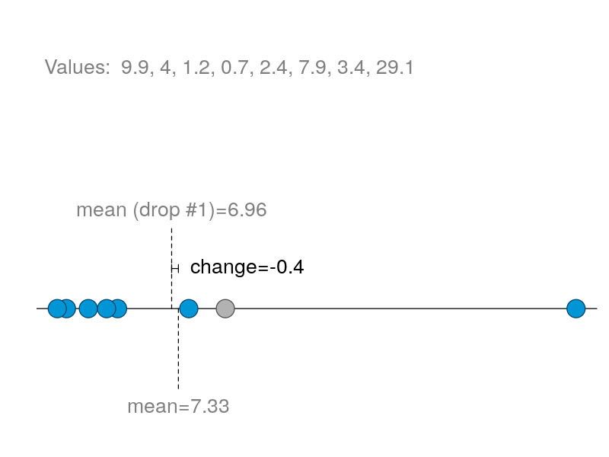

Slide 57
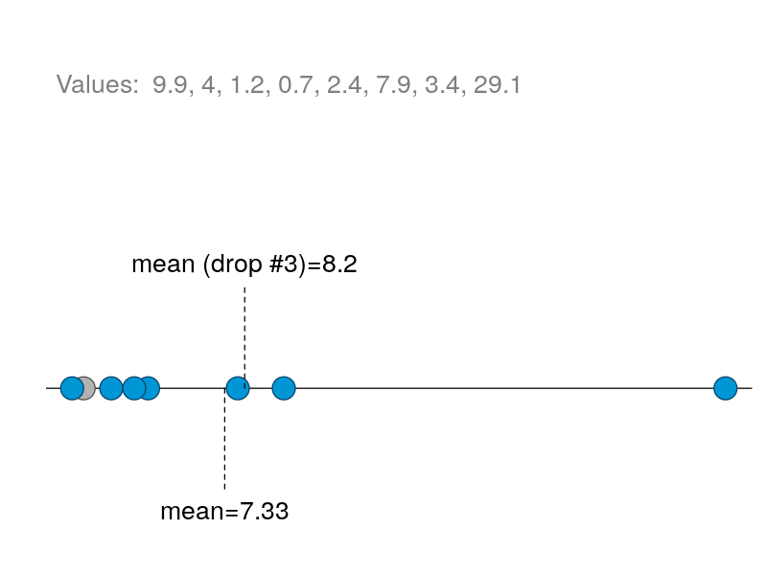

Slide 58
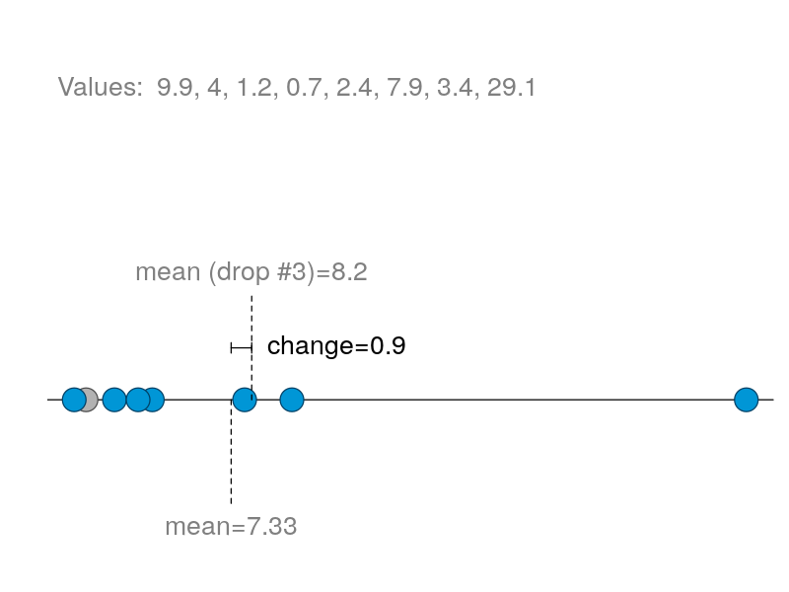

Slide 59
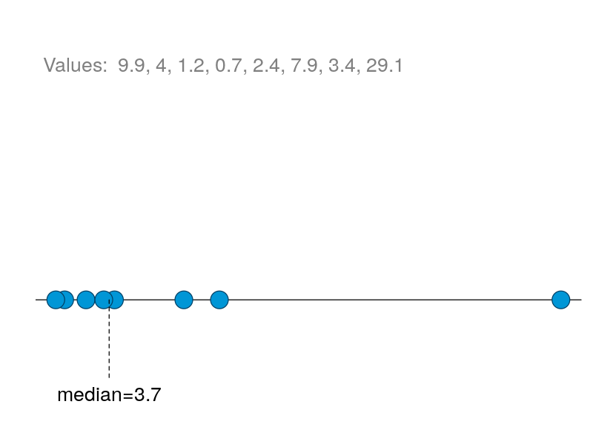

Slide 60
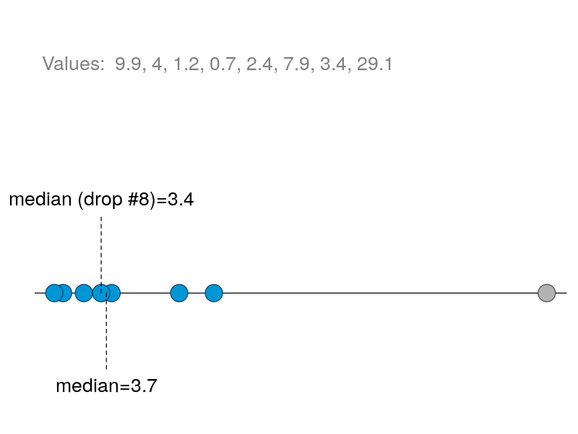

Slide 61
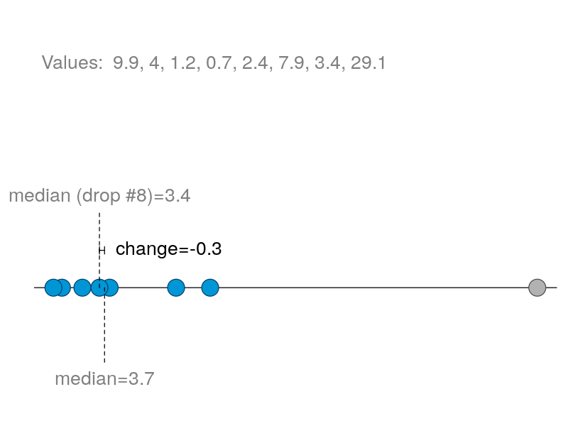

Slide 62
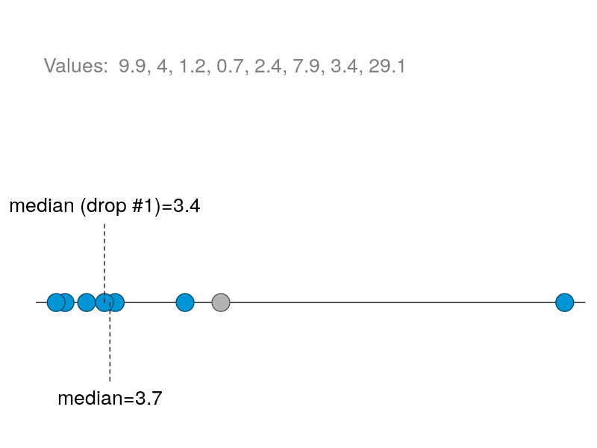

Slide 63
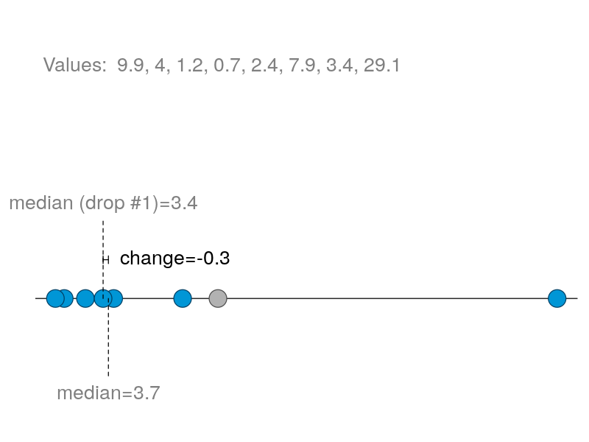

Slide 64
Drop 1 Statistics
Calculate the value for the full dataset
Calculate the value without the 1st observation
Report the change
Repeat for each observation in turn. Note: only one observation dropped at a time!

Slide 65
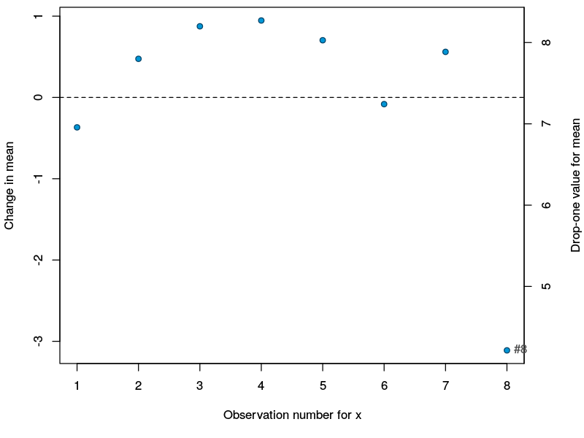

Slide 66
Reading an influence plot
Are a few points much more influential than others
Is the change caused by influential points acceptable (judgment)

Slide 67
Influence Plots for the Median
Median is normally not influenced by single points
Plot often has a banded appearance

Slide 68
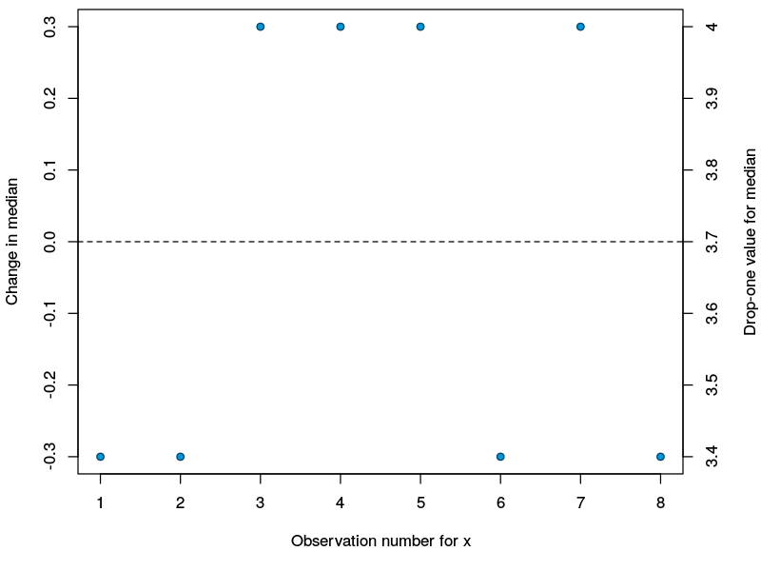

Slide 69
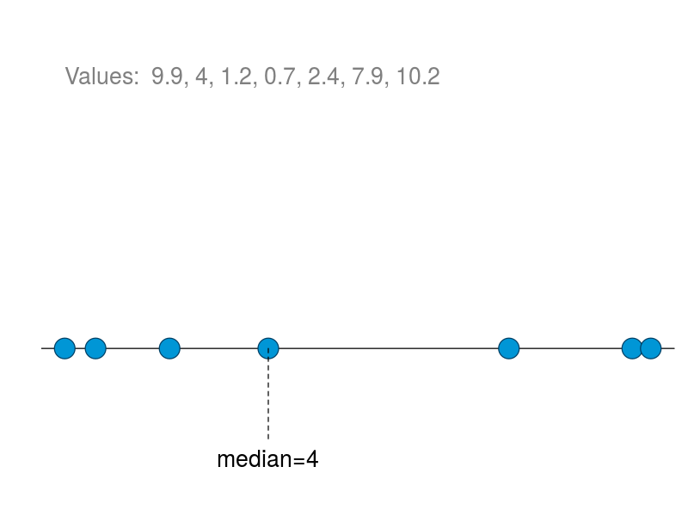

Slide 70
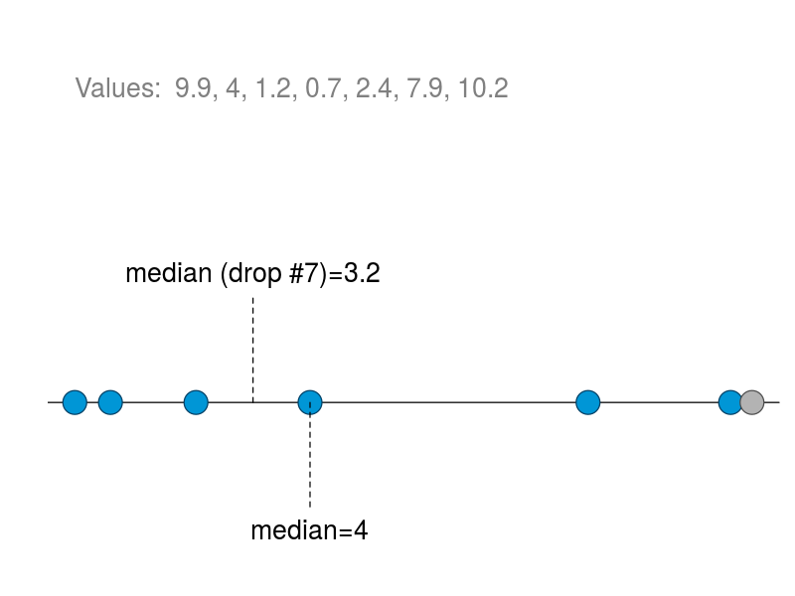

Slide 71
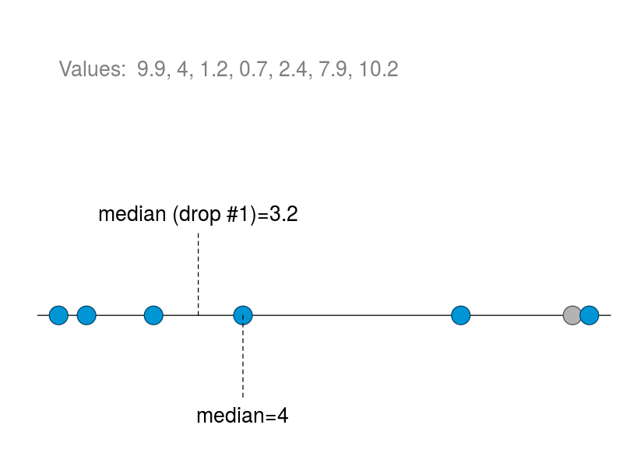

Slide 72
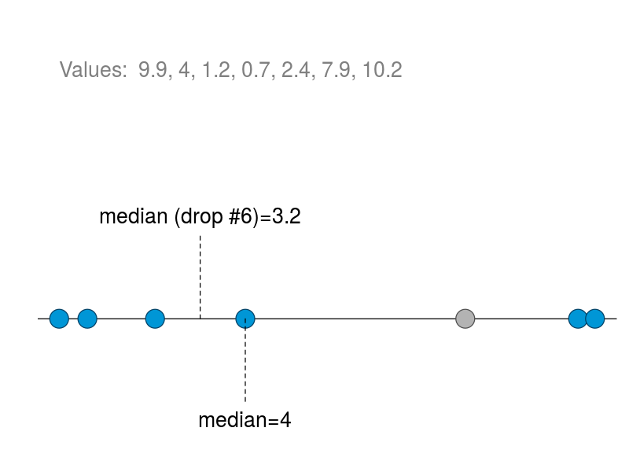

Slide 74
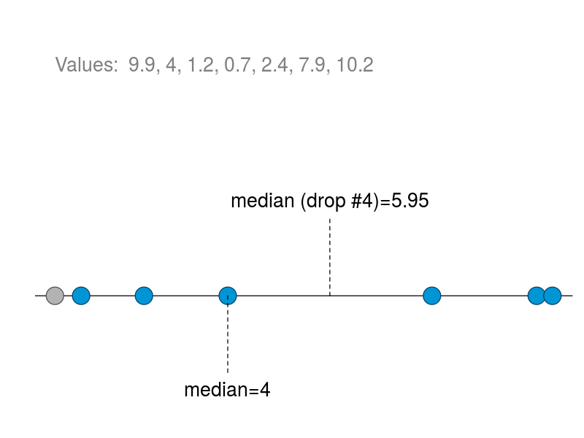

Slide 75
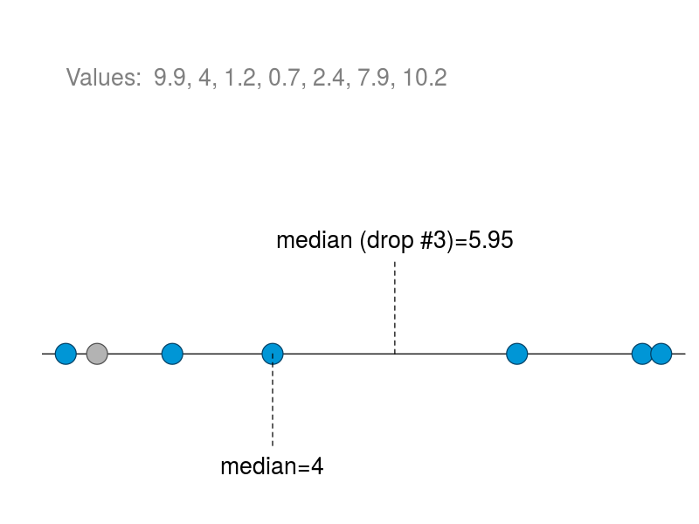

Slide 76
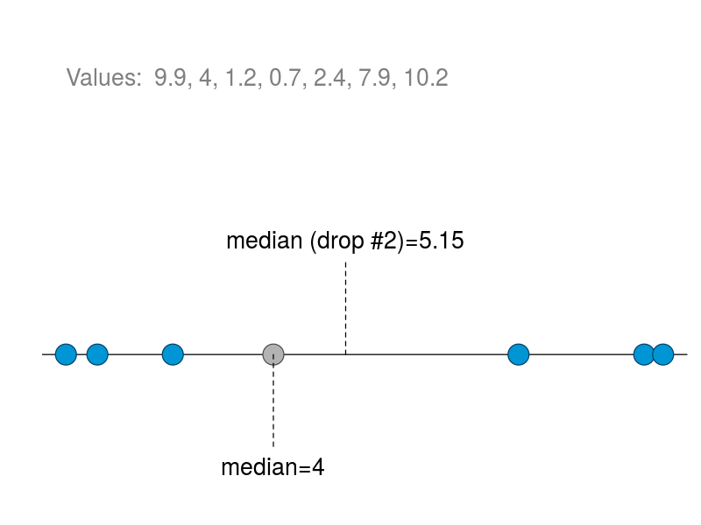

Slide 78
What to do with outliers or influential points?

Slide 79
What do you do with outliers?
Keep them? Remove them?
Investigate: is this a legitimate value? An error? What kind of error? What happened?
What question are you answering if you keep vs. remove the outlier?

Slide 80
Dropping vs Keeping outliers
Sample with outlier
Sample without outlier

Slide 81
Options for dealing with outliers
Drop them
You are answering questions about situations where such outliers don’t happen: is this realistic? Is this the right question?
Keep them
You are answering questions about situations where such outliers do happen: is this realistic? Is this the right question? Beware of statistics that are sensitive to outliers like means and standard deviations
Keep them but use outlier resistant methods
Medians, IQR, transformations, more methods later

Slide 82
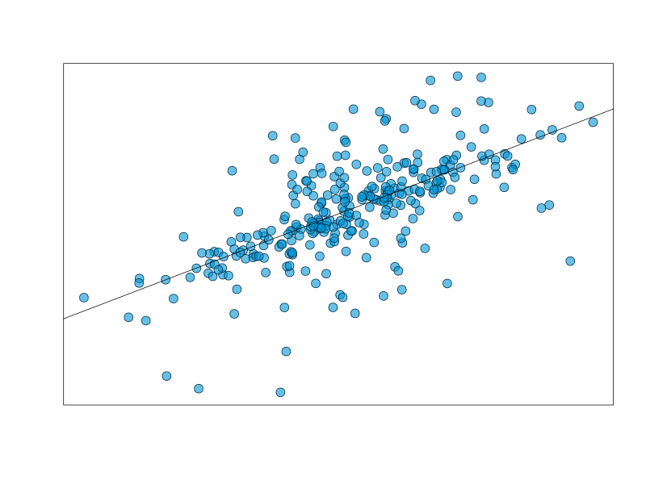

Slide 83
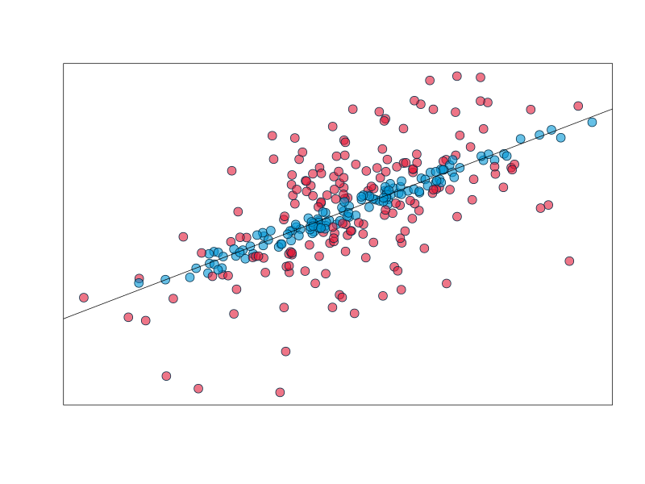

Slide 84
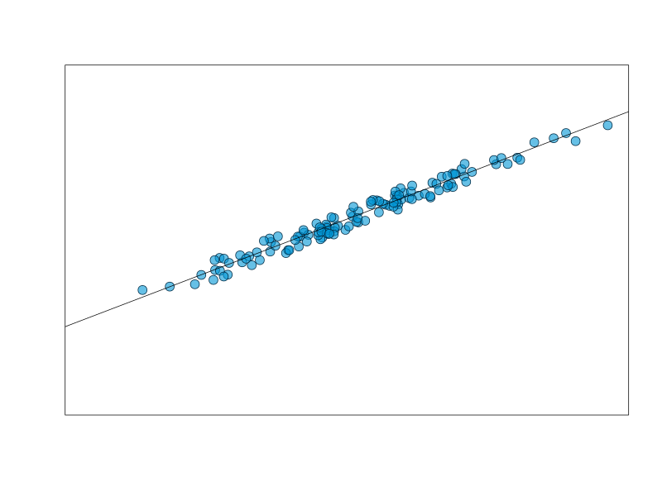

Slide 85
Dropping outliers
Are they influential?
if not, leave them alone
Need a convincing rationale
What are they? Why drop them? What question do you answer if you drop them?
Preferably stated before you see the data
No fitting data to preconceptions!
Note: outliers are sometimes the most interesting thing in your data!

Slide 86
Problem 3: Skewed Distributions
Power transformations

Slide 87
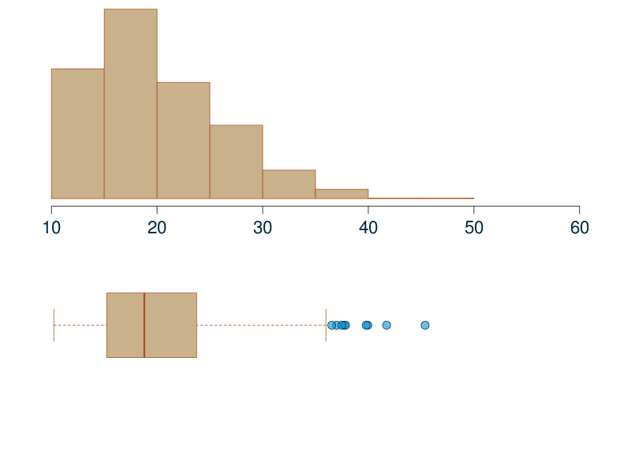
Are these really
Outliers?

Slide 88
Transformation
Transform the values of the offending variable
Perform analyses on the transformed variable
Problem: findings apply to the transformed variable, interpretation issues

Slide 89
Monotone Transformation
A monotone transformation changes the values, but not their ordering. The biggest values are still the biggest, etc.
Original values | Monotone | Not Monotone
1.2 | 12 | 5
4.1 | 23 | 2
12.3 | 28 | 18
20 | 31 | 7
…

Slide 90
Monotone Transformations and Interpretation
Direction of relationships interpretable with monotone relationships
Exposure | Response | Transformed Response (monotone) | Transformed Response (not monotone)
20 | 1.2 | 12 | 5
26 | 4.1 | 23 | 2
34 | 12.3 | 28 | 18
47 | 20 | 31 | 7
 | …

Slide 91
Transforming Data
Example: transform using x²
Original values | Transformed values
1.2 | 1.44
4.1 | 16.81
12.3 | 151.29
0.6 | 0.36
…

Slide 92
Transforming Data
Example: transform using log(x)
Original values | Transformed values
1.2 | 0.18
4.1 | 1.41
12.3 | 2.51
0.6 | -0.51
…

Slide 93
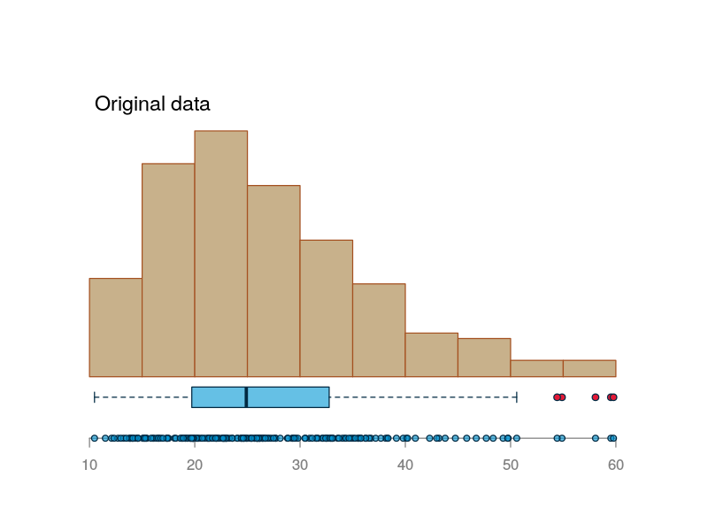
Moderate Skew

Slide 94
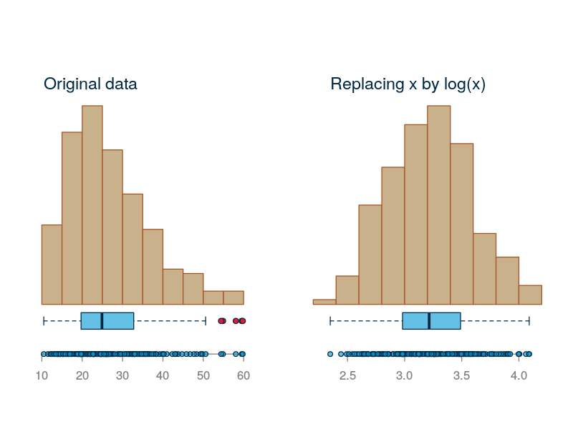
Moderate Right Skew

Slide 95
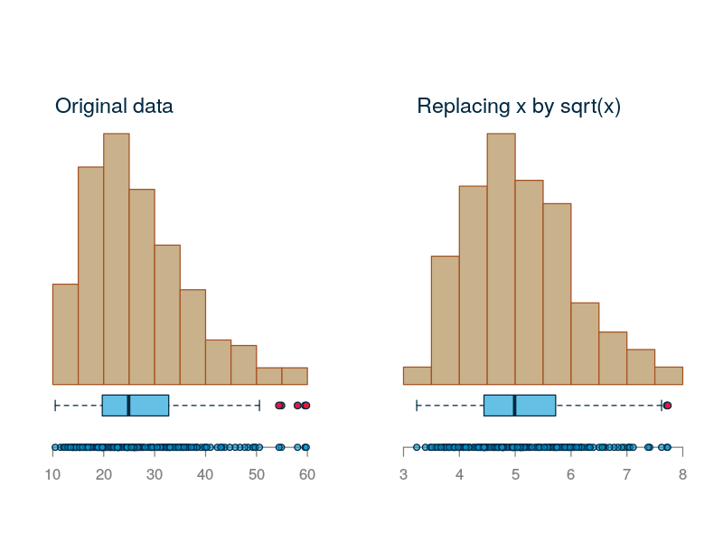
Moderate Right Skew

Slide 96
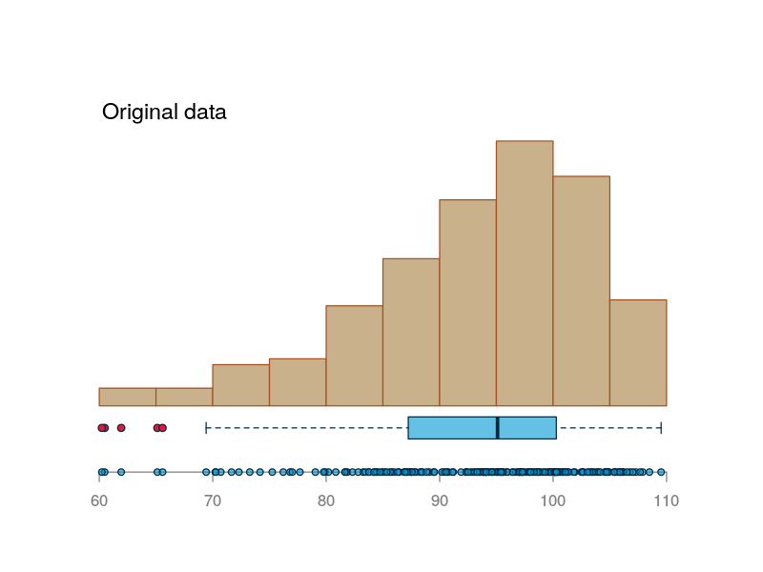
Moderate Left Skew

Slide 97
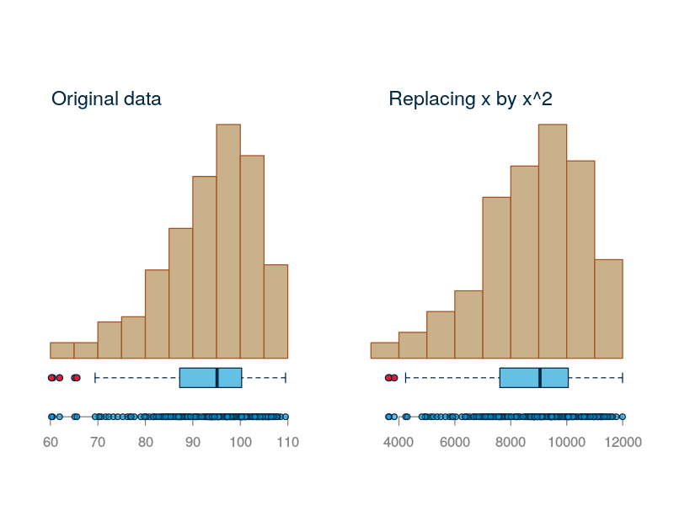
Moderate Left Skew

Slide 98
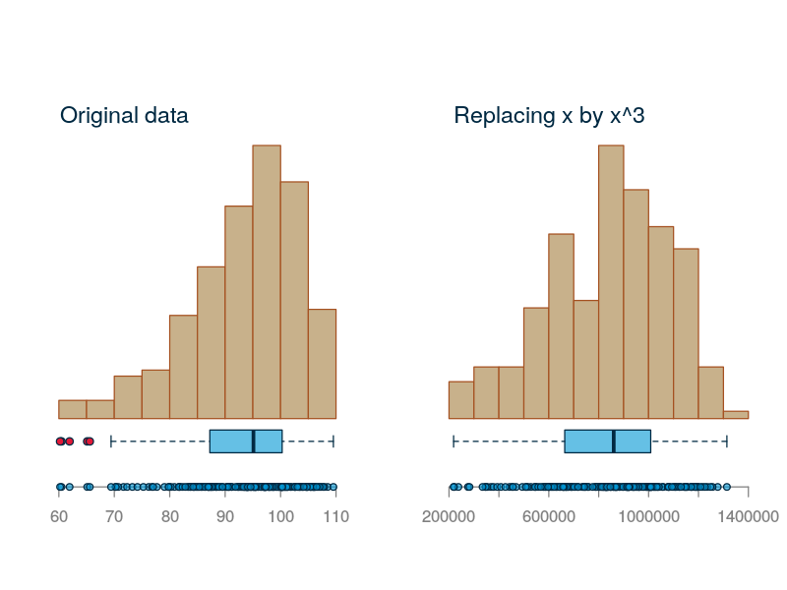
Moderate Left Skew

Slide 99
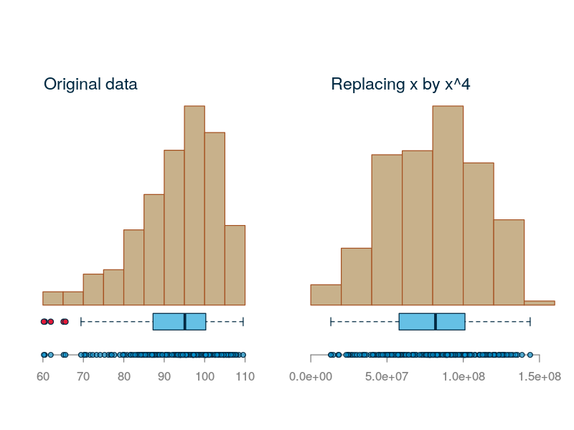
Moderate Left Skew

Slide 100
Guidelines
Transformation for improving symmetry
For severe skew: power transformations will usually not help
For mild right skew: log or sqrt
For mild left skew: x², x³, etc.

Slide 101
Reality check
Only a few transformation are going to be accepted. Log is the most commonly used one.

Slide 102
Problem 3: Skewed Distributions
Rank transformations

Slide 103
Other transformations?
Rank transformation: replace the values by their rankings (1=smallest, 2=next largest, …)
Original values | Transformed values
1.2 | 2
4.1 | 3
12.3 | 4
0.6 | 1

Slide 104
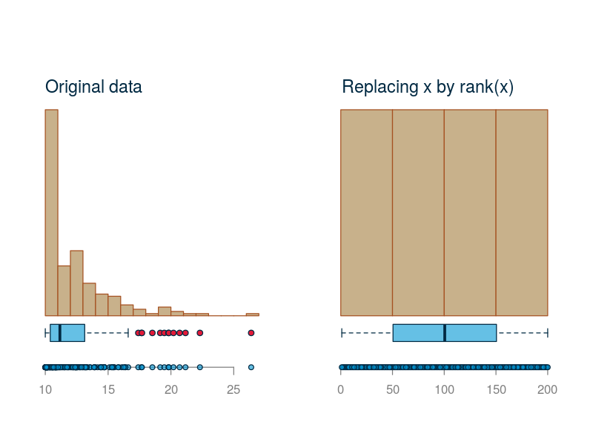

Slide 105
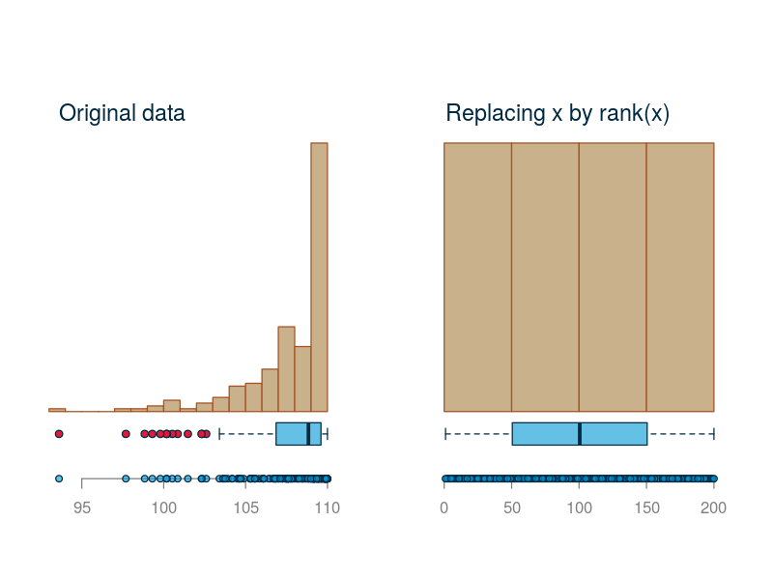

Slide 106
Interpreting rank transformed data
Only order is preserved. Original values are lost
Interpretation ok for direction of relationships
More on this in later lectures

Slide 107
Problem 4: Bad Data Values

Slide 108
What to look for
Max and min
Impossible values (negative durations, biologically impossible readings, impossible dates)
Spelling mistakes in categories
The famous 99’s

Slide 109
What do do?
First, investigate.
What caused it?
Can you figure out the correct value?
Next: Drop? Keep? Replace?
Same issue as outliers

Slide 110
Problem 6: Many Modes

Slide 111
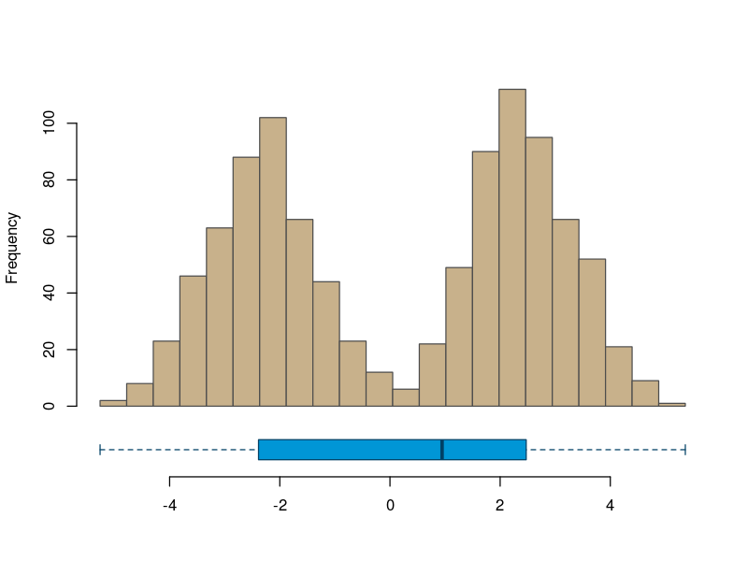

Slide 112
What to do?
How severe is the problem
Can you identify who falls in the groups? If so, analyze separately
Use latent class analysis
A rank transformation will fix this, but you probably shouldn’t even think of it

Slide 113
Problem 5: Small Categories

Slide 114
How small is small?
No fixed general rule!
Small N under or near 10, say?
Small proportion less than 5% of the sample maybe?

Slide 115
Option 1: combine categories
Lump several categories into a single one. Ideally the combined category has enough data.
Issue: does the combined category make sense?

Slide 116
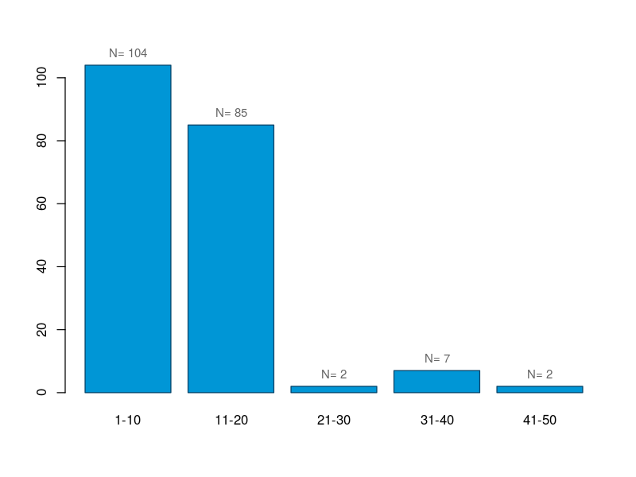

Slide 117
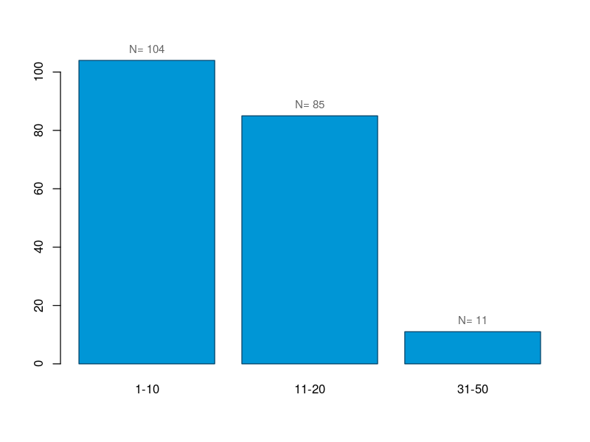

Slide 119
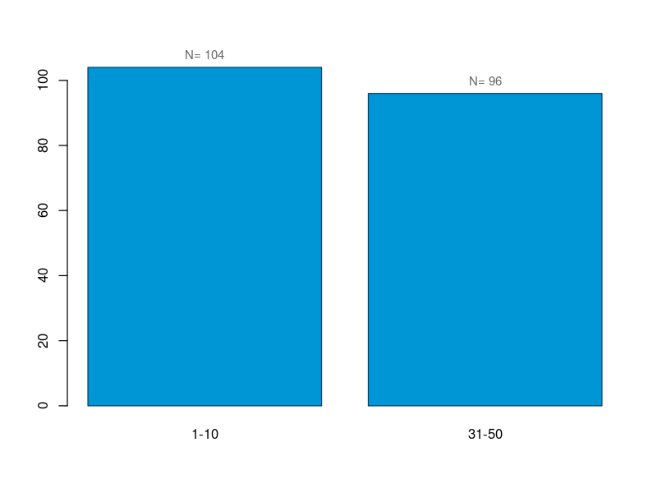

Slide 120
Option 2: Drop categories
Issues:
Generalizability
Adds up!

Slide 122
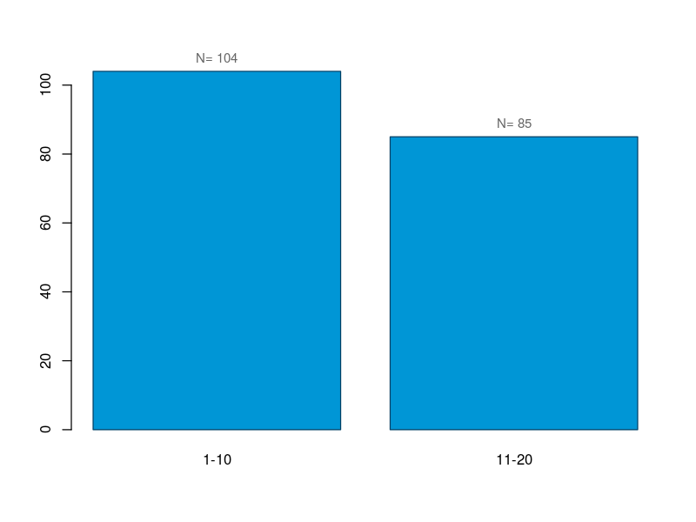

Slide 123
Sensitivity Analysis
Do the analysis with and without combining: are the results consistent? Meaningful?

Slide 124
General Strategy

Slide 125
Get to know the variables you plan to use
Do you know what each one means?
Graph each variable
Are there outliers? Errors? Lots of missing values?
Are there anomalies? Skewness? Bimodal? Rare categories?
Can you fix some issues?
Pick appropriate summary statistics, methods of analysis.

