Slide 1
Formal Methods
Lecture 5

Slide 2
Take home
Due today
In Class Quiz next week
About half and hour
Same material as the take home

Slide 3
Description vs. Inference

Slide 4
Descriptive Questions about the data we have.
Inference Questions about the population that data came from.

Slide 5
Population
Sample
Conclusions

Slide 6
Population
Conclusions
Sample
Conclusions

Slide 7
Population
Other
Sample
Other
Sample
Sample
Other
Sample
Other
Sample

Slide 8
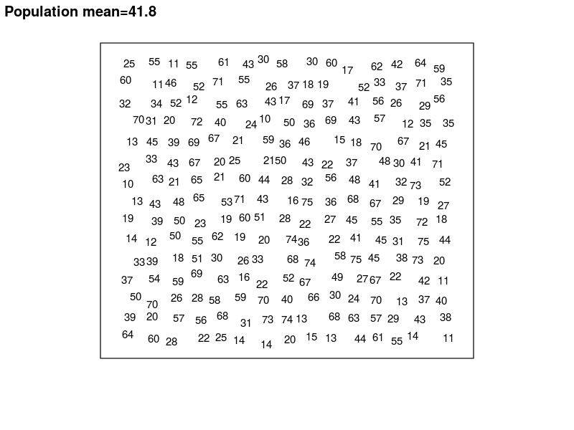

Slide 9
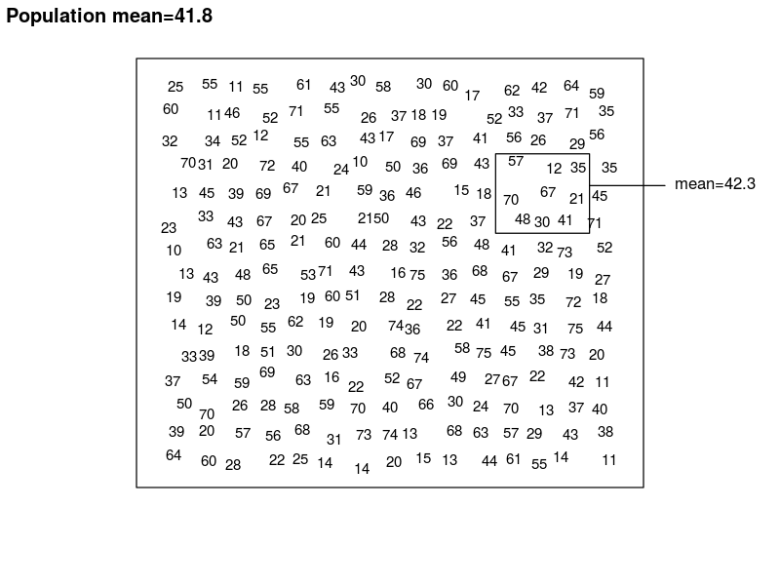
Is our sample mean any good?

Slide 10
What does Good mean?

Slide 11
The two meanings of mean
The mean is the sum of the values divided by however many values there are
The mean is 42.3
hahaha

Slide 12
Two Meanings
The result of a calculation, a number
A good number is one that is close to the correct value
A procedure for calculating something
A good procedure is one that has a good track record

Slide 13
Is the mean good?
The mean is 42.3
42.3 is good if it’s real close to the true value (41.8)
The mean is the sum of the values divided by however many values there are
The mean is a good procedure if it has a good track record

Slide 14
Problem
Is the sample mean of 42.3 good? Is it close to the true value?
To answer we need to know the true mean
Is the sum of the values divided by the sample size good? Does it have a good track record?
What does it do if we use it repeatedly?

Slide 15
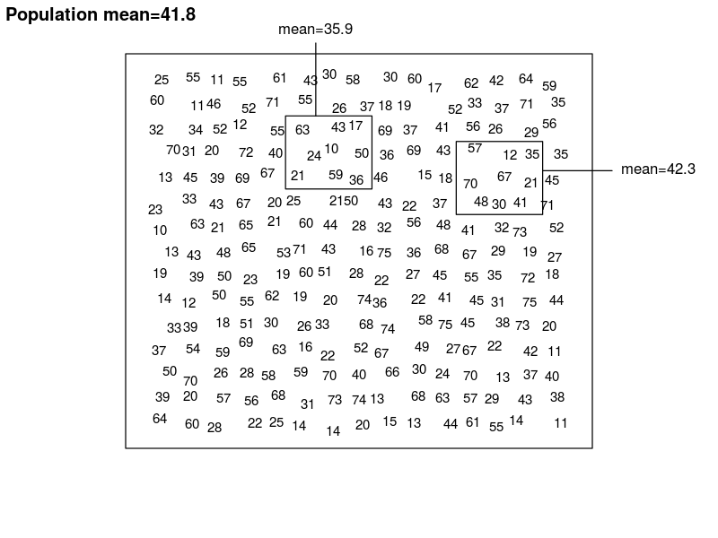

Slide 16
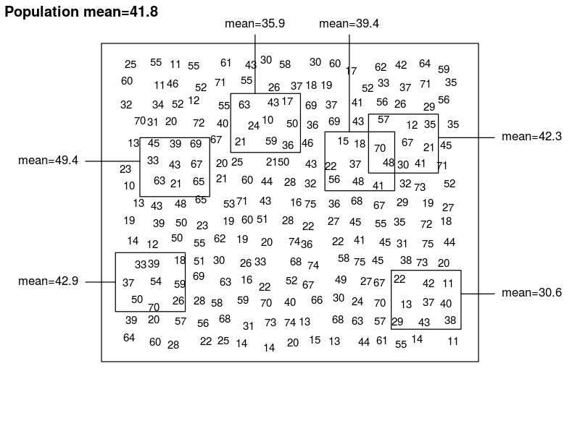

Slide 17
We can ask the question about any statistic
What happens when we calculate the statistic repeatedly using many samples?

Slide 18
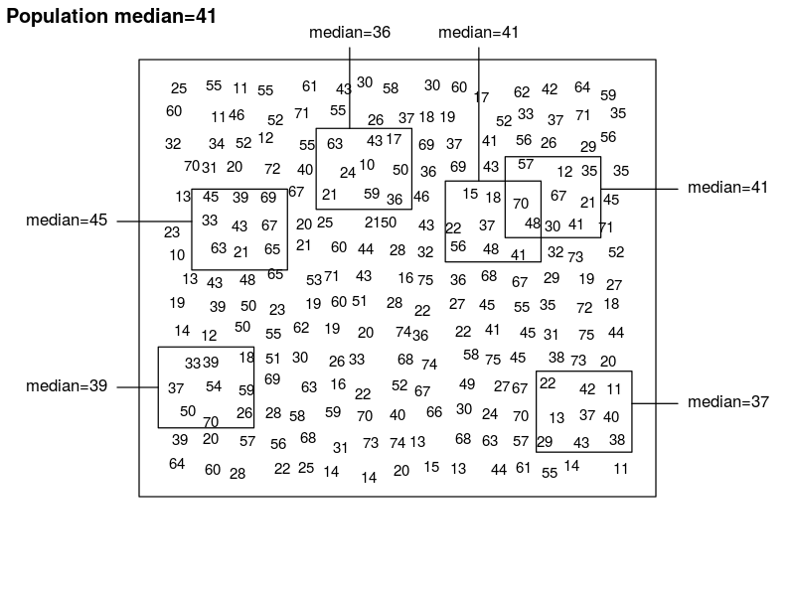

Slide 19
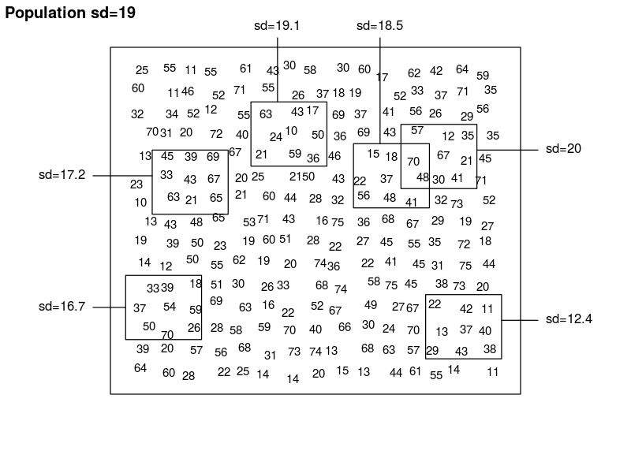
What do we hope to see?

Slide 20


Slide 21


Slide 22
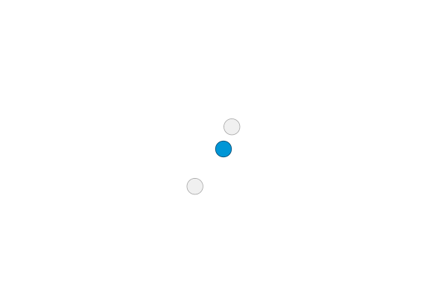

Slide 23
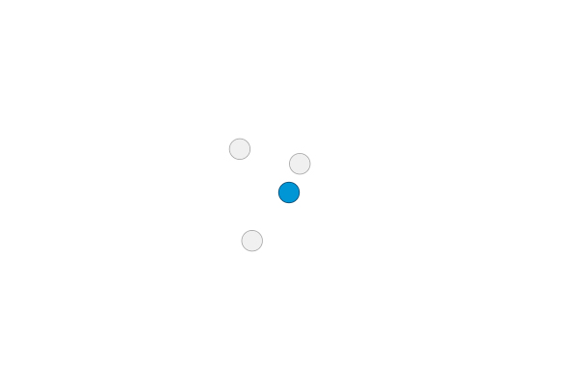

Slide 24
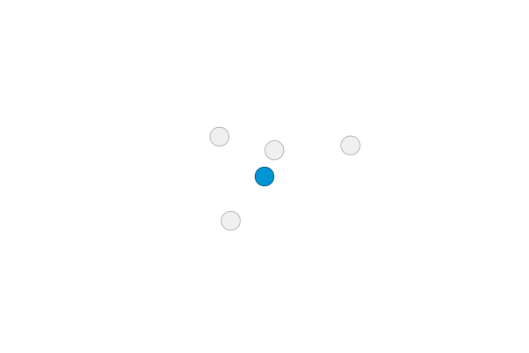

Slide 25
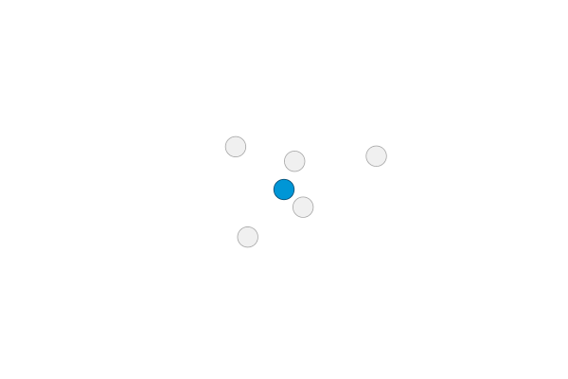

Slide 26


Slide 27


Slide 28


Slide 29
Some good properties
Centers around the correct value
e.g. the sample means tend to be around the true value, not systematically above it or systematically below it
Small spread
The sample means tend to stay close to the true value, so any given sample is likely to give a close estimate.

Slide 30


Slide 31
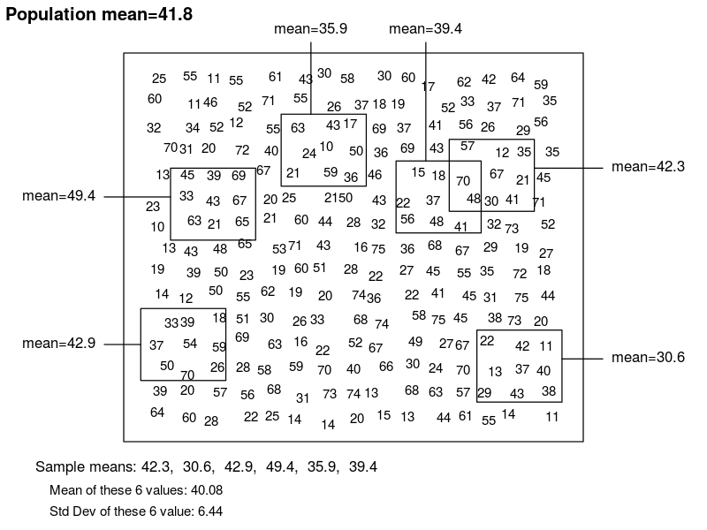

Slide 32
What drive the variability of a sample statistic?
Variability of the data
Sample size
Type of statistic

Slide 34
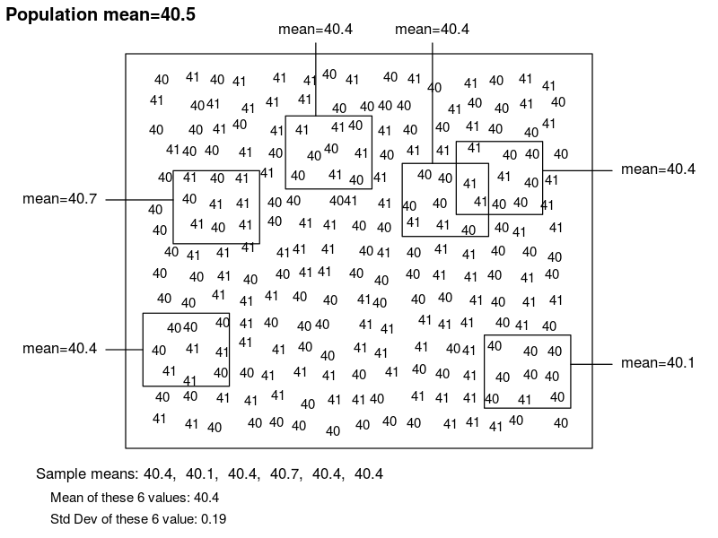

Slide 36
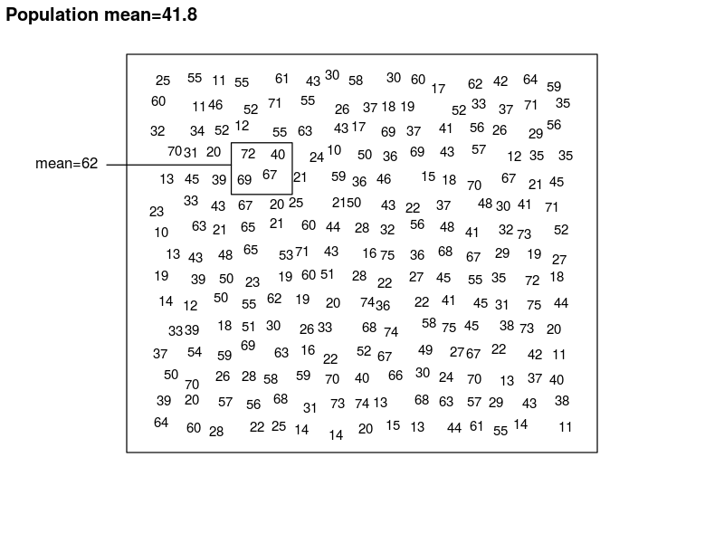

Slide 37
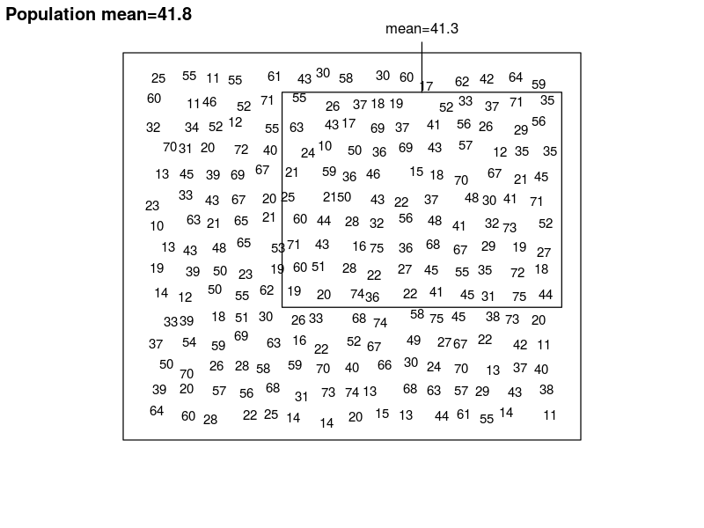

Slide 39
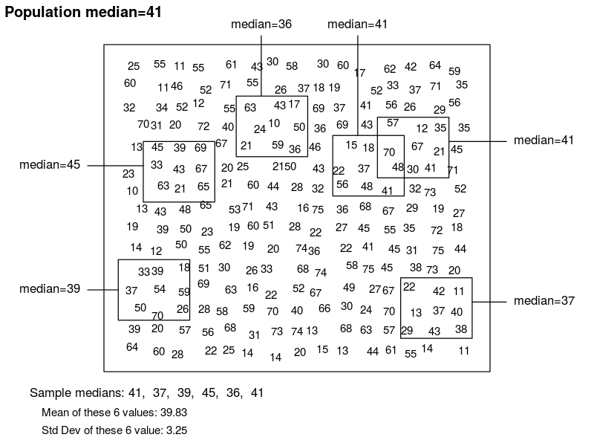

Slide 40
Describing one sample

Slide 42
My sample: 57,12,35,70,67,21,48,30,41
Its mean: 42.3
My best guess of the population mean is 42.3
How reliable is this guess?

Slide 44
Across samples
The sample means vary with a standard deviation of 6.44
This is called the standard error of the mean

Slide 45
What if we have only one sample?
Approximate calculation of the standard error
My sample: 57,12,35,70,67,21,48,30,41
Its mean: 42.3
Its std dev: 20.0125
Sample size: 9 values

Slide 46
What if we have only one sample?
Approximate calculation of the standard error
Std Error: 6.44
Sample std dev: 20.0125
Sample size: 9 values
Approx Std Error: 20.0125/√9= 6.670

Slide 47
Estimating the spread of the mean
Standard deviation of the sample means
=
Standard deviation of the sample values
divided by
Square root of sample size

Slide 48
Well not really
This only works:
for means
if the data are symmetric, without outliers
the sample is at least moderately large (sample size in the double digits)

Slide 49
95% Confidence interval
It’s a procedure (like the sample mean)
Different samples, different means, different standard deviation = different intervals
You can’t ask if an individual interval is good
You can only ask about its track record

Slide 50
95% Confidence interval for means
Sample mean ± 2 x standard error
My sample: 57,12,35,70,67,21,48,30,41
Mean: 42.3
Std dev: 20.0125
Sample size: 9 values
Est. Std. Error: 6.67
So 42.3 ± 2x6.67 = 28.96 to 55.64

Slide 51
What does this interval mean?
The formula
Sample mean ± 2 x standard error
Has a good track record: it includes the correct value 95% of the time.

Slide 52
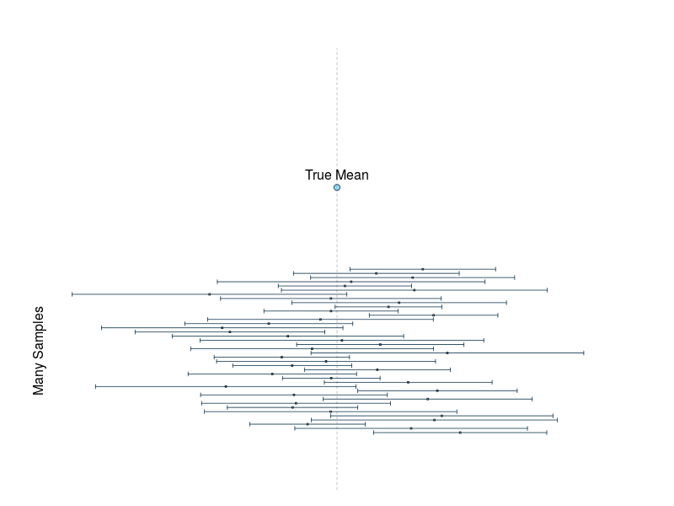
What does this interval mean?

Slide 53
What about my interval, 28.96 to 55.64?
No conclusion possible
Unless we happen to know the true value
We do here: it’s 41.8 and it happens to be in the interval. Yay!

Slide 54
Single Estimates vs Confidence Intervals
Single (point) estimate: a statistic calculated from the sample that provides our best guess of the corresponding value in the population
Example: sample median estimates the population median

Slide 55
Single Estimates vs Confidence Intervals
Confidence Interval: An interval around the point estimate. We are “confident” that the true value is inside that interval.
Confident because the procedure (formula) used to calculate the interval has a good track record

Slide 56
Notched Boxplots

Slide 57
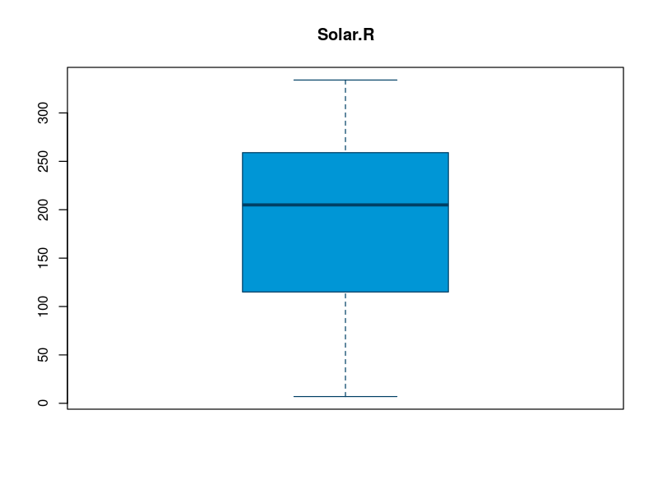

Slide 58
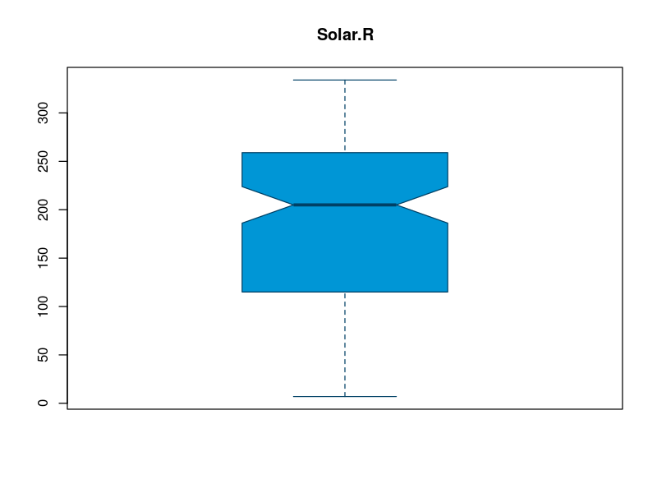

Slide 59
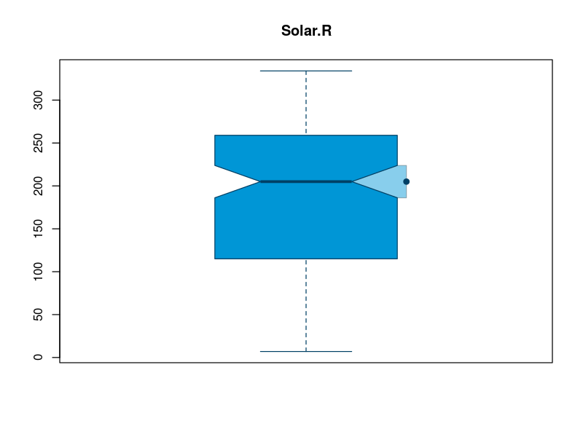

Slide 60
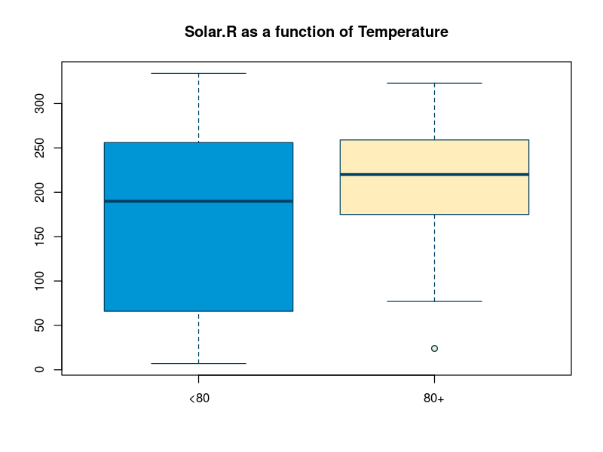

Slide 61
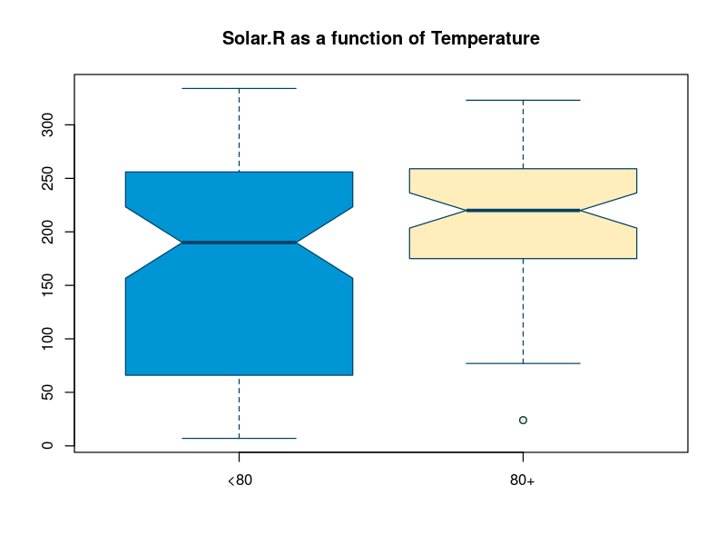

Slide 62
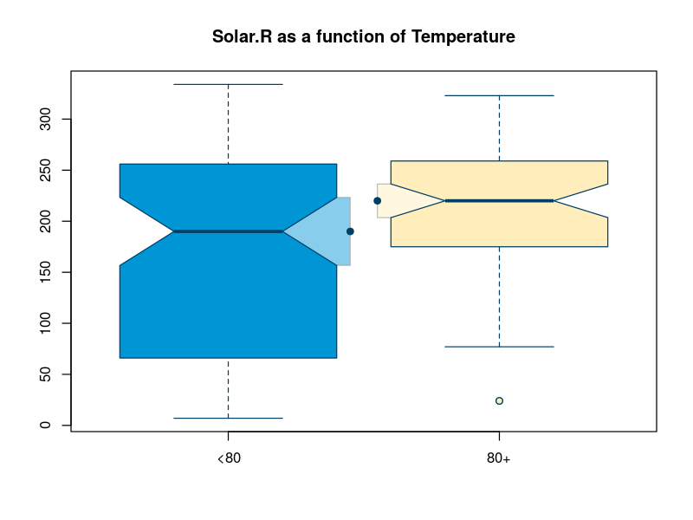

Slide 63
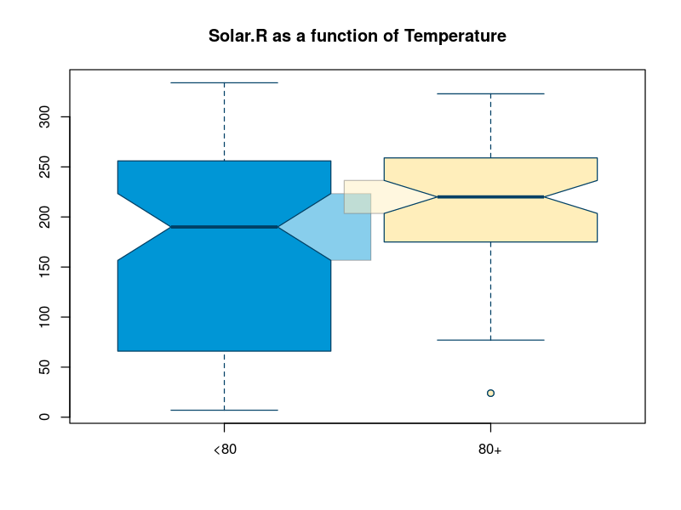

Slide 64
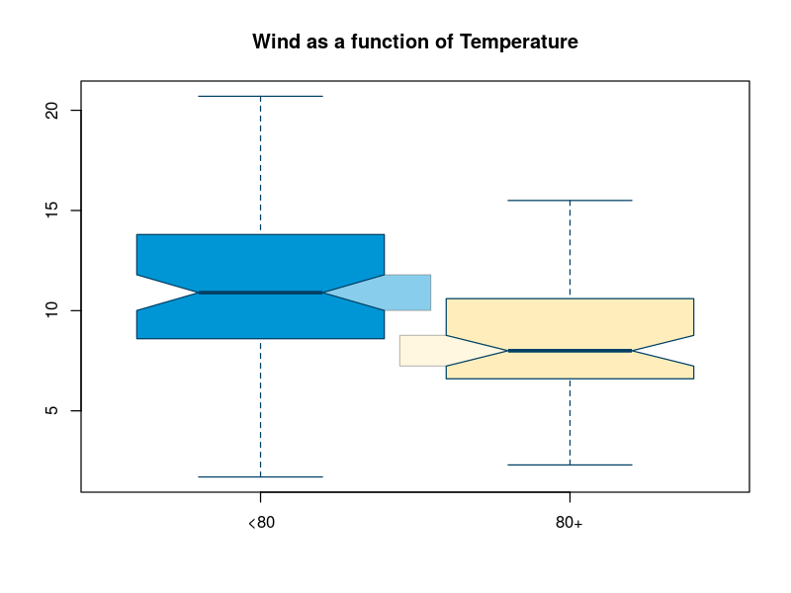

Slide 65
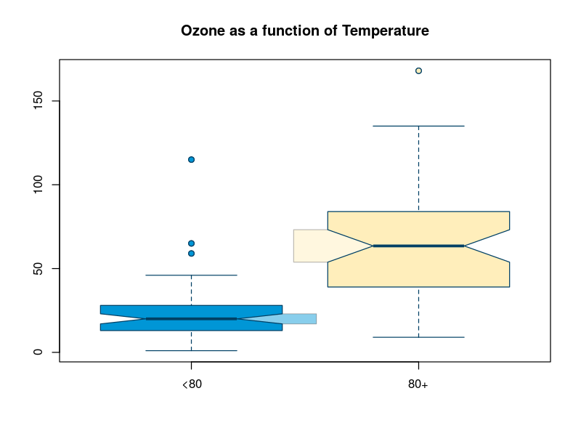

Slide 66
Interpreting notched boxplots
Do the notches overlap?
No indication of a difference in medians in the population
Yes inconclusive
Note this is generally true of confidence intervals

Slide 67
General Advice
Use confidence interval to get a sense of the precision of an estimate
Don’t use them for comparisons

Slide 68
In R
Option notch=TRUE requests notches.
Without notches
boxplot(y ~ group)
With notches
boxplot(y ~ group, notch=TRUE)

Slide 69
Comparing two groups

Slide 70
Typical situation
We have two groups
(e.g. treated and untreated)
We measure something in both groups (e.g. cholesterol levels)
Do the two groups have the same average cholesterol levels?

Slide 71
Do the two groups have the same average cholesterol levels?
Easy answer: in the sample
Calculate the mean cholesterols, say 212.1 and 215.6. Are they the same number?
Harder answer: in the population
We only have indirect information about the population

Slide 72
Problem
Sample vary
So sample means will vary too
So a sample may show a difference even if there isn’t on in the population

Slide 73
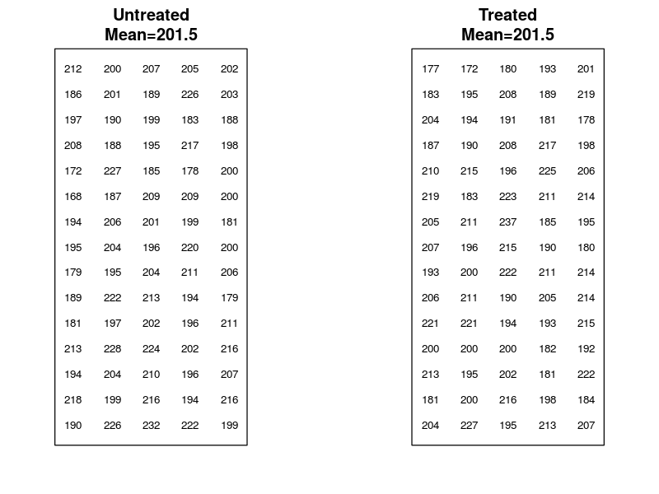

Slide 74
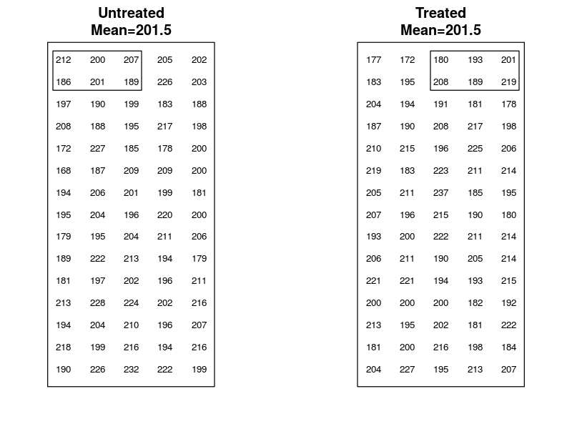

Slide 75
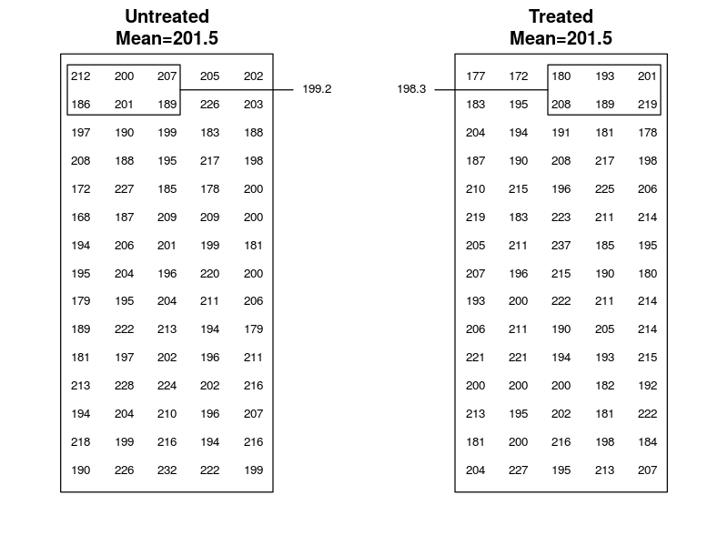

Slide 76
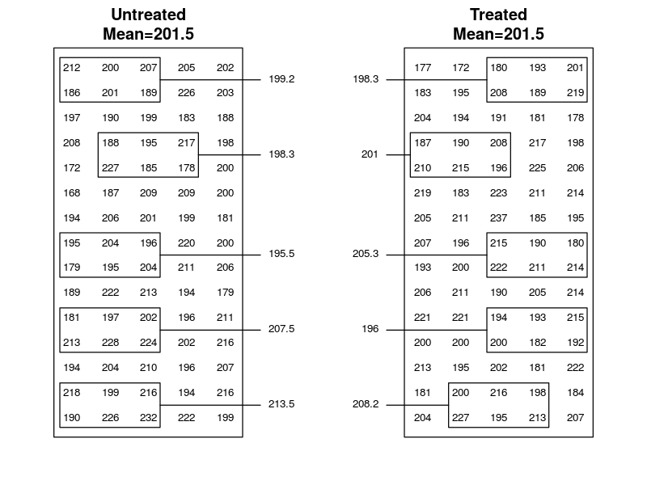

Slide 77
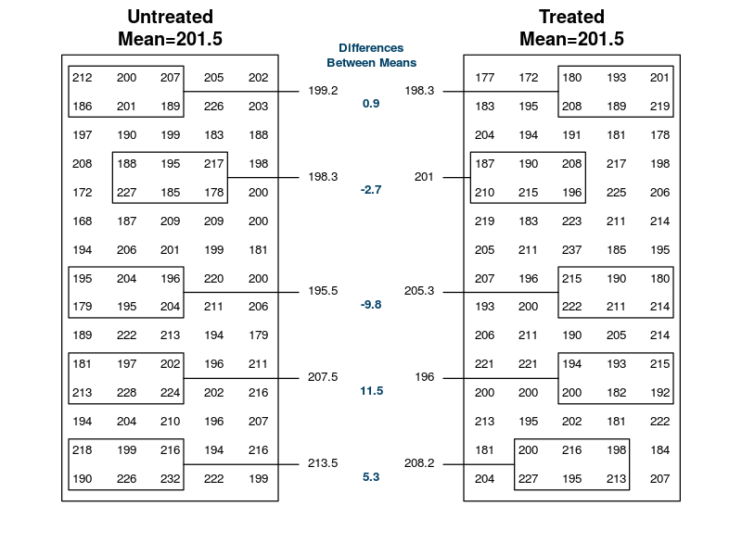

Slide 78
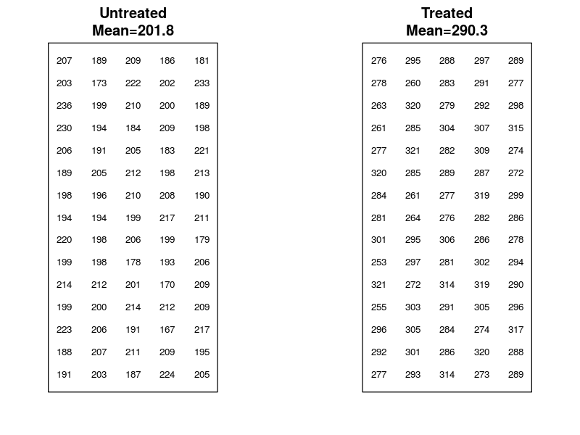

Slide 79
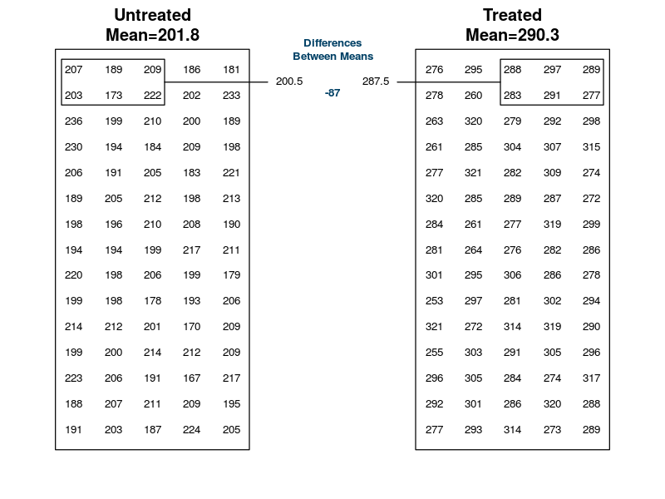

Slide 80
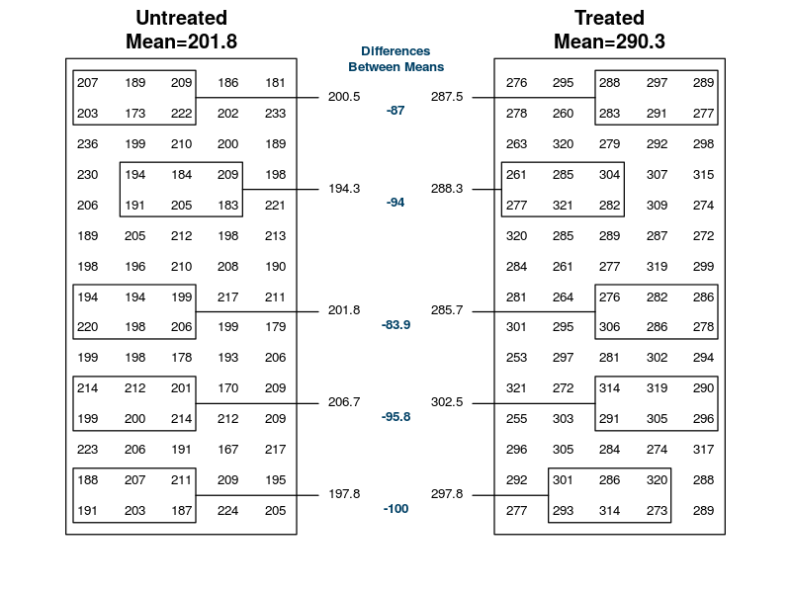

Slide 81
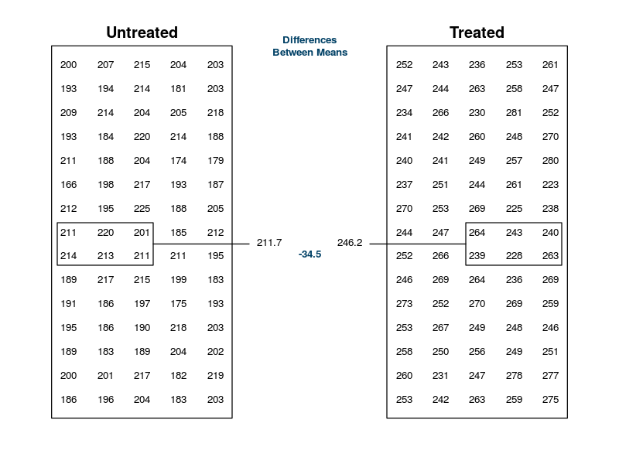

Slide 82
Crucial question
Is the difference in the sample
Typical of differences we expect to see if the population means are the same?
Not typical
And how do we figure out what’s typical?

Slide 83
What’s a typical difference when the populations have the same mean?
Use historical data, data on normal peoples
Get multiple samples from unexposed and compare
Use mathematical models
Cheat

Slide 84
Permutation tests

Slide 85
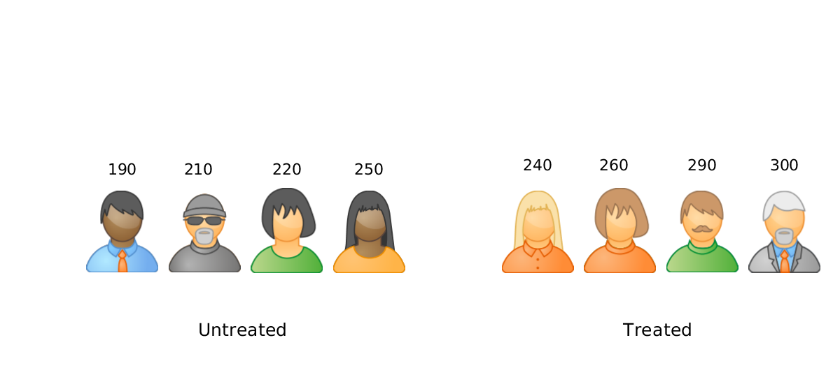
Notes:
Cholesterol levels

Slide 86
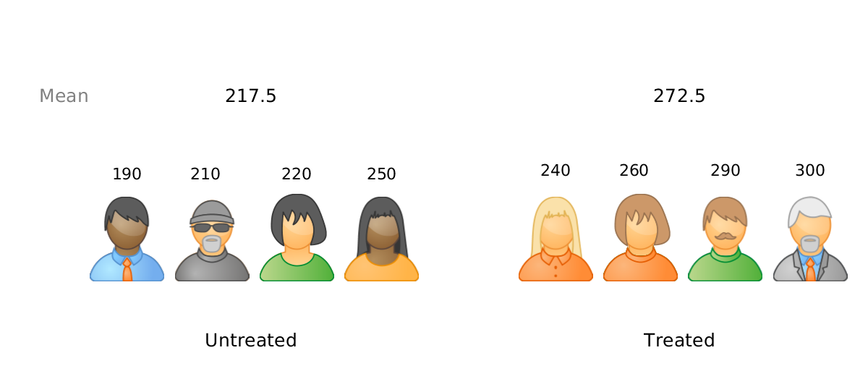

Slide 87
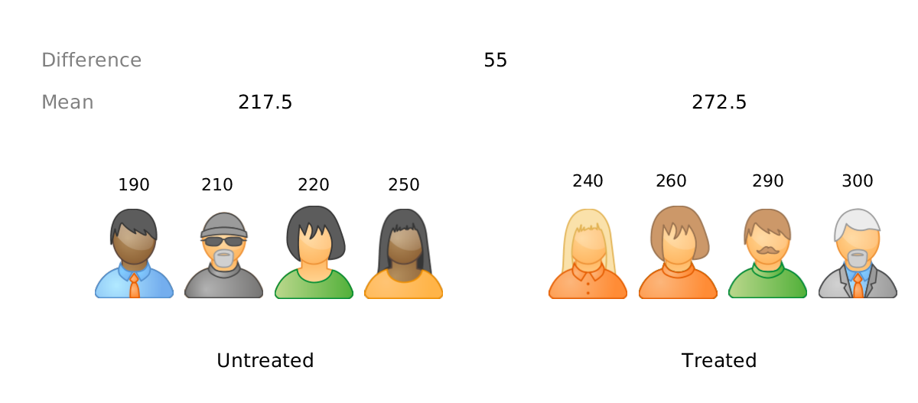

Slide 88
Is 55 “large”?
What kind of difference would we expect to see if the there is no difference between the treated and untreated population?

Slide 89
Notes:
Cholesterol levels

Slide 90
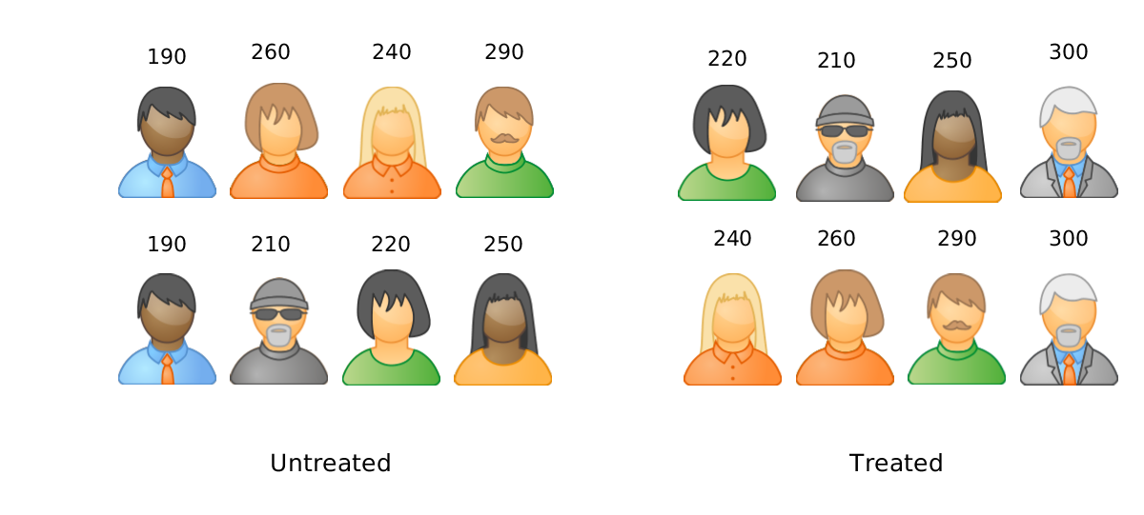

Slide 91
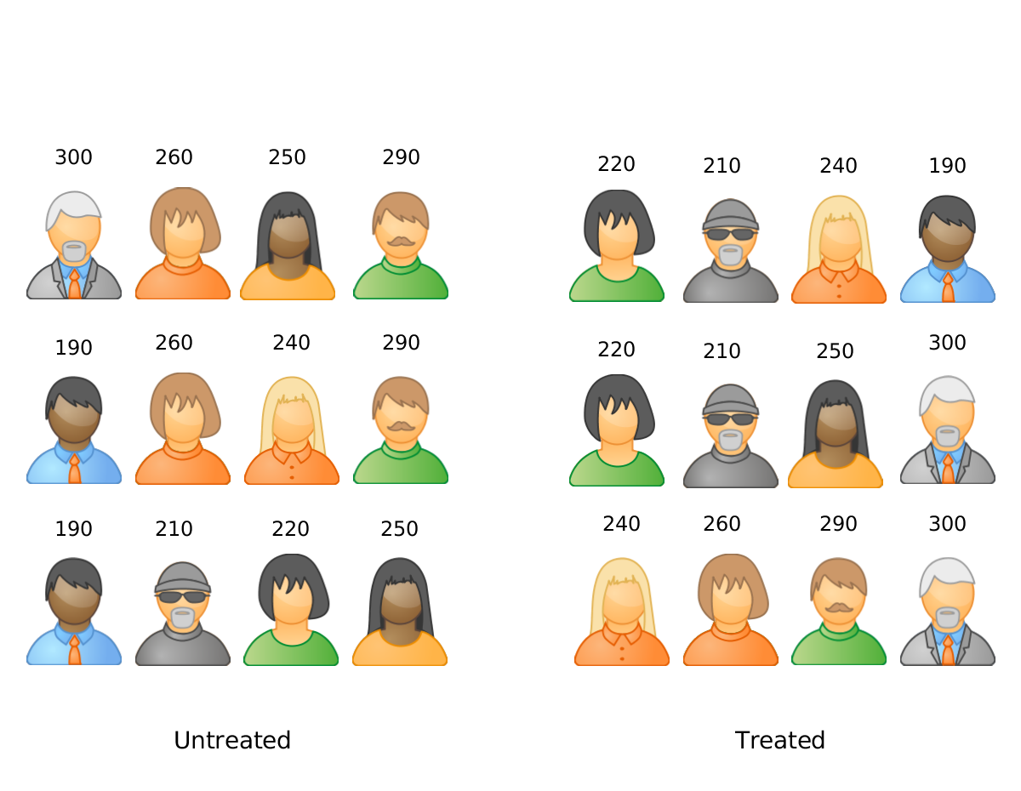

Slide 92
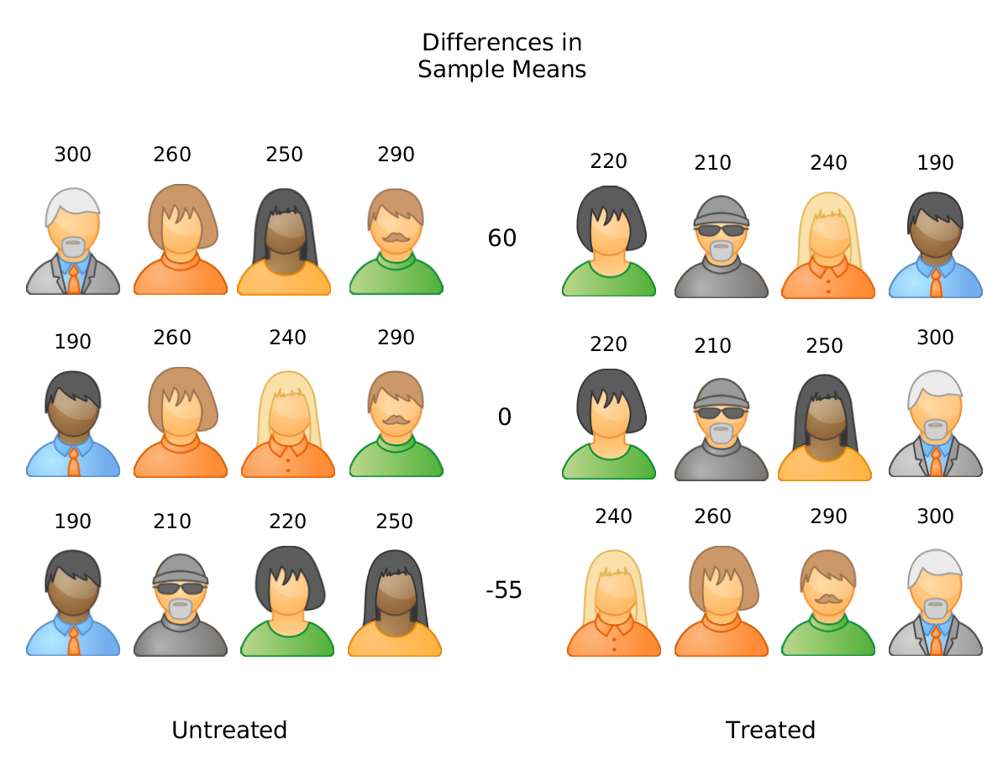

Slide 93
Idea
Randomly shuffle people between the two groups
Calculate the group means and their difference
Compare -55 to those difference
Permutation test

Slide 94
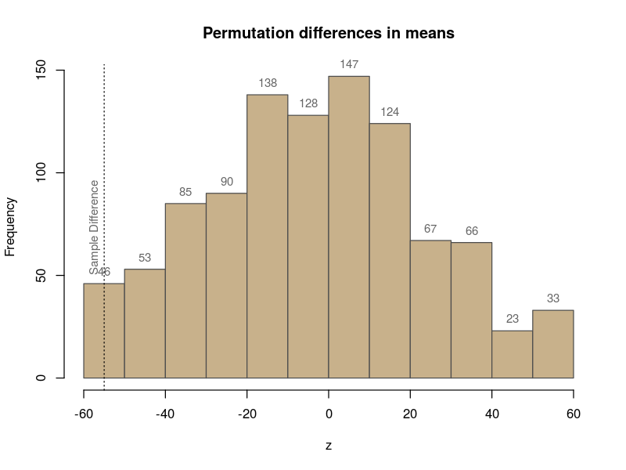

Slide 95
How unusual is the observed difference -55?
Well within the distribution of “typical” values
On the edge of the distribution of typical values

Slide 96
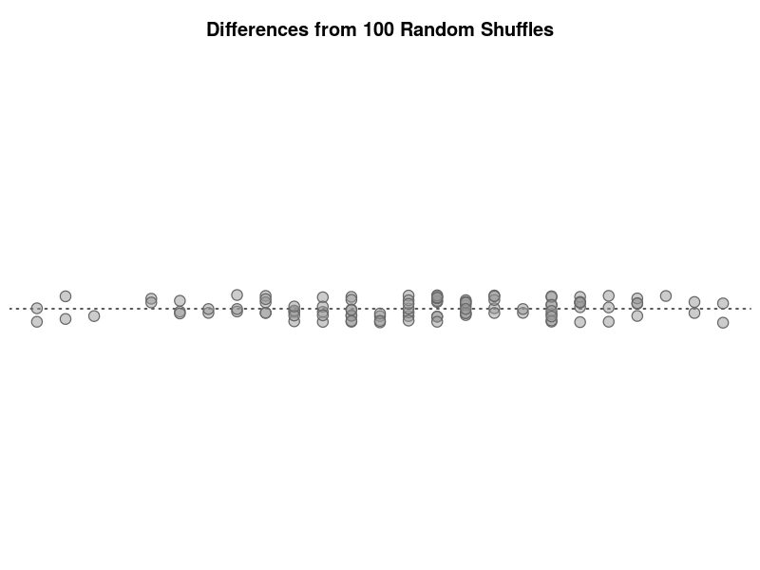

Slide 97
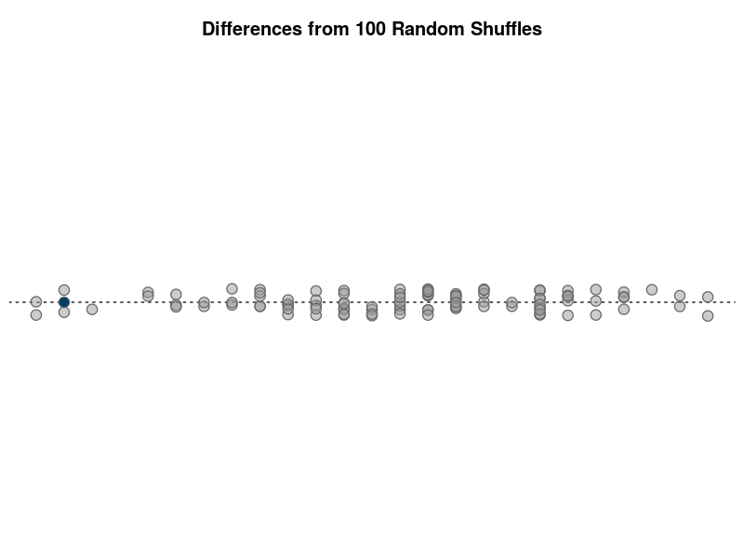

Slide 98
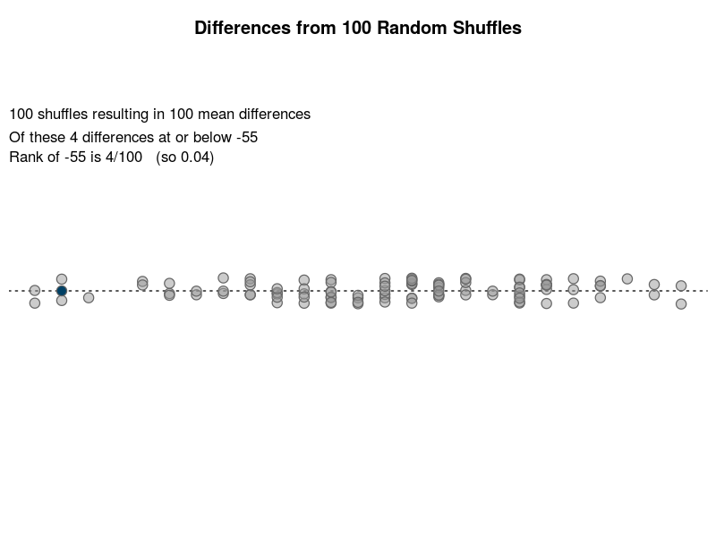

Slide 99
Percentile rank
The observed value (-55) is in the lower 4% of the data (or 0.04)
This rank (0.04 or 4%) is called the p-value

Slide 100
Interpreting the p-value for -55
If the p-value is small
If the population means are the same, -55 is not the sort of sample difference you expect to see
If the p-value is large
If the population means are the same ,-55 is pretty much the sort of sample difference you expect to see

Slide 101
How Small is “Small”?
Traditionally: 0.05 or smaller is considered small
Practically: Depends. Sometimes 0.1 or 0.2 used

Slide 102
Interpreting the p-value for -55
P-value how often random shuffles produced a difference as extreme as -55 or worse
How often a sample is expected to produce a difference a difference or -55 or worse when the populations are identical
The probability of seeing -55 or worse when the populations are identical

Slide 103
In R
permutation.test(chol ~ group)
Permutation test for a difference in means
data: chol by group
Sample difference = -55, permutations = 1000, p-value = 0.0580
alternative hypothesis: true difference in means is not equal to 0
sample estimates:
mean in group Untreated mean in group Treated
217.5 272.5

Slide 104
In R
permutation.test(chol ~ group)
Permutation test for a difference in means
data: chol by group
Sample difference = -55, permutations = 1000, p-value = 0.0580
alternative hypothesis: true difference in means is not equal to 0
sample estimates:
mean in group Untreated mean in group Treated
217.5 272.5

Slide 105
In R
permutation.test(chol ~ group)
Permutation test for a difference in means
data: chol by group
Sample difference = -55, permutations = 1000, p-value = 0.0580
alternative hypothesis: true difference in means is not equal to 0
sample estimates:
mean in group Untreated mean in group Treated
217.5 272.5

Slide 106
In R
permutation.test(chol ~ group)
Permutation test for a difference in means
data: chol by group
Sample difference = -55, permutations = 1000, p-value = 0.0580
alternative hypothesis: true difference in means is not equal to 0
sample estimates:
mean in group Untreated mean in group Treated
217.5 272.5

Slide 107
Other statistics
We compared sample means, but we could have compared sample medians:
Calculate the medians of the 2 groups, and their difference
Shuffles people around, recalculating the difference in medians each time to get “typical” value when populations are equal
Compare the initial difference to typical

Slide 108
permutation.test(chol ~ group, statistic=median)
Permutation test for a difference in medians
data: chol by group
Sample difference = -60, permutations = 1000, p-value = 0.0570
alternative hypothesis: true difference in medians is not equal to 0
sample estimates:
median in group Untreated median in group Treated
215 275

Slide 109
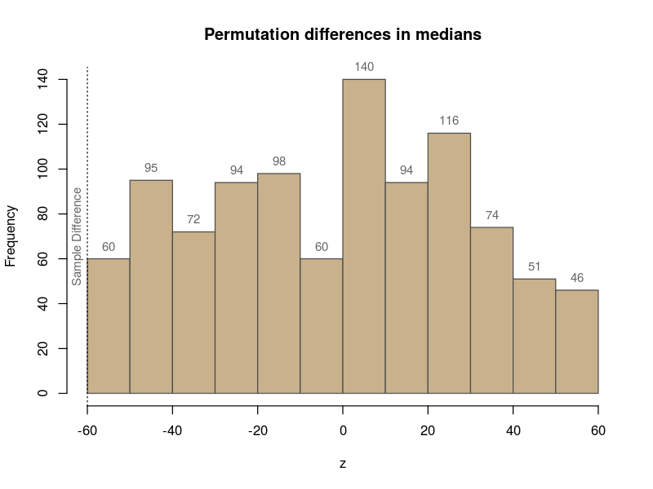

Slide 110
permutation.test(chol ~ group, statistic=sd, plot=TRUE)
Permutation test for a difference in sds
data: chol by group
Sample difference = -2.5379, permutations = 1000, p-value = 0.8820
alternative hypothesis: true difference in sds is not equal to 0
sample estimates:
sd in group Untreated sd in group Treated
25.00000 27.53785

Slide 111
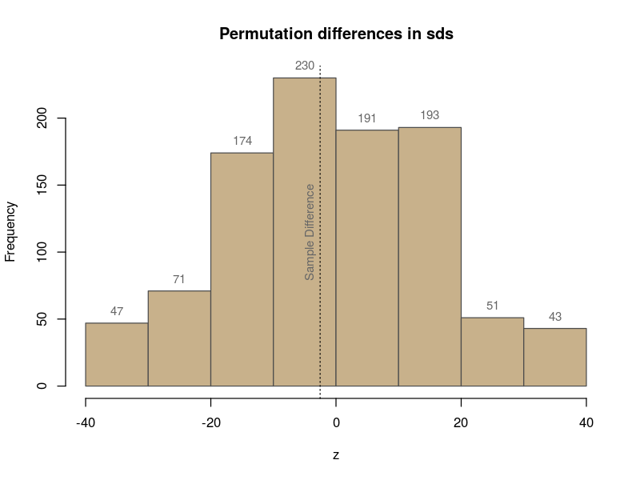

Slide 112
Mathematical Tests

Slide 113
This is the t-test (z-test if n is large)
Where sd is the standard deviation of the all children combined, and the n’s are the number of children in each group.

Slide 114
In R
t.test(chol ~ group)
Welch Two Sample t-test
data: chol by group
t = 2.9575, df = 5.9448, p-value = 0.0256
alternative hypothesis: true difference in means is not equal to 0
95 percent confidence interval:
9.393102 100.606898
sample estimates:
mean in group Treated mean in group Untreated
272.5 217.5

Slide 115
Will the t and permutation test agree?
If the data are symmetric without outliers, and the sample is large, yes. In general no
Permutation test makes fewer assumptions
T-test only works for means

