Slide 1


AI-BTDS
AI Powered Brain Tumour Detection System
New here!?
USERNAME
PASSWORD

Slide 2


Fact of the Day
Brain tumours are the worst thing for patients but for technology geeks wejust love them for new problems and thus enables us to develop more solutions effectivey
Learn More

Slide 3




OUR SERVICES
IJI Systems Provides Easy and Smart Health related services
Early Stage Detection
Traditional
Procedures
Access History

Slide 4

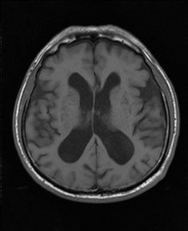
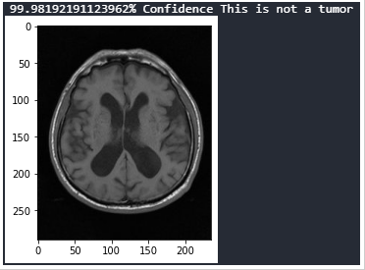
IJI SYSTEMS
Enter the Scanned IMAGE

Slide 5



Meet our Team
Ishan Modi
Ishan Srivastava
Janhavi Panambor
AI - ENGINEER
ALL ROUNDER
DOCUMENTATION LEAD
The enthusiast team lead with good tech stack in his brains powering the system
The Experienced Guy handling comprehensive perspects for the system
Excellent Tech Documentator with ideas putting on paper

Slide 6

IJI SYSTEMS
GET IN TOUCH
Mailing Address
IJI SYSTEMS, International Institute of Information Technology, Hinjewadi
Email Address
iji@beentcprojects.com
Book a consultation
Phone Number
(123) 456-7890

