Slide 1

SAMSUNG PRISM
Generative AI
Hackathon
3rd Edition 2026 – 27
Theme ID – Theme 2: Guided Troubleshooting
Team Name – Cognifix
College Name – SRM Institute of Science and Technology
Member Name & Email 1- Pallavi Kumari & pk2239@srmist.edu.in
Member Name & Email 2- Adriza Srivastava & as3129@srmist.edu.in
Member Name & Email 3- Aastha Singh & as1572@srmist.edu.in
Member Name & Email 4- Aakash Kumar & ak0260@srmist.edu.in
Submission Github link - https://github.com/imAakas-h/TROUBLEWISE-AI
Notes:
Opening slide for the 3rd edition of the PRISM Generative AI Hackathon. Replace the SAMSUNG PRISM pill with the official PRISM logo image if you have the asset. Confirm the academic year label (2026-27) before circulating.

Slide 2
Theme
Problem statement
Customers describe issues in vague language
"screen flickers, battery dies fast" mapping that to exact troubleshooting steps takes 15 min per case across millions of support interactions.
What we built
Query enrichment: raw complaint to canonical technical query
Deterministic extraction: SIIS text to ordered Goal / Action / StepGroup, zero invention
Hybrid deeplink retrieval: BM25 + TF-IDF matched to exact Settings screens
Fast-path cache: validated answers in <1ms on repeat / near-duplicate queries
Scope & constraints
Deliverable: REST API (FastAPI) returning schema-validated JSON no mobile app
POST /v1/troubleshoot, GET /health per the official contract
Zero fabricated URLs/URIs deeplinks copied verbatim from the masked catalog

Slide 3
Existing Solutions & Gaps
Today
A support agent reads unstructured SIIS articles, mentally maps steps
Generic RAG chatbots
Return prose steps, not one-tap actions to the user still hunts through Settings
No verified deep link grounding to risk of pointing to the wrong screen
No zero-hallucination guarantee the steps can be invented
Our gap to close
Every step is programmatically derived from SIIS text
Every deeplink is a verbatim catalog match, or explicitly withheld
Every output is schema-validated before it reaches the evaluator or the user
Then explains manual Settings navigation in 15 minutes per interaction.
never generated freestyle

Slide 4
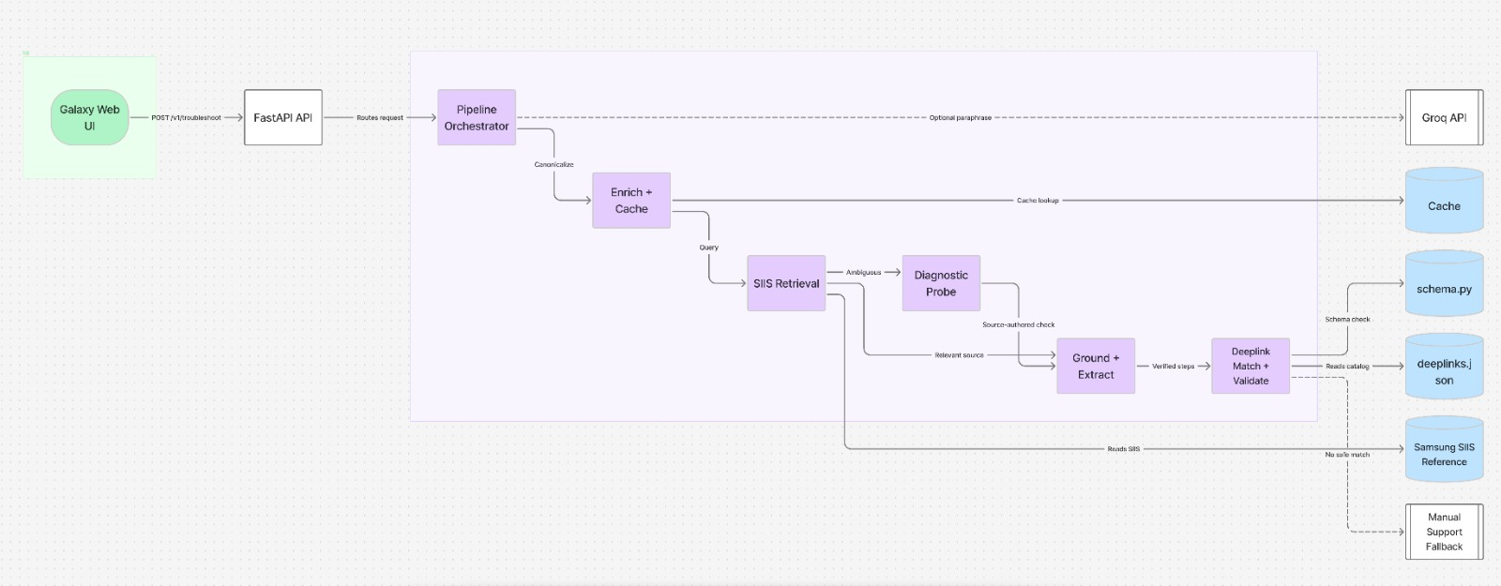
Our Solutions & Architecture Diagram
[1] Structure Extraction
Segments SIIS text on headings; one action = one physical screen/feature
[2] Hybrid Deeplink Matching
BM25 (lexical) + TF-IDF (semantic-ish), domain stopword filtering, hard overlap gate against false positives
[3] Fast-Path Semantic Cache
Exact-match dict lookup, then TF-IDF cosine similarity for near-duplicates
Continuous Learning Flow
1. User Feedback
Solved / Not Solved
2. Experience Learning
Analyse successful & failed solutions
3. Improve Future Responses
Better retrieval, more accurate solutions

Slide 5
Demo & Product Walkthrough
Seed scenario replay
Any of the 20 supplied complaints to exact cache hit, less than 1ms, fully schema-valid plan
Unseen scenario
A speaker-distortion complaint never seen in the kit to correctly extracted, ordered, zero rule violations
No-context fallback
Query with no siis_response and no cache match to empty contexts + fallback: “no_siis_context” will never a guess
Try it
POST /v1/troubleshoot {"query": "..."} to GET /health

Slide 6
Tools and tech stack used
Backend
Retrieval
Validation
Testing
No LLM used in this build
No model credentials / embedding-API network access available in this environment
Every stage isolated behind one function so a real LLM/embedding model is a one-file swap
Python 3.12, FastAPI, Pydantic v2, Uvicorn
rank_bm25 (lexical) + scikit-learn TF-IDF (semantic-ish), hybrid reranking
schema.py enforced programmatically end-to-end, not left to prompt instructions
Custom benchmark harness (tests/run_benchmark.py): schema compliance, URL-leak checks, latency, cache behaviour

Slide 7
Impact & Use case
Expected Impact
Customer
Agent
Organization
Faster access to relevant solutions
More consistent and scalable support
Less repetitive documentation lookup
TARGET USERS
Samsung Customers
Understand technical instructions easily
Customer Support Agents
Quickly access relevant troubleshooting information
Samsung Support Operations
Scale support across large volumes of queries
Improve consistency of troubleshooting responses
Get immediate troubleshooting assistance
Reduce repetitive document-searching work
Key Use Cases
Screen/display problems
Audio problems & Connectivity issues
Settings-related problems
General device troubleshooting
Battery and charging issues

Slide 8
Innovation highlights, results and limitations
Innovation
Zero-hallucination by construction: extraction never generates new sentences, only segments supplied text
Programmatic rule enforcement every word-count/prefix/category rule is checked in code, not hoped for from a prompt
Measured results
0 schema/rule violations across all 20 seed scenarios
100% of “auto” actions carry a resolved, verified deeplink
Cache-hit latency:0.12ms P50 (target 300ms)
Cold-path latency:3.6ms P50 (target 8000ms)
Known limitation
Cross-phrasing semantic cache hit rate: 11% measured vs. 80% target root-caused to TF-IDF's lexical-only similarity; fix is a real embedding model (isolated, one-file swap)
How the system improves ?
1. User Interaction
Customer describes the problem
AI provides troubleshooting steps
2. Resolution Feedback
Solved
Not solved
Tried another solution
3. Experience Capture
Was the response useful?
Did the customer need additional help?
4. Learning Layer
Identifies recurring failure patterns
5. Future Response
Similar future queries receive more relevant troubleshooting guidance
Improves future response generation

Slide 9
What’s next
Swap TF-IDF for a real sentence-embedding model to close the semantic cache gap (highest-leverage next step)
1
Scale the deep link index for the 10k+ scenario production target (approximate nearest-neighbour store)
2
LLM assisted rewrite pass on action descriptions, still programmatically validated afterward
3
Broaden the keyword classifier's training set beyond the 20 supplied scenarios
4

Slide 10
Brownie points slide( differentiation)
Fully deterministic pipeline : no per query inference cost, no output variance
Every claim in this deck is backed by a re-runnable benchmark (tests/run_benchmark.py) : including the one honest shortfall
Rule compliance enforced in code, not prompted for an immune to an LLM “forgetting” a formatting constraint
Architecture designed for incremental upgrade : LLM/embedding swap points isolated from day one

Slide 11
Checklist- Updated on Public GitHub
Demo video – https://drive.google.com/file/d/1l9v6KPA7RoTcdm5nBBgkUKpcvDj8vmtR/view?usp=drivesdk
GitHub Link - https://github.com/imAakas-h/TROUBLEWISE-AI
LangAI_Disclosure:https://docs.google.com/document/d/1PJjLEDijBzu7WrAmaPgfZ_6kCTvPw1qo/edit?usp=sharing&ouid=109958161132401601635&rtpof=true&sd=true

Slide 12
Thank you
Organised by the Language AI Team and the PRISM Team, Samsung R&D Institute India
Notes:
Closing slide. Add the Google Form URL and a contact email before sharing. Edition 2 organising team for reference: Language AI - Sourabh Tiwari, Gaurav, Sanjeeth Pothireddy, Gorang Maniar; PRISM - Binny Lakra, Prakhar Chandrakar, Vishu Kumar; Kick-off and mentors - Giridhar Jakki, Deepraj Prabhakar Patkar (Language AI), Srimanu Prasad Nagaraju, Ashish Kumar (Tech Strategy).

