Slide 1

Research Question – Tutorial Presentation for Feedback Date:
Group Name: A069 Name of Student Presenting: Vinayak

Slide 2
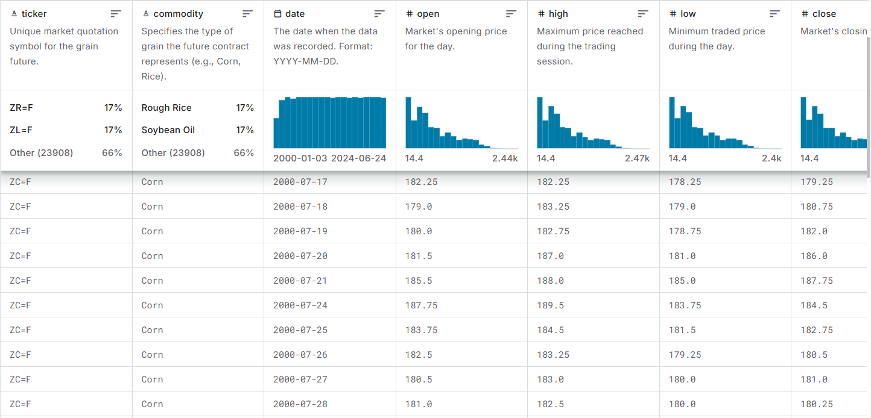
This Dataset has 44 rows

Slide 3
This dataset is interesting to us because it is fascinating as they reveal trends, efficiencies, and opportunities for advancing sustainability and combating climate change. Our Independent variable is: commodity This Independent variable datatype is : Nominal/categorial Our Dependent variable is: close This Dependent variable datatype is : Interval/measurement data
Dataset ID: (TS283) Corn, Oat, Cereals & Grains Futures Data
Notes:
Before specifying your Research Question you must define the type of data you are analysing. Are the variables you select interval data (measurement data you can divide, multiple, etc), OR are they ordinal (there is a definite order but the intervals between each variable are not necessarily equal, or the terms might be subjective like in a likert scale); OR are they just categorical/nominal (Items such as film names, cities, etc., that you can count numbers of occurrences? You also need to understand whether the variable is either dependent or independent and this will vary according to the context. Independent variables may cause an effect, whereas the dependent variable might be effected by the independent variable. Check the lecture notes on the RQ for more information and examples.
You will get only one opportunity to present your Research Question ahead of the submission date. Have your questions ready, and be ready to take notes on feedback.

Slide 4
“Is there a difference in the mean of CLOSE between COMMODITY ”.
Our Research Question is

Slide 5
Null hypothesis (H₀): There is no difference in the mean/median of the Close variable between Commodity.
Alt hypothesis (H₁): There is a correlation between Close variable and Commodity variable.

