Slide 1



Hariom Kumar
Let's Grow More Virtual Internship Program as Data Science Intern

Slide 2
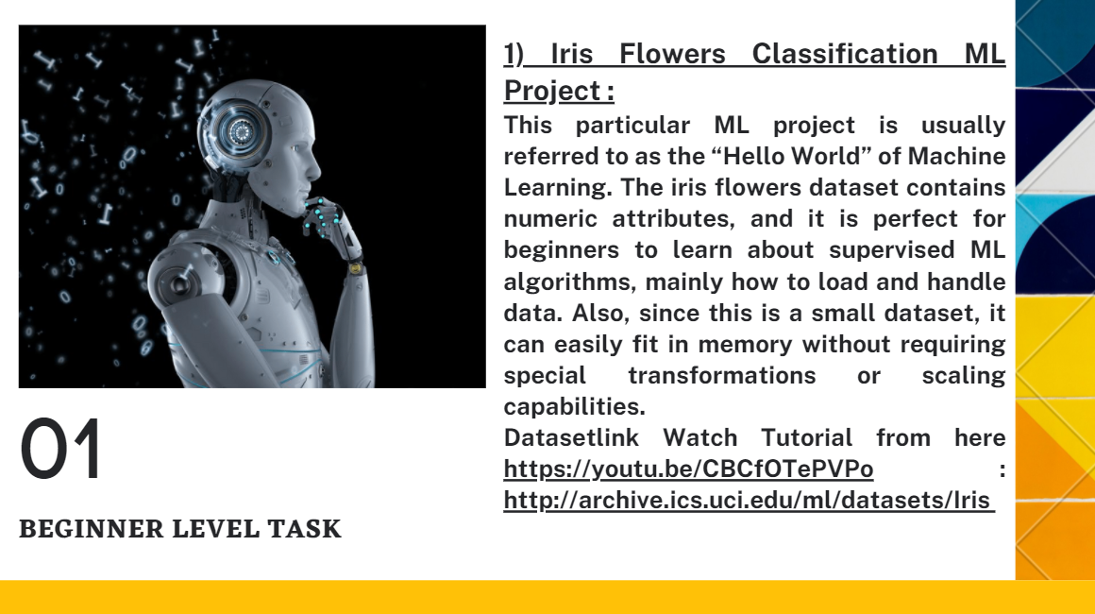
Beginner Level Task

Slide 3
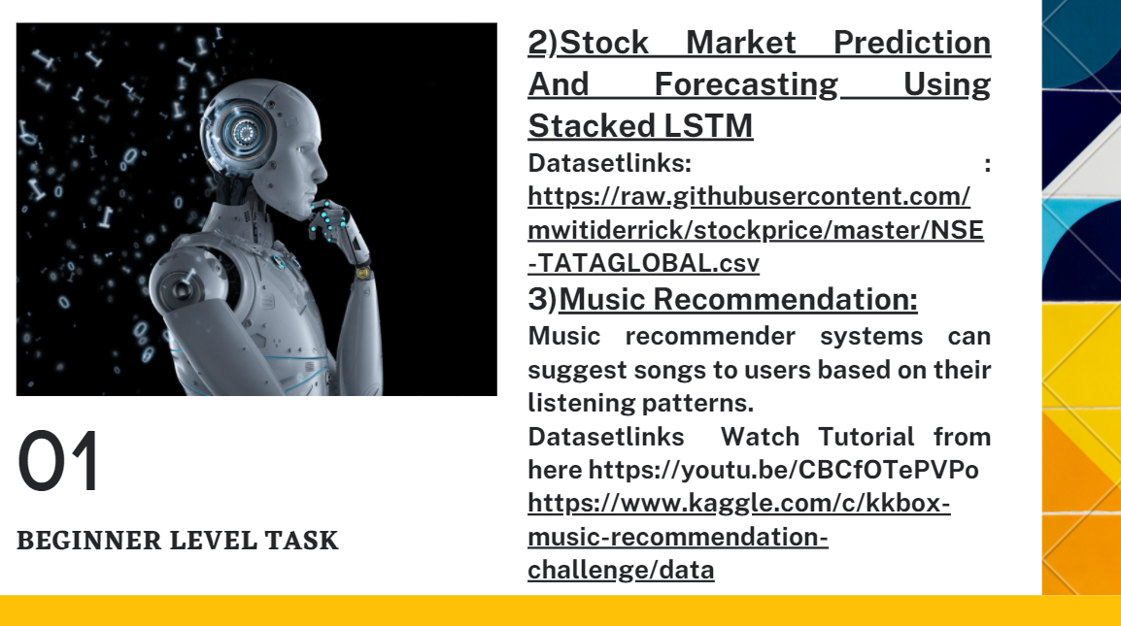
Beginner Level Task 2&3

Slide 4
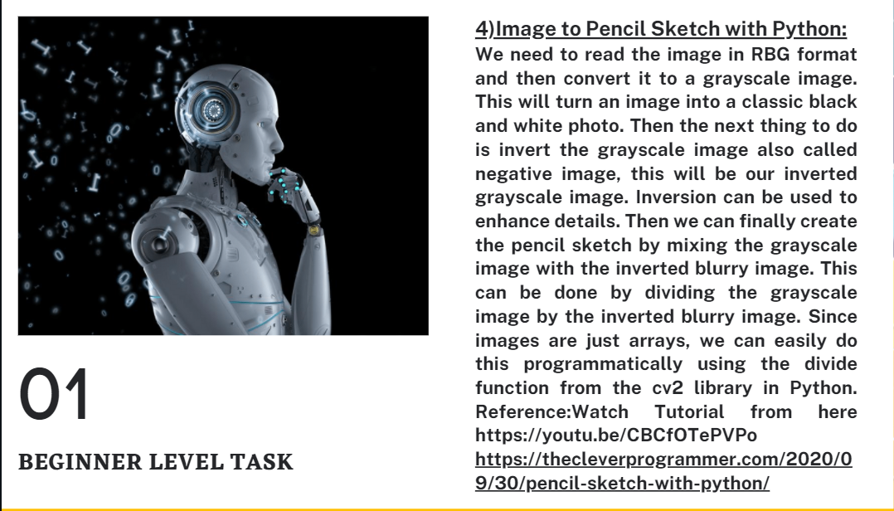
Beginner Level Task 4

Slide 5


