Slide 1

Multithreading & Synchronization Mechanism
BY- Madhav Mohan
Multithreading

Slide 2
Outline
Process V/S Thread
Threads
Synchronization & its classic problems
Multithreading using Posix library
Ways to Control access to the Shared Resource
  Mutex
  Cond_var
  Semaphore
Multithreading

Slide 3
Process
A process is a sequential program in execution.
A process is a unit of computation.
Process components:
  The program (code) to be executed.
  The data on which the program will execute.
  Resources required by the program.
  The status of the process execution.
A process runs in an abstract machine environment (could be OS) that manages the sharing and isolation of resources among the community of processes.
Code
Data
Process Status
Resource
Abstract Machine Environment
Multithreading

Slide 4
Program and Process
Program and process – distinction?
A program is a static entity made up of program statements. The latter define the run-time behavior.
A process is a dynamic entity that executes a program on a particular set of data.
Two or more processes could execute the same program, each using its own data and resources.
Multithreading

Slide 5
Thread Model
A thread is an alternative form (to the process) of the schedulable unit of computation.
Threads are lightweight processes as the overhead of switching between threads is less.
Each thread has its own data, program counter, stack, and set of registers.
In the thread model:
  Each thread is associated with a process.
  A thread is an entity that executes by relying on the code and resources, held by the associated process.
  Several threads could be associated with a single process. Those threads share the code and resources of the process.
  A thread is allocated part of the process’s resources for its needs.
  A thread has its own data and status.
Multithreading

Slide 6
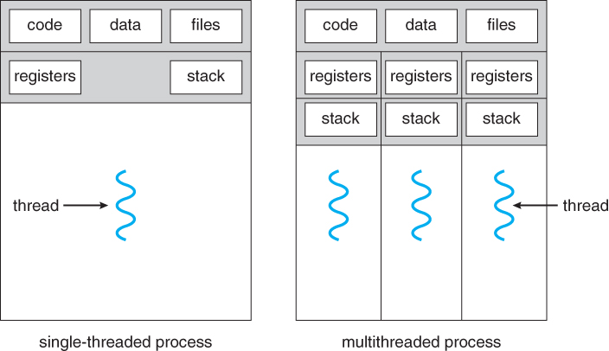
Thread Model
Multithreading

Slide 7
Thread Model
Why do we need threads?
Creating and terminating a thread is faster compared to creating or terminating a process.
Context switching is faster in threads compared to processes.
A thread has much less overhead than a process as they share the resources of a single process. On the other hand, creating processes is expensive.
Improves the response time to the user & Enhanced the throughput of the system.
What differentiates threads from normal processes is the shared memory (objects), which is visible to all threads in a multi-threaded program.
Multithreading

Slide 8
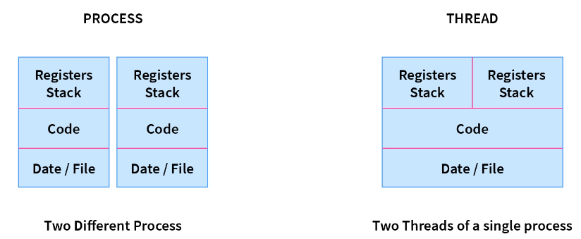
Thread Model
Process:
Ex: Opening two different browsers.
Thread:
Ex: Opening two tabs in the same browser.
Multithreading

Slide 9
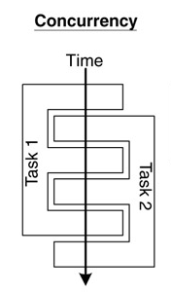
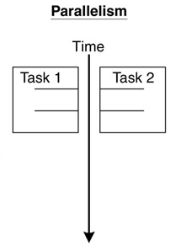
Concurrency and Parallelism
  Concurrent multithreading systems give the appearance of several tasks executing at once, but these tasks are actually split up into chunks that share the processor with chunks from other tasks.
  In the Multithreading context switching is possible by using scheduling algorithms or some interrupt.
  In parallel systems, two tasks are actually performed simultaneously. Parallelism requires a multi-CPU system.
Multithreading

Slide 10
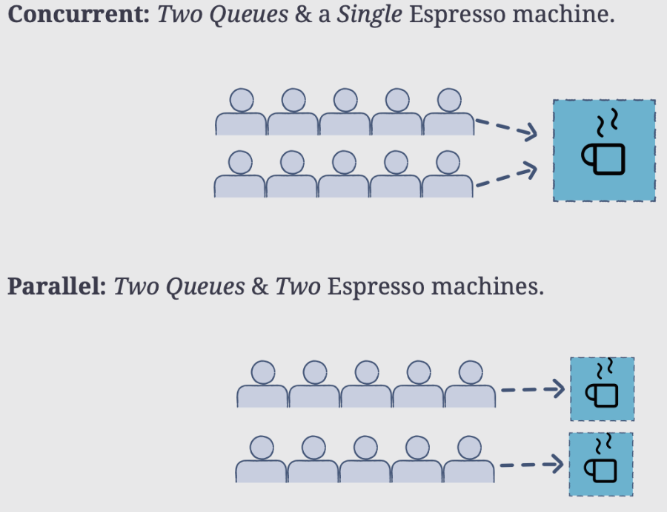
Multithreading

Slide 11
Multithreading
A program with multiple threads running within a single instance could be considered as a multitasking system within an OS.
In a multithreading program, threads have the following properties:
  A thread begins execution at a predefined, well-known location. For one of the threads in the program, that location is the main() method; for the rest of the threads, it is a particular location the programmer decides on when the code is written.
  A thread executes code in an ordered, predefined sequence.
  A thread executes its code independently of the other threads.
  The threads appear to have a certain degree of simultaneous execution.
Multithreading

Slide 12
Synchronization
  Background
  Concurrent access to shared data may result in data inconsistency.
  Maintaining data consistency requires mechanisms to ensure the
  orderly execution of cooperating processes (or threads).
  When do we need synchronization?
  When two or more processes (or threads) work on the same data simultaneously. There is the possibility of dirty reading or dirty writing that may cause Race conditions.
  If multiple threads access shared data and are not synchronized with each other, we can face situations wherein the threads processing the shared data generate different results every time.
  Ex: Bank Account deposits from 2 different Apps simultaneously may give different o/p if they aren’t properly synchronized.
Multithreading

Slide 13
Synchronization
  Example:
  Two threads are trying to update the same shared variable simultaneously:
    The result is unpredictable.
    The result depends on which of the two threads was the last one to change the value.
    The competition of the threads for the variable is called a race condition.
    The first thread is the one that wins the race to update the variable.
Multithreading

Slide 14
Classical Synchronization Problems
  Bounded-buffer
  (Producer-Consumer problem)
  A pool of n size.
  Producer processes put items into the pool.
  Consumers take items out of the pool & consume them.
  There must be synchronization between producers to avoid conflict.
  So, the rate of producer & consumer should be synchronized else they would not complete the task in the stipulated time(RR).
  Note: I have shared the code or you can ask for it in person.
Multithreading

Slide 15
Classical Synchronization Problems
  Readers-Writers
  Multiple processes access a shared data object X.
  Any number of readers can access X at the same time.
  No two writer-writer & reader-writer can access shared data X at the same time.
  So, for the writer we want mutual exclusive access.
  Ex: Access a file in Reader or Writer mode by more than one thread.
  Note: I have shared the code or you can ask for it in person.
Multithreading

Slide 16
The Critical Section Problem
  Definition:
  A critical section is a piece of code that accesses a shared resource (data structure or device) that must not be concurrently accessed by more than one thread of execution.
  Conditions:
  n threads all competing to use some shared data.
  Each process has a code segment, called the critical section, in which the shared data is accessed.
  Problem:
  How to ensure that when one process is executing in its critical section, no other process is allowed to execute in its critical section?
Multithreading

Slide 17
The Critical Section Problem - Example
  Suppose that two processes are trying to increment the same variable. They both execute the statement
x := x + 1;
  To execute this statement each process reads the variable x, then adds one to the value, and then writes it back.
  Suppose the value of x is 3.
    If both processes read x at the same time then they would get the same value 3.
    If they then both added 1 to it then they would both have the value 4.
    They would then both write 4 back to x.
    The result is that both processes incremented x, but its value is only 4, instead of 5.
Multithreading

Slide 18
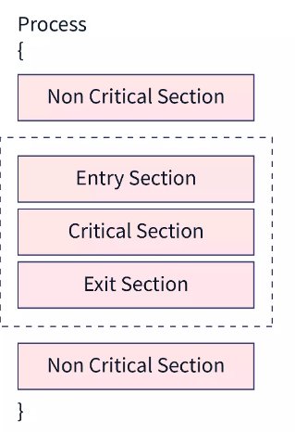
The Critical Section Problem
  Solution – three requirements:
  If a process enters the critical section, then no other process should be allowed to enter the critical section. This is called mutual exclusion.
  Progress means that if a process is not using the critical section, then it should not stop any other process from accessing it. In other words, any process can enter a critical section if it is free.
  If a process wants to enter into the critical section, then there should be a specified time that the process can be made to wait. This property is called bounded waiting.
Multithreading

Slide 19
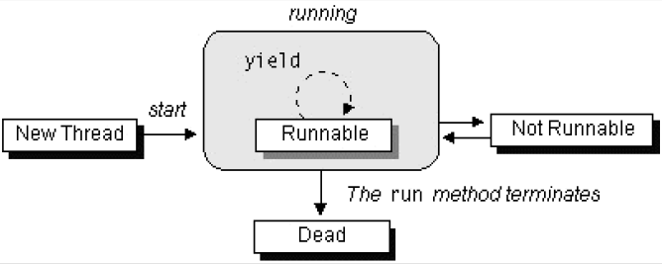
The Lifecycle of a Thread
The start() method creates the system resources necessary to run the thread, schedules the thread to run, and calls the thread's run() method.
A thread becomes Not Runnable when one of these events occurs:
  If sleep() method is invoked.
  The thread calls the wait() method.
  The thread is blocked on I/O operations.
The thread dies naturally when the run() method exits.
Multithreading

Slide 20
Synchronization Mechanism in Multithreading (Using Posix Library )
There are several ways to control access to the shared resource like-
  Mutex,
  Semaphores,
  Conditional variable.
Note: I have shared the code or you can ask for it in person.
Multithreading

Slide 21
Posix Thread Functions
pthread_create: used to create a new thread
int pthread_create(pthread_t *th, pthread_attr_t *attr, void* fun, void* arg)
pthread_exit: is used to exit the thread that calls it & returns the val to pthread_join().
void pthread_exit(void* ret)
pthread_join: suspend execution of the thread that calls it unless the target thread terminates. int pthread_join(pthread_t th1, void **thread_return)
pthread_self: used to get the thread id of the current thread
pthread_t pthread_self()
pthread_equal: compares whether two threads are the same or not. If the two threads are equal, the function returns a non-zero value otherwise zero.
int pthread_equal(pthread_t th1, pthread_t th2)
pthread_cancel: used to send a cancellation request to a thread.
int pthread_cancel(pthread_t thread)
pthread_detach: used to detach a thread. A detached thread does not require a thread to join on terminating. The resources of the thread are automatically released after termination if the thread is detached.
int pthread_detach(pthread_t thread)
Note- all functions having int as return type returns 0 on success & -1 on error.
Multithreading

Slide 22
Mutex
A Mutex is a lock that we set before using a shared resource and release after using it.
When the lock is set, no other thread can access the locked region of the code.
So, we see that even if thread 2 is scheduled while thread 1 was not done accessing the shared resource and the code is locked by thread 1 using mutexes, thread 2 cannot even access that region of code.
So, this ensures synchronized access to shared resources in the code.
A mutex is initialized and then a lock is achieved by calling the following two functions :
pthread_mutex_t mtx: is used to declare a mutex var.
int pthread_mutex_init(pthread_mutex_t *mtx, pthread_mutexattr_t *attr): use to init a mutex.
int pthread_mutex_lock(pthread_mutex_t *mtx) : use to acquire lock.
A mutex can be unlocked and destroyed by calling the following two functions :
int pthread_mutex_unlock(pthread_mutex_t *mtx) : used to unlock,
int pthread_mutex_destroy(pthread_mutex_t *mtx) : is used to destroy the mutex_obj referenced by the mutex, but if we want to init it again then we can do this using pthread_mutex_init().
Note- all functions having int as return type above return 0 on success & -1 on error.
Multithreading

Slide 23
Condition variable
condition variables allow the implementation of powerful and efficient synchronization mechanisms. That allows the Conditional variable to exchange signals among threads.
It blocks other threads until another thread modifies the shared variable & notifies the condition variable.
The principle of the Condition variable is signal & wait.
The following functions are used to achieve synchronization based on the Condition variable:
a) pthread_cond_t: is used to declare the condition variable.
Syntax: pthread_cond_t *cond;
b) pthread_cond_wait() : use to block other threads
Syntax: int pthread_cond_wait(pthread_cond_t *cond, pthread_mutex_t mutex);
c) pthread_cond_timedwait() : same as above fun(), but here we define an absolute time after which we no longer want to wait. If this abs_time passes & doesn’t receive any signal, it’ll report an error.
Syntax: int pthread_cond_timedwait(pthread_cond_t *cond, pthread_mutex_t mutex, struct timespec *abstime);
struct timsespec{time_t tv_sec; long tv_nsec;}
d) pthread_cond_signal() : use to signal other threads
Syntax: int pthread_cond_wait(pthread_cond_t *cond);
Note- all functions above return 0 on success & -1 on error.
Ex: We can use this mechanism in the Producer & Consumer problem.

Slide 24
Semaphore
A semaphore is an integer variable, shared among multiple processes. The main aim of using a semaphore is process synchronization and access control for a common resource in a concurrent environment.
Kind of semaphore: a) Counting Semaphore b) Binary Semaphore
Binary Semaphore: used to solve the Critical section problem of mutual exclusion.
Counting Semaphore: used to solve the resource allocation problem(H).
We have a Posix semaphore that allows threads to provide synchronized access to the critical section.
Posix library divided semaphores into 2 categories:
1. Named semaphore: stored in filesystem 2. Un-named semaphores: are stored in RAM
Following are some common functions that are used with both:
sem_t *sem: use to declare a semaphore.
int sem_post(sem_t *sem): increments the value of the semaphore & releases the lock over the semaphore.
int sem_wait(sem_t *sem): decrements the value of the semaphore & acquires the lock over the semaphore(TRYWAIT, TIMEDWAIT).
int sem_getvalue(sem_t *sem, int *val): Gets the value of a specified counting semaphore.

Slide 25
Semaphore
Named Semaphore: (File System)
sem_t* sem_open(char *name, int O_Flag, mode_t md, int val): Opens/creates a named semaphore for use by a process
int sem_close(int *sem): Deallocates the specified named semaphore,
int sem_unlink(char *name): and after sem_close() remove the named semaphore using this function.
2. Un-named semaphore: (RAM)
int sem_init(sem_t *sem, int pshared, int val): use to create the un-named semaphore declared semaphore. If pshared=0 means the semaphore will be shared with threads else with processes. We can assign the initial value to the semaphore in val arg. This value indicates how many processes can be run concurrently.
int sem_destroy(sem_t *sem): once a function/process is finished the un-named semaphore should be destroyed.
Note- all functions having return type int above return 0 on success & -1 on error.
Multithreading

Slide 26
Multithreading

