Slide 1
TEAM BEE
Members:
BAPU PRUTHVIDHAR
C TARUN
ADVAITH PRAVEEN
Theme: AI/ML

Slide 2
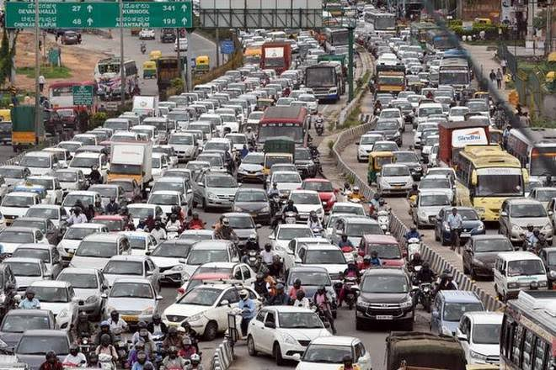
Idea Summary
AUTONOMOUS TRAFFIC CONTROL SYSTEM
Uses Deep Neural Networks and OpenCV with custom trained models meant for the Indian traffic to detect the density at a Junction and assign time required to switch back from green to red light autonomously.

Slide 3
Business Proposition
It is one of a kind. Build cost is extremely low and when implemented, It can single handedly reduce the carbon footprint of fuel viz. Petrol and Diesel and helps in time management too. Thus, reducing stress for an Individual making it a highly sought after product.

Slide 4
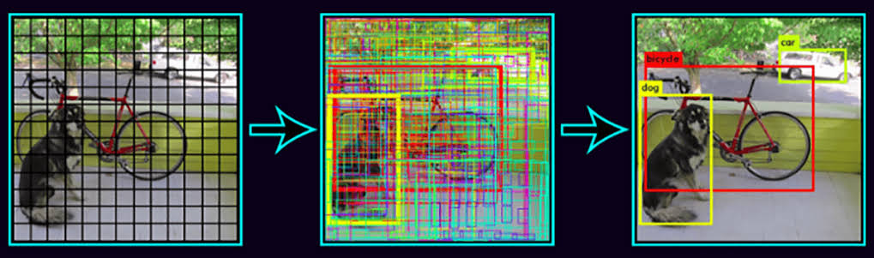
Tech Stack / Architecture / API
The Algorithm uses Image Segmentation and Priority marking using Neural Networks where different priority is assigned to different vehicles that is found in the traffic based on the situation.

Slide 5
Advantages:
With more promising technology like 5G nearing, our product is designed in such a way that it can be easily implemented and maintained for pre-trained models in the cloud and processed for more efficiency using Rakuten Rapid API and it is also highly optimized to work in challenging situations like Power cut,Natural disasters etc.

Slide 6
Thank You

