Slide 1
Distributor Ecosystem
Name:Kiran Patel
ID:201801153
Mentor:Prof. Lavneet singh

Slide 2
What is Distributor Ecosystem(DE)?

Slide 3
Modules of DE
Dashboard
My Lead
My Proposal
My Customers
My Renewals
My claims

Slide 4
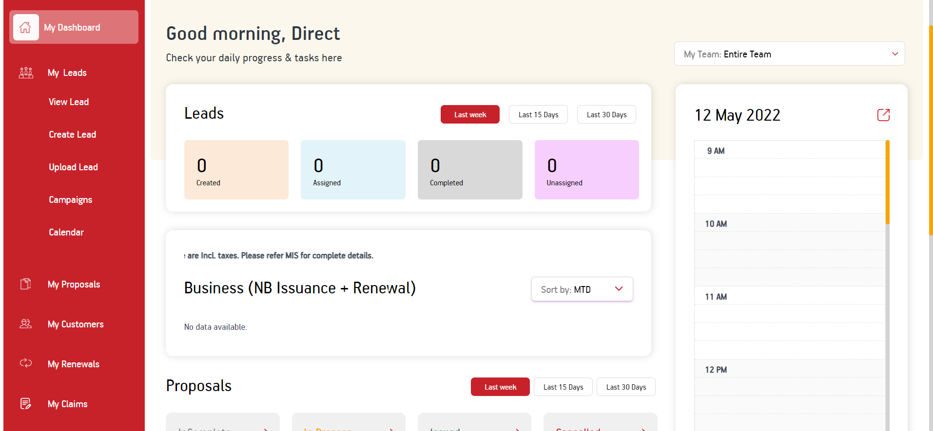
Modules of DE

Slide 5
Tech Stack
Angular
Asp.Net Core
MSSQL
Notes:
1213213

Slide 6
My work

Slide 7
Browser Notification
Need to show notification when particular user logged in using their ID.
Message should be send to mention ID only from backend.
SignalR
Service-worker

Slide 8
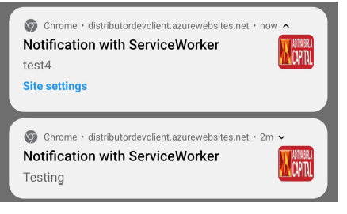
Browser Notification
Navigation to particular page on notification click.

Slide 9
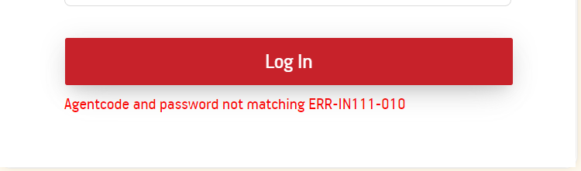
Implementation of ERROR Code
Internal Code
External Code

Slide 10
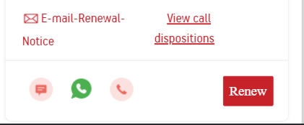
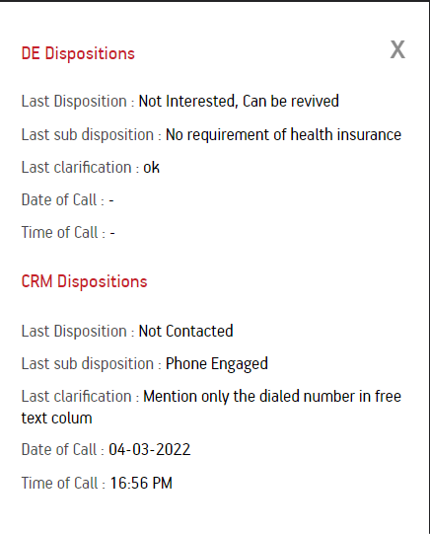
Dispositions Pop-up
Enable button based on the Isfirstcall flag.
Post API which takes policy number as request and returns Disposition details.
Bind API in the front end and store response in a variable.
Using Ng-template create a Pop-up.

Slide 11
Bug fixes
UI Improvement
Alignment and color-coding of components
Backend API errors
External API errors

Slide 12
Learning
Tech Stack
Complex Architecture of Backend
Explore multiple solutions and pick the optimal one.
Collaboration with Team.

Slide 13
Acknowledgements
I would like to thank Prof. Lavneet Singh for supervising my internship. With their constant support, I have learned many things during my internship.
I would like to to thank my teammates who helped me throughout my internship.

Slide 14
References
Angular
Asp.Net Core
HTML
CSS
SignalR
Asp.Net Core

Slide 15
Thank You

