Slide 1
Data Base Management System
By
Prof. Dr. O.P.Vyas
M.Tech. ( Computer Sc. ) from IIT Kharagpur
Ph.D. (from TU Kaiserslautern-Germany & IIT Kharagpur)
DAAD Fellow (Germany), AOTS Fellow(Japan)
International Institute of Information Technology, Naya Raipur

Slide 2
“ We are pouring in data but starving in Knowledge ”
Jiawei Han

Slide 3
Database Management System
Data – Information – Knowledge
DBMS Definition & Application
Why DBMS ?
  Developing Information Systems
  Transaction Management
  DBMS Types & users
DBMS languages
  DDL Vs. DML
DBMS Architecture
  Client-server based
  Web-based architecture
DBMS Implementation
  Data Modeling & Design
    E-R Diagram & Pitfalls in Design
    From diagram to Tables
    Types of Attributes & retrieval of Information
  Data Base design
  Data Querying: Concepts & Constructs
  Query / Report format design, development.
Recent trends in DBMS
Notes:
Ranjana vyas

Slide 4
RDBMS
  Data Modeling & Design
    E-R Diagram & Pitfalls in Design
    From diagram to Tables
    Types of Attributes & retrieval of information
    Concept of Key Attributes : Weak Entity, Strong Entity
  Data Base Organization
    File, Records, Fields, Byte, Bit

Slide 5
Relational Database Management System
RDBMS is one of the most successful model of Data Base Management.
In RDBMS is a DBMS in which data is stored in tables and the relationships among the data are also stored in tables.
Any large and complex organization can be expressed in form of smaller tables and the relationships between them.
The data can be accessed or modified in many different ways without having to change the table forms.
In RDBMS large body of data can be modeled and described as group of tables which are connected to each other through Relations.
  ER Diagrams are most effective First step for designing RDBMS.
Entities & Relations are represented in form of Tables….
Attributes are converted as Fields…

Slide 6
Relational Model
Attributes
Example of Tabular data in the Relational model
Customer-id
customer-
name
customer-
street
customer-
city
account-
number
192-83-7465
019-28-3746
192-83-7465
321-12-3123
019-28-3746
Johnson
Smith
Johnson
Jones
Smith
Alma
North
Alma
Main
North
Palo Alto
Rye
Palo Alto
Harrison
Rye
A-101
A-215
A-201
A-217
A-201
Notes:
Ranjana vyas

Slide 7
Database
File
Record
Field
Byte
Bit

Slide 8
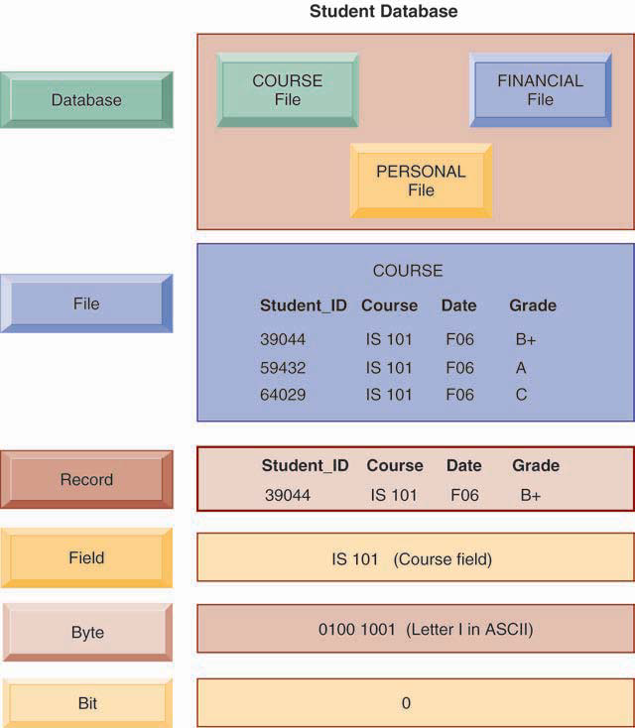
Database Organization

Slide 9
Database
A database consists of multiple relations, which means multiple tables.
Information about an enterprise is broken up into parts, with each relation ( table) storing one part of the information
Ex: Table account : stores information about accounts
Table customer : stores information about customers
Table depositor : stores information about which customer owns which account
But Why to Break into Smaller parts ….?
Notes:
Ranjana vyas

Slide 10
Database
Storing all information as a single relation such as
bank(account-number, balance, customer-name, ..) results in
  repetition of information (e.g. two customers own an account)
  the need for null values (e.g. represent a customer without an account) and null values may pose problems..
Normalization theory deals with how to design relational schemas- comes under Logical Design.
Let us have look at detail ER Diagram for Banking Enterprise…
Notes:
Ranjana vyas

Slide 11
Banking Enterprise : ER Diagram
The Banking Enterprise will involve many more components and in real life scenario and customers will have depositor account as well as Loan Account to borrow money. Both these accounts will be in a branch of the city, whereas there will be many Branches of the Bank with Branch name, Branch city and assets having customers with these Accounts may have final balance as well as Loan Amount. accidents.
List of Entities in this scenario:
Customer
Account
and ……..?
Branch
Loan
Notes:
Ranjana vyas

Slide 12
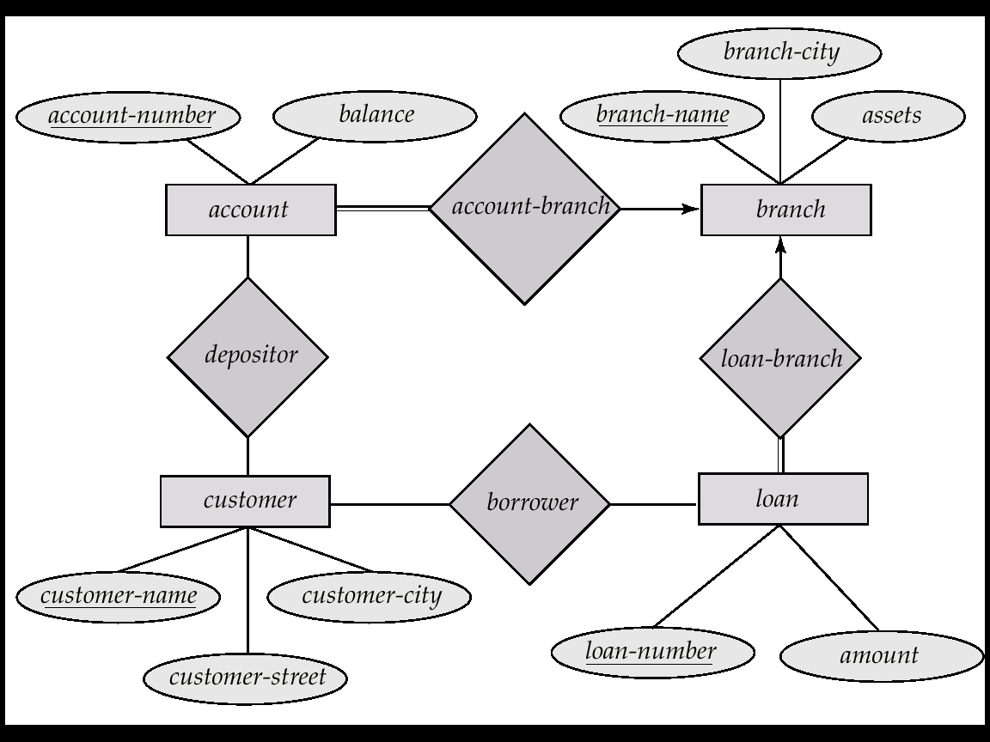
E-R Diagram for the Banking Enterprise
Notes:
Ranjana vyas

Slide 13
Pitfalls in Relational Database Design
Relational database design requires that we find a “good” collection of relation schemas. A bad design may lead to
  Repetition of Information.
  Inability to represent certain information.
Design Goals:
  Avoid redundant data
  Ensure that relationships among attributes are represented
  Facilitate the checking of updates for violation of database integrity constraints.
Notes:
Ranjana vyas

Slide 14
Database implementation
Date Base Design: 03 Phases
Modeling : E-R Modeling : Conceptual design
  Conversion of ER model into Table: Concept of Keys
    Table Creation & SQL commands
Data Base Languages & Querying
  Relation Algebra
  Query Language
  DDL, DML: SQL Basics
Logical Design of Database: Normalization
Notes:
Ranjana vyas

Slide 15
Database Design
The process of designing the database is first step in developing Information system:
Design – Database design requires that we find a “good” collection of tables (relation ) schemas.
  What attributes should we record in the database so that our expected queries are efficiently answered?
  What relation schemas should we have and how should the attributes be distributed among the various relation schemas so that
    All significant aspects of the system are included in the Database design-Completeness !
    No aspects of system are getting repeated- Redundancy
Measure of Design Appropriateness

Slide 16
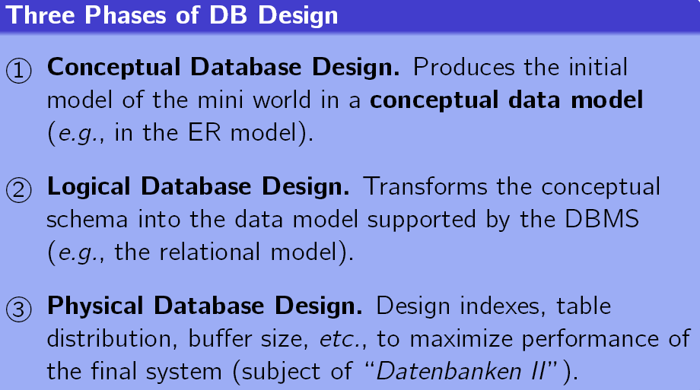
Database Design
The Normalization Theory in Database also relates to Logical Database Design

Slide 17
Attributes
An entity is represented by a set of attributes, that is descriptive properties possessed by all members of an entity set.
Domain – the set of permitted values for each attribute
Attribute types:
  Simple and composite attributes.
  Single-valued and multi-valued attributes
Example:
customer = (customer_id, customer_name, customer_street, customer_city )
loan = (loan_number, amount )

Slide 18
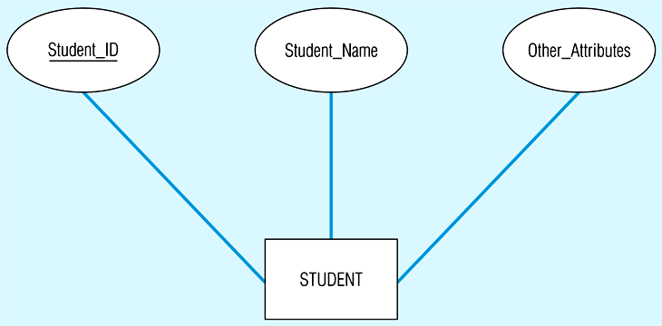
Simple and composite key attributes
(a) Simple key attribute

Slide 19
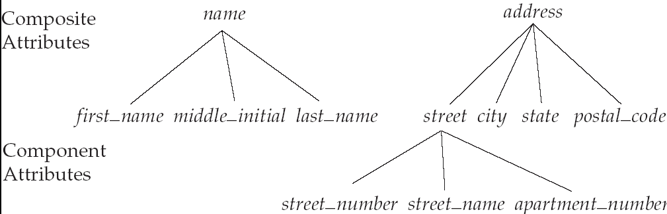
Composite Attributes

Slide 20
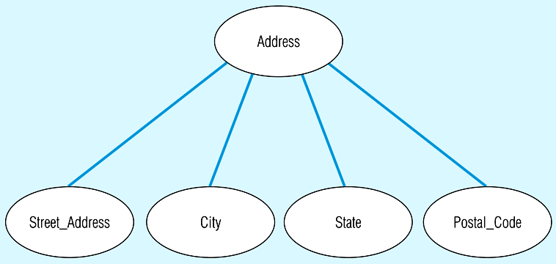
A composite attribute

Slide 21
Single-Valued versus Multivalued Attribute
It frequently happens that there is an attribute that may have more than one value for a given instance,
e.g. EMPLOYEE may have more than one Skill.
    Example: multivalued attribute: phone_numbers
A multivalued attribute is one that may take on more than one value – it is represented by an ellipse with double lines

Slide 22
Derived Attributes
  Some attribute values can be calculated or derived from othersattributes
    Can be computed from other attributes
    Example: age, given date_of_birth
if Years_Employed needs to be calculated for EMPLOYEE, it can be calculated using Date_Employed and Today's_Date.
A derived attribute is one whose value can be calculated from related attribute values (plus possibly other data not in the database)
A derived attribute is signified by an ellipse with a dashed line.

Slide 23
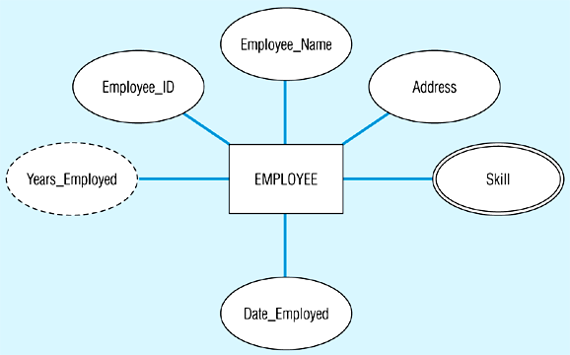
Entity with a multivalued attribute (Skill) and derived attribute (Years_Employed)

Slide 24
Entity with a multivalued attribute (Skill) and derived attribute (Years_Employed)

Slide 25
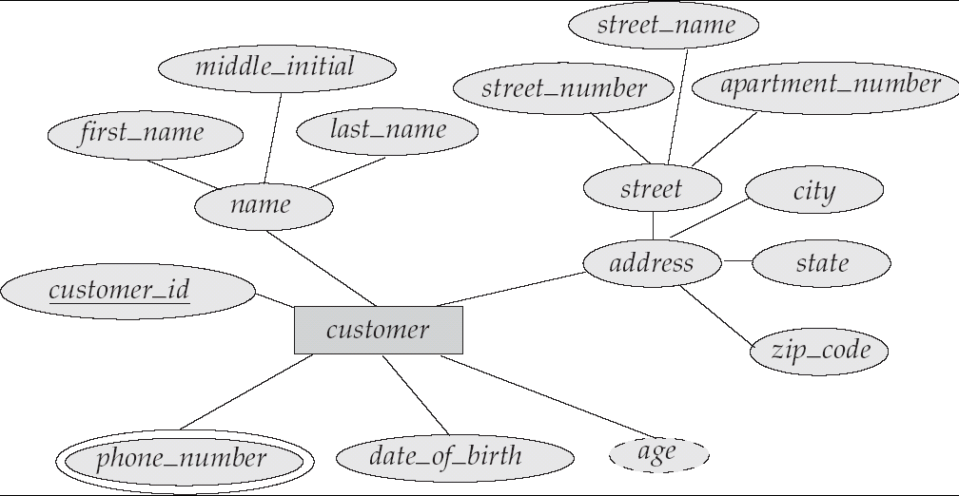
E-R Diagram With Composite, Multivalued, and Derived Attributes

Slide 26
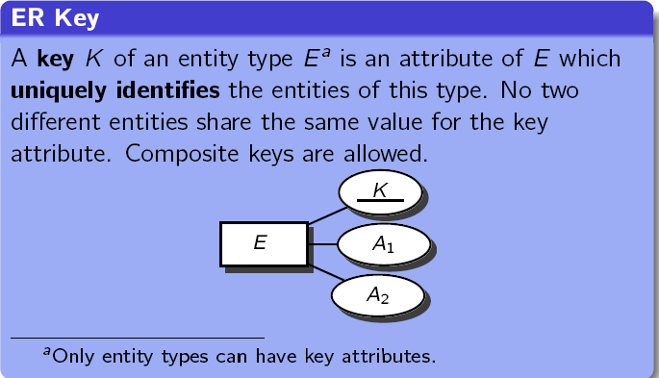
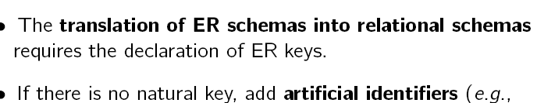
Key Attributes
A Key Attribute is special attribute which can uniquely identify the record for Entity

Slide 27
Concept of Keys
A Key Attributes is special attribute which can uniquely identify the record in a given table.
A super key of an entity set is a set of one or more attributes whose values uniquely determine each entity.
Ex. Super key : ( customer-id, Customer-name)
A candidate key of an entity set is a minimal super key
  Customer-id is candidate key of customer
  account-number is candidate key of account
Although several candidate keys may exist, one of the candidate keys is selected to be the primary key.
The combination of primary keys of the participating entity sets forms a super key of a relationship set.
  (customer-id, account-number) is the super key of depositor
Notes:
Ranjana vyas

Slide 28
Weak Entity Sets
An entity set that does not have a primary key is referred to as a weak entity set.
The existence of a weak entity set depends on the existence of a identifying entity set
The primary key of a weak entity set is formed by the primary key of the strong entity set on which the weak entity set is existence dependent, plus the weak entity set’s discriminator.
Notes:
Ranjana vyas

Slide 29
Weak Entity
In real world there are many such cases where Weak Entity exists and we are required to uniquely identify records as well !!
If an entity does not have a key by itself, but it is only unique in the context of some other (master) entity.
Note: In such cases, keys are always composite.
Examples:
A classroom is identified by a building and a room number.
A section in a book is identified by a chapter and a section title.
There is also an existence dependency.
If the building is pulled down, the classrooms automatically disappear.

Slide 30
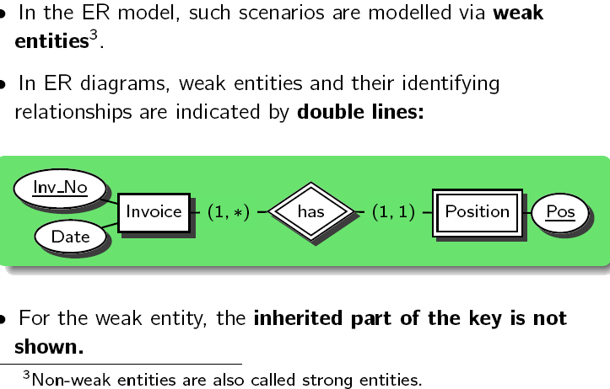
Weak Entities….

Slide 31
Foreign Keys
A relation schema may have an attribute that corresponds to the primary key of another relation. The attribute is called a foreign key.
  E.g. customer_name and account_number attributes of depositor are foreign keys to customer and account respectively.
  Only values occurring in the primary key attribute of the referenced relation may occur in the foreign key attribute of the referencing relation.

Slide 32

A Sample Relational Database
Notes:
Ranjana vyas

Slide 33
Referential integrity and referential constraints
Referential integrity is the state in which all values of all foreign keys are valid.
Referential integrity is based on entity integrity.
Entity integrity requires that each entity have a unique key.
For example, if every row in a table represents relationships for a unique entity, the table should have one column or a set of columns that provides a unique identifier for the rows of the table.
This column (or set of columns) is called the parent key of the table. To ensure that the parent key does not contain duplicate values, a unique index must be defined on the column or columns that constitute the parent key. Defining the parent key is called entity integrity.
Indexes can be unique or non-unique. Unique indexes guarantee that no two rows of a table have duplicate values in the key column (or columns). Non-unique indexes do not impose this restriction on the column values.
Notes:
Ranjana vyas

Slide 34
A referential constraint
A referential constraint is the rule that the non null values of a foreign key are valid only if they also appear as values of a parent key.
The table that contains the parent key is called the parent table of the referential constraint, and the table that contains the foreign key is a dependent of that table.
The relationship between some rows of the DEPT and EMP tables, illustrates referential integrity concepts and terminology.
Notes:
Ranjana vyas

Slide 35
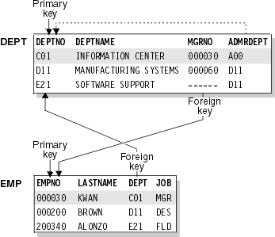
For example,
Referential integrity ensures that every foreign key value in the DEPT column of the EMP table matches a primary key value in the DEPTNO column of the DEPT table.
Referential integrity of DEPT and EMP tables
Notes:
Ranjana vyas

Slide 36
Two parent and dependent relationships exist between the DEPT and EMP tables.
The foreign key on the DEPT column establishes a parent and dependent relationship. The DEPT column in the EMP table depends on the DEPTNO in the DEPT table. Through this foreign key relationship, the DEPT table is the parent of the EMP table. You can assign an employee to no department (by specifying a null value), but you cannot assign an employee to a department that does not exist.
The foreign key on the MGRNO column also establishes a parent and dependent relationship. Because MGRNO depends on EMPNO, EMP is the parent table of the relationship, and DEPT is the dependent table.
Notes:
Ranjana vyas

Slide 37
Cont….
You can define a primary key on one or more columns. A primary key that includes two or more columns is called a composite key.
A foreign key can also include one or more columns.
When a foreign key contains multiple columns, the corresponding primary key must be a composite key.
The number of foreign key columns must be the same as the number of columns in the parent key, and the data types of the corresponding columns must be compatible.
Notes:
Ranjana vyas

Slide 38
Foreign Key
In the context of relational databases, a foreign key is a referential constraint between two tables.
The foreign key identifies a column or a set of columns in one (referencing) table that refers to set of columns in another (referenced) table.
The columns in the referencing table must be the primary key or other candidate key in the referenced table. The values in one row of the referencing columns must occur in a single row in the referenced table.
Thus, a row in the referencing table cannot contain values that don't exist in the referenced table (except potentially NULL).
Notes:
Ranjana vyas

Slide 39
Referential integrity enforces the following three rules:
We may not add a record to the Employees table unless the ManagedBy attribute points to a valid record in the Managers table.
If the primary key for a record in the Managers table changes, all corresponding records in the Employees table must be modified using a cascading update.
If a record in the Managers table is deleted, all corresponding records in the Employees table must be deleted using a cascading delete.
Notes:
Ranjana vyas

Slide 40
Surrogate Keys
Real world keys sometimes cause problems in a database.
Example: Customer
  Customer-ids are not easy to remember by account holder !
  Avoid phone numbers: people may not notify you when numbers change.
Often best to let the DBMS generate unique values
  Access: AutoNumber
  SQL Server: Identity
  Oracle: Sequences (but require additional programming)
Drawback: Numbers are not related to any business data, so the application needs to hide them and provide other look up mechanisms.
Notes:
Ranjana vyas

Slide 41
Assignment-I
A university registrar’s office maintains data about the following entities:
  Courses including number ,title, credits, syllabus and pre requisties ;
  Courses, including number ,year ,semester ,section number ,instructor(s)
  timings and classroom;
  Students, including student- Id, name, and program:
  Instructors, including identification number, name, department, and title. Further, the enrollment of students in courses and grades awarded to students in each course they are enrolled for must be appropriately modeled.
  Construct ER diagram for Registrar’s office .

Slide 42
Assignment II
Design an E.R diagram for keeping track of the exploits of your favorite sports team. You should store the matches played, the stores in each match, the players in each match, and individual player statistics for each match. Summary statistics should, be modeled as derived attributes.

Slide 43
Querying the Database
&
DBMS Languages

Slide 44
Querying the Database
Users put Query to a Database and the efficiency and accuracy of the database depends upon the fast, accurate and appropriate information provided by the Database.
The reasons for longevity and success of RDBMS is its underlying concepts/mechanism to address the user queries.
It is required to understand the query and its working mechanism in a RDBMS.
There were many Querying Languages proposed for working with RDBMS, some of which became popular & standard.
Query Language has its own syntax and working mechanism?
Notes:
Ranjana vyas

Slide 45
DBMS Languages
DBMS Languages are used to deal with different tasks associated with DBMS.
DBMS Languages are different from general programming Languages ( Ex. C / C++ etc).
DBMS Languages can be categorized as;
  DDL ( Data Definition Languages)
  DML ( Data Manipulation Languages)
  DCL (Data Control Language)
DBMS has to manage the Database and also special operations like Transaction…
Notes:
Ranjana vyas

Slide 46
Transactions
A transaction is a sequence of queries and update statements executed as a single unit
  Transactions are started implicitly and terminated by one of
    commit work: makes all updates of the transaction permanent in the database
    rollback work: undoes all updates performed by the transaction.
Motivating example
  Transfer of money from one account to another involves two steps:
    deduct from one account and credit to another
  If one steps succeeds and the other fails, database is in an inconsistent state
  Therefore, either both steps should succeed or neither should
If any step of a transaction fails, all work done by the transaction can be undone by rollback work.
Rollback of incomplete transactions is done automatically, in case of system failures

Slide 47
What is DDL
We specify a database schema by a set of definitions expressed by a special language called a Data Definition Language .
The DDL is also used to specify additional properties of the data.
  The storage structure and access methods used by the database systems in a special type of DDL is called Data Storage and Definition Language
  These defines at the implementation details of database Schema which are usually hidden from the users.
  DDL is just like other programming Language gets input some instructions and generates some output ,the output is placed in the Data Dictionary(Data Dictionary considered special type of table which can be only accessed by database system(not a regular user)
Notes:
Ranjana vyas

Slide 48
Condition of DDL syntax
DDL syntax cannot be applied to the manupaltion of data .
DDL is never used by ordinary user accessing the table.
DDL is almost used by DBA,a data base schema implementation
Examples of DDL are as follows:
CREATE-creates objects in the database schema
ALTER- Alters the structure of objects that exist within the database Schema
Drop - Drops objects that exist within the database schema
Truncate Removes all records from a table including all space allocated for the records.
Comment: Adds comments ,generally used for proper documentation of a database Schema to the data dictionary
Notes:
Ranjana vyas

Slide 49
Data Manipulation Language (DML)
Language for accessing and manipulating the data organized by the appropriate data model
  DML also known as query language
Two classes of languages
  Procedural – user specifies what data is required and how to get those data
  Declarative (nonprocedural) – user specifies what data is required without specifying how to get those data
Notes:
Ranjana vyas

Slide 50
DML cont….
Language for accessing and manipulating the data organized by the appropriate data model
INSERT - Inserts data into table
Update - Update existing data in a table
Delete - Deletes unwanted records existing
in a table.
Notes:
Ranjana vyas

Slide 51
DCL
Commit - Save work done currently in memory ,permanently to DB tables
Save point-Documents a named point in a transaction to which the transaction be rolled back in case of a problem
Roll Back –Restores database table data to exactly what it was since the last COMMIT was executed.
SET TRANSACTION- Sets transaction options,for example ,what roll back segment to use.
Grant /Revoke –Grant user permission on a database schema
Notes:
Ranjana vyas

Slide 52
Query Languages
Categories of languages
  Procedural
  Non-procedural, or declarative
“Pure” languages:
  Relational algebra
  Tuple relational calculus
  Domain relational calculus
Pure languages form underlying basis of query languages that people use.
Notes:
Ranjana vyas

Slide 53
SQL
SQL is a Non-procedural language.
IBM developed the original version of SQL
SQL being most popular commercial language is being implemented in most RDBMS namely Oracle, Access, SQL server etc.
Notes:
Ranjana vyas

Slide 54
SQL: History
IBM Sequel language developed as part of System R project at the IBM San Jose Research Laboratory
Renamed Structured Query Language (SQL)
ANSI and ISO standard SQL:
  SQL-86
  SQL-89
  SQL-92
  SQL:1999 (language name became Y2K compliant!)
  SQL:2003
Commercial systems offer most, if not all, SQL-92 features, plus varying feature sets from later standards and special proprietary features.
  Not all examples here may work on your particular system.

Slide 55
DBMS Languages
Categories of languages
  Procedural
  Non-procedural, or declarative
“Pure” languages:
  Relational algebra
  Tuple relational calculus
  Domain relational calculus
Pure languages form underlying basis of query languages that people use.
SQL is Non-procedural Language but many times it is needful to write some procedural constructs also in DBMS…
PL-SQL serves the purpose of handling such situation by extending the SQL
Notes:
Ranjana vyas

Slide 56
What is PL/SQL
SQL is the most widely used query language, and definitely Non Procedural language.
PL-SQL is Procedural Language – SQL
An extension to SQL with design features of programming languages (procedural and object oriented)
PL/SQL is supported as internal host languages within Oracle products.
All Oracle development tools use PL/SQL as its NATIVE LANGUAGE.
Provides the ability to add middle tier business logic to client/server applications.
PL-SQL is used for writing Stored procedures, Assertions and Triggers.

Slide 57
Relational Algebra

Slide 58


