Slide 1
IT Workshop @IIITNR
Prof. Dr. O.P.Vyas
DAAD Fellow (Germany), AOTS Fellow (Japan)
Dean - Academic
International Institute of Information Technology, Naya Raipur (CG)

Slide 2
IT Workshop Team
Prof.O.P.Vyas, Dr. Vivek Tiwari, Mr.Abir Bhattacharya, Mr Parvinder Singh, Ms Yogita Sahu & Ms Nisha Sahu
&
One more Faculty and one Technical Staff will join

Slide 3
IT Workshop at IIIT-NR: Outline
Objectives behind IT Workshop !
What’s in IT: Contents, Delivery & Expected outcome
  Lectures, Tutorials, Practical and ??
  IT Workshop
    Software Module
    Hardware Module
Broad Outline
  Each Module Instructor will details the Syllabi..?
    Today we have First Unit- Basic networking Concepts by Mr Abir Bhattacharya ( Senior Network Engineer) & Mr Parvider Singh (Network Engineer)

Slide 4
IT Workshop: Learning by Doing IT
Software Module (50%)
Hardware Module (50%)
Basic Networking concepts & Campus Network@IIITNR
Software Organization & Role of OS
Unix Commands & Bash Scripting
HTML & CSS
Hardware Overview and Virtual Machine
Free Open Source Software (FOSS)
The major focus of the course is as follows
1. Soldering, wiring and PCB making skill
2. Electronic projects making skill
3. Prototyping using circuit simulators
4. Prototyping using Bread-board
5. Electronics project making using PCB
Microcontroller concepts
Range of sensors and electronic components
Open Source products for Hardware Projects- Arduino Boards and their functionalities.
Laboratory Practical and Activities will be provided by respective Instructors during their interaction

Slide 5
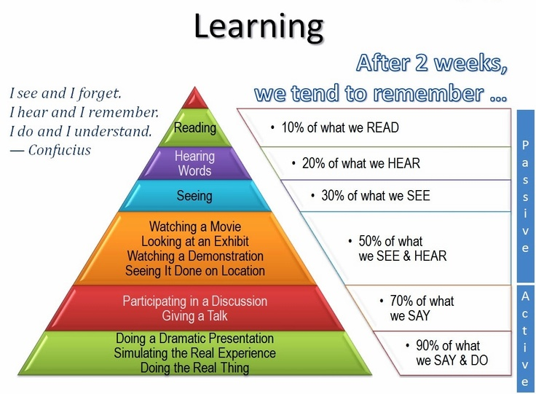

Slide 6
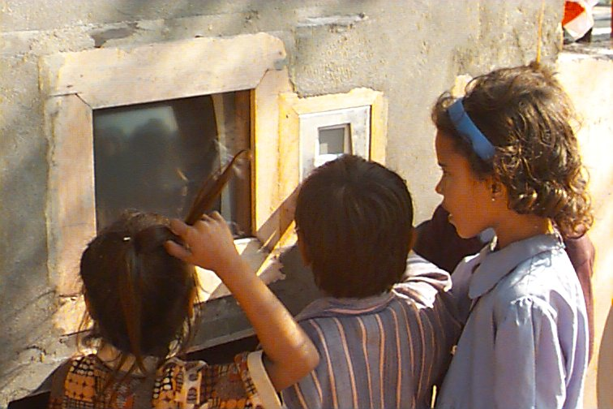
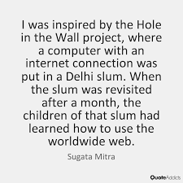
The Hole in the Wall Project
Power of Self-Organized Learning

Slide 7


IT Workshop is designed and developed on this principle..

Slide 8
Dispel these myths at IIIT NR !
B.Tech. programs need not emphasis much in skills but SHOULD concentrate only on sound Fundamentals & Theory
You need to learn all the concepts first before getting Skill based training to pursue Computer science or Electronics
A Computer science degree from abroad is very expensive and can not be undertaken by ordinary persons
Programming is a solitary activity and can not be done in group
Research in Computer science and Electronics can not be done at BTech level
Computer science, Electronics research can not provide career in Industry and Business..
Learning can not be Fun…!

