Slide 1
Video Stabilization using Point Feature Matching in OpenCV
Krutika Bapat (16100034)
Kushashwa Ravi Shrimali (16100035)
Saurabh Kumar Singh (16100051)
Mentor: Dr. Santosh Kumar (Asst. Professor, CSE)

Slide 2
Why Video Stabilization?
It is widely used in areas where most of the videos are taken through mobile phone cameras.
Digital Video Stabilization is one of the latest technique.
Its applications include wide areas such as video surveillance.
Various applications use video stabilization technique for a given input video.
Mechanical video stabilization techniques are not cost-effective.

Slide 3
Video Stabilization Techniques
Mechanical Video Stabilization
Uses the vibration feedback of the camera which is detected via special sensors like gyros accelerometers etc.
In these methods, accelerometer and gyros sensors are used for motion detection
Then the camera is moved against the movement.

Slide 4
Optical Video Stabilization
In this method, instead of moving the whole camera just the pieces of the lens glass move, which is the most effective one and employs a moveable lens assembly that variably adjusts the path length of the light as it travels through the camera’s lens system.
The angle and speed of the camera shake are detected through gyro sensors.According to the movement direction of the entire lens, the select lens elements should be moved so the image passing through the lens can be steady and sharp when it hits the imaging sensor.

Slide 5
Digital Video Stabilization
In this method, algorithms contains three main steps including
1. Motion estimation.
2. Motion smoothing
3. Image composition.
The transformation parameters between two consecutive frames are derived in the first stage. The second stage filters out the unwanted motion and in the last stage the stabilized video will be reconstructed.

Slide 6
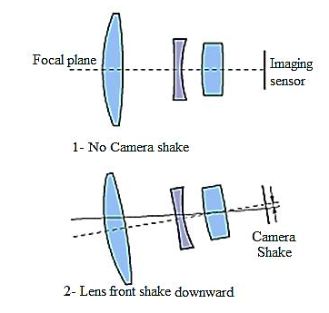
Figure 1: Lens positions during camera handshake

Slide 7
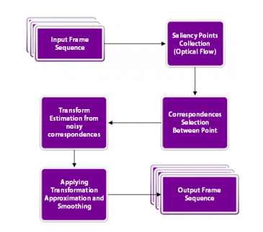

Slide 8
Steps
Transformation
Find the affine transformation from previous to current frame using optical flow for a set of frames(collected in a Frame queue). The transformation only consists of three parameters: dx (deviation in x-direction), dy (deviation in y-direction), da (deviation in angle).
2. Accumulate features
Accumulate these transformations to estimate trajectory for x, y, angle for the given queue.

Slide 9
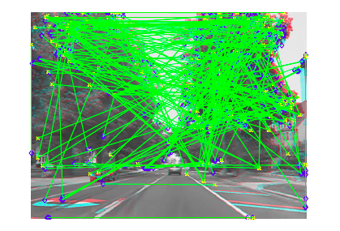
Figure 3: After finding keypoints in image

Slide 10
3. Finding motion between frames:-
Good Features to Track
The question now is what points should we choose for tracking. Keep in mind that tracking algorithms use a small patch around a point to track it. Such tracking algorithms suffer from the aperture problem as explained in the video below
So, smooth regions are bad for tracking and textured regions with lots of corners are good. Fortunately, OpenCV has a fast feature detector that detects features that are ideal for tracking. It is called goodFeaturesToTrack.

Slide 11
Optical Flow between Image frames:-
Once we have found good features in the previous frame, we can track them in the next frame using an algorithm called Lucas-Kanade Optical Flow named after the inventors of the algorithm.
It is implemented using the function calcOpticalFlowPyrLK in OpenCV. In the name calcOpticalFlowPyrLK, LK stands for Lucas-Kanade, and Pyr stands for the pyramid. An image pyramid in computer vision is used to process an image at different scales (resolutions).

Slide 12
Estimate Motion:-
We found good features to track in the previous frame.
In step 2, we used optical flow to track the features. In other words, we found the location of the features in the current frame, and we already knew the location of the features in the previous frame.
So we can use these two sets of points to find the rigid (Euclidean) transformation that maps the previous frame to the current frame. This is done using the function estimateRigidTransform.

Slide 13
Calculate smooth motion between images:
In the previous step, we estimated the motion between the frames and stored them in an array. We now need to find the trajectory of motion by cumulatively adding the differential motion estimated in the previous step.
Calculate trajectory:-
In this step, we will add up the motion between the frames to calculate the trajectory. Our ultimate goal is to smooth out this trajectory.

Slide 14


Slide 15
Advantages:-
This method provides good stability against low-frequency motion (slower vibrations).
This method has low memory consumption thereby ideal for Embedded devices(like Raspberry Pi).
This method is good against zooming(scaling) jitter in the video.

Slide 16
Disadvantages:
This method performs poorly against high-frequency perturbations.
If there is a heavy motion blur, feature tracking will fail and the results would not be optimal.
This method is also not good with Rolling Shutter distortion.

Slide 17
Thanks for your attention
Any question?
Every Ending is
Really Just A New Beginning!

