Slide 1
Protecting Barrier Reef from Outbreak of COTS
Team Member’s of : “COTS”
Purvam Sheth AU1940151
Nihar Patel AU1940119
Vedant Thakore AU1940122
Dhairya Purohit AU1940116
End-term Project Presentation
Computer Vision
Under Guidance of Prof. Mehul Raval & TA-Arpit Patel

Slide 2
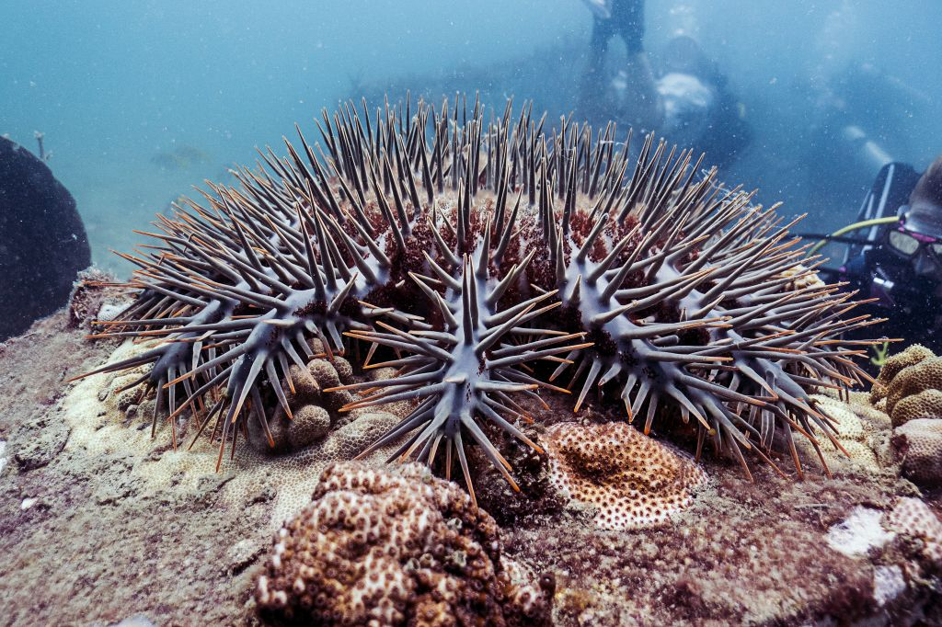
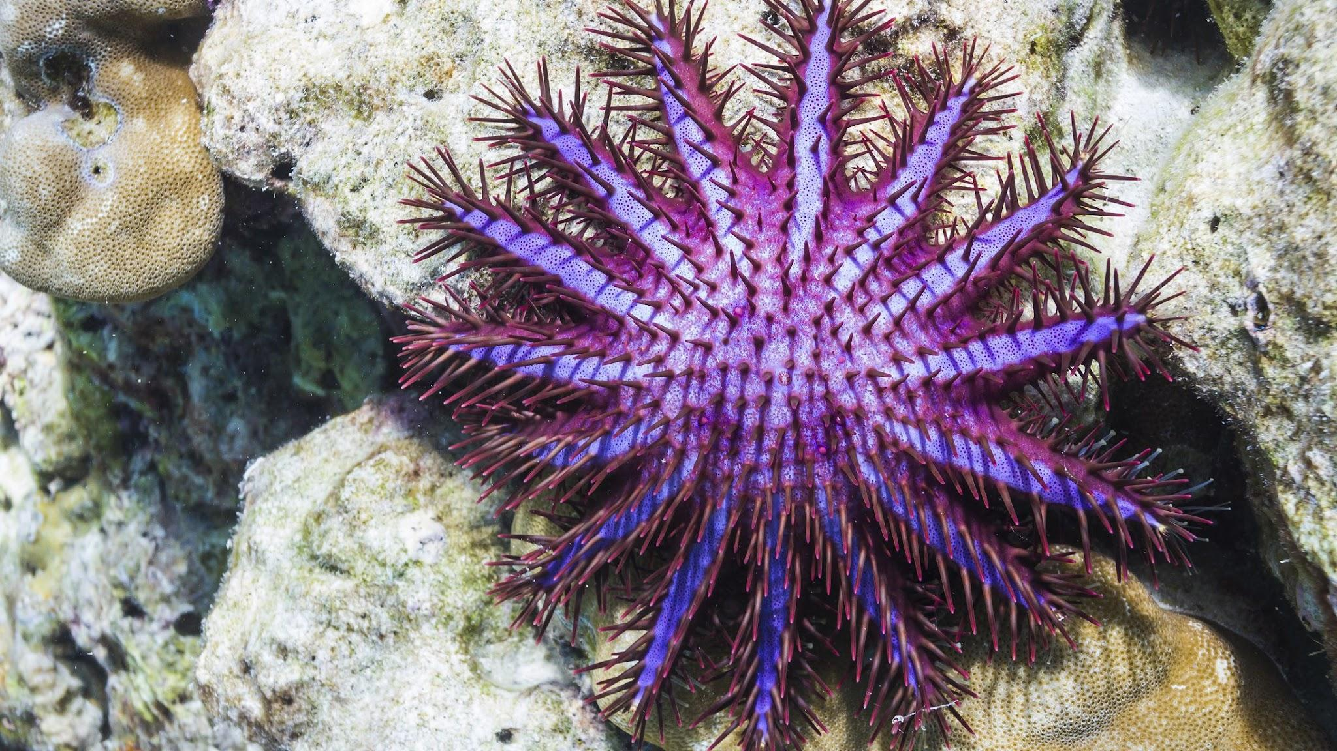
Introduction
What are COTS ?
Crown-of-thorns starfish (COTS)
What is the importance of COTS in coral habitat ?
They eat faster growing corals
Help slower growing species to catch-up
Enhances the coral diversity of reefs.
Why are COTS a problem ?
Frequent Outbreak
Density increases upto 30/hectare (normally < 1/hectare)
Significantly damage the reefs.
Figure : 1
Figure : 2
Figure:1 https://newheavenreefconservation.org/templates/yootheme/cache/crown-of-thorns-starfish-4b4c61ed.jpeg
Figure : 2 https://www.thoughtco.com/thmb/iy1za4dO8rgkbp3h4OkL5lLr9D8=/2184x1228/smart/filters:no_upscale()/GettyImages-1790686811-3fa3efde3ae94e989718fa91f71d5704.jpg

Slide 3
Problem Statement
For protecting barrier reef, COTS detection needs to be done so with the help of ‘Computer Vision’ we will make faster and accurate ‘Object detection’ model, which is to be trained on underwater videos of coral reefs for detecting COTS.
It will help researchers to recognize the threat to Australia's Great Barrier Reef
Planned Action will help to protect the reef.
Notes:
In order to make sure the sustained development of Barrier Reef, we should have a keen check over the population of ‘COTS’ in the entire region. Manual processes can be futile in marine life over a large area, so with the help of ‘Computer Vision’ we will make process a lot easier and accurate by creating ‘Object detection’ model, which will be trained from underwater videos of coral reefs.

Slide 4
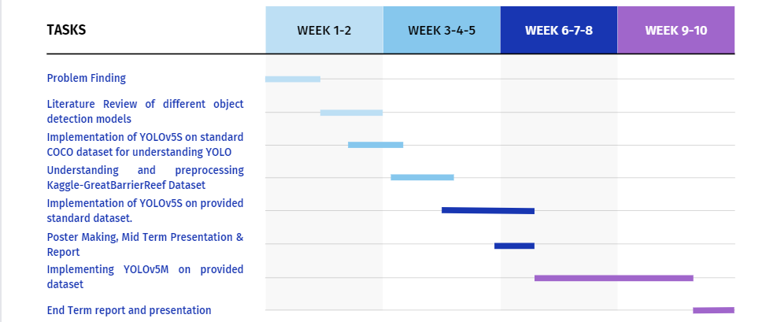
Gantt Chart

Slide 5
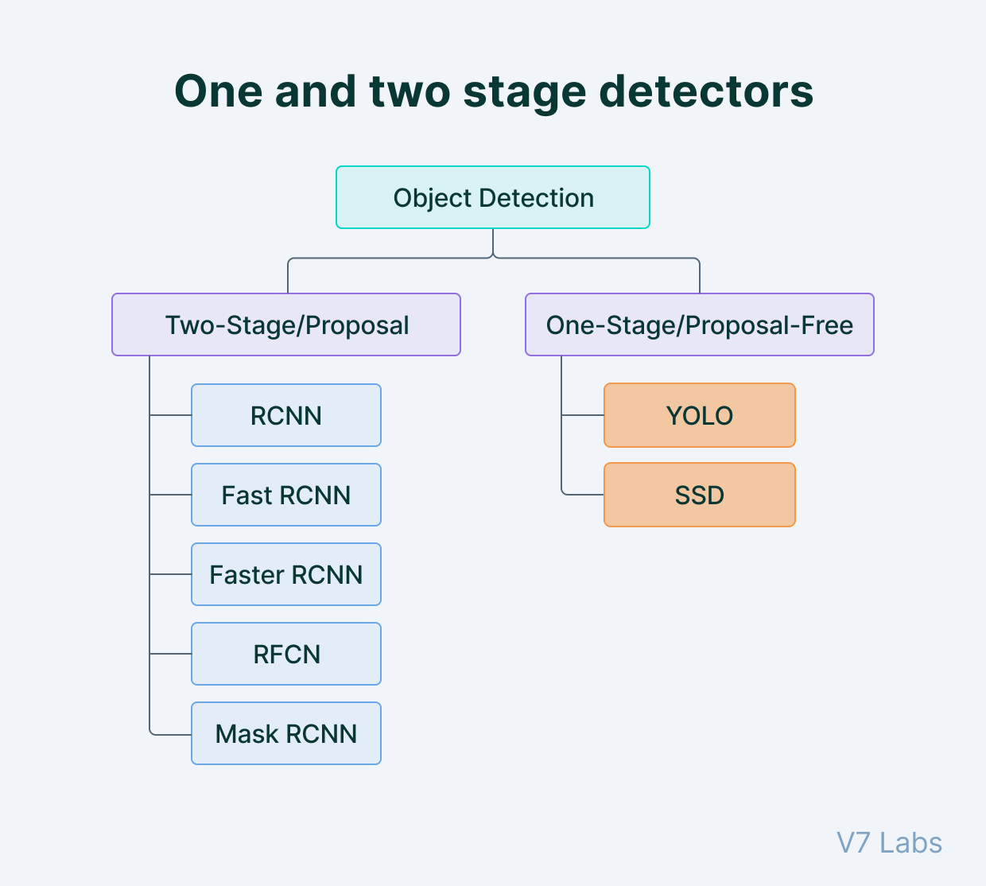
Existing body of work
2 types of object detection methods:
One-stage detection method (high inference speeds)
Two-stage detection method (high localization accuracy)
R-CNN is used for object detection greatly.
R-CNN is not made for real time computation work
Uses selective search algorithm.
It takes huge time to train the network
Faster R-CNN has high precision detection
Significant disadvantage is less detection speed
Figure : 1
Figure : 1 https://assets-global.website-files.com/5d7b77b063a9066d83e1209c/60d31e388536752a275673aa_machine-learning-infographic.jpg

Slide 6
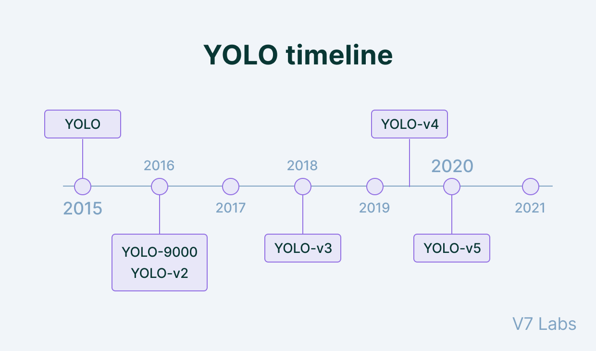
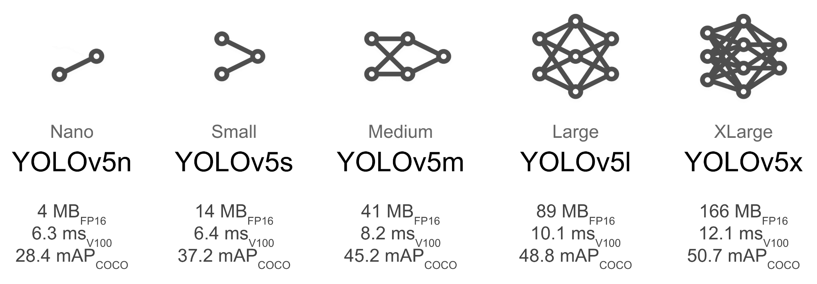
Our Approach
Object detection using YOLO-v5
Made up by single CNN
Only one forward pass required (You only look once)
Extremely Fast compared to other current models
Outperforms R-CNN & Faster R-CNN
How it works:
Residual blocks
Bounding box regression
Intersection Over Union (IOU)
Figure : 1
Figure : 1 https://assets-global.website-files.com/5d7b77b063a9066d83e1209c/6115390ff9a74f770cf01306_timeline-yolo.png
Figure : 2 https://github.com/ultralytics/yolov5/releases/download/v1.0/model_comparison.png
Figure : 2

Slide 7
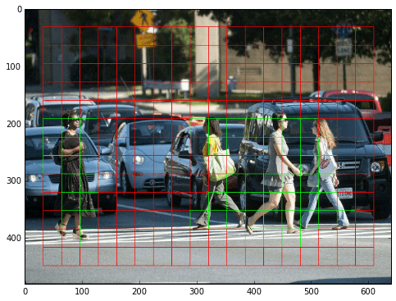
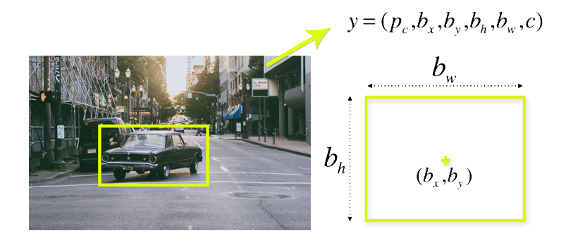
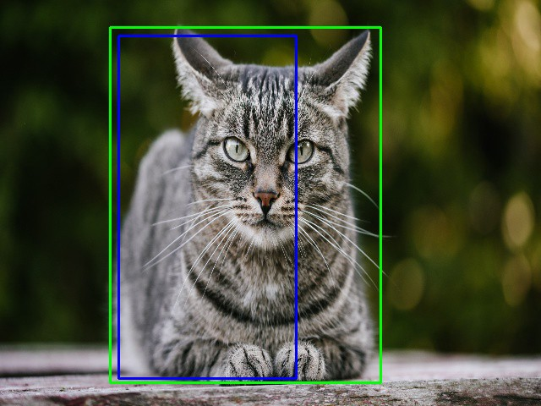
How YOLO works?
Residual blocks
Image is divided into various grids. Each grid has a dimension of S x S.
Bounding box regression
Bounding box is an outline that highlights an object in an image.
Intersection Over Union (IOU)
Intersection over union (IOU) is a phenomenon in object detection that describes how boxes overlap.
Figure : 1
Figure : 2
Figure : 1 https://www.guidetomlandai.com/assets/img/computer_vision/grid.png
Figure : 2 https://appsilon.com/assets/uploads/2018/08/bbox-1.png
Figure : 3 https://miro.medium.com/max/640/1*VuAsK1Wwa_mOxW2nK2UovQ.jpeg
Figure : 3

Slide 8
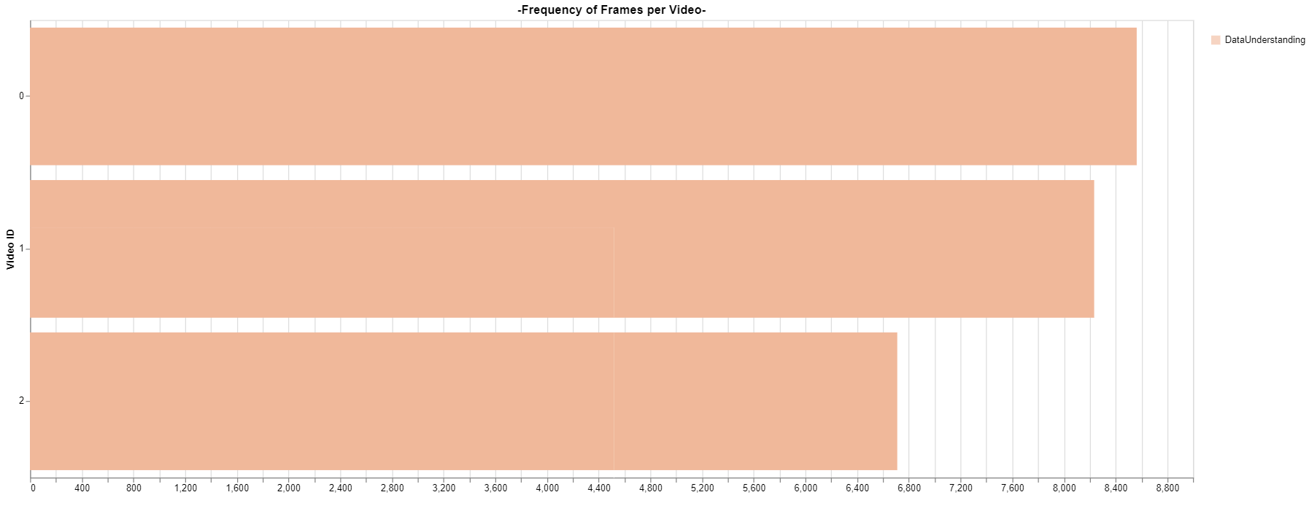
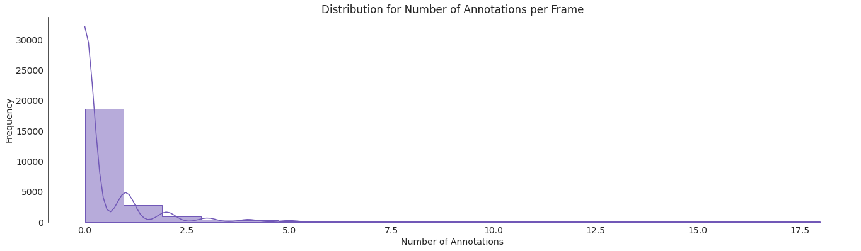
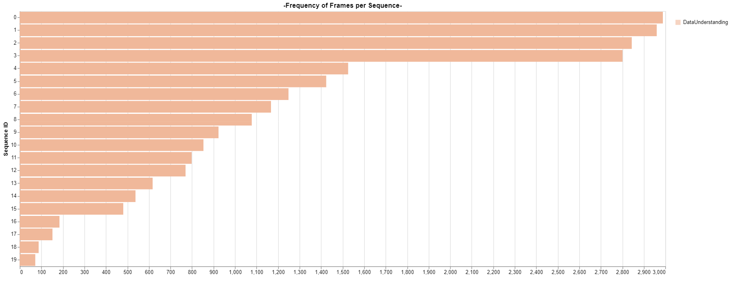
Dataset Overview
Contains 23K frames spread over 3 underwater videos
Contains CSV files contains COCO-format annotations for each frame
5K images has at least one annotation.

Slide 9
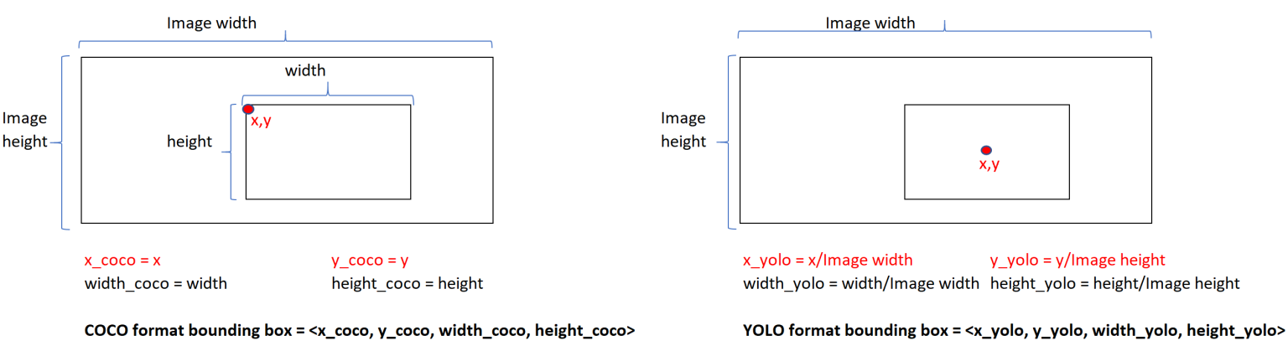
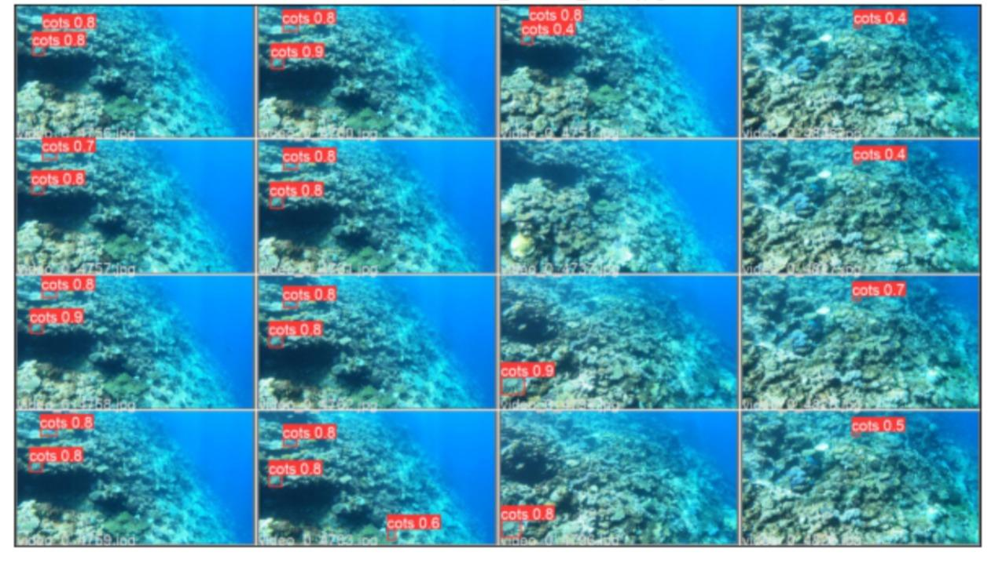
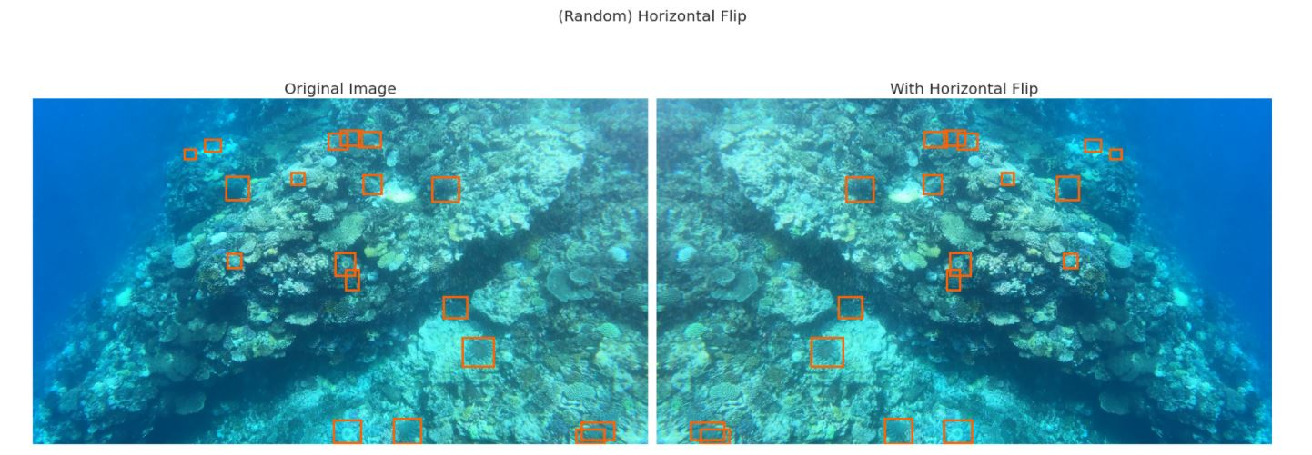
Work done
Understanding of Problem & dataset
Preprocessing of Dataset
Bounding Box format from COCO to YOLO format
[x,y, width, height] -> [x_center, y_center, width, height]
Trained model
Before Mid sem
YOLOv5s
Batch_Size - 8
Epoch - 3
Learnings
Had a bad framework
Needed a larger architecture to run
More training was required
After End sem
YOLOv5m
Batch_Size - 12
Epoch - 18

Slide 10
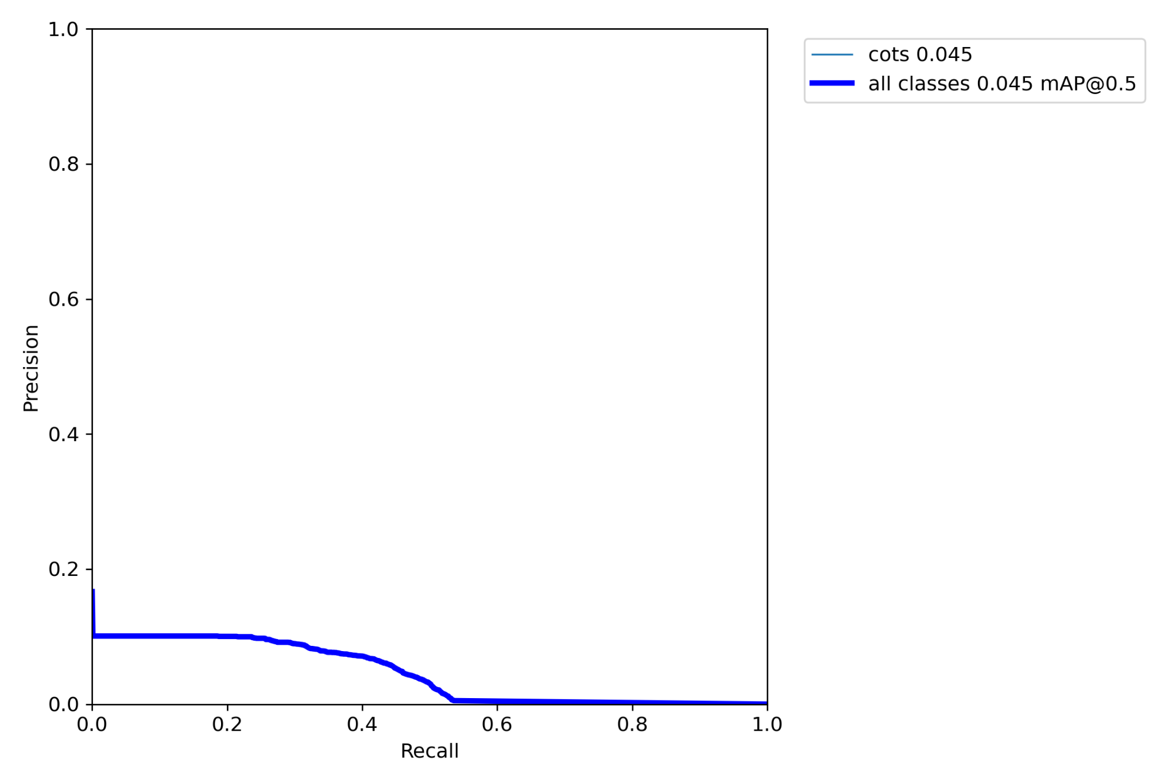
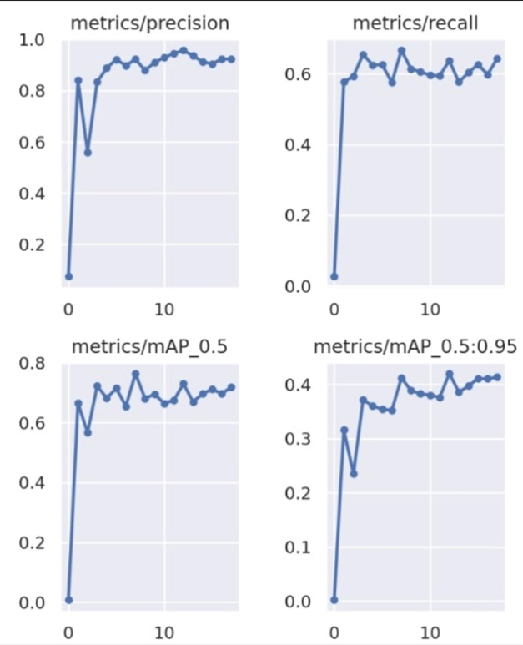
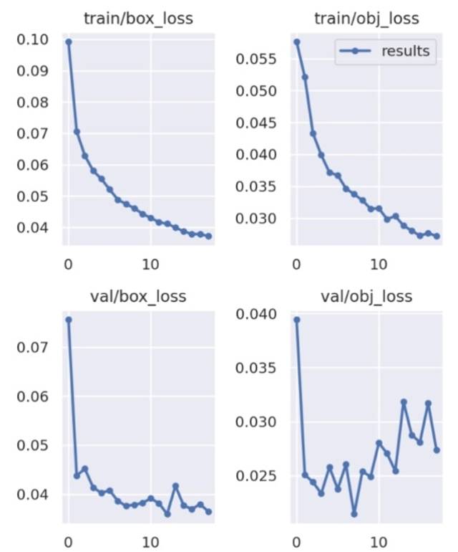
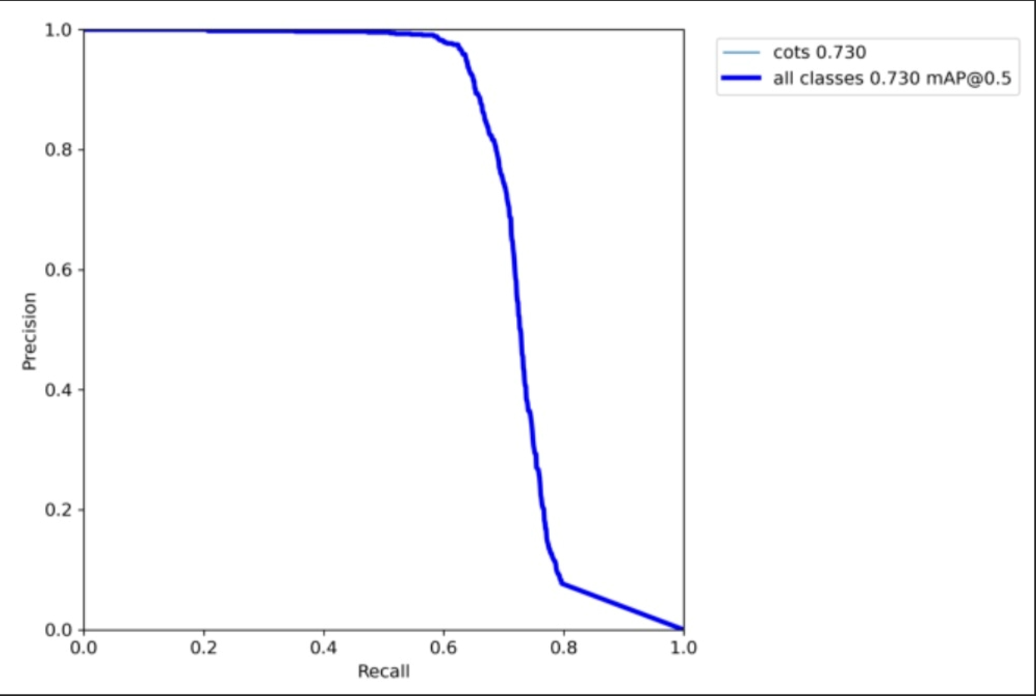
Results
PR Curve @mAP 0.5 YOLOv5s
YOLOv5m
PR Curve @mAP 0.5 YOLOv5m

Slide 11
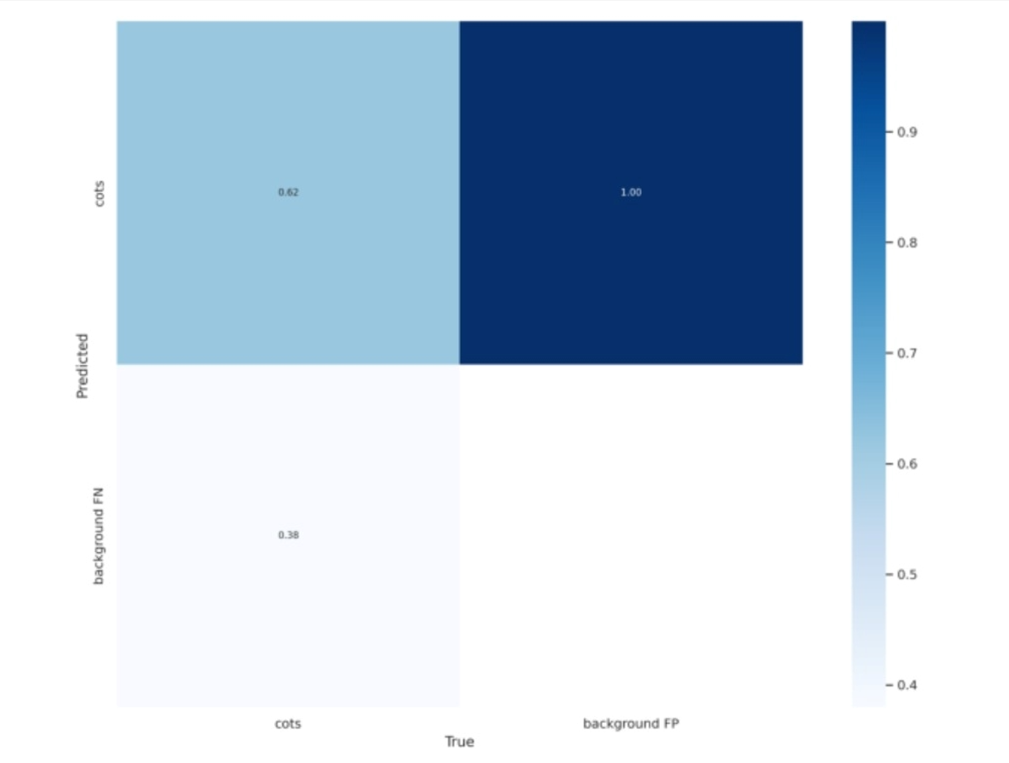
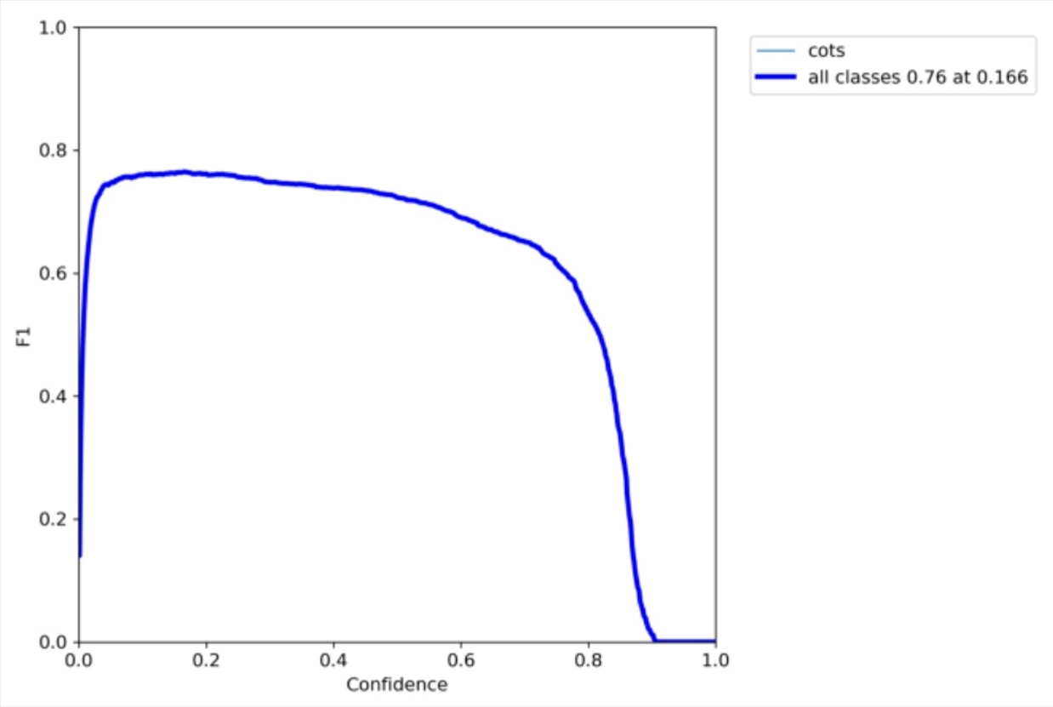
Results
PR Curve @mAP 0.5 YOLOv5s
F1 Curve
Confusion Matrix

Slide 12
Role of each member
Group Members | Purvam | Nihar | Vedant | Dhairya
Coding | ⧫ | ⧫ |  | ⧫
End-Term-PPT | ⧫ | ⧫
End-Term-Report |  |  | ⧫ | ⧫
Weekly Report | ⧫ | ⧫ | ⧫

Slide 13
Conclusion
Successfully modeled YOLOv5m
Minimize box-loss and object-loss, improvisation on true positive in comparison to Mid-Semester work.
Experimentation on Kaggle data-set shows an accuracy of nearly 62% for Yolov5m.
Outperforms other classical models
Limitation
Restricted amount of annotated data
Possible to extend to newer YOLO version - YOLOR & YOLOx

Slide 14
References
Crown of Thorns Starfish. (n.d.). Great Barrier Reef Foundation. Retrieved March 19, 2022, from https://www.barrierreef.org/the-reef/threats/Crown-of-thorns%20starfish
Crown of Thorns Starfish | Reef Resilience. (n.d.). Reef Resilience Network. Retrieved March 20, 2022, from https://reefresilience.org/stressors/predator-outbreaks/crown-of-thorns-starfish/
YOLO: Real-Time Object Detection Explained. (n.d.). V7labs. Retrieved March 20, 2022, from https://www.v7labs.com/blog/yolo-object-detection#:%7E:text=a%20negative%20prediction.-,How%20does%20YOLO%20work%3F,of%20the%20object%20it%20contains.
Introduction to YOLO Algorithm for Object Detection. (n.d.). Engineering Education (EngEd) Program | Section. Retrieved March 20, 2022, from https://www.section.io/engineering-education/introduction-to-yolo-algorithm-for-object-detection/
YOLO vs Faster RCNN. (2018, August 10). Everitt’s Blog. Retrieved March 20, 2022, from https://everitt257.github.io/post/2018/08/10/object_detection.html
G. Yang et al., "Face Mask Recognition System with YOLOV5 Based on Image Recognition," 2020 IEEE 6th International Conference on Computer and Communications (ICCC), 2020, pp. 1398-1404, doi: 10.1109/ICCC51575.2020.9345042.
https://www.mdpi.com/1999-4893/14/4/114/htm

