Slide 1
Conceptual Framework of the Study
6th Grade
Presented by: Cristel Marie Santos

Slide 2
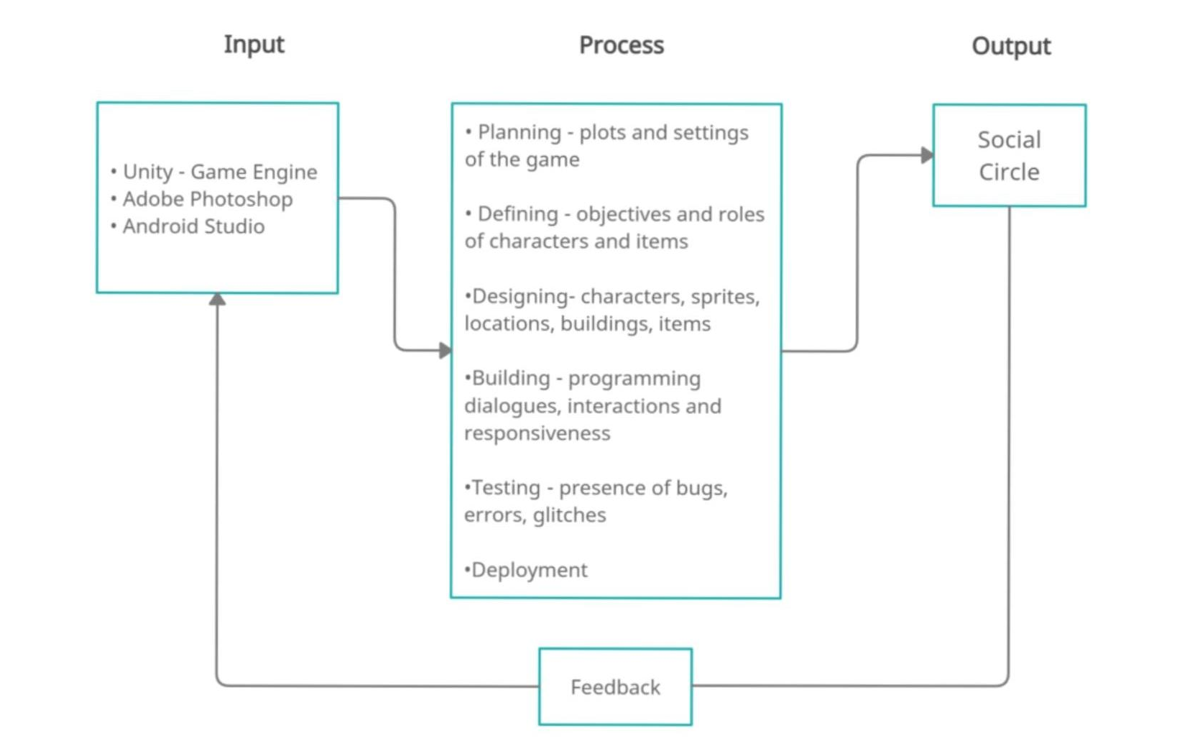
Conceptual Flow Diagram

Slide 3
Input
2
3
1
Unity – Game Engine
Android Studio
Adobe Photoshop
platform used for game development
Support the game within the Android operating system.
For graphics and design of the game.

Slide 4
Process
Planning
Building
Plots and settings
of the game
Programming dialogues, interactions, and responsiveness
Defining
Testing
Objectives and roles of
Characters and items
Presence of bugs, errors
Or glitches
Designing
Deployment
Characters, sprites, locations
Buildings, items
Release of the game

Slide 5

Output

