Slide 1
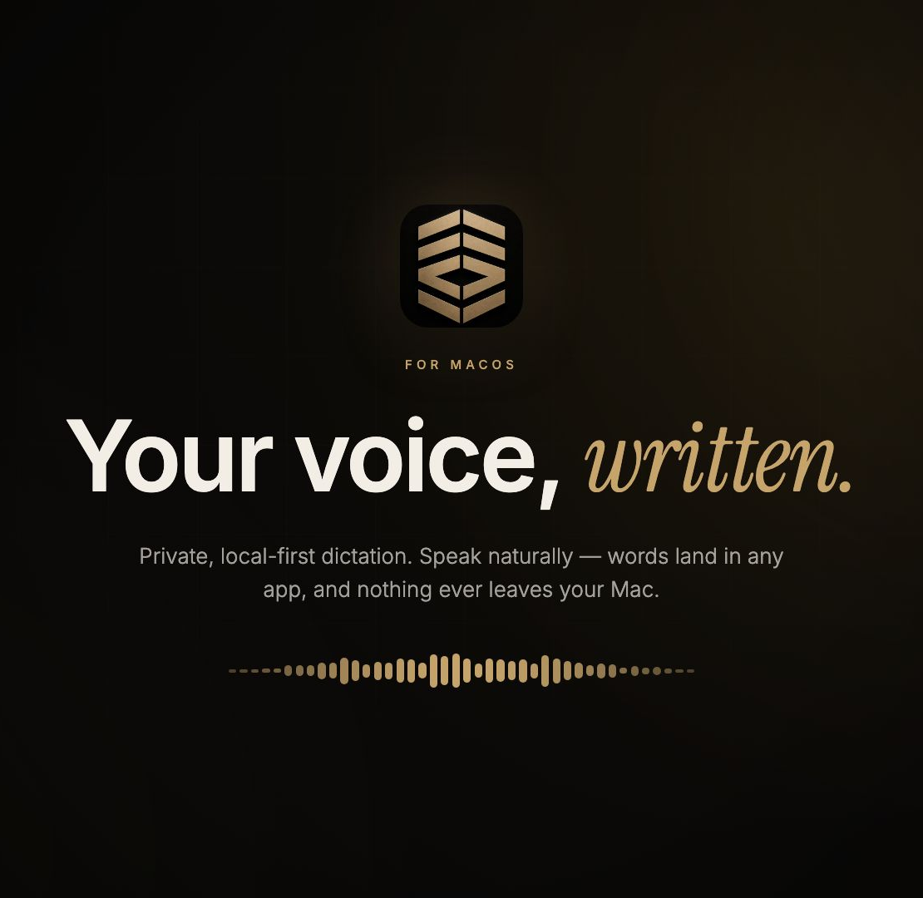

Zen
Voice
Your voice,
written.
Company product + college project
Native macOS • AI/ML • Privacy
Product, technology, use, and next steps
Notes:
Open with the idea in one sentence: ZenVoice turns speech into text inside the app a person is already using, while keeping the core speech path on their Mac. This deck treats ZenVoice as a working product-in-progress for a company and a college project; it does not claim a completed public release.
[Sources]
ZenVoice README.md; docs/ROADMAP.md; docs/RELEASE_READINESS.md; owned asset: docs/images/hero.jpg; owned asset: Resources/Brand/ZenLogo.png

Slide 2
02 / THE PROBLEM
Typing slows us down when ideas arrive faster than fingers.
People want the speed of voice without the privacy trade-off of sending their work to a remote speech service.
Students
Professionals
Private-work users
Capture an explanation or turn a rough idea into notes without stopping the lesson.
Write messages, briefs, and reports while staying inside the tools they already use.
Keep sensitive spoken context on the device instead of making cloud transcription the default.
The design question is simple: can dictation feel immediate, useful, and trustworthy at the same time?
ZENVOICE | PRIVATE LOCAL-FIRST DICTATION
02
Notes:
Explain that the product problem is not only speech-to-text accuracy. It is also friction: the user should not have to open a separate recorder, copy text manually, or sacrifice control over speech data. ZenVoice is designed around the focused app and a short, repeatable interaction.
[Sources]
ZenVoice README.md; docs/PRIVACY.md

Slide 3
03 / THE SOLUTION
ZenVoice types spoken words into the focused Mac app.
Its product promise is not “AI everywhere.” It is a focused local workflow: speak, review if needed, and keep working.
1. Natural input
2. Local intelligence
3. Useful output
Use a global shortcut to start and stop dictation without leaving the current app.
Choose an on-device speech engine that fits the language, hardware, and task.
Insert clean text, remember corrections, and give the user control over history.
ZENVOICE | PRIVATE LOCAL-FIRST DICTATION
03
Notes:
The class should leave this slide with the product definition: ZenVoice is native macOS software, not a website or a cloud-only chatbot. It uses a global shortcut, a local ASR engine, and Accessibility insertion to move text into the app where the caret already is.
[Sources]
ZenVoice README.md; Package.swift

Slide 4
04 / HOW TO USE IT
Daily dictation should take seconds, not attention.
A small repeatable loop is more useful than a complicated voice workspace.
01
02
03
04
05
Focus
Start
Speak
Stop
Continue
Place the cursor in any editable field.
Press Ctrl + Option + Space.
ZenBar shows recording and preview.
Press again, or release hold-to-dictate.
Text is inserted; History can reuse it.
Accessibility permission enables direct insertion. Without it, ZenVoice still leaves the transcript on the clipboard.
ZENVOICE | PRIVATE LOCAL-FIRST DICTATION
04
Notes:
Walk through this using a simple example: open Notes, put the cursor in a document, press the shortcut, say a sentence, press again, and keep typing. The app does not replace the target application; it augments it. Mention the clipboard fallback because it is an honest accessibility-permission behavior.
[Sources]
ZenVoice README.md — Features, Quick Start, How it works

Slide 5
05 / CORE FEATURES
Small interface. Deliberately rich workflow.
Features are designed around speed, recovery, and predictable behavior instead of a crowded dashboard.
ZenBar
Audio Doctor + permissions
A compact 108 × 36 capsule appears on the display being used; controls stay out of the way until needed.
A short local microphone check and clear live permission status help diagnose setup problems.
Live preview
Per-app rules
Optional on-device preview gives feedback while speaking; final insertion still comes from the chosen final engine.
Language, refinement, and voice-command behavior can follow the app where the dictation started.
ZENVOICE | PRIVATE LOCAL-FIRST DICTATION
05
Notes:
These are the visible product controls. Explain that ZenBar acts like a lightweight recording status surface rather than a full window. The Audio Doctor is especially useful in a class demo because microphone selection and permission problems are common; the check is local and deletes its temporary fixture immediately.
[Sources]
ZenVoice README.md — Features; docs/PRIVACY.md — Microphone audio

Slide 6
06 / PRIVACY BY DESIGN
The default is local processing, not a hidden data pipeline.
That is the central product boundary: audio, transcript handling, and paste happen on the Mac unless a user explicitly opts into a text-only cloud formatting request.
No account
Encrypted history
Private Dictation
Optional cloud
No subscription and no analytics are required for core dictation.
Transcripts use AES-GCM in local SQLite; the key stays in macOS Keychain.
A dedicated mode keeps no transcript or recovery audio.
Finished text + a prompt — never audio.
Important nuance: optional Audio History is off by default and is not encrypted at rest. ZenVoice exposes that trade-off instead of hiding it.
ZENVOICE | PRIVATE LOCAL-FIRST DICTATION
06
Notes:
This is the privacy slide to slow down on. The point is not to say that technology is magically private. The point is that the product explicitly separates local default operation from optional cloud formatting. Explain that encrypted transcript history and optional Audio History are different things; the product documents Audio History as an explicit local archive with its own risk.
[Sources]
ZenVoice README.md — Privacy; docs/PRIVACY.md; docs/decisions/0010-audio-history.md; docs/decisions/0011-cloud-ai-enhancement.md

Slide 7
07 / PERSONALIZATION
Personalize text without profiling the person.
ZenVoice personalizes text behavior through local corrections and controls, not a biometric voiceprint.
Text quality controls
History and insight controls
• Deterministic Clean formatting
• Guarded on-device Smart refinement
• Local correction rules for names and repeated phrases
• Optional next-dictation context kept only in memory
• Search, copy, retry, delete, and Recovery Inbox
• Local words, WPM, streaks, and app insights
• Pause history; correction rules stay encrypted locally
ZENVOICE | PRIVATE LOCAL-FIRST DICTATION
07
Notes:
Use this slide to make the AI/ML work concrete without exaggerating it. ZenVoice first applies deterministic cleanup, then can use guarded on-device refinement where supported. A Voice Profile means language-use patterns and explicit corrections stored locally; it is explicitly not a biometric voiceprint. This distinction matters for privacy and consent.
[Sources]
ZenVoice README.md — Formatting, Insights, Voice profile; docs/VOICE_PROFILE.md; docs/INSTANT_REFINE.md; docs/PRIVACY.md

Slide 8
08 / HOW IT WORKS
A native Mac pipeline turns a shortcut into text.
The architecture is intentionally direct: one user action, one local audio path, one selected engine, and a controlled insertion step.
Shortcut
Microphone
AI engine
Cleanup
Insert
Global hotkey
16 kHz mono
Whisper / Parakeet / Apple Speech
Formatting + corrections
Clipboard + Accessibility
Storage is a separate choice: encrypted transcript history is local, while Private Dictation can leave no record at all.
ZENVOICE | PRIVATE LOCAL-FIRST DICTATION
08
Notes:
Describe this as a data-flow diagram. The shortcut starts local recording. The selected local engine performs speech recognition. Then controlled cleanup and personal correction rules run before the result is copied and, with Accessibility permission, inserted into the target app. This separation lets the team change the engine without changing the product’s basic privacy behavior.
[Sources]
ZenVoice README.md — How it works and Architecture table; Package.swift; docs/ARCHITECTURE.md

Slide 9
09 / LOCAL AI MODEL STRATEGY
One model does not fit every language or Mac.
ZenVoice keeps an explicit, hardware-aware model catalogue so that the app recommends an engine rather than treating all models as interchangeable.
Parakeet TDT v3
Whisper Turbo
Apple Speech
Recommended final insert for English and supported European languages on Apple Silicon.
Multilingual and auto-detect fallback for a broad set of languages.
Zero-download fallback that uses installed on-device macOS Speech languages.
25 languages • Apple Silicon
Up to 99 languages • Apple Silicon
System languages • Apple Silicon + Intel
Model files are selected, downloaded, verified, and removable through the app — the engine runtime and model file are treated as separate things.
ZENVOICE | PRIVATE LOCAL-FIRST DICTATION
09
Notes:
This is an AI/ML design decision, not just a list of model names. An engine is the code that runs a model. Hardware-aware recommendation matters because a very large model is not always better for latency, memory, or a particular language. The model catalogue keeps compatible family pairs pinned and verified.
[Sources]
ZenVoice README.md — Supported models; docs/MODEL_CATALOG.md; docs/decisions/0005-multi-engine-architecture.md

Slide 10
10 / MEASURED QUALITY, NOT ONLY A FEATURE CLAIM
The recommended engine leads on measured quality.
These numbers guide product defaults. They are not a promise that public speech data fully represents every user’s dictation.
Test context: 262 frozen Common Voice Spontaneous English clips, 3,084 seconds, MacBook Pro M5, measured 2026-08-18. A consented representative dictation cohort is still pending.
ZENVOICE | PRIVATE LOCAL-FIRST DICTATION
10
Notes:
Explain WER as Word Error Rate: lower is better. Real-time multiple shows the ratio between processing speed and recording duration: 73× means the engine processed the test audio about 73 times faster than real time. Then add the scientific caveat: public spontaneous-speech data is useful for comparison, but it is not treated as representative of real ZenVoice dictation. A product-quality decision must earn that claim through a consented cohort.
[Sources]
docs/REAL_SPEECH_CORPUS.md — Per-engine baselines; docs/PHASE_6.md; docs/CONSENTED_DICTATION_MODEL_CYCLE.md

Slide 11
11 / WHERE THE PRODUCT CREATES VALUE
One local-first core, three kinds of value.
Different users get different value from the same basic flow: faster text input in the place they already work.
College project
Company workflow
Individual use
Practice local AI/ML integration, accuracy evaluation, native macOS engineering, and responsible data design.
Draft emails, reports, tickets, documentation, and notes without switching to a separate dictation workspace.
Keep control over shortcuts, language, correction rules, history, and whether anything is saved.
ZENVOICE | PRIVATE LOCAL-FIRST DICTATION
11
Notes:
For a class, make the link between theory and product work explicit. This is not only a UI project. It includes speech models, performance measurement, encryption at rest, permission design, and the human factors of fitting voice into existing workflows. For a company, the opportunity is reliable text production without a disruptive new workspace.
[Sources]
ZenVoice README.md; docs/ROADMAP.md; Package.swift

Slide 12
12 / EDUCATION DIRECTION
Lecture capture: useful, local, and safely scoped.
This is a defined product direction — not a claim that ZenVoice can reliably identify teachers or students today.
V1: usable core
Text-only cloud summary
V2: deliberately gated
Local WAV + immutable transcript + encrypted summary. Delete removes its local data.
Only finished text may go through the existing BYO-key cloud summary path; audio never goes to that service.
Teacher/student diarization is not being integrated because tested candidates did not meet the reliability gate.
Product lesson: a feature that mislabels people is worse than no feature. The safer version waits for evidence.
ZENVOICE | PRIVATE LOCAL-FIRST DICTATION
12
Notes:
This slide shows mature product thinking. Lecture capture v1 is intentionally narrow: one local audio file, one original transcript, and an optional summary. The team researched two-role diarization but the benchmark did not meet a conservative reliability threshold, so the correct engineering choice is to stop rather than ship incorrect teacher or student labels. That limitation is a strength in a college presentation because it demonstrates evidence-based development.
[Sources]
docs/decisions/0014-lecture-capture-v1.md; docs/decisions/0015-lecture-two-role-diarization.md; docs/DIARIZATION_ENGINE_GATE_2026-08-22.md; docs/TEACHER_REST_ARCHITECTURE_GATE_2026-08-22.md

Slide 13
13 / CURRENT STATUS AND NEXT MILESTONES
Working personal alpha. Clear path to shipping.
The app is running and the core product is implemented; public shipping is intentionally deferred until release gates are completed.
The guiding rule: do not call a green build or a running prototype a finished public release without the delivery evidence.
Now
Next
Ship
Native menu-bar app
Local engines
Encrypted history
Daily reliability
Lifecycle coverage
Manual QA
Developer ID signing
Notarization
Clean-device + accessibility QA
ZENVOICE | PRIVATE LOCAL-FIRST DICTATION
13
Notes:
Be transparent about status. The codebase has a native menu-bar app, local engines, history, model catalogue, and validation checks. But the project roadmap says public shipping is deferred. A real external release needs Developer ID signing, notarization, exact-package testing on a clean supported Mac, and accessibility QA. In a company setting, this protects user trust; in a college setting, it shows that release engineering is real work.
[Sources]
docs/ROADMAP.md; docs/RELEASE_READINESS.md; docs/RELEASE_QA_RECORD.md

Slide 14
ZenVoice makes speaking a private, productive way to write.
A focused native app, local AI models, measurable quality, and honest product boundaries — built as both a company product and a college project.
Thank you • Questions / demo
ZenVoice for macOS
Notes:
Close by repeating the product outcome rather than the feature list. Invite questions about the local-AI architecture, privacy model, accuracy measurement, or the next milestones. If you are demoing, this is the moment to open an editable text field and show the short dictation loop from slide four.
[Sources]
ZenVoice README.md; docs/ROADMAP.md; owned asset: Resources/Brand/ZenLogo.png

