Slide 1

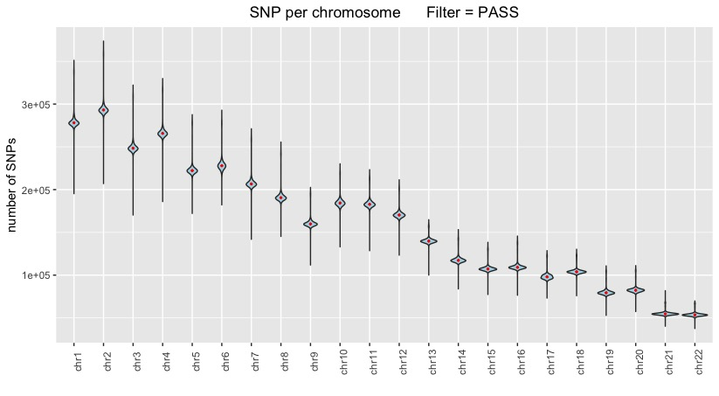
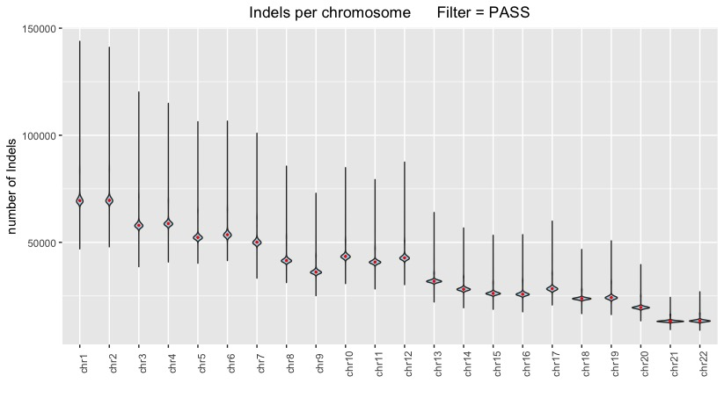
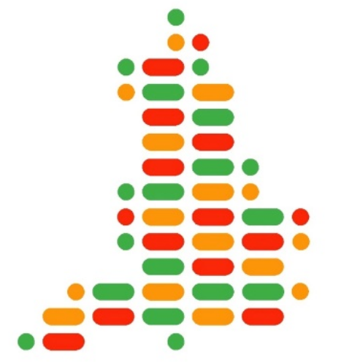
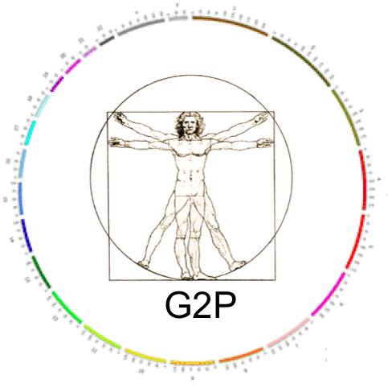
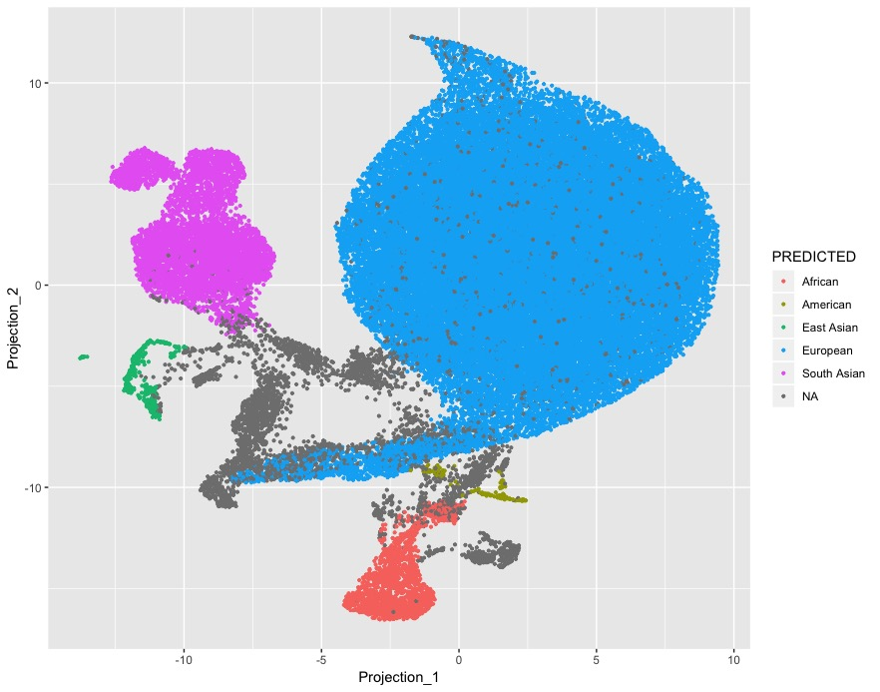
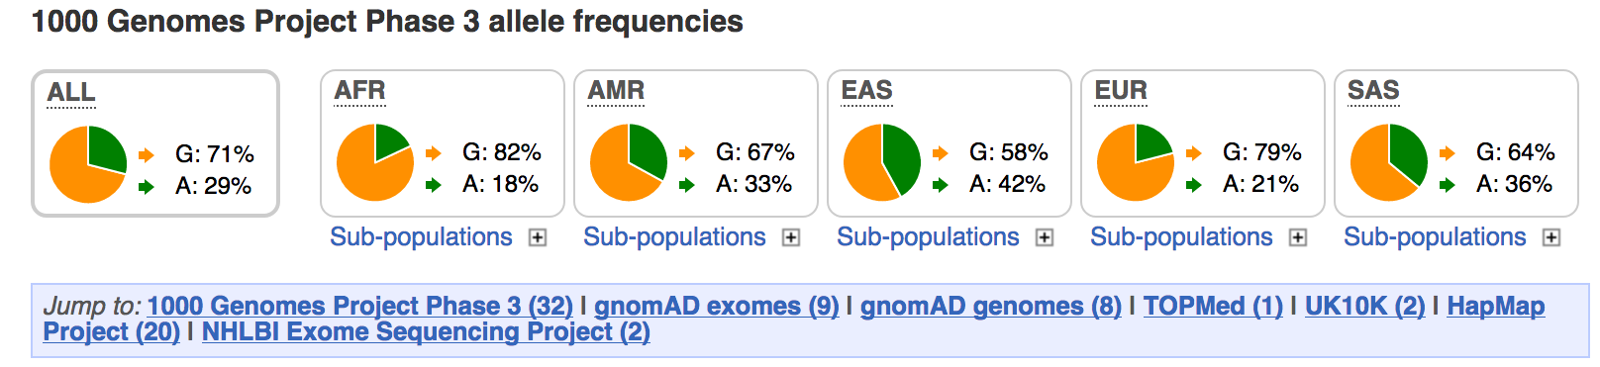
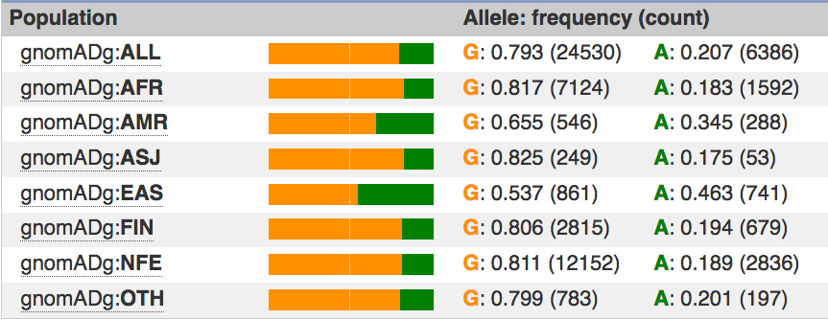

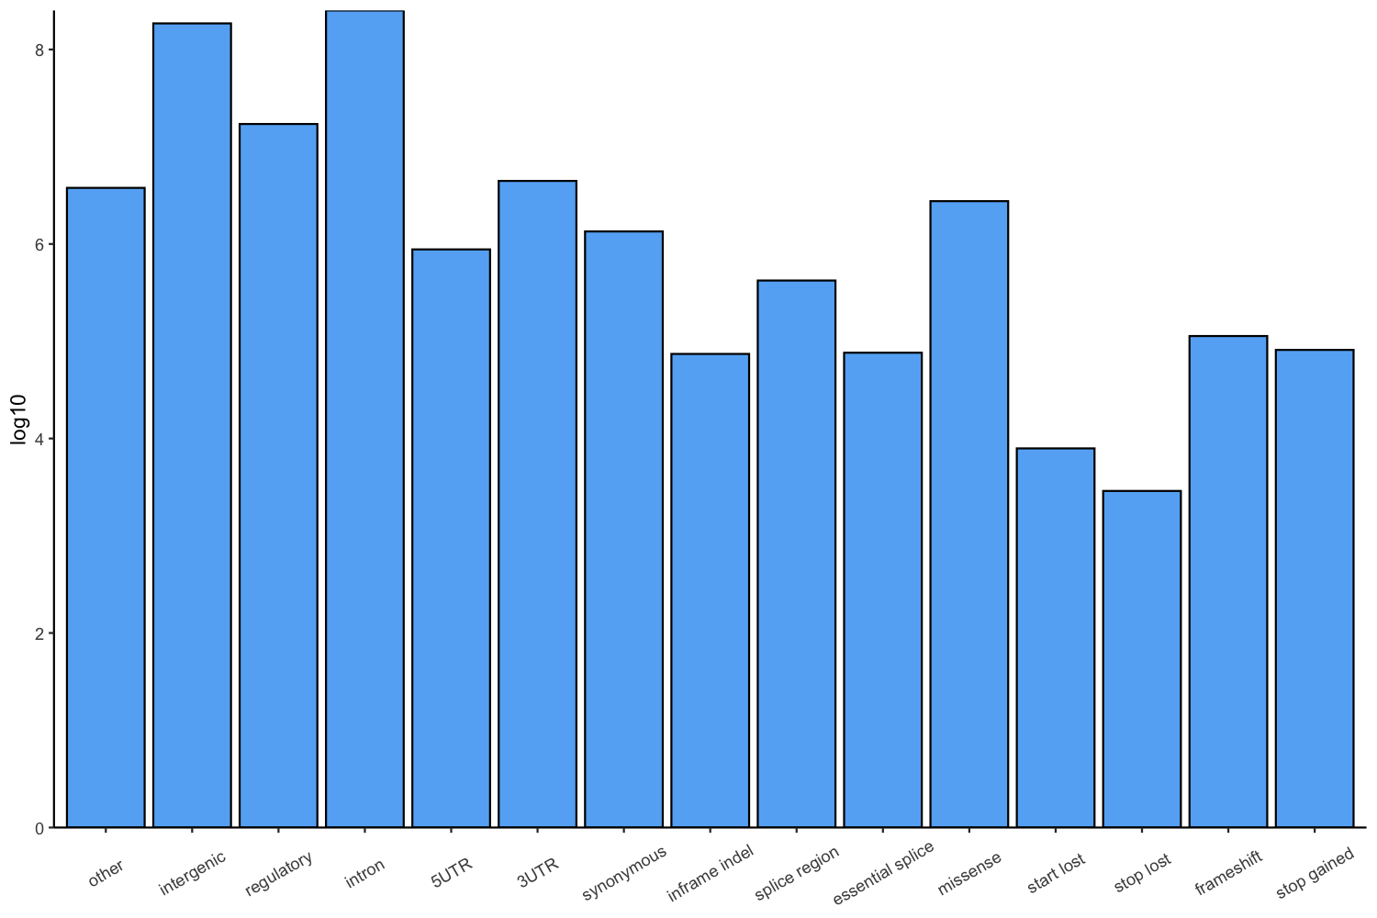
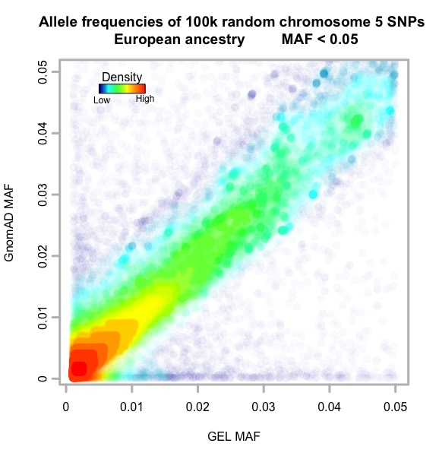
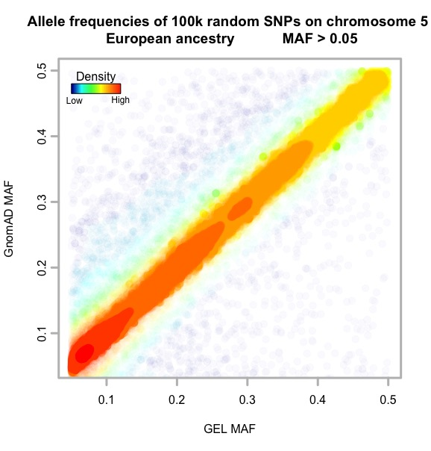
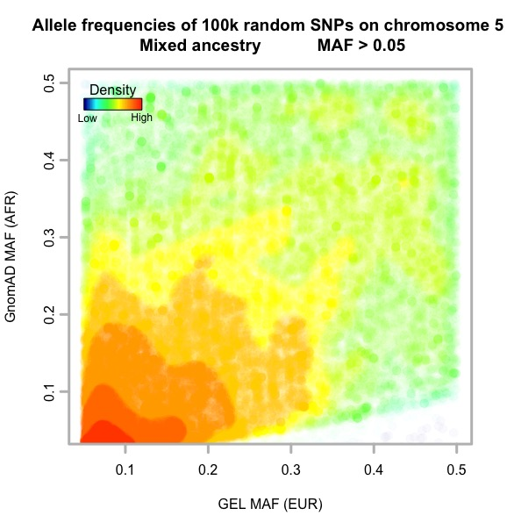
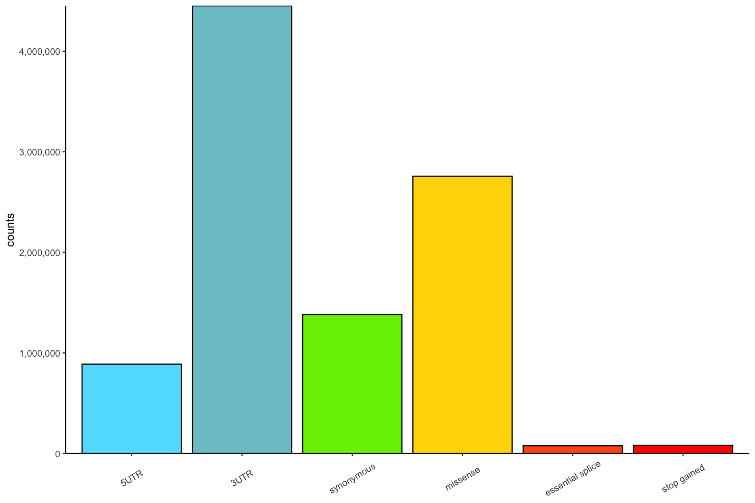
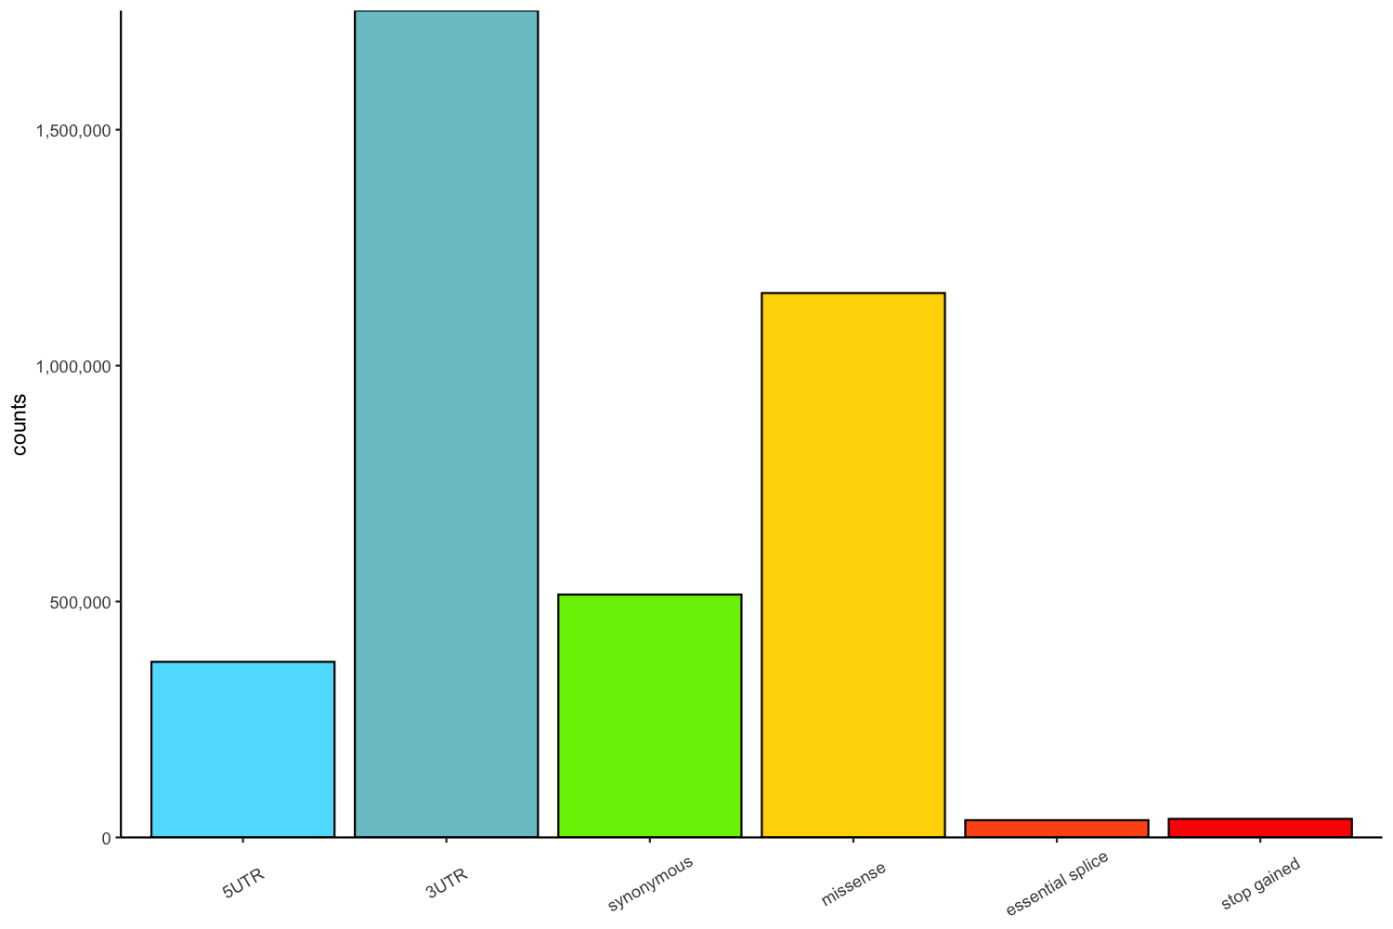
Creation of a dense, public allele frequency resource
Sarah Hunt ¹, Matthias Wielscher², Loukas Moutsianas², Irina Armean¹, Patrick Short³, Paul Flicek¹, Matthew Hurles³, Augusto Rendon², Anna Need², Ewan Birney¹,the Genomics England Research Consortium
¹ European Molecular Biology Laboratory, European Bioinformatics Institute, Hinxton, Cambridgeshire, UK
² Genomics England, Dawson Hall, Queen Mary University of London, Charterhouse Square, London, UK
³ Wellcome Sanger Institute, Wellcome Genome Campus, Hinxton, Cambridgeshire, UK
Data Available
Data Importance
Sequence from 59,464 individuals (release 5.1) has been analysed and 677,003,512 variants have been called on GRCh38.
Basic quality control has been applied:
The 100,000 Genomes Project will create a deep collection of population frequency data
These data will enable an improved understanding of constraint in the genome
Allele frequency distributions at this scale can accelerate diagnosis of rare disease
Sample filtering:
cross-contamination < 5%
mapping rate > 75%
mean sample coverage > 20
insert size < 250
The variant PASS flag is set if:
missingness < 5%
coverage >= 10
genotype quality >=15
genotypes passing allelic imbalance test >= 0.25
Example: VEP – G2P
Proband
VCF
+ 100,000 Genomes Project data
Variants per individual, per chromosome
Gene information
Frequencies filter
1000 Genomes
gnomAD
TOPMed
PanelApp
Mutational
consequence
Predicted
Consequences
bi-allelic gene < 0.005
mono-allelic gene < 0.0001
Alleleic
requirement
Filtered variants
Filtered transcripts
G2P DDD | Sensitivity | Precision
de novo | 97.3% | 33%
inherited | 81.6% | 22.7%
Probable gene
Thormann et al. 2019
Ancestry prediction
Data Distribution
A 100,0000 Genomes Project data browser is planned
Frequencies will be also displayed alongside other large scale data in the Ensembl browser and available in Ensembl VEP
Uniform Manifold Approximation and Projection (UMAP) plot showing inferred ancestries.
Ancestries were inferred using the R-package randomForest, and data from the 1000 Genomes project (1kGP3) as the truth. The 1kGP3 study participants were split into broad ancestries (African, American, East Asian, European, and South Asian). Based on the similarity of the first 6 PCs between the 1kGP3 dataset and the 100,000 Genomes dataset, probabilities of each sample in the 100,000 Genomes dataset belonging to any one of the broad ancestries were calculated. A threshold of T=0.9 was applied for assignment. Participants below this threshold are shown in grey. For further details, see data freeze folder: /gel_data_resources/main_programme/aggregated_illumina_gvcf/GRCH38/20190228
Example of current Ensembl frequency distribution views
Consequence prediction
Minor allele frequency comparison
Most severe consequence per variant in the most supported Ensembl transcript per gene, as calculated with Ensembl VEP, version 98.
Passed variants only
Genome Aggregation Database MAF
a
100,000 Genomes Project MAF
b
100,000 Genomes Project MAF
c
100,000 Genomes Project MAF
Minor allele frequencies (MAF) across cohorts, for variants with MAF below (a) or above (b) 5%, for individuals of European ancestry or between individuals of European and African ancestry (c).
Every dot represents a pair of minor allele frequencies.
Colour indicates the proportion of SNPs with a pair of MAFs (red: common, blue: rare).
Data from unrelated participants was stratified by inferred ancestry
When allele frequencies across different ancestries are compared (c), we see reduced concordance between the datasets as expected.
All passed variants, major transcript consequences only.
Only singletons, major transcript consequences only.
This research was made possible through access to the data and findings generated by the 100,000 Genomes Project. The 100,000 Genomes Project is managed by Genomics England Limited (a wholly owned company of the Department of Health and Social Care). The 100,000 Genomes Project is funded by the National Institute for Health Research and NHS England. The Wellcome Trust, Cancer Research UK and the Medical Research Council have also funded research infrastructure. The 100,000 Genomes Project uses data provided by patients and collected by the National Health Service as part of their care and support.
Ensembl receives majority funding from the Wellcome Trust (grant number WT108749/Z/15/Z) with additional funding for specific project components from the National Human Genome Research Institute (U41HG007823 and 2U41HG007234), the Biotechnology and Biological Sciences Research Council (BB/L024225/1 and BB/M011615/1), Open Targets, the Wellcome Trust (WT104947/Z/14/Z, WT200990/Z/16/Z, and WT201535/Z/16/Z) and the European Molecular Biology Laboratory. This project has received funding from the European Union’s Horizon 2020 research and innovation programme under grant agreement n° 634143 (MedBioinformatics). This project has received funding from the European Union’s Horizon 2020 research and innovation programme under grant agreement n° 733161 (MultipleMS).

