Slide 1













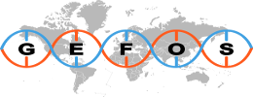







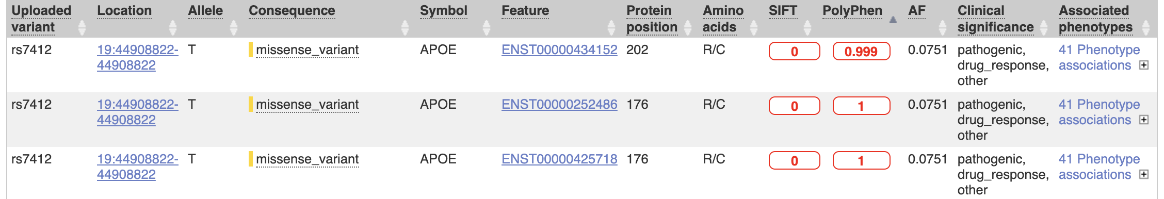
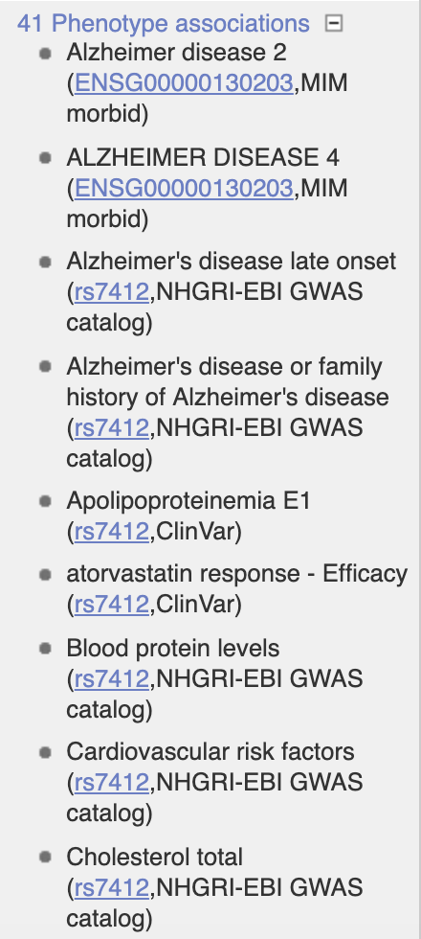

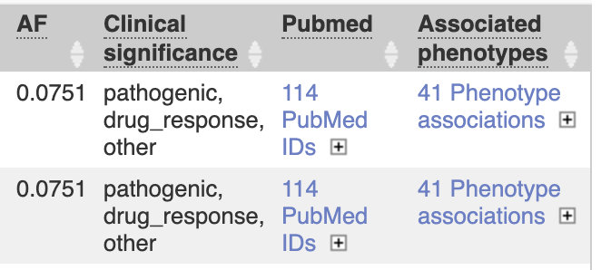

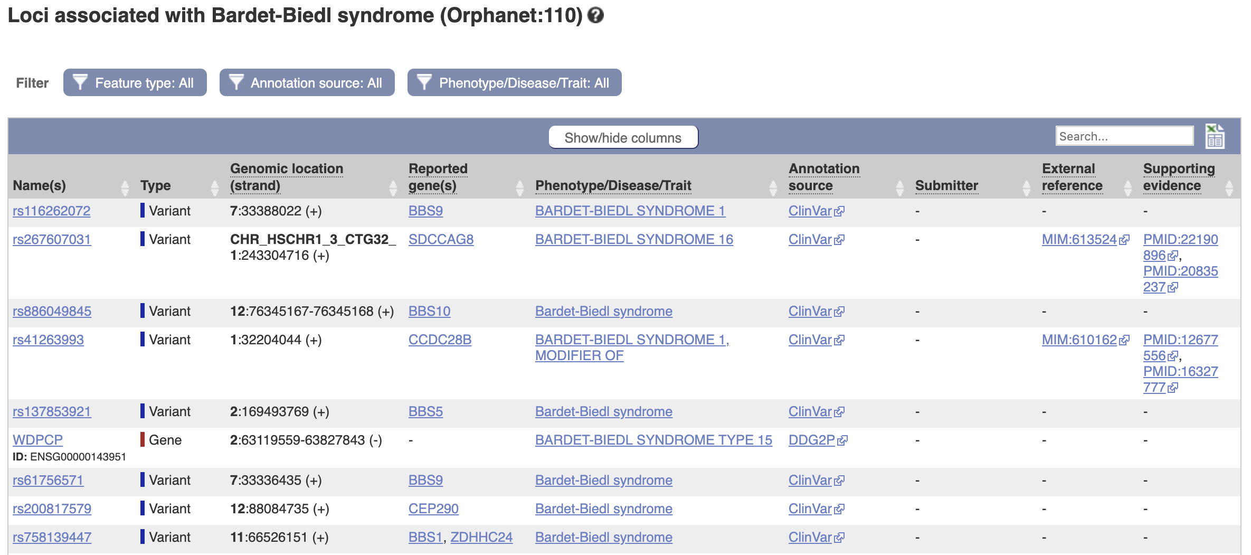
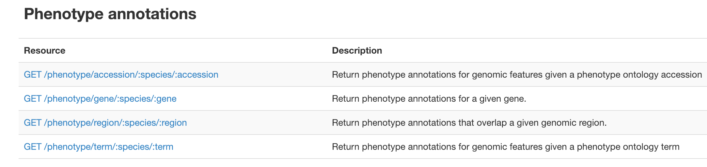
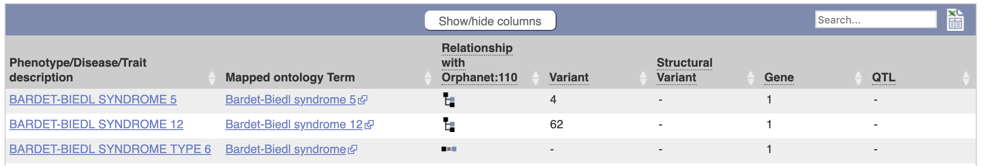
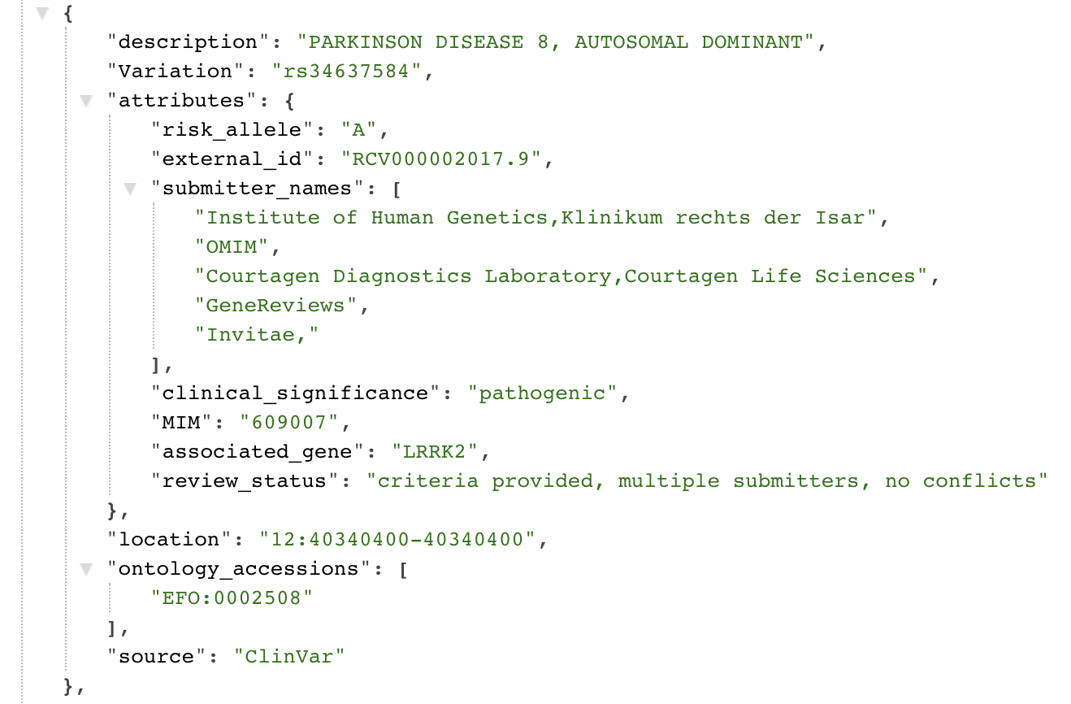
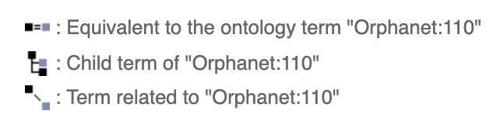
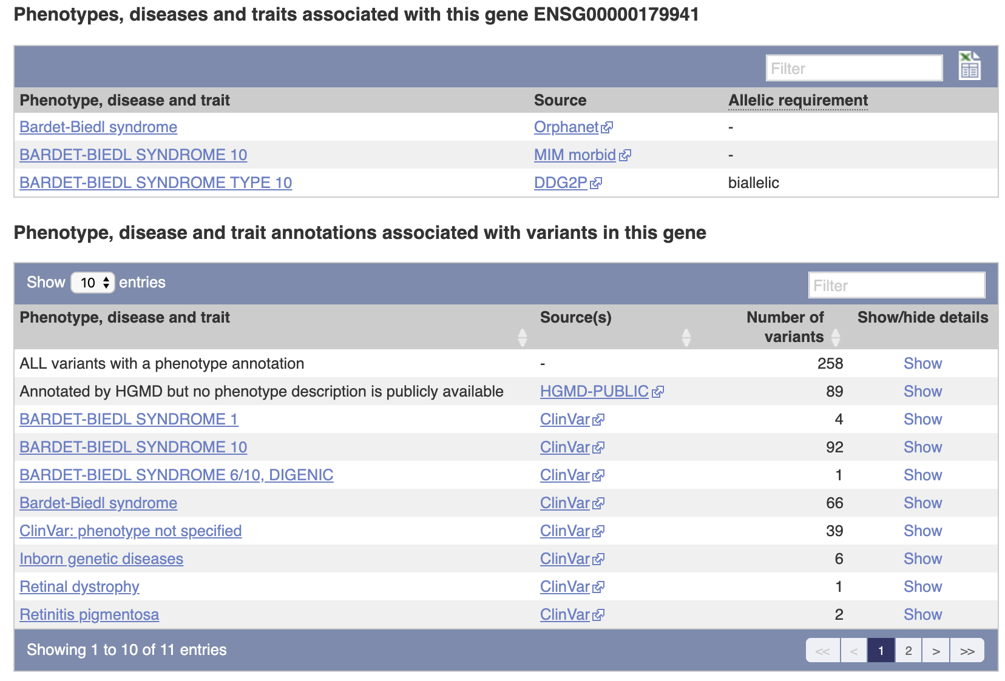
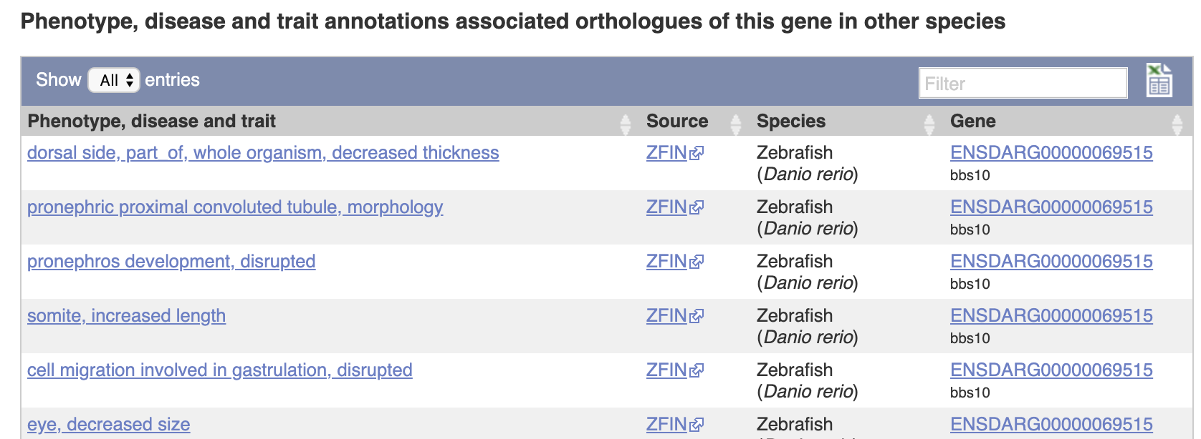
Enhanced access to extensive phenotype and disease annotation of genes and genetic variation in Ensembl
Irina M. Armean, Laurent Gil, Diana Lemos, Andrew Parton, Helen Schuilenburg, Anja Thormann, Sarah E. Hunt, Fiona Cunningham
European Molecular Biology Laboratory, European Bioinformatics Institute, Wellcome Genome Campus, Hinxton, Cambridge, CB10 1SD, United Kingdom
NHGRI-EBI
GWAS
Catalog
Ensembl Variant Effect Predictor (VEP)
Powerful open-source toolset for genomic variants interpretation and annotation
Uses the extensive Ensembl transcriptomic, regulatory and variation data to predict consequences of variants
Reports allele frequency data from reference projects and the results of multiple pathogenicity predictors
Reports aggregated phenotypes for genes and variants from overlapping genes and variants
Ontology Mapping
Interfaces
OLS exact match
OLS partial match
ZOOMA HIGH confidence match
Command line interface
Exact matches
Partial matches
./vep --cache -i input.vcf –-plugin Phenotypes
## PHENOTYPES : Phenotypes associated with overlapping genomic features
Web tool: https://www.ensembl.org/Tools/VEP
Variant
Gene
Structural Variant
Ensembl e!
Ensembl release 96
Type | Source | Coverage Count
Short Variant | ClinVar | 385,811
Short Variant | GWAS | 68,257
Short Variant | Other* | 37,175
Structural Variant | DGVa | 77,319
Structural Variant | ClinVar | 23,349
Genes | Other** | 6,070
VEP is also available in REST
*MAGIC, dbGaP, AMDGC, GIANT, GEFOS, Teslovich
**DDG2P, MIM morbid, Orphanet, Cancer Gene Census
Genome Browser
https://www.ensembl.org/vep
View genes and variants for traits associated with the same ontology term
Filter by a data source, feature type and original trait description
REST API
Retrieval of phenotype annotations directly assigned or overlapping the variant or gene name/symbol or region of interest
Search by ontology term to query across traits described differently in different resources
View summary counts for related terms
View phenotypes by gene and the variants within it
also in orthologues
https://rest.ensembl.org/
https://www.ensembl.org/
Ensembl receives majority funding from the Wellcome Trust (grant number WT108749/Z/15/Z) with additional funding for specific project components from the National Human Genome Research Institute (U41HG007823 and 2U41HG007234), the Biotechnology and Biological Sciences Research Council (BB/N019563/1 and BB/M011615/1), Open Targets, the Wellcome Trust (WT104947/Z/14/Z, WT200990/Z/16/Z, WT201535/Z/16/Z, WT108749/Z/15/A, WT212925/Z/18/Z ), ELIXIR: the research infrastructure for life-science data, and the European Molecular Biology Laboratory. This project has received funding from the European Union’s Horizon 2020 research and innovation programme under grant agreement n° 733161 (MultipleMS). We also receive funding from the 'Save the Tasmanian Devil Program

