Slide 1


01 / SLP
Speech-language therapy
is a closed room.
A clinician models sounds. A child imitates. Feedback is rich, live, and human — for 30–45 minutes. Then the door closes.
01
Live correction
Works in session. Vanishes the second practice moves home.
02
Paper notes
Written after the fact. No replay of mouth shape, tone, or volume.
03
Home homework
Assigned without sensors. Parents guess what “good” looked like.
04
Next week
Carryover is thin. Sessions often restart colder than they should.
Clinic → notes → home gap

Slide 2
02 / PROBLEM
The feedback loop
breaks after the session.
No shared visual
No live signal
No durable lesson
Families leave without a picture of the target mouth. Practice becomes imitation of memory.
Volume, pitch, smile, jaw — none of it is instrumented between visits.
What the therapist modeled can’t be replayed as a mouth-shape lesson at home.
Speak & See exists to keep the clinician’s model alive between appointments.

Slide 3
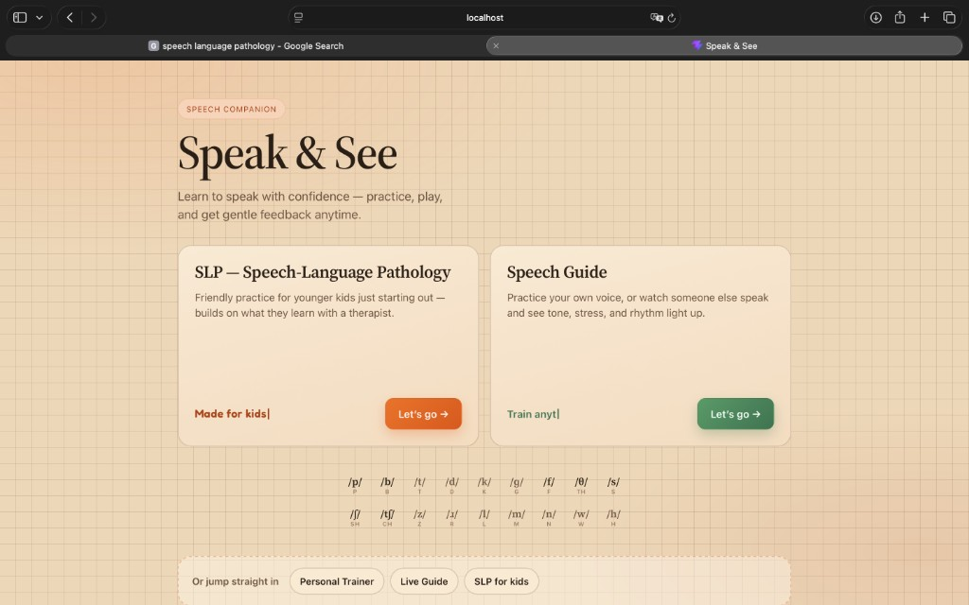
03 / SPEAK & SEE
What we built
A speech companion with two doors: an SLP path that turns therapy targets into home practice, and a Speech Guide that coaches the mouth in real time — lips, voice, and tone.
SLP for younger learners
· Therapist assigns minimal-pair words and therapy sounds from a Speech Alphabet (IPA-ish cells).
· SIMPLE session worksheet: topic → targets → schedule → activities → vocab, Gemma can expand the plan.
· Learner opens “Practice next” and jumps straight into camera practice; progress logs stay on-device.
Speech Guide trainer & live
· Personal Trainer: MediaPipe lip mesh + live cues (“open a little more”) with open/wide/round meters.
· Live Guide: record a teacher speaking, then build word lessons from their real lip vectors.
· Voice wave runs continuously for the take: loud / happy / mid / shallow baselines, not a resetting spectrogram.
Stack: MediaPipe lips · browser STT · Gemma (plans / lessons / cues) · local progress store

Slide 4
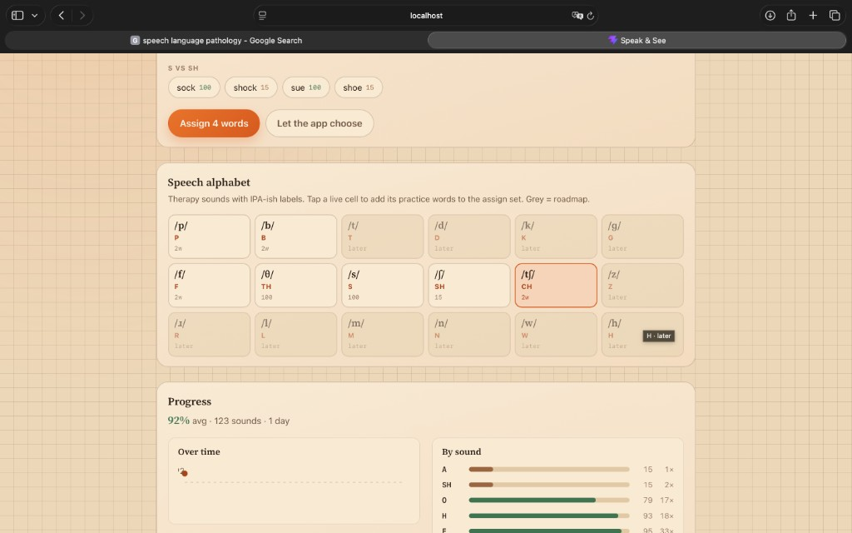
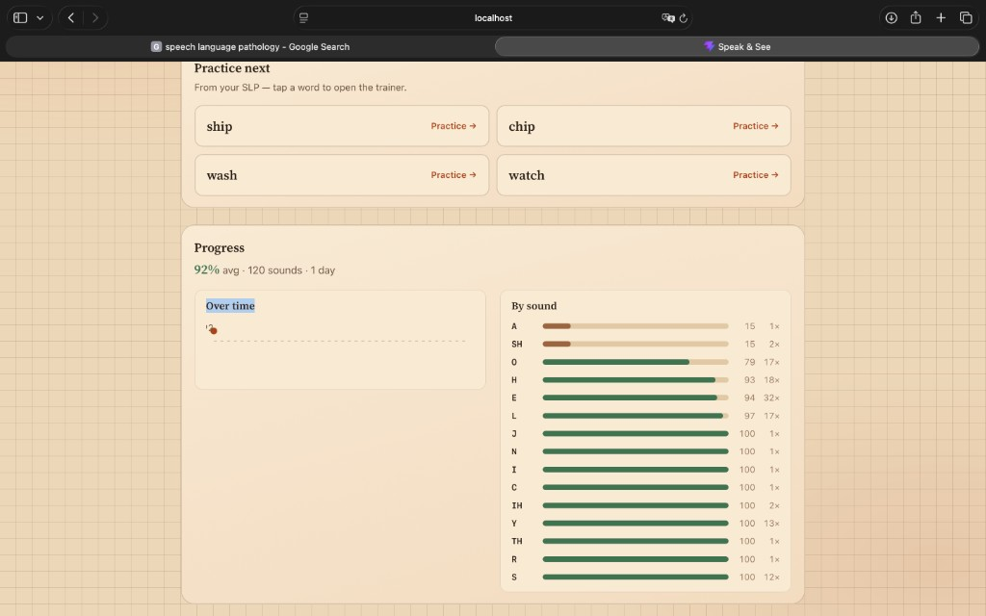
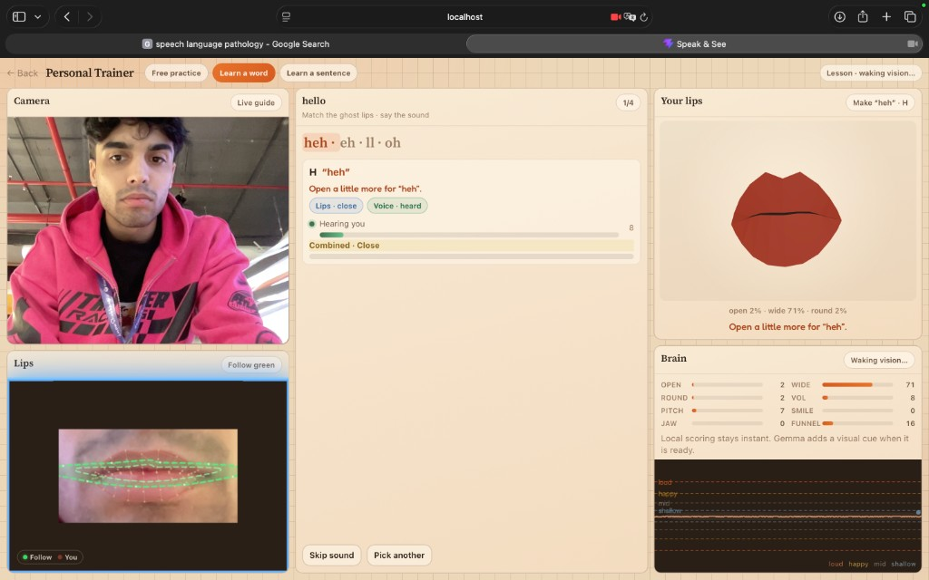
04 / THE LOOP
Assign → practice → coach → measure
1. Assign
2. Practice
3. Coach
4. Measure
SLP picks sounds & words
Learner taps Practice →
Lips + voice wave + cues
By-sound accuracy over time
Therapist side
· Speech Alphabet: tap a live sound cell to add its bank words to the assign set.
· Minimal pairs (S vs SH, SH vs CH…) with per-word scores when logged.
· Progress panel: 92% avg in this take: green bars for strong sounds, brown for targets still weak.
Practice next + by-sound bars
Assigned words open the trainer. Accuracy rolls up per phoneme so the next session isn’t a black box.
Live lip coach
Landmark follow, step cues (heh · eh · ll · oh), brain meters, and a continuous voice wave with loud/happy/mid/shallow lines.

