Slide 1
RESTful APIs
For the Non-Technical or Business Professional

Slide 2
RESTful APIs: What is a RESTful API
RESTful API design was defined by Dr. Roy Fielding in his 2000 doctorate dissertation.
A RESTful web application exposes information about itself in the form of information about its resources.
A RESTful API is an application program interface (API) that uses HTTP requests to GET, PUT, POST and DELETE data.
An API for a website is code that allows two software programs to communicate with each another.
The REST used by browsers can be thought of as the language of the internet.
A true RESTful API, a web service must adhere to the following six REST architectural constraints: Uniform interface, Client-server based, Stateless operations, Resource caching, Layered system, Code on demand.
A RESTful API enables the client to take actions on those resources, such as create new resources or change existing resources.

Slide 3
RESTful APIs: How are RESTful APIs Used
A client uses an HTTP request to a server to perform an action.
The server will parse the request to see if it is valid.
If the call is a GET request, the server will return a Representational State of what was requested.
If the call is a POST request, the server will add the Representational State to the server’s resources.
If the call is a PUT/PATCH request, the server will update the Representational State that is already part of it’s resources.
If the call is a DELETE request, the server will remove the Representational State from it’s resources.
The request is made up of four pieces: Endpoint, Method, Headers, and Data.

Slide 4
RESTful APIs: How are RESTful APIs Used
Flickr’s RESTful API enables bloggers to easily embed images on their sites and social media feeds.
Facebook’s and Twitter’s APIs all users to post content to their own feeds.
Amazon’s Web Service allows site data to be accessed by other systems though their API.
Ebay’s API allows for external account interaction, inventory interaction, analytics interaction, and many more.
Open weather’s allows applications to request current weather data to be used for free. Data can be delivered as JSON, XML, or HTML.
Twilio’s API allows for the complete use of their services, from SMS txt messages to email marketing.

Slide 5
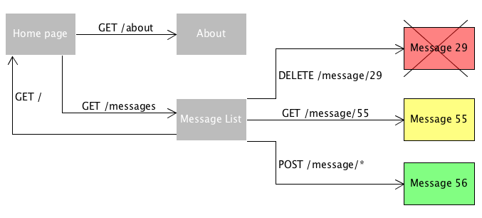
RESTful APIs: Communications Diagram

Slide 6
RESTful APIs: RESTful API Advantages
RESTful APIs were designed to take advantage of existing protocols.
REST APIs provide a great deal of flexibility.
Data is not tied to resources or methods.
RESTful APIs can handle multiple types of calls, return different data formats and even change structurally with the correct implementation of hypermedia.
Developers can build an API that meets the needs and the needs of a diverse group of customers.
RESTful APIs are not constrained to only XML, but instead can return XML, JSON, YAML or many any other format depending on what the client requests.
RESTful APIs may be scaled by a development team without much difficulty.
It flexibility makes it extremely portable.

Slide 7
RESTful APIs: RESTful API Disadvantages
The lose of the ability to maintain state.
RESTful APIs can be more difficult for newer developers to use.
The separation of client server logic adds a negligible amount of latency.
RESTful request add a negligible amount of data to the bandwidth.
RESTful API requests are HTTP based. HTTP is a synchronous, request/response protocol. This means the protocol does not support server-initiated notifications.
RESTful APIs are limited to the HTTP verbs: GET, POST, PUT, DELETE, and PATCH.

Slide 8
RESTful APIs: URI and URL Differences
URI
A URI (Uniform Resource Identifier) is a string that refers to a resource.
URIs guarantee uniformity, by following a predefined set of syntax rules.
URIs maintain extensibility through a separately defined hierarchical naming scheme.
The most common form of URI is the Uniform Resource Locator (URL).
A rarely seen form of URI is with the usage of the Uniform Resource Name (URN).
A URI begins with a scheme name that refers to a specification for assigning identifiers within that scheme.
A URI with no fragment component is called an absolute URI.

Slide 9
RESTful APIs : URI and URL Differences
URL
A Uniform Resource Locator (URL), colloquially termed a web address, is a reference to a web resource that specifies its location on a computer network and a mechanism for retrieving it.
A URL is a specific type of Uniform Resource Identifier (URI).
URLs occur most commonly to reference web pages (http), but are also used for file transfer (ftp), email (mailto), database access (JDBC), and many other applications.
Every HTTP URL conforms to the syntax of a generic URI.
URL is one of the key concepts of the Web.
In theory, each valid URL points to a unique resource.

Slide 10
RESTful APIs : URI and URL Differences
A URL is a subset of URI.
A URI could be a name instead of a locator.
The URI is the identifier of the resource and it can also happen to be a locator, but does not have to be.
URL includes location as well as the protocol to retrieve the resource.
The difference between URI and URL is very subtle and only occurs when URI specifies only the name.
The W3C realized that there is a ton of confusion about this. They issued a URI clarification document that says that it is now OK to use the terms URL and URI interchangeably (to mean URI).

Slide 11
RESTful APIs: References
https://searchapparchitecture.techtarget.com/definition/RESTful-API
https://medium.com/extend/what-is-rest-a-simple-explanation-for-beginners-part-1-introduction-b4a072f8740f
https://www.smashingmagazine.com/2018/01/understanding-using-rest-api/
https://www.mulesoft.com/resources/api/restful-api
https://www.infoq.com/news/2013/05/rest-drawbacks/
https://en.wikipedia.org/wiki/Uniform_Resource_Identifier
https://developer.mozilla.org/en-US/docs/Learn/Common_questions/What_is_a_URL
https://dev.to/flippedcoding/what-is-the-difference-between-a-uri-and-a-url-4455
https://hackr.io/blog/url-vs-uri

