Slide 1
Hypermedia Design
For the Non-Technical or Business Professional

Slide 2
Hypermedia Design: Business use case
Bring Optional Books: Independent book publisher
New publishing company. Only been around for ten years.
Publish books for independent authors.
They cater to the Sci-fi, Fantasy, and Romance genres.
Publishing fifty books a year. Projected to expand to two hundred books a year.
They publish hardback, paperback, e-books, and audiobooks.
They publish in over fifty countries.
They publish in fifteen languages.

Slide 3
Hypermedia Design: ROI
The API will allow them to:
Update book information quicker.
Develop applications for different platforms that pull data from one singular location.
Allow other companies to retrieve their most current information.
Reduce the amount of time duplicating data across multiple systems.
System is quickly scalable.
System is readily adaptable.

Slide 4
Hypermedia Design: 7-step design
Step 1: Determine Semantic Descriptors
Determine all the type of information the API users may require.
Make a list of these semantic descriptors.
Form the descriptors into hierarchies.
Descriptors that refer to real-world object, like author, can be broken down into even smaller objects. Example: sir_name, given_name, date_of_birth, etc.
The aim of book directory lends itself to a few hierarchical lists: List of Books, List of Authors, and List of Genres.
All three hierarchies have the single book at their centers.

Slide 5
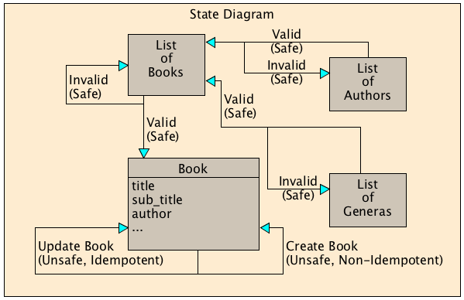
Hypermedia Design: 7-step design
Step 2: Create a State Diagram
Draw out the API.
Each box on the diagram represents one kind of representation.
Use arrows to connect the representations in ways that seem natural.
These arrows will represent state transitions, triggered by HTTP requests.
Take note of each state transition, keep track of it being safe, unsafe and idempotent, or unsafe and nonidempotent.
Work through whether any of the semantic descriptors would make better since as a link relation.

Slide 6
Hypermedia Design: 7-step design
Step 3: Profile String Reconciliation
Here is where you reconcile the strings with the existing profile strings.
Find a profile at IANA, schema.org, or alps.io that best matches your API needs.
Be watchful because with certain protocol semantics, unsafe link relations could switch between being idempotent and not idempotent.
Try to keep the reconciled name concise with the layout of the stat diagram.
Try to find names that can be reused. This will reduce the amount of work, documentation, and opportunities for humans to misunderstand your strings.
A lot of existing profiles are tied to a specific media type. Try to put in the extra work to find one that is not. The choice of media type should not be tied to the choice of a profile.

Slide 7
Hypermedia Design: 7-step design
Step 4: Choose Media Type
Choose a media type for the API.
The media type must be compatible with the protocol and application semantics.
There is a chance a domain-specific media type could be found that covers some of the needed application semantics.
Defining your own media type is an option and can be written to do exactly what API needs it to do.
If a domain-specific media type is chosen, profile strings may need to be reconciled again in order to match up with the given media type.
Something to remember, JSON is not a hypermedia format and does not have any hypermedia capabilities.

Slide 8
Hypermedia Design: 7-step design
Step 5: Write a Profile
The representation will include the the Content-Type header along with a link to any profiles needed to explain the representation’s application semantics.
The profile should explain all the strings, excluding IANA-registered link relations and strings explained by the media type.
The profile can be written in ALPS, JSON-LD, or a straight up web page.
The more semantics borrowed from your media type the less work needed here.
A human-readable profile look like traditional API documentation. Remember to include links to any other profiles you may borrow from.
Using your own media type is a viable option and would negate the need for writing a profile, if the media type specification contains enough information.

Slide 9
Hypermedia Design: 7-step design
Step 6: Implementation
Develop an HTTP server that implements the state diagram developed from the string reconcile step.
HTTP requests should trigger appropriate state transitions and get specific representations in response.
Each representation will use the media type chosen for the API and link to your chosen predefined or written profiles.
The data returned will convey values for the semantic descriptors that were laid out as needing to be a part of the API.
Another part of the returned data will be hypermedia controls to show the API users how to trigger the further state transitions as per the API diagram.
The secrete to this step is to have a well-developed state diagram and profile that fits the needs of the API.

Slide 10
Hypermedia Design: 7-step design
Step 7: Publication
Publish the billboard URL.
Publish your profile.
Register new media types.
Register new link relations.
This URL should be the only thing users of the API will need to know.
An alternate human-readable profile, tutorials, and example clients can be written to help users get started but should not be needed and are not part of the design process.

Slide 11
References
Richardson, L. (2013). RESTful Web APIs.

