Slide 1
Exam-Cell Module -Project Progress Review
Presenting By:
Exam-Module Team()
{
Sujay Chatterjee(140301CSL115)
Renu Toppo(140301csl116)
Abhi Mitra(140301CSL117)
Snigdha Samal(140301CSR061)
}
Mentoring By:
Rakesh Ray
Asst. Professor, CSE.
Special Thanks To: Mr. Nanda Kishor Ray
Administrator,Exam-Cell.

Slide 2
Project Schedule
Topic | Work | Duration
Gathering Information | Meeting with exam-cell admin and collecting the information | 20th July 2017 to 25th July 2017
Analyzing Gathered Information | Coordinate with team members along with mentor. | 26th July 2017 to 29th July 2017
Documentation | Use case of pages. | 30th July 2017 to
Modeling | Extracting the table from current view pages | 30th July 2017 to 19th August 2017
Codding | Maven project quickstart. Executing the first spring application. | 20th August 2017 to 22th August 2017
 | Login page design | 23th August 2017 to 26th August 2017
*Deadline is:

Slide 3
Contents
Project Overview
Project requirements
Project Lifecycle
E-R Model
E-R Model Overview
How to map tables
Current Project Dashboard
Documentation

Slide 4
Project Overview
Exam-Cell module is an important individual part of ERP system.
The major roles of Exam-Cell are-
Scheduling Exam
Assigning Invigilators
Provide Exam materials (Question paper/Answer Copy)
Checking Copies
Publishing Result

Slide 5

Project Requirements
Html5
[View]
AngularJs
[Script]
SpringRest
[Framework]
JPA Hibernate
[Model]

Slide 6
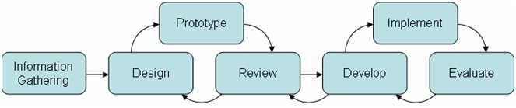
Lifecycle we are using
Prototyping Model

Slide 7
Documentation
Use Case of pages:
Exam-Category
Exam-Component
Grades
Mark-Details

Slide 8

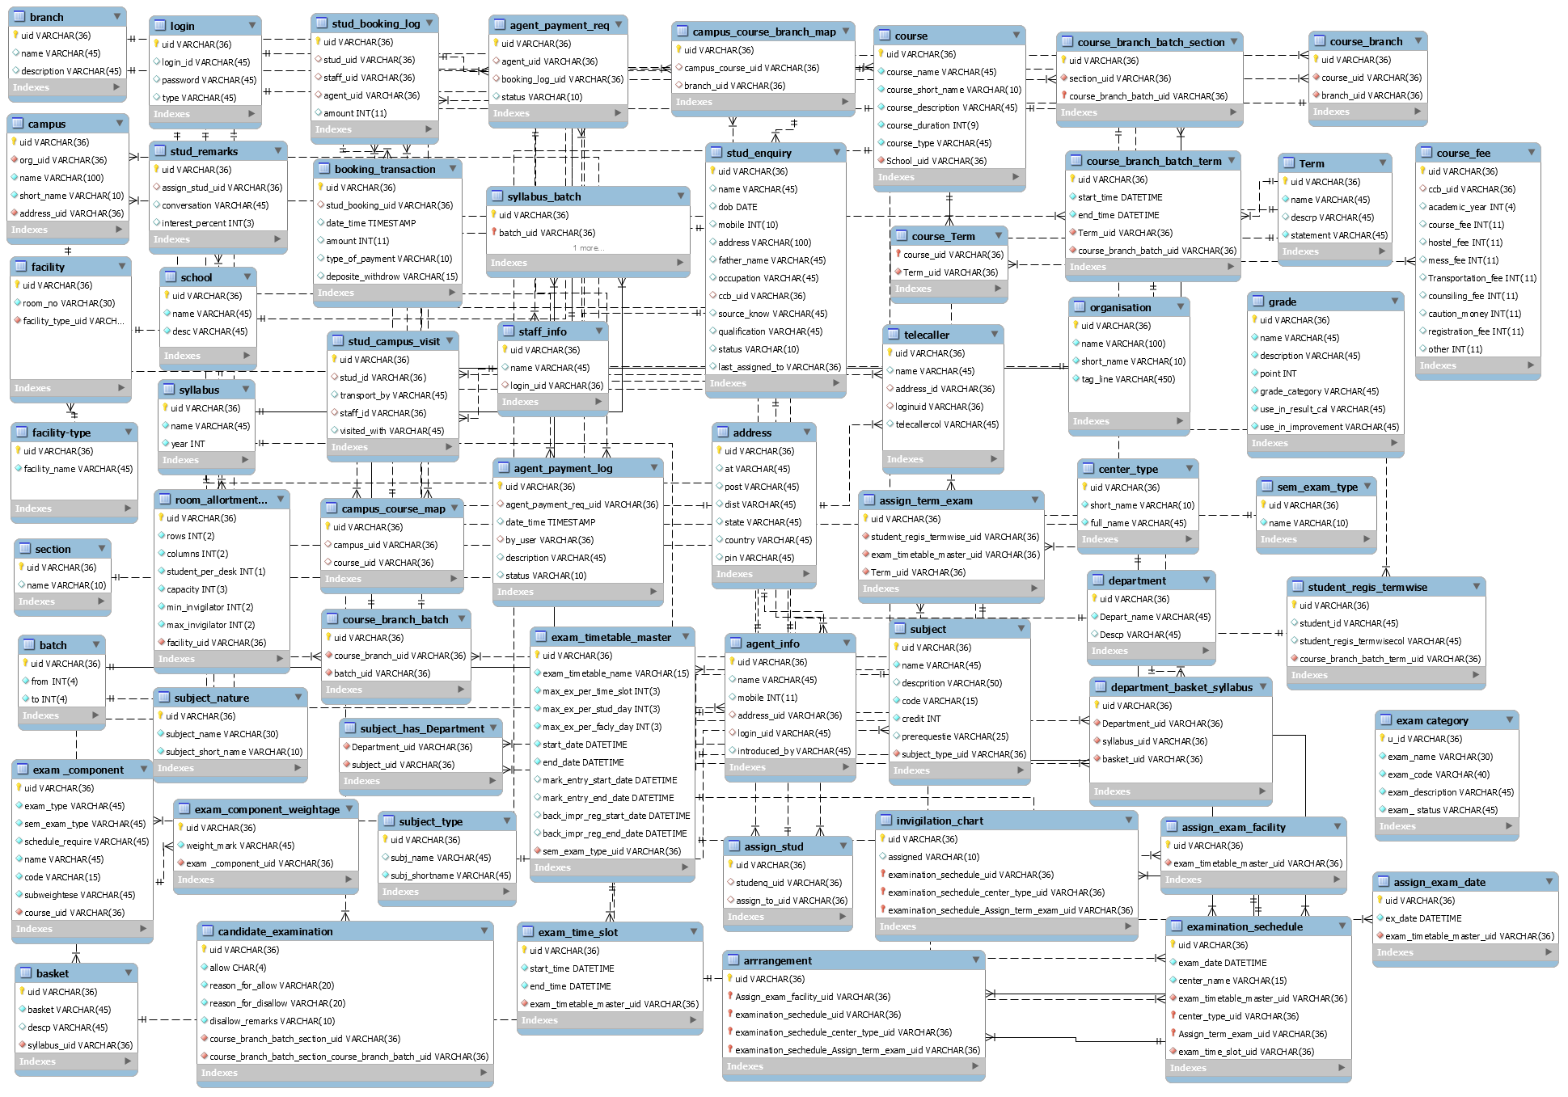
E-R Model

Slide 9
E-R Model Overview
66 Tables are there
Model is dependent to-
Course Module
Facility Module
Faculty Module
Student Module.

Slide 10
How we mapped the tables
semester
sem_uid
sem_name
branch
branch_uid
branch_name
section
section_uid
section_name
semester_branch_section_mapping
semester_branch_section_uid
sem_uid
branch_uid
section_uid

Slide 11
Overall Project Dashboard.
Work Flow
E-R Model
Maven Project Quick-start
Documentation

Slide 12
Thank You
Have a nice day ☺

