Slide 1
Time Keepers Game Concept
The object of the game is to stop the timer on a whole second.
Your score for each round is the distance from a whole second. Ex. If you stop the timer on 07:42 your score is 42. If you stop the timer on 07:88, your score for the round is 12.
Similar to golf, the lower the score the better. The max score for each round would be 50, stopping the timer on exactly _ _ :50. A perfect score for a round would be 0, stopping the timer on exactly _ _:00.
If the timer reaches 0, the player will automatically receive a score of 50 for that round.
Players will play 10 rounds each per standard game. 9 rounds broken into 3 eras and 1 final round.

Slide 2
Game Modes
VS Mode
After Players 1 and 2 select their characters, the vs screen plays with a highlight of player 1 and player 2 and the characters walk out to the center of the watchtower.
After the initial 3,2,1 countdown begins in the middle of the screen, the timer will start on player 1’s side.
When player 1 hits stop their score for that round will be recorded in the 1st round red box on both sides.
Once player 1 hits stop, the timer for player 2 immediately starts and player 1’s timer resets. Once player 2 completes their first round their score for that round will be recorded in the 1st round blue box on both sides and the timer for player 1 starts again.
This cycle repeats for 3 rounds for each player. The players’ totals will be recorded in the fourth box

Slide 3
Game Modes
VS Mode Continued
One completed cycle of three rounds is called an era. After an era completes, scores for each round will reset, but the score totals will remain.
At the start of the second era, player 2 will go first. 3 rounds complete, round scores reset, begin the 3rd era.
At the start of the third era, player 1 will start again. 3 rounds complete. Final round begins.

Slide 4
Game Modes
VS Mode Continued
In the final round, both timers of player 1 and 2 are going at the same time. Once each player hits stop, the points from the final round are added to the total scores.
The win/lose screens display based on who has the best (lowest) score.
In the event of a draw, a draw screen displays

Slide 5
Game Modes
Practice Mode
Practice mode will allow players to hone their skills by themselves.The timer will reset after the player hits stop but will continue to countdown.

Slide 6
Game Modes
Records
Players will be able to look at the low scores of other players. Scores will display a P next to their score if it was recorded from practice mode.

Slide 7
Game Modes
Story

Slide 8

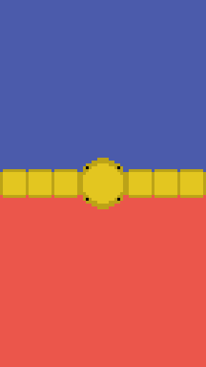
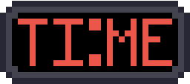
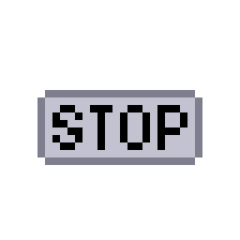
Home Screen
KEEPERS
Timer counts down from 10:00 when screen loads
10:00
Once player hits stop, the timer stops.

Slide 9
KEEPERS
KEEPERS
KEEPERS
08:11
08:76
08:42
Notes:
The timer will flash green if the centi seconds are between 01-15 or 99-85
The timer will flash yellow if the centi seconds are between 16-35 or 84-65
The timer will flash red if the centi seconds are between 36-50 or 64-50
The timer will flash rainbow if the centiseconds are stopped on 00 with a more impactful sound effect

Slide 10

Practice Mode
KEEPERS
10:00

Slide 11
Home Screen
KEEPERS
10:00

Slide 12

VS Mode
10:00
10:00

Slide 13


Slide 14
