Slide 1
Skin Dose

Slide 2
Skin Dose - Fluoroscopy
 | Skin dose (mGy/min)
RF | 14 ± 6
C-Arm | 13 ± 5
Angio | 7 ± 4
Cath Lab | 12 ± 5

Slide 3
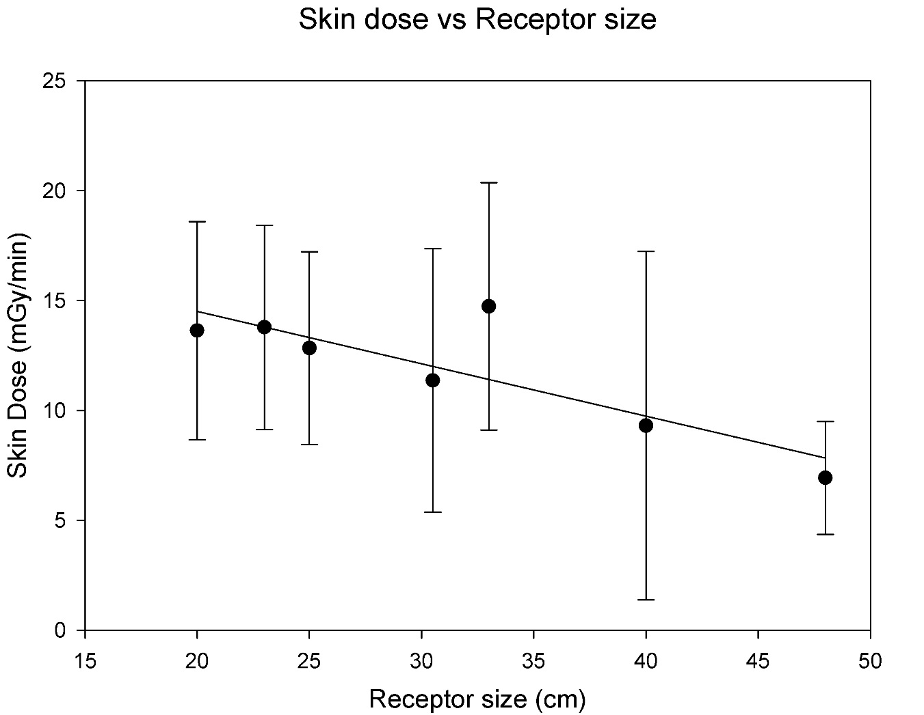
Fluoroscopy

Slide 4
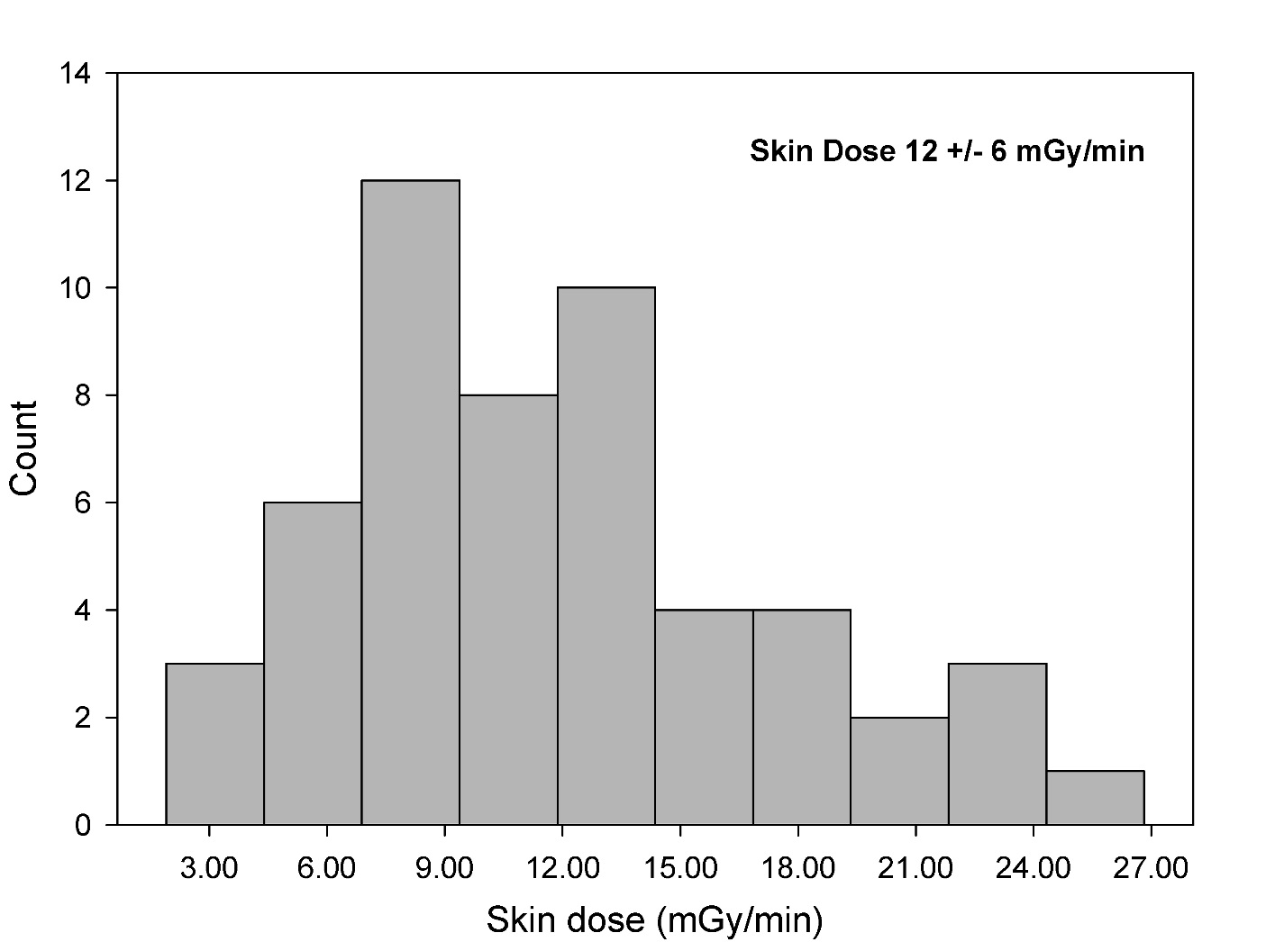
Fluoroscopy

Slide 5
Fluoroscopy
Low dose – 0.52 ± 0.19
High dose – 1.7 ± 0.6

Slide 6
Fluoroscopy
10 cm Lucite – 0.17 ± 0.06
30 cm Lucite – 4.8 ± 2.2

Slide 7
Fluoroscopy
Mag 1 – 1.41 ± 0.27
Mag 2 – 2.16 ± 0.79

Slide 8
Pulse Fluoroscopy

Slide 9
Spot Imaging – RF/C-Arm
0.4 mGy/frame

Slide 10
DSA
Angio
Cath Lab
1 μGy/frame
0.15 μGy/frame

Slide 11
Receptor dose

Slide 12
Fluoroscopy

Slide 13
Spot Imaging

Slide 14
RF
1.1 ± 0.6 μGy/frame

Slide 15
C-Arm
1.03 ± 0.6 μGy/frame

Slide 16
DSA Imaging

Slide 17
Angio
2.5 ± 1.3 μGy/frame

Slide 18
Cath Lab
0.3 ± 0.05 μGy/frame

Slide 19
Angio and Cath Lab

