Slide 1
The Office
Pokémon GO IV Calculator
imacat
imacat@mail.imacat.idv.tw
2017/2/4

Slide 2

“The Office Pokémon GO IV Calculator” is created by imacat (Yang Shih-Ching),
and licensed under a Creative Commons Attribution 3.0 Unported License

Slide 3
imacat / Yang Shih-Ching
Taiwan OpenOffice/LibreOffice community
Apache OpenOffice PMC
Women in FOSS in Taiwan

Slide 4
imacat / Yang Shih-Ching
Taiwan OpenOffice/LibreOffice community
Apache OpenOffice PMC
Women in FOSS in Taiwan
A game player for almost three decades.
  MS-DOS, Windows 95, 98, Linux Steam
  PC game, MUD, Wii, mobile games
  My favorite genre: RPG

Slide 5
All in all,
it started as a spreadsheet.

Slide 6
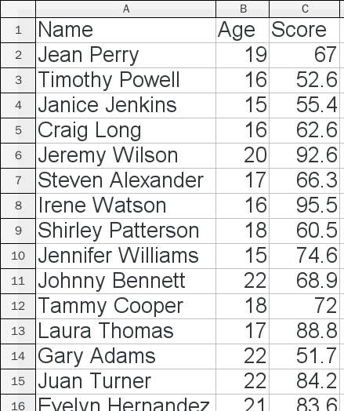
A Spreadsheet
A spreadsheet is a convenient place to store data.

Slide 7

A Spreadsheet
You don’t have to worry about the meta-data: data types, size, precision, etc.
LONG?
DECIMAL(4,2)?
INT?
VARCHAR(32)?
VARCHAR(64)?
DOUBLE?

Slide 8
I use spreadsheets to store all kinds of
daily information.
For example, …

Slide 9
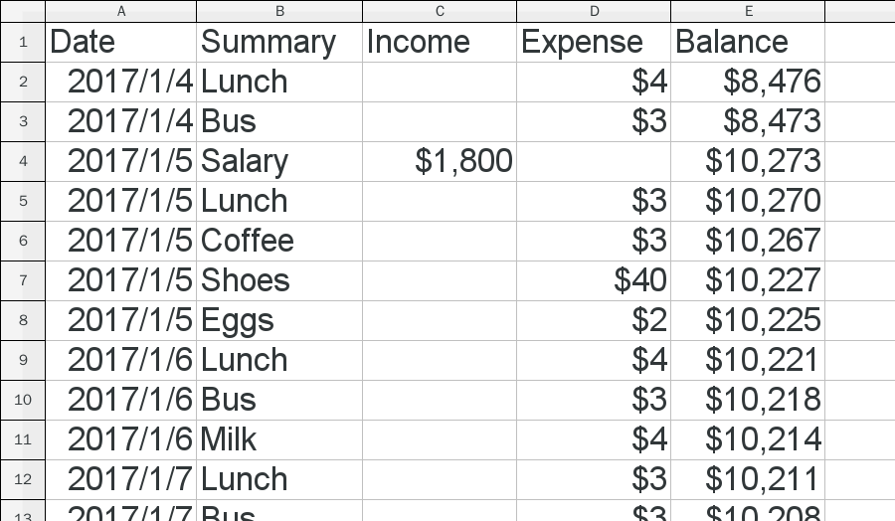
Journal Account

Slide 10
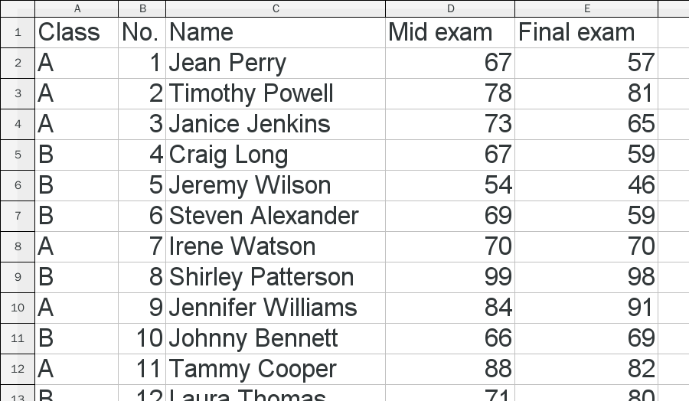
Students’ Scores

Slide 11
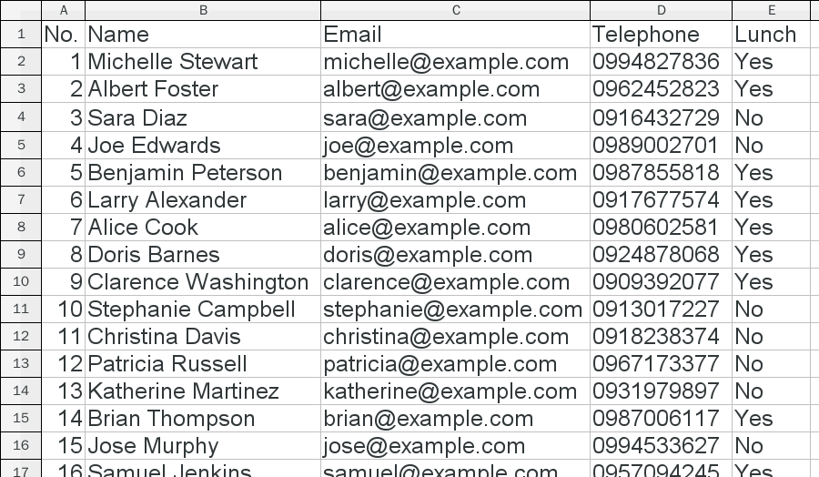
Attendees List

Slide 12
This is also true when it comes to games.

Slide 13
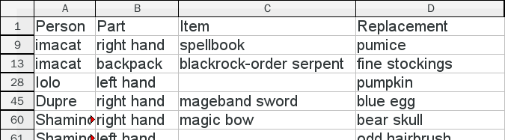
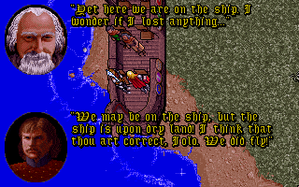
Lost Items in
Ultima VII Part Two: Serpent Isle

Slide 14
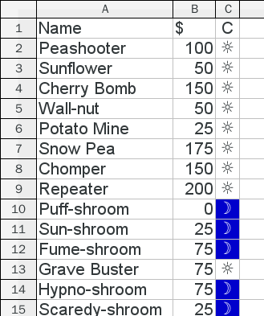
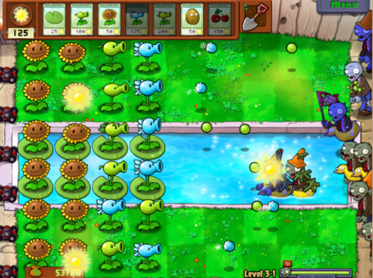
Plants and Their Costs in
Plants vs. Zombies

Slide 15
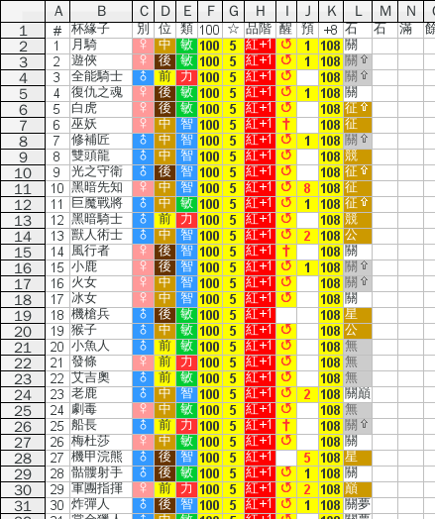
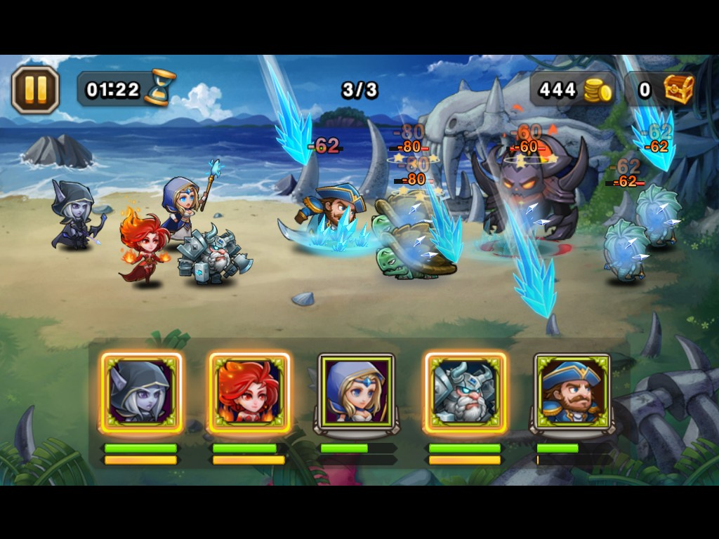
Heroes in
Sanctuary Battle (Chinese)

Slide 16
Now it goes for Pokémon GO.

Slide 17
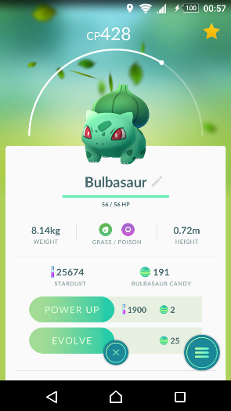
Pokémon GO CP & IV
CP 428
In Pokémon GO, every Pokémon has its CP (combat power), that indicates how strong it is.

Slide 18
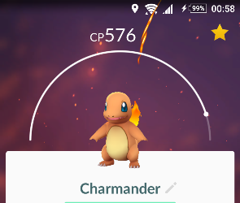
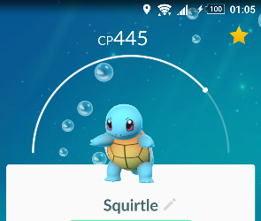
Pokémon GO CP & IV
CP 576
We often compare Pokémons by their CP to know which one is stronger than the other.
CP 445

Slide 19
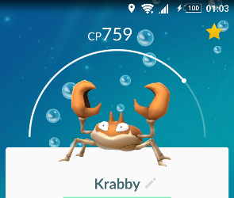
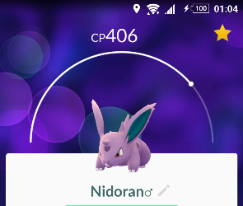
Pokémon GO CP & IV
CP 759
Some species are just stronger than others.
CP 406

Slide 20


Pokémon GO CP & IV
CP 1594
But even within the same species, their CP may still be different. They are still different from one another.
CP 1555

Slide 21

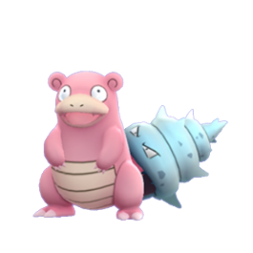
Pokémon GO CP & IV
Base stats
  Pokémons of the same species share the same set of base stats.
Pikachu
  Base Attack: 112
  Base Defense: 101
  Base Stamina: 70
Slowbro
  Base Attack: 177
  Base Defense: 194
  Base Stamina: 190

Slide 22
Pokémon GO CP & IV
Individual values (IV)
  In addition, Pokémons have their own individual values (IV). IV are added to the base stats. They range from 0 to 15.
    IV Attack: 0~15
    IV Defense: 0~15
    IV Stamina: 0~15

Slide 23
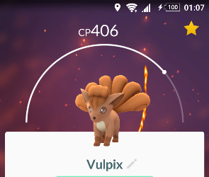
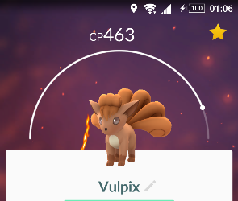
Pokémon GO CP & IV
Level
  Pokémons also have their levels. Levels are indicated by the arc below CP.
Level 20
Level 25

Slide 24
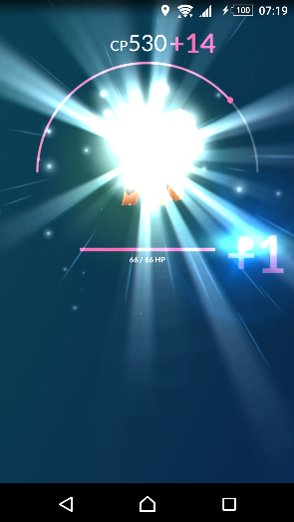
Pokémon GO CP & IV
Level
  Levels are advanced by “Power Up”.
  Each “Power Up” advanced the level by 0.5.

Slide 25
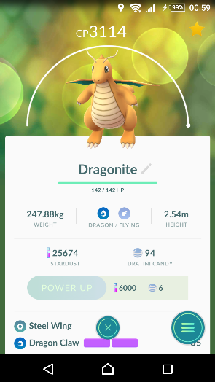
Pokémon GO CP & IV
CP 3114
To get the strongest Pokémon, we…
  Choose strong species with high base stats;
  Within a species, pick the Pokémon with highest IV;
  Power up to maximum advance its level.

Slide 26
Question:
How do we know their IV?

Slide 27

Actually, IV are hidden values
that Niantic (the Pokémon GO company)
does not want players to know.

Slide 28

You will be banned
if you are found to peep the IV.

Slide 29

But, we are hackers.
We can still infer the IV
from the given hints and clues.

Slide 30
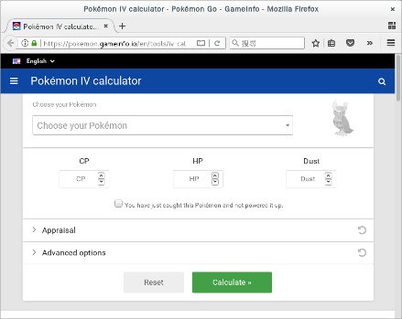
Pokémon GO IV
There are several websites that calculates Pokémon IV for you.

Slide 31
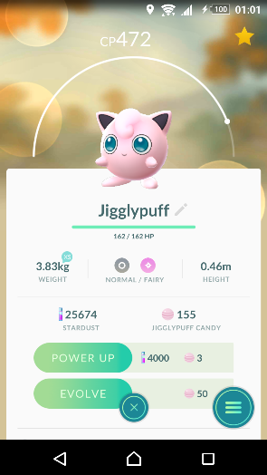
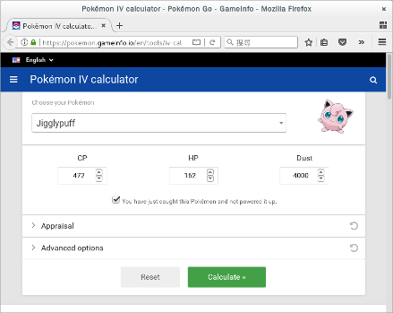
Pokémon GO IV
Species: Jigglypuff

Slide 32
Pokémon GO IV
CP 472
CP 472

Slide 33
Pokémon GO IV
HP 162
HP 162

Slide 34
Pokémon GO IV
Dust
4000
Power up requires:
- 4000 stardust
- 3 Jigglypuff candies

Slide 35
Pokémon GO IV
“You have just caught this Pokémon
and not powered it up.”

Slide 36
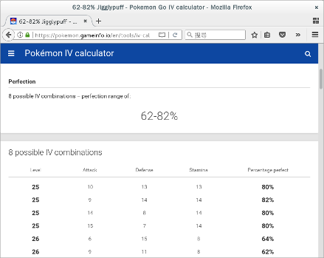
Pokémon GO IV
Found 8 possible IV combinations.

Slide 37
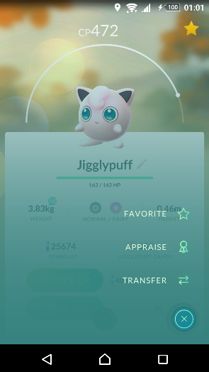
Refine by Appraisal
We further refine the result by our team leader’s appraisal.

Slide 38

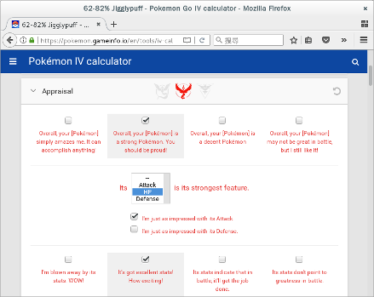
Refine by Appraisal
Team Valor (red)
“Overall, your Jigglypuff is a
strong Pokémon. You
should be proud.”

Slide 39
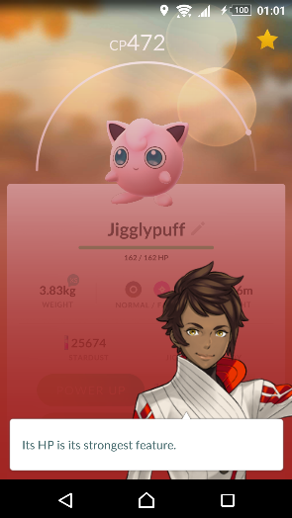
Refine by Appraisal
“Its HP is its strongest
feature.”

Slide 40
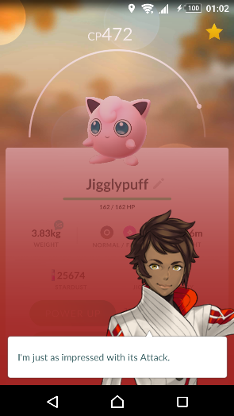
Refine by Appraisal
“I’m just as impressed
with its Attack.”.

Slide 41
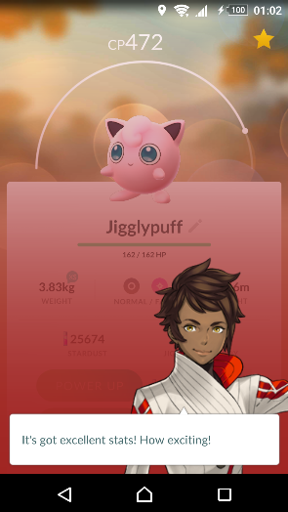
Refine by Appraisal
“It’s got excellent stats!
How exciting!”

Slide 42
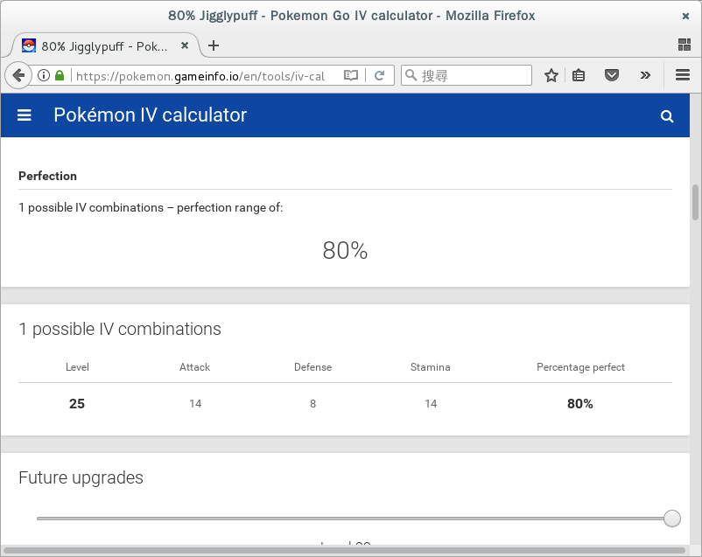
Refine by Appraisal
Found!
  Level 25
  Attack 14
  Defense 8
  Stamina 14

Slide 43
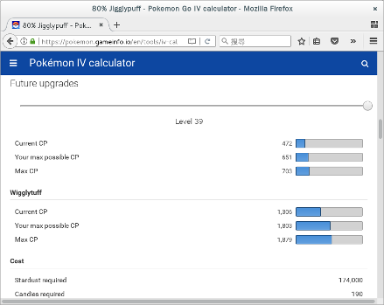
Refine by Appraisal
Future power-up estimation, for Pokémon level 39
  Max CP: 1803
  Require 174,000 stardust
  Require 190 Jigglypuff candies

Slide 44
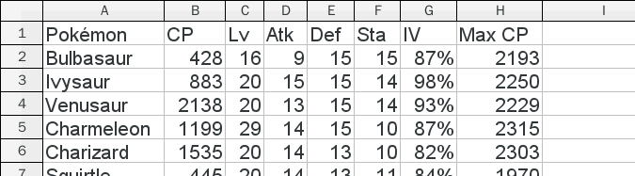
Pokémon GO Data Sheet
Using the IV calculator, I created a spreadsheet to record my strongest Pokémons.

Slide 45
A More Advanced Spreadsheet

Slide 46
Now I have a question …

Slide 47

A More Advanced Spreadsheet
My Lapras has the following IV:
  Level: 20, Attack: 13, Defense: 12, Stamina: 11
For Pokémon level 39, to max power up:
  205,000 stardust, 218 Lapras candies, CP 2866

Slide 48
A More Advanced Spreadsheet
My Lapras has the following IV:
  Level: 20, Attack: 13, Defense: 12, Stamina: 11
For Pokémon level 39, to max power up:
  205,000 stardust, 218 Lapras candies, CP 2866
But I only have the following resources:
  237,436 stardust, 29 Larpas candies.

Slide 49
A More Advanced Spreadsheet
My Lapras has the following IV:
  Level: 20, Attack: 13, Defense: 12, Stamina: 11
For Pokémon level 39, to max power up:
  205,000 stardust, 218 Lapras candies, CP 2866
But I only have the following resources:
  237,436 stardust, 29 Larpas candies.
What’s its max CP under this limitation? Should I power it up?

Slide 50
To answer this question,
I need to be able to calculate CP myself.

Slide 51
For a popular game like Pokémon GO,
someone must have hacked the formula.
And this is true.
With a little Google,
the CP formula is found.

Slide 52
The CP (Combat Power) Formula

Slide 53
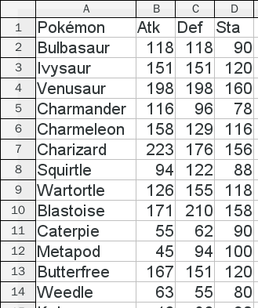
The CP (Combat Power) Formula
Base stats
  The basic attributes for each species
  This can be found on the internet.

Slide 54
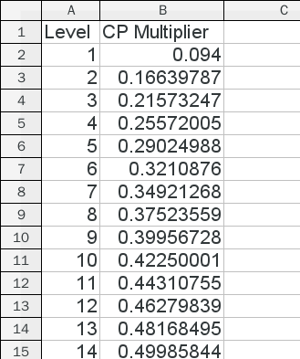
The CP (Combat Power) Formula
CPM (CP multiplier)
  A list of constants increase with level.
  This can be found on the internet, too.
  CPM of 0.5 levels are culculated at real time:

Slide 55
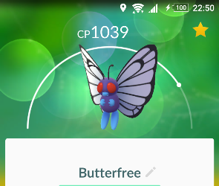
The CP (Combat Power) Formula
For example, my Butterfree is:
  Base: Attack 167, Defense 151, Stamina 120
  IV: Attack 14, Defense 15, Stamina 9
  Level 22, CPM 0.62656713

Slide 56
For my Lapras problem,

Slide 57
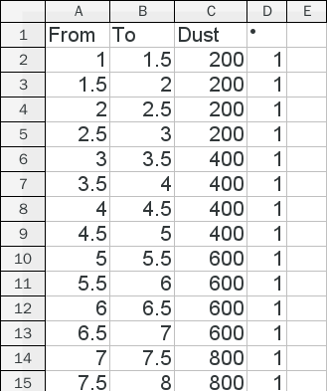
My Larpas Problem
The amount of stardust and candies to power up can be found on the internet, too.

Slide 58
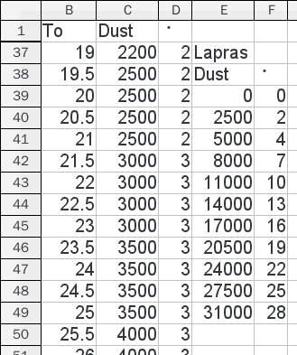
My Larpas Problem
With a total 29 candies, I can power up my Lapras from level 20 to level 25.

Slide 59
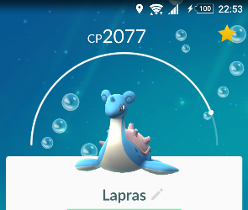
My Larpas Problem
At level 25, my Lapras is:
  Base: Attack 186, Defense 190, Stamina 260
  IV: Attack 13, Defense 12, Stamina 11
  Level 25, CPM 0.667934

Slide 60
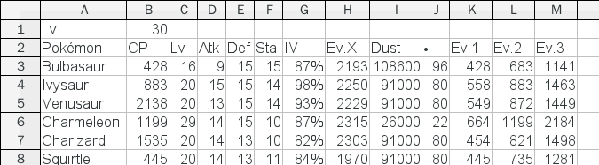
A More Advanced Spreadsheet
With the ability to calculate CP, I produced a more advanced spreadsheet to tell the potentials of my Pokémons.

Slide 61
From a Spreadsheet to an Application

Slide 62
Knowing the CP formula,
My own CP calculator
is just one step away.
It is simply brute force.

Slide 63
The Pokémon GO IV Calculator
' Psuedo code
Found = Array()
For Level = 1 To 40 Step 0.5
For StaIV = 0 To 15
For AtkIV = 0 To 15
For DefIV = 0 To 15
If CalcCP(Level, AtkIV, DefIV, StaIV) = CP Then
AddFound(Found, Level, AtkIV, DefIV, StaIV)
End If
Next IVDef
Next IVAtk
Next IVSta
Next Level

Slide 64
This runs
79×15×15×15=266,625 times.

Slide 65
This runs
79×15×15×15=266,625 times.
A HUGE number!!

Slide 66
Refining the Brute Force

Slide 67
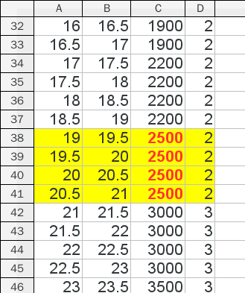
Refining the Brute Force
Knowing the amount of stardust to power up limits the number of possible levels from 79 to 4.

Slide 68
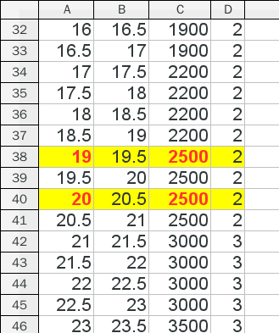
Refining the Brute Force
Newly-caught Pokémons only have whole-numbered levels.
  The number of possible levels are further reduced to 2.

Slide 69
Refining the Brute Force
HP is the value of StaminaLevel (as a whole number).
This limits StaminaIV to one or two values.

Slide 70
The number of runs is reduced to
2×2×15×15=900 times.

Slide 71
The number of runs is reduced to
2×2×15×15=900 times.
A lot smaller.

Slide 72
Further Refinement
with Team Leader Appraisal

Slide 73
Team Leader Appraisal #1
The Total
“Overall, your [Pokémon] simply amazes me. It can accomplish anything!”
“Overall, your [Pokémon] is a wonder! What a breathtaking Pokémon!”
“Overall, your [Pokémon] looks like it can really battle with the best of them!”
  AtkIV + DefIV + StaIV ≥ 37

Slide 74
Team Leader Appraisal #1
The Total
“Overall, your [Pokémon] is a strong Pokémon. You should be proud!”
“Overall, your [Pokémon] has certainly caught my attention.”
“Overall, your [Pokémon] is really strong!”
  30 ≤ AtkIV + DefIV + StaIV ≤ 36

Slide 75
Team Leader Appraisal #1
The Total
“Overall, your [Pokémon] is a decent Pokémon.”
“Overall, your [Pokémon] is above average.”
“Overall, your [Pokémon] is pretty decent!”
  23 ≤ AtkIV + DefIV + StaIV ≤ 29

Slide 76
Team Leader Appraisal #1
The Total
“Overall, your [Pokémon] may not be great in battle, but I still like it!”
“Overall, your [Pokémon] is not likely to make much headway in battle.”
“Overall, your [Pokémon] has room for improvement as far as battling goes.”
  AtkIV + DefIV + StaIV ≤ 22

Slide 77
Team Leader Appraisal #2
The Best Stats
“Its [Stat] is its strongest feature.”
  “I'm just as impressed with its [Stat].”
“I see that its best attribute is its [Stat].”
  “It is matched equally by its [Stat].”
“Its best quality is [Stat].”
  “Its [Stat] is great, too!”
  The listed HP/Attack/Defense are equally its best stats.

Slide 78
Team Leader Appraisal #3
The Maximum Stat Value
“I'm blown away by its stats. WOW!”
“Its stats exceed my calculations. It's incredible!”
“Its stats are the best I've ever seen! No doubt about it!”
  Max(AtkIV, DefIV, StaIV) = 15

Slide 79
Team Leader Appraisal #3
The Maximum Stat Value
“It's got excellent stats! How exciting!”
“I am certainly impressed by its stats, I must say.”
“Its stats are really strong! Impressive.”
  Max(AtkIV, DefIV, StaIV) = 13 or 14

Slide 80
Team Leader Appraisal #3
The Maximum Stat Value
“Its stats indicate that in battle, it'll get the job done.”
“Its stats are noticeably trending to the positive.”
“It's definitely got some good stats. Definitely!”
  8 ≤ Max(AtkIV, DefIV, StaIV) ≤ 12

Slide 81
Team Leader Appraisal #3
The Maximum Stat Value
“Its stats don't point to greatness in battle.”
“Its stats are not out of the norm, in my opinion.”
“Its stats are all right, but kinda basic, as far as I can see.”
  Max(AtkIV, DefIV, StaIV) ≤ 7

Slide 82
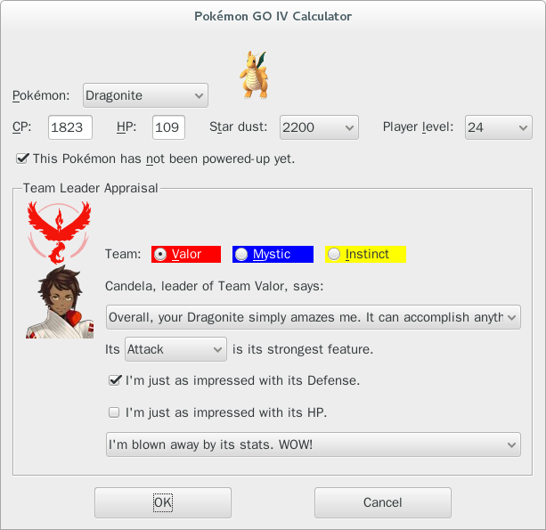
The Pokémon GO IV Calculator

Slide 83
But things are not always so easy.

Slide 84
Case #1

Slide 85
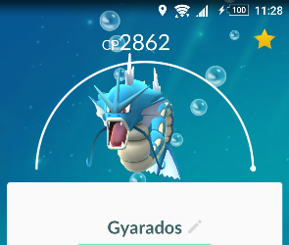
One morning in November when I woke up,
I found my second and third strongest Pokémons, my Gyarados sisters,
become much stronger than I remembered!

Slide 86
In fact, not only my Gyarados sisters,
but all of them have different CP!

Slide 87
I went to the Pokémon GO fan page,
and found the following announcement…

Slide 88
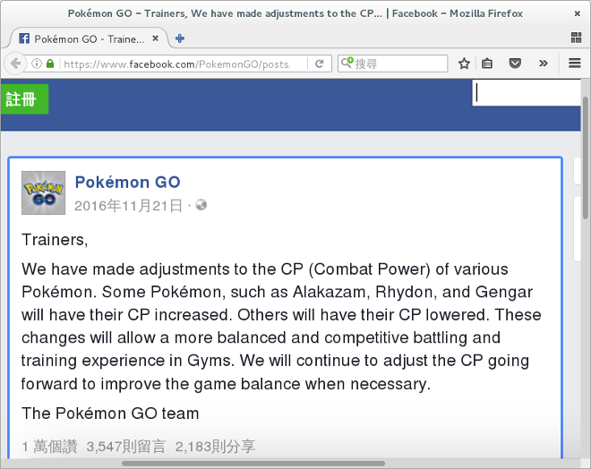
Update: Pokémon CP Adjustment

Slide 89
So the base stats was updated?
That is a terrible news!

Slide 90
Fortunately,
my IV calculator was not published yet.

Slide 91
I Googled,
and found someone has already published
a new base stats table.
I immediately applied it to my IV calculator.

Slide 92
Case #2

Slide 93

The other day when I was walking,
I hatched something I had never seen!
So I went to the Pokémon GO fan page again.

Slide 94
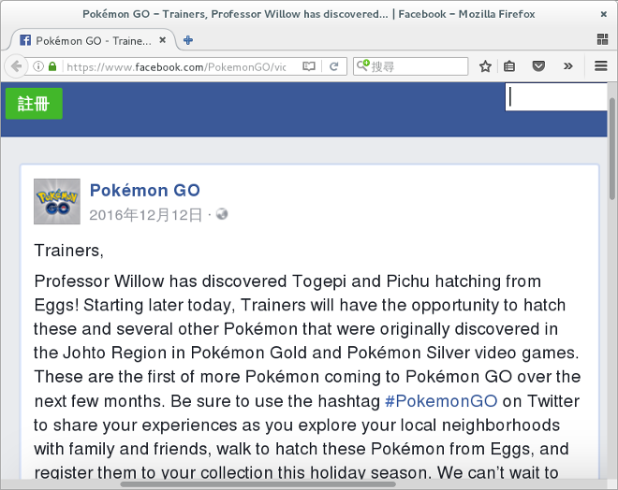




Update: New Pokémons Added!

Slide 95
Ouch!
I don’t have the data of these babies yet!

Slide 96

It’s not hard to Google
for the base stats of these new babies.
But I do not have their images!

Slide 97
I spent all my game coins
to hatch these baby Pokémons.
And, in the end,
I beg my every friend
for screenshots of baby Pokémons
that I missed.

Slide 98
Lessons I Learned

Slide 99
Lesson #1
If you are creating some game hacking tool without commercial support,
you had better not publish it.

Slide 100
When the game updates,
you’ll have to update immediately.
It’s a nightmare.

Slide 101

Lesson #2
For strong species like Dragonite,
base stats take the largest part of the CP.
Dragonite is just stronger!
Attack: 263 + IV 15 = 278
Defense: 201 + IV 15 = 216
Stamina: 182 + IV 11 = 193

Slide 102
The second factor
is the Pokémon level (the CPM).

Slide 103
And your individual values (IV)?

Slide 104
Well, it doesn’t really matter. :p

Slide 105
Thank you.
Any questions?

