Slide 1

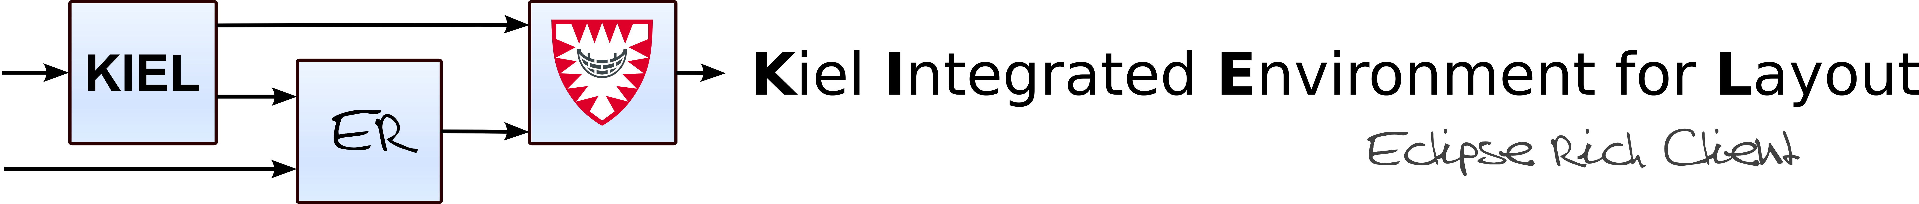
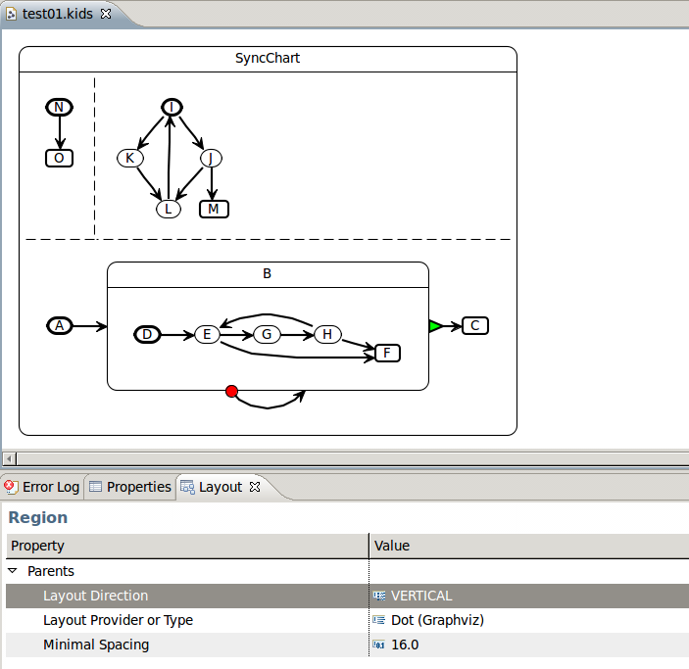
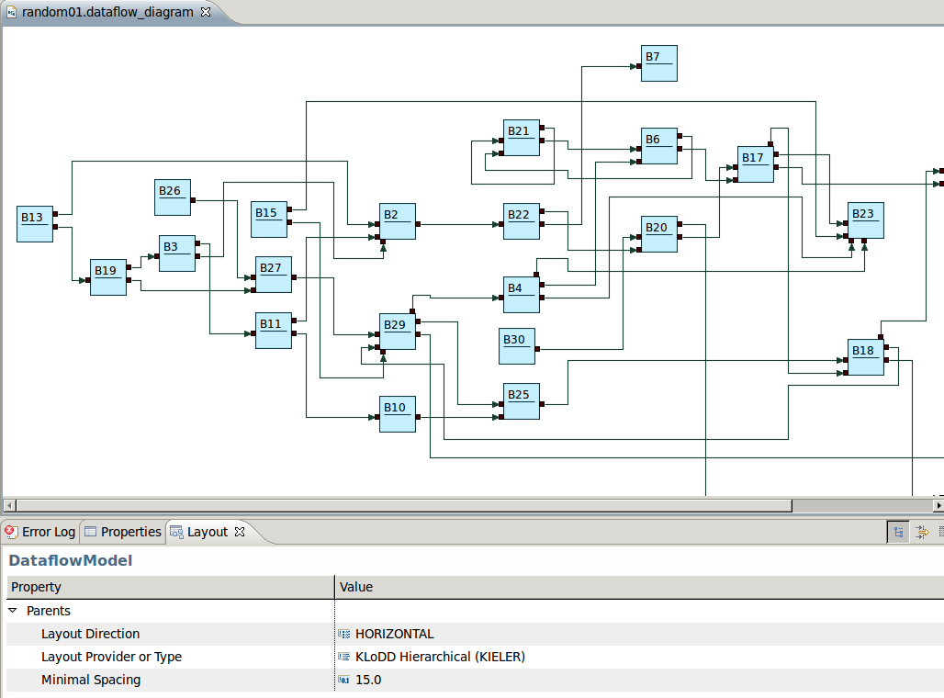
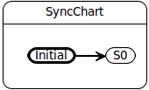
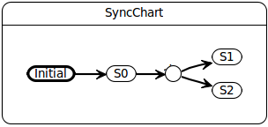
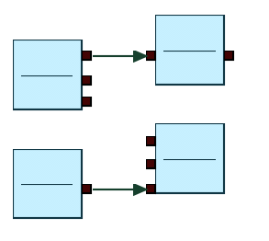
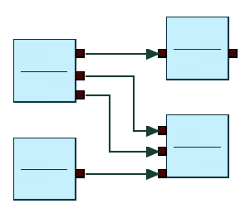
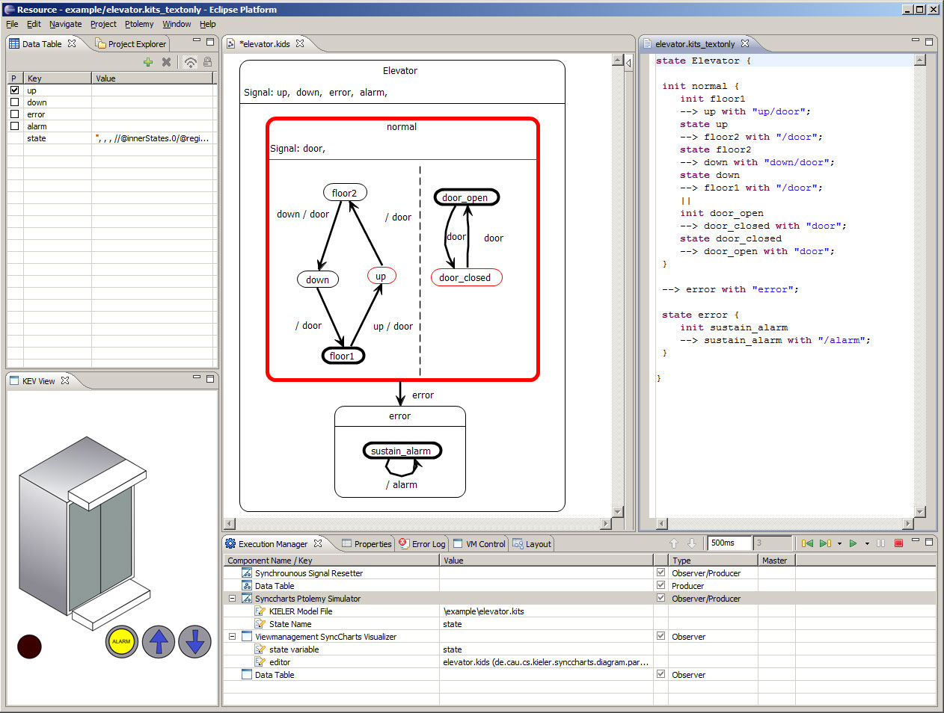
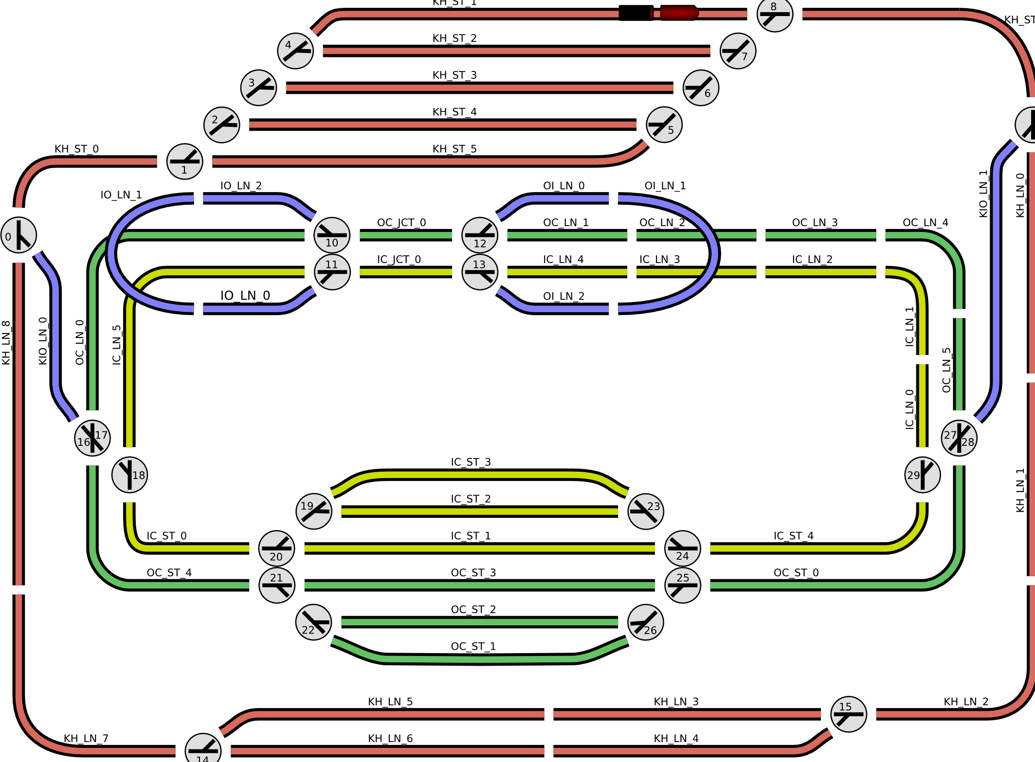
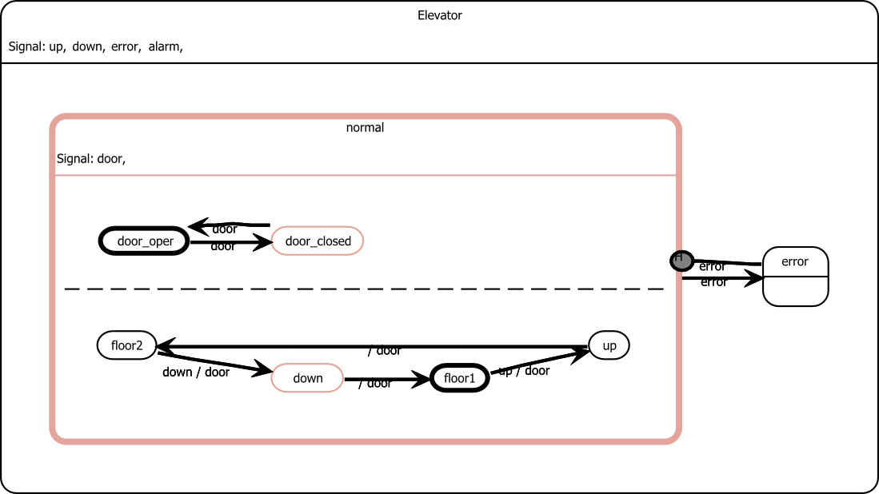
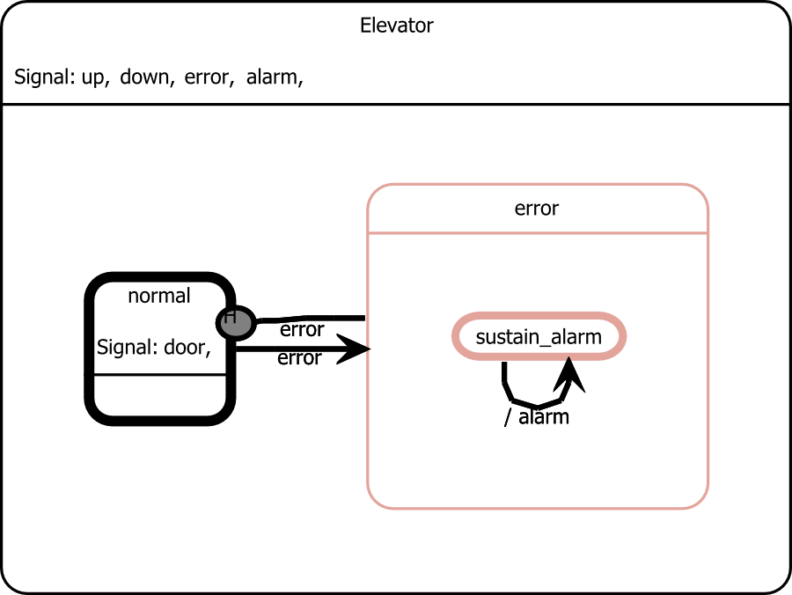
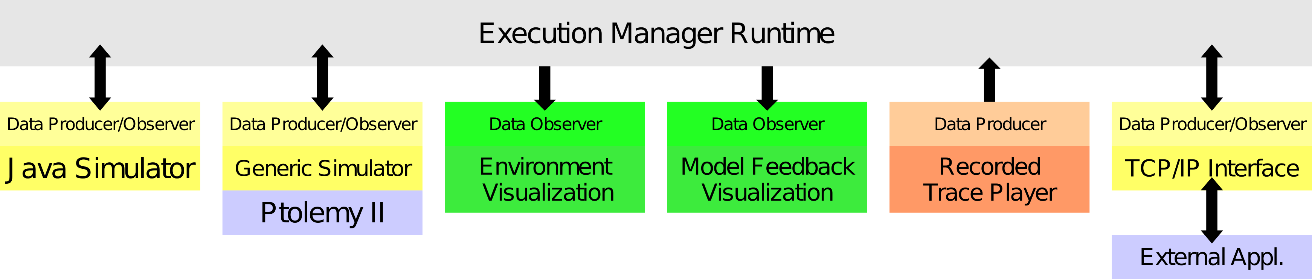
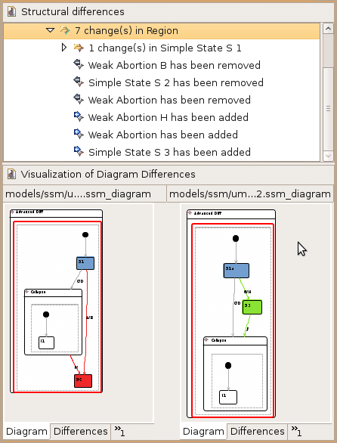
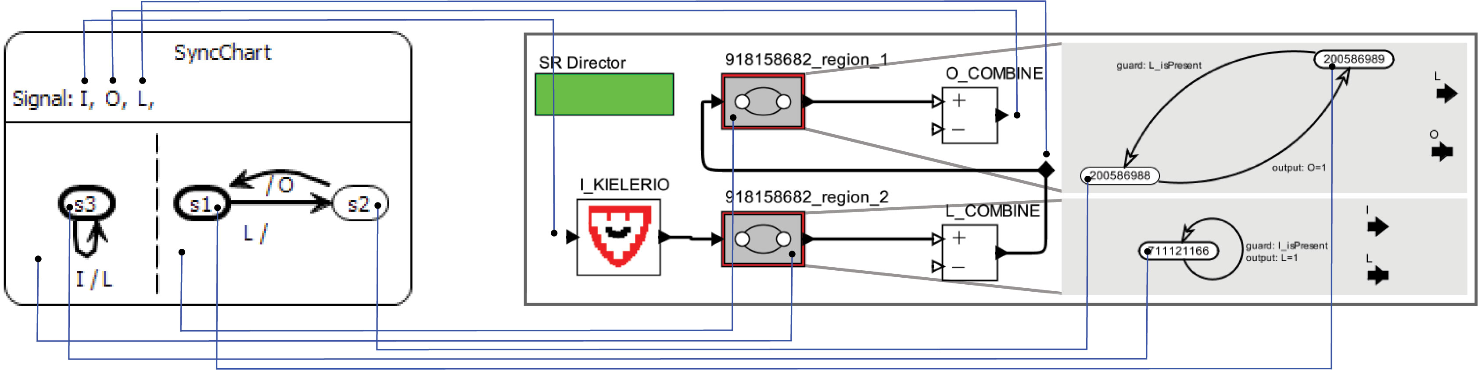
Christian-Albrechts-Universität zu Kiel
Faculty of Engineering
Department of Computer Science
Automatic Layout
KIML – KIELER Infrastructure for Meta Layout [2]
Automatic layout of GMF diagrams
Generic interface for layout algorithms
Flexible configuration of layout options by the user
Structure Based Editing
KSBasE – KIELER Structure Based Editing
Improve editing of graphical models by using model
transformations for arbitrary operations
Generic interface for GMF diagram editors
Textual Editing
Synchronization of
graphical models with
textual representations
Connect textual editors
created with Xtext to
GMF editors
Transformation of the
Esterel language to
SyncCharts
Layout of a SyncChart diagram
Layout of a data flow diagram
Environment Visualization
SVG based rendering of arbitrary
environments for simulation
Specification of animations
GUI for testing and demonstration
of behavioral models
View Management
Dynamically create and layout
graphical views of the model
Arbitrary conditions can trigger
different visual effects
Visualization of a
railway model
Focus and context: the active states of a SyncChart are fully
shown, while other states are collapsed
KIELER: Enhancing graphical modeling in Eclipse by integrating into
existing frameworks such as EMF, GMF, and TMF [1]
Model Execution
KIEM – KIELER Execution Manager
The semantic domain of Ptolemy is used as a possible
simulation backend for KIEM.
Model Comparison
KiViK – KIELER Visual Komparison [3]
Visualizes differences in two
versions of a model graphically
Integrates into standard Eclipse
GMF and comparison mechanisms
Employs EMF Compare project as
differencing engine
Employs automatic layout and
automatic zooming and scrolling
for navigation
Code Generation
Generate code with
Xpand
Connect executable
code to KIEM
Examples:
SyncCharts in C [4]
Dataflow to Lustre
Overview of the execution manager infrastructure
A SyncChart model (left) and a generated Ptolemy model (right)
Contact Person:
Hauke Fuhrmann
Department of Computer Science
Christian-Albrechts-Universität zu Kiel
Olshausenstr. 40, 24098 Kiel, Germany
Phone: +49 (0) 431 880-7297
Fax: +49 (0) 431 880-7615
haf@informatik.uni-kiel.de
http://www.informatik.uni-kiel.de/rtsys
Contact Person:
Prof. Dr. Reinhard von Hanxleden
Department of Computer Science
Christian-Albrechts-Universität zu Kiel
Olshausenstr. 40, 24098 Kiel, Germany
Phone: +49 (0) 431 880-7281
Fax: +49 (0) 431 880-7615
rvh@informatik.uni-kiel.de
http://www.informatik.uni-kiel.de/rtsys
Further Information:
http://www.informatik.uni-kiel.de/rtsys/kieler
[1] Hauke Fuhrmann and Reinhard von Hanxleden. On the pragmatics of model-based design. Technical Report 0913,
Christian-Albrechts-Universität zu Kiel, Department of Computer Science, May 2009.
[2] Miro Spönemann, Hauke Fuhrmann, Reinhard von Hanxleden, and Petra Mutzel. Port constraints in hierarchical
layout of data flow diagrams. In Proceedings of the 17th International Symposium on Graph Drawing (GD’09), LNCS,
Chicago, September 2009.
[3] Arne Schipper, Hauke Fuhrmann, and Reinhard von Hanxleden. Visual comparison of graphical models. In
Proceedings of the Fourth IEEE International Workshop UML and AADL, held in conjunction with the 14th International
Conference on Engineering of Complex Computer Systems (ICECCS’09), Potsdam, Germany, 2009.
[4] Reinhard von Hanxleden. SyncCharts in C—a proposal for light-weight, deterministic concurrency. In Proceedings
of the International Conference on Embedded Software (EMSOFT’09), Grenoble, France, October 2009.

