Slide 1
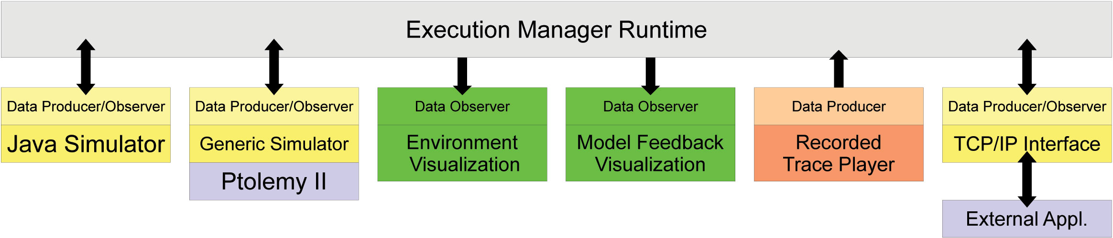
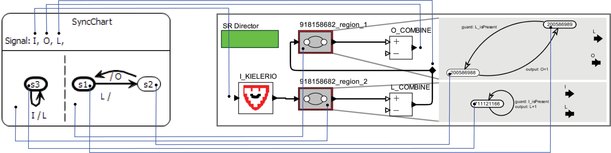
The KIELER Execution Manager (KIEM) integrates iterative executions into the
Eclipse platform
Ptolemy as one example 'semantic domain' leveraged by the KIELER SyncChart Editor as
a simulation backend engine integrated into the KIEM infrastructure

