Slide 1
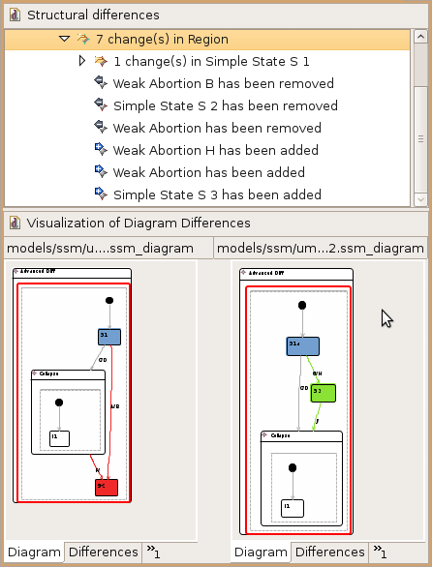
Visual Comparison of Graphical Models
[1] Arne Schipper and Hauke Fuhrmann and Reinhard von Hanxleden.
Visual Comparison of Graphical Models. In Proceedings of the
Fourth IEEE International Workshop UML and AADL,
held in conjunction with the 14th International International Conference on
Engineering of Complex Computer Systems (ICECCS’09),
Potsdam, Germany, 2 2009.
KiViK: Kieler Visual Komparison [1]
Visualize differences in two versions of the same model graphically.
Integrates into standard Eclipse GMF and comparison mechanisms.
Employs EMF Compare project as differencing engine.
Employs automatic layout, auto zooming and scrolling for navigation.

