Slide 1



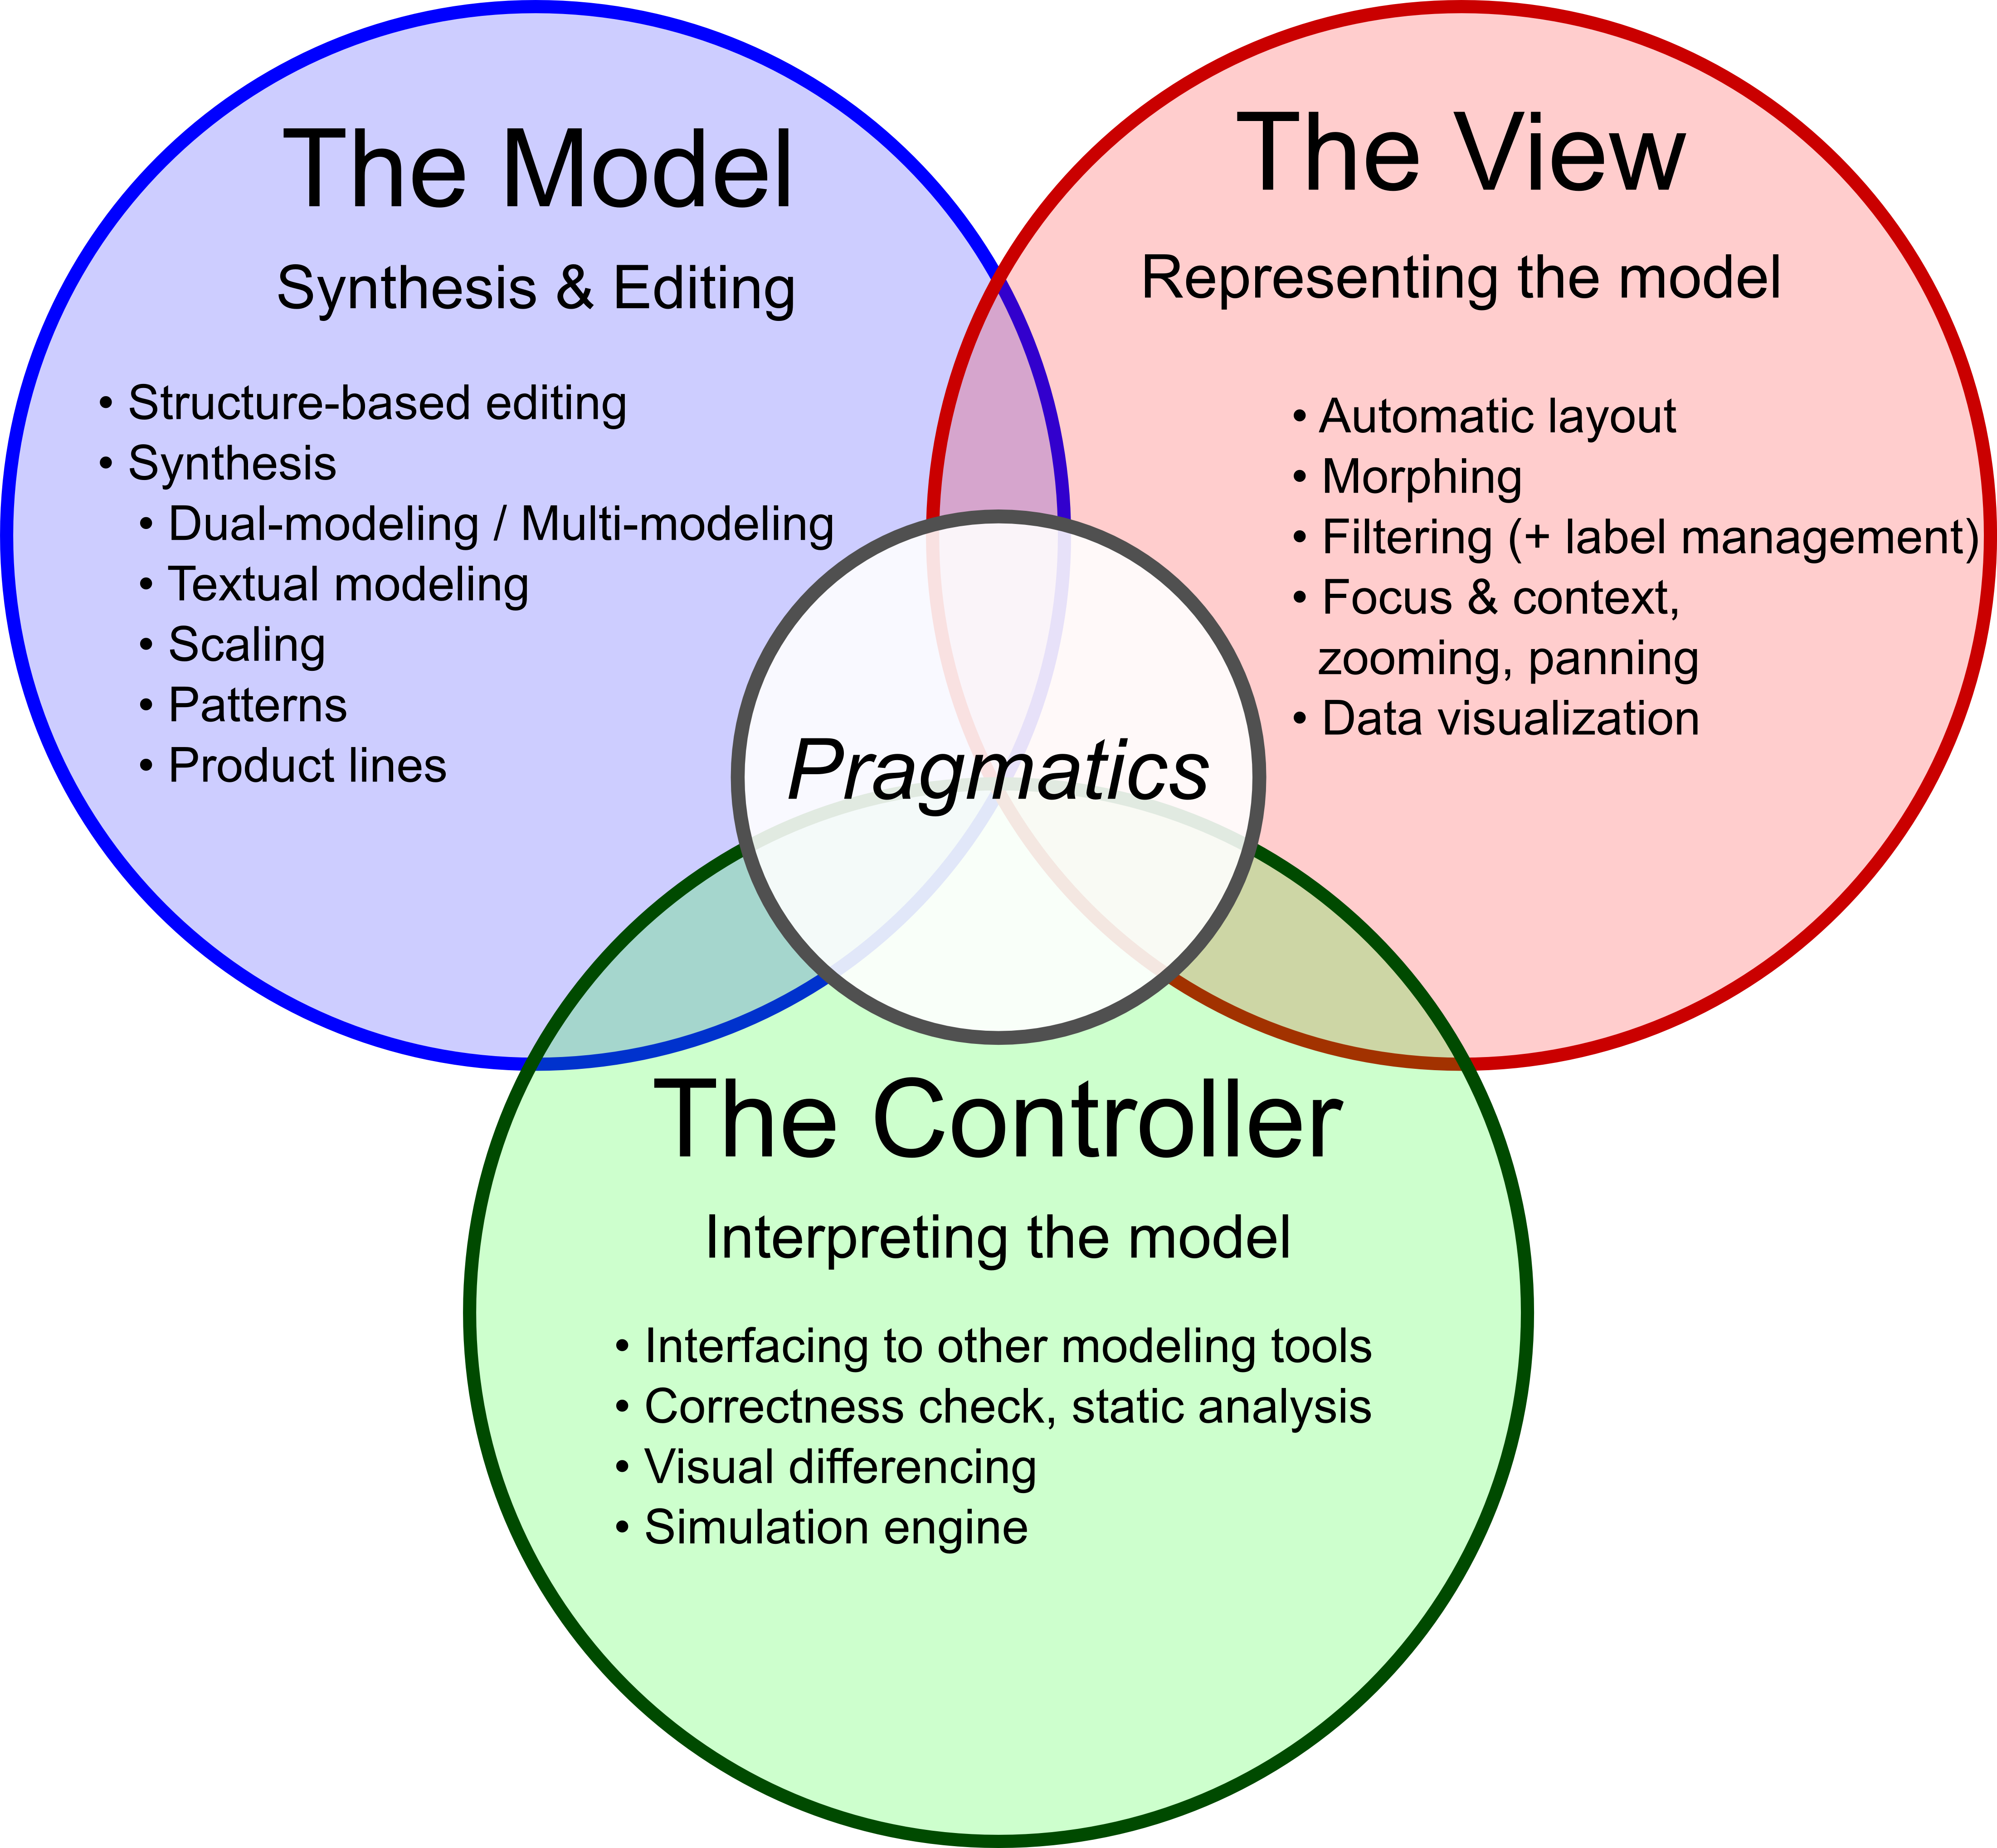
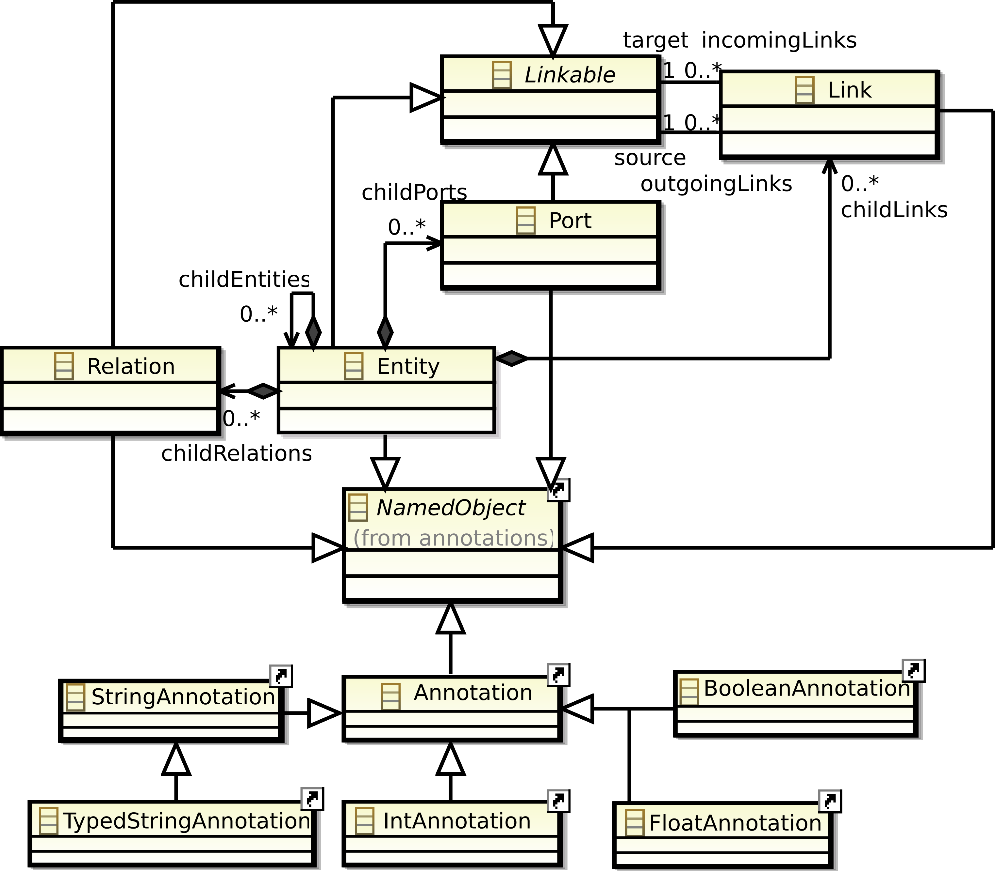
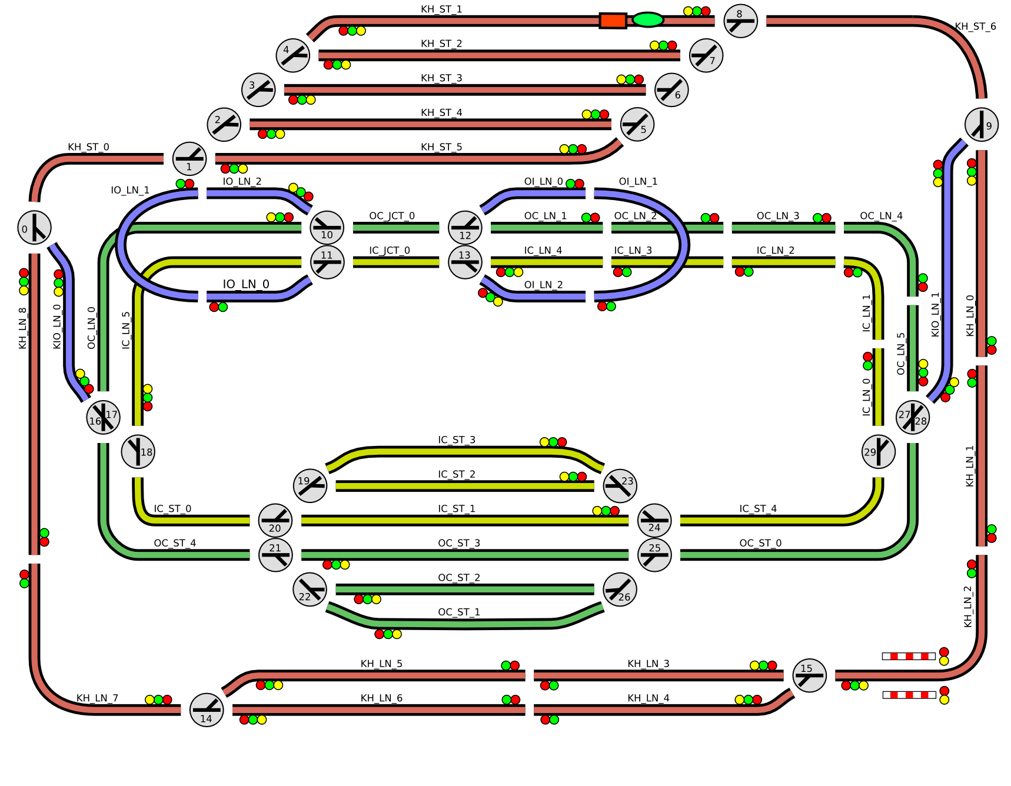
Christian-Albrechts-Universität zu Kiel
Faculty of Engineering
Department of Computer Science
KIELER Actor Oriented Modeling
Meta Modeling
KAOM – KIELER Actor Oriented Modeling
View Management
KiVi – KIELER View Management
Metamodel-based abstract syntax in Eclipse EMF enables a broad technology synergy
Query View
Transformation
QVT
Atlas
Transformation
Language ATL
oAW Xtend
XML
Text – Xtext
Databases
Teneo
CDO
Versioning
EMFStore, JCR
Persistence
EMF Compare
Validation
Transaction
Evolution COPE
J2EE (SDO)
Model-to-Model
Transformations
Processing
Code
Generation
oAW Xpand
Java Emitter Templates JET
Editing
Graphical Modeling Framework GMF
Graphiti
Textual Xtext, TCS
Eclipse standard Editors/Views
Extended Editing Framework
KiVi Focus & context on a Ptolemy Data Flow Diagram
KiVi Separation of Concerns
Model Execution
KIEM – KIELER Execution Manager [3]
Data Visualization
Overview of the Execution Manger Infrastructure
Visualization of a Railway Installation
Traffic Light Environment Visualization
KlePto Ptolemy Simulation Concept
KAOM with Automatic Layout, Ptolemy rendering
and Simulation in KIELER
Ptolemy Plotter
Animated Data Tokens
Automatic Layout
KIML – KIELER Infrastructure for Meta Layout [2, 5]
Automatic layout of GMF and
Graphiti diagrams
Generic interface for layout algorithms
Flexible configuration of layout options by the user
Automatic layout integrated into Ptolemy's graphical editor Vergil
Model Rendering
KARMA – KIELER Advanced Rendering for Model Appearance
Possible customized model rendering
options:
E.g., Ptolemy, LabView, Simulink,
ASCET, SCADE
GMF editor support, Graphiti (planned)
Ptolemy Actor Rendering
Layout of a State Chart Diagram
Layout of Data Flow Diagrams
Rendering Ptolemy Annotations
Rendering Ptolemy Data Flow
Rendering Ptolemy State Machines
Contact Persons:
Miro Spönemann / Christian Motika
Department of Computer Science
Christian-Albrechts-Universität zu Kiel
Olshausenstr. 40, 24098 Kiel, Germany
Phone: +49 (0) 431 880-7282 /-7526
Fax: +49 (0) 431 880-7615
msp@ / cmot@informatik.uni-kiel.de
http://www.informatik.uni-kiel.de/rtsys
Contact Person:
Prof. Dr. Reinhard von Hanxleden
Department of Computer Science
Christian-Albrechts-Universität zu Kiel
Olshausenstr. 40, 24098 Kiel, Germany
Phone: +49 (0) 431 880-7281
Fax: +49 (0) 431 880-7615
rvh@informatik.uni-kiel.de
http://www.informatik.uni-kiel.de/rtsys
Further Information:
http://www.informatik.uni-kiel.de/rtsys/kieler
[1] Hauke Fuhrmann and Reinhard von Hanxleden. Taming Graphical Modeling. In Proceedings of the ACM/IEEE 13th
International Conference on Model Driven Engineering Languages and Systems (MoDELS’10), LNCS, Oslo, Norway,
2010. Springer.
[2] Miro Spönemann, Hauke Fuhrmann, Reinhard von Hanxleden, and Petra Mutzel. Port constraints in hierarchical
layout of data flow diagrams. In Proceedings of the 17th International Symposium on Graph Drawing (GD’09), LNCS,
Chicago, September 2009.
[3] Christian Motika, Hauke Fuhrmann and Reinhard von Hanxleden. Semantics and Execution of Domain Specific Models.
In 2nd Workshop Methodische Entwicklung von Modellierungswerkzeugen (MEMWe 2010) at conference
INFORMATIK 2010, GI-Edition – Lecture Notes in Informatics (LNI), Leipzig, Germany, 2010.
[4] Reinhard von Hanxleden. SyncCharts in C—a proposal for light-weight, deterministic concurrency. In Proceedings
of the International Conference on Embedded Software (EMSOFT’09), Grenoble, France, October 2009.
[5] Miro Spönemann, Hauke Fuhrmann and Reinhard von Hanxleden. Automatic Layout of Data Flow Diagrams in KIELER and
Ptolemy II. Technical Report 0914, Christian-Albrechts-Universität zu Kiel, Department of Computer Science, July 2009.
Poster presented at 9th Biennial Ptolemy Miniconference (PTCONF'11), Berkeley, CA, February 2011, © Christian Motika. Miro Spönemann, Reinhard v. Hanxleden 2011

