Slide 1



EEE4084F
Digital Systems
Lecture 5:
Review of paper: Temporal Partitioning Algorithm for a Coarse-grained Reconfigurable Computing Architecture by
Chongyong Yin, Shouyi Yin, Leibo Liu, Shaojun Wei
Blocking and Non-blocking comms
Lecturer:
Simon Winberg
Attribution-ShareAlike 4.0 International (CC BY-SA 4.0)

Slide 2
PM4.4 Course Assessment – some more detail
Course assessment
Examination- 50%
Class Tests- 20%
Group Portfolio- 15%
Pecha Kucha Presentation- 7.5%
Pecha Kucha YouTube video- 7.5%
Examination
You will be provided with 15 possible examination questions before the examination. Five of these question will be selected for the examination
Group Portfolio
From your weekly submission select ten items that that best reflects you understanding of the project life cycle and project management triangle. Do the following for each item
1- Point out the relevant attributes, antecedents and consequences of the concept underpinning the item
2-Explain why you think it is an important concept in project management
2- Describe how you will use it in project management

Slide 3
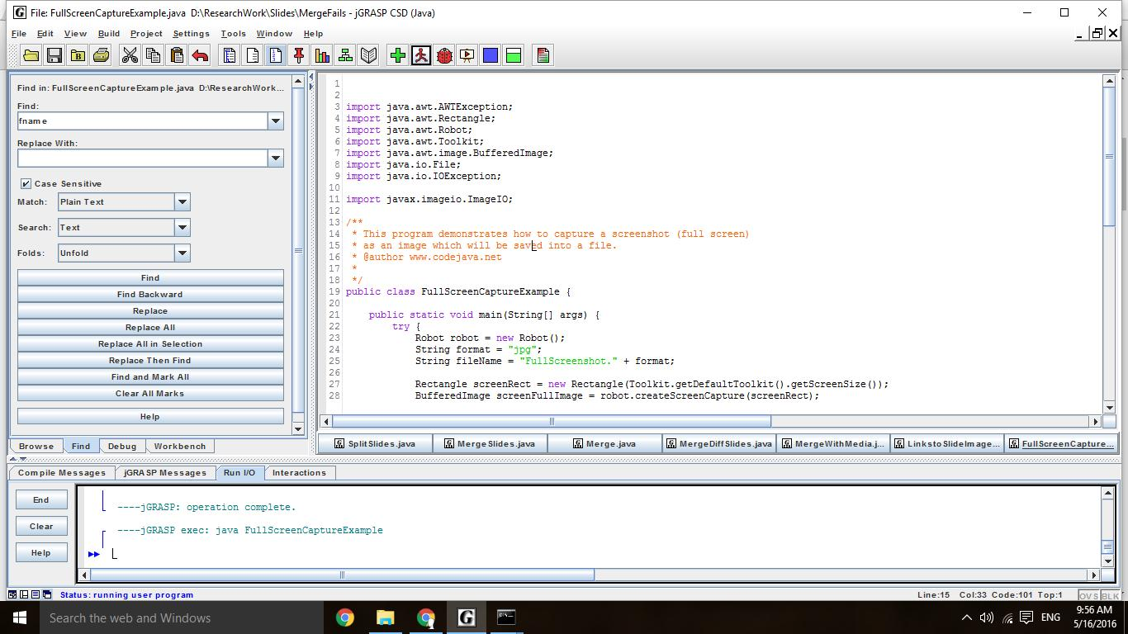

Slide 4
Yin et al.’s Purpose
A temporal partitioning algorithm for a coarse grained reconfigurable computing architecture is presented to improve system’s performance for satisfying the constraints of application parts executed on the reconfigurable hardware

